Slide 1
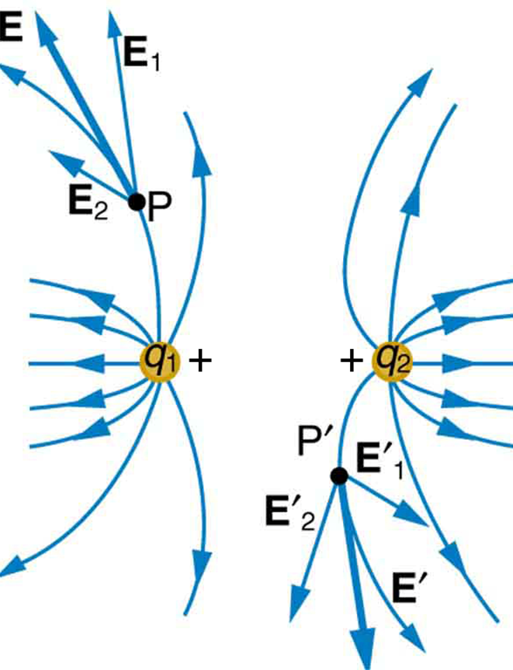

ELECTRIC FIELD LINES

Slide 2
Today’s objectives
By the end of this class, you will be able to:
Describe an electric field diagram of a positive point charge; of a negative point charge with twice the magnitude of positive charge
Draw the electric field lines between two points of the same charge; between two points of opposite charge.

Slide 3
Electric field lines
Electric field lines are imaginary lines drawn through a region of space to help visual the electric field.
The electric field lines are drawn so that
  The electric field is tangent to the line at any point.
  The field lines are closer together where the electric field strength is greater.

Slide 4
Electric field lines, how to draw
The electric field is created by charges. Draw field lines starting on positive charges (or infinity) and moving toward negative charges (or infinity).
Draw the number of lines associated with a charge so it is proportional to the magnitude of the charge.
At any point, the electric field has a unique direction, so field lines never intersect.
CAUTION: The motion of a charged particle is not necessarily along the electric field line!

Slide 5
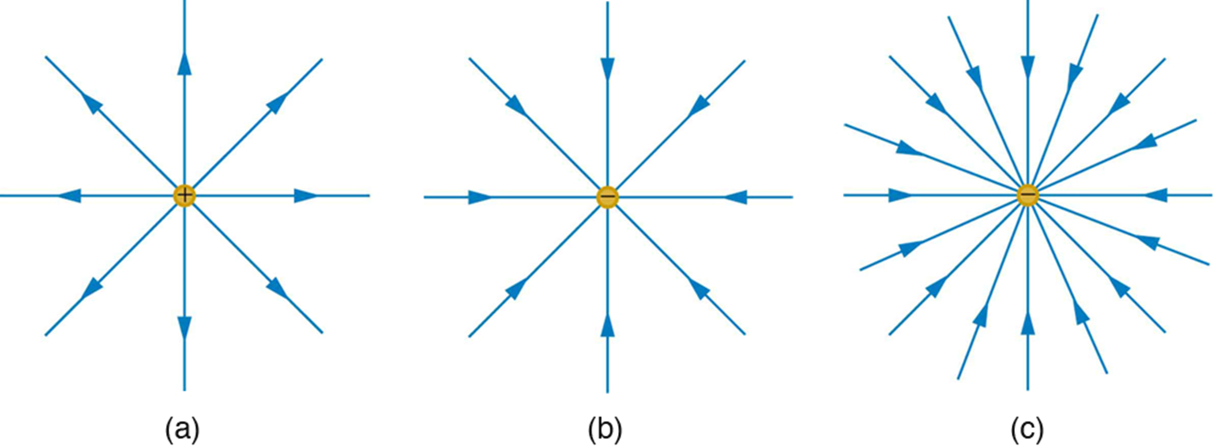
Electric field lines of point charges
The electric field surrounding three different point charges.
A positive charge.
A negative charge of equal magnitude.
A larger negative charge.

Slide 6
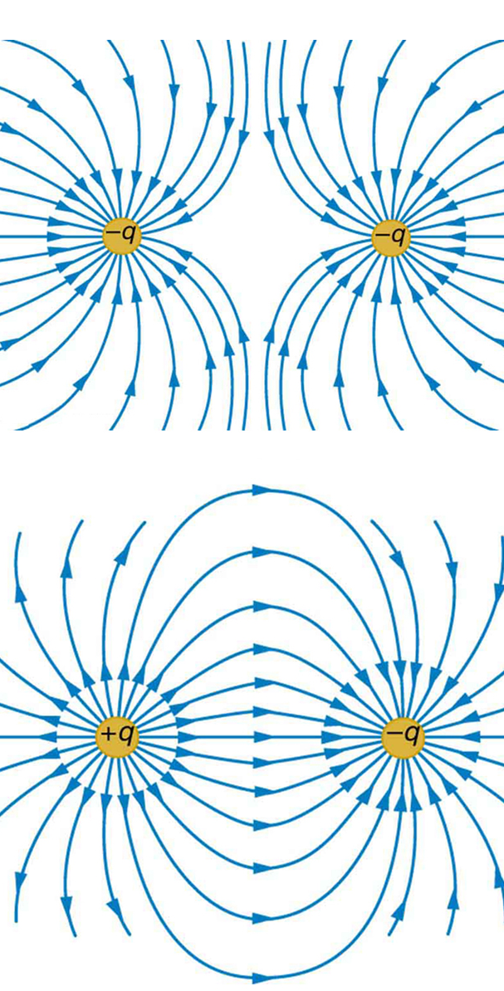
Electric field lines of two point charges
Two negative charges produce the fields shown. It is very similar to the field produced by two positive charges, except that the directions are reversed. The field is clearly weaker between the charges. The individual forces on a test charge in that region are in opposite directions.
Two opposite charges produce the field shown, which is stronger in the region between the charges.

