Slide 1
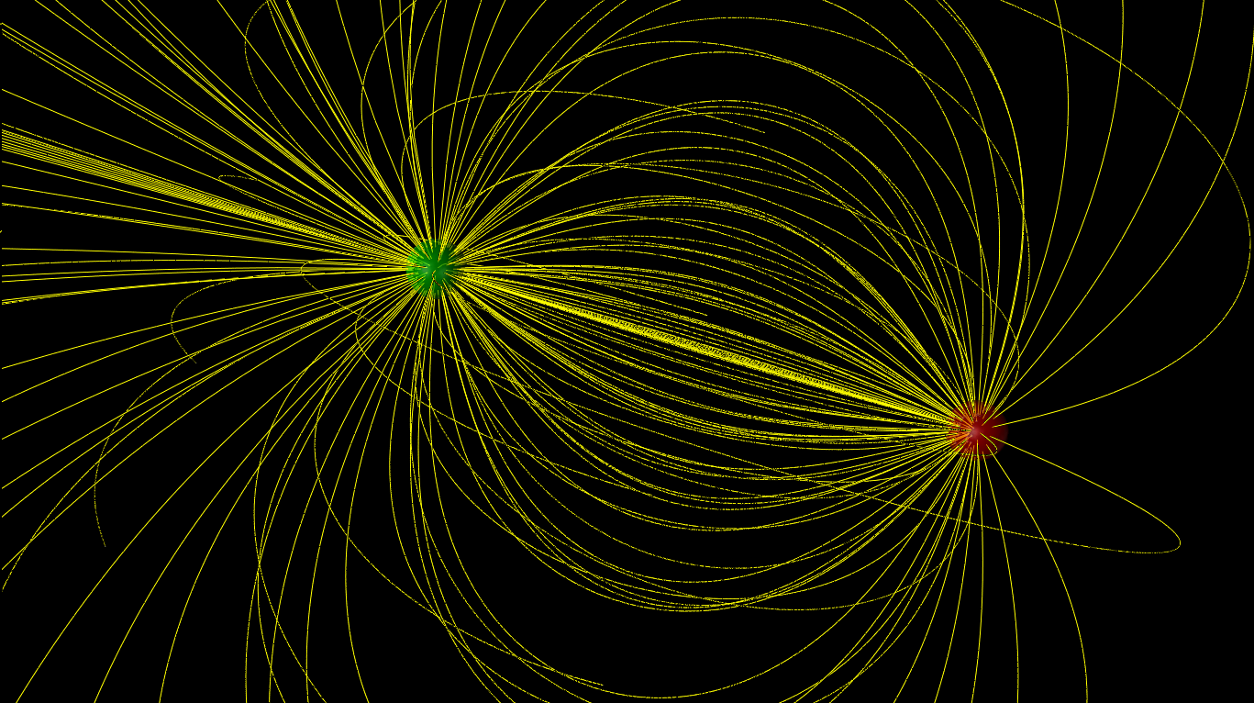

ELECTRIC FIELDS

Slide 2
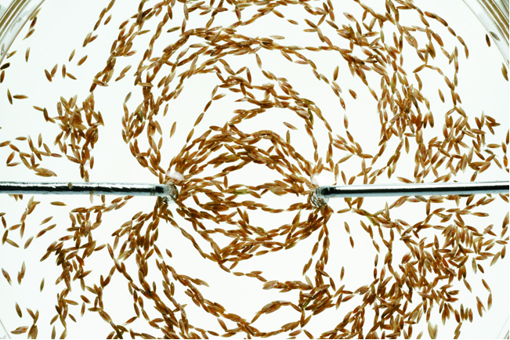
The concept of the electric field
The field model explains how the force due to charges is transmitted through empty space from one charge to another.
The figure shows a shallow pan of oil with grass seeds floating on it. When positive and negative wires touch
the oil, a pattern emerges.
Some kind of electric influence from the charges fills the space around the charges.

Slide 3
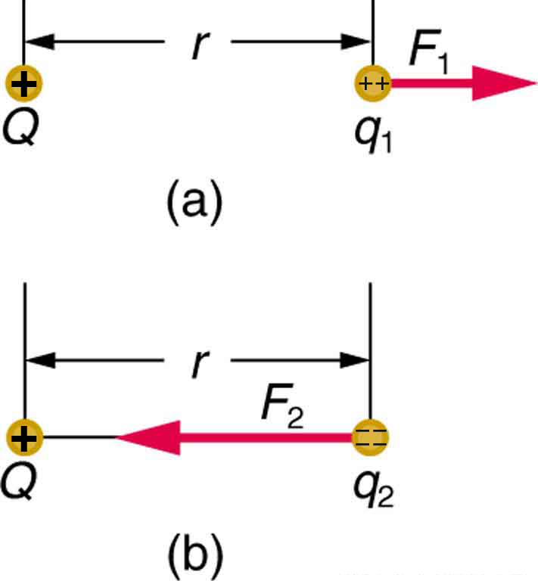
Electric field: introduction
The Coulomb force field due to a positive charge Q
is shown acting on two different charges. Both charges are the same distance from Q . (a) Since q1
is positive, the force F1 acting on it is repulsive. (b) The charge q2
is negative and greater in magnitude than q1, and so the force F2
acting on it is attractive and stronger than F1. The Coulomb force field is thus not unique at any point in space, because it depends on the test charges q1
and q2
as well as the charge Q.

Slide 4
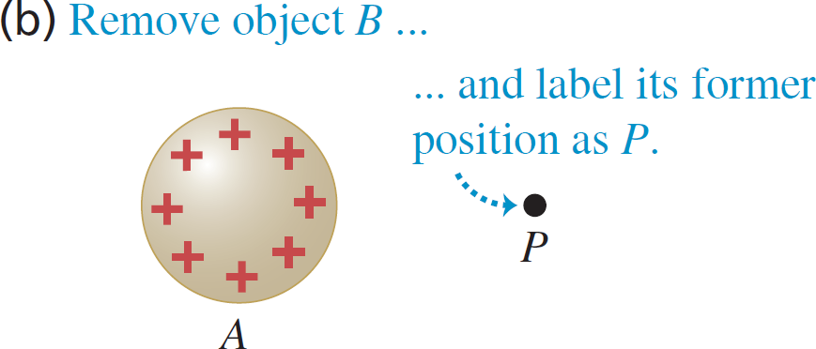
Electric Field: Introduction
Next consider object A on its own.
We can say that object A somehow modifies the properties of the space at point P. The space around a charge is altered to create an electric field.
The alteration of space around a mass is called the gravitational field.
The alteration of space around a magnet is called the magnetic field.

Slide 5
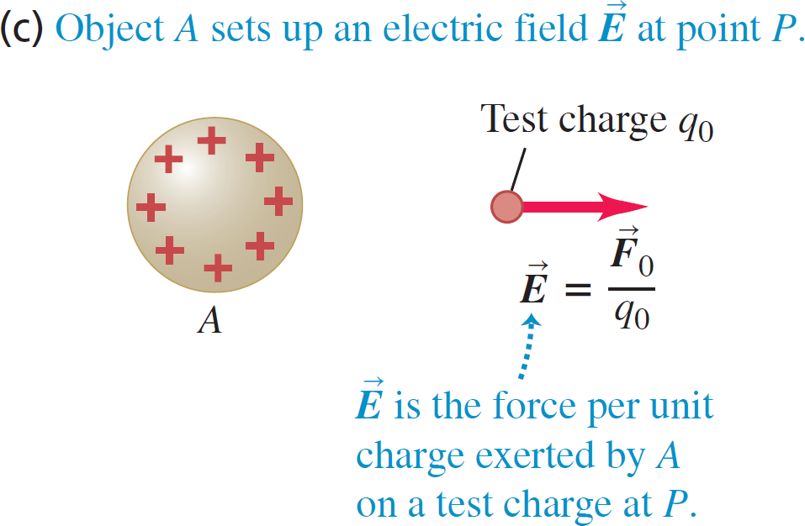
Electric Field: definition
We can measure the electric field produced by A with a test charge.
A group of charges, which we will call the source charges, alters the space around them by creating an electric field
If another charge (test charge) is then placed in this electric field, it experiences a force exerted by the field.

Slide 6
Electric Field: details
Electric field is a vector.
SI Units: N/C.
Direction of the electric field at a certain location is the same as the direction of the electric force on a positive test charge at this location.
We can think about electric field as “electric force per unit charge”.
The field “belongs” to the source charge. The electric field is independent of the charge q used to probe the field. The electric field depends only on the source charges that create the field.

Slide 7






TYPICAL ELECTRIC FIELD
STRENGTHS
Field | Field strength (N/C)
Inside a current-carrying wire | 10 to the negative second power.
Earth’s field, near the earth’s surface | 10 squared.
Near objects charged by rubbing | 10 cubed to 10 to the sixth power.
Needed to cause a spark in air | 10 to the sixth power.
Inside a cell membrane | 10 to the seventh power.
Inside an atom | 10 to the eleventh power.

Slide 8
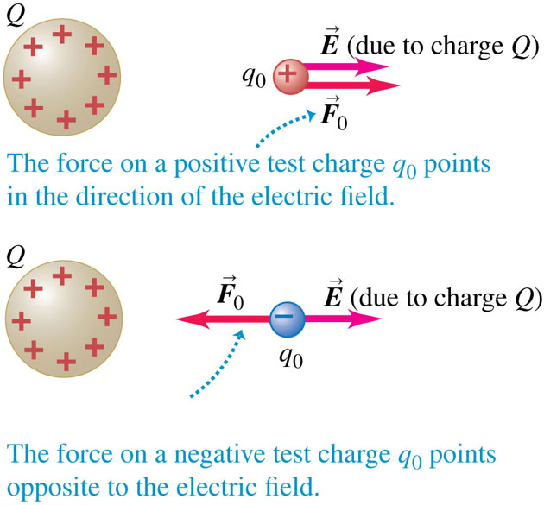
Electric Force Produced by an Electric Field

Slide 9
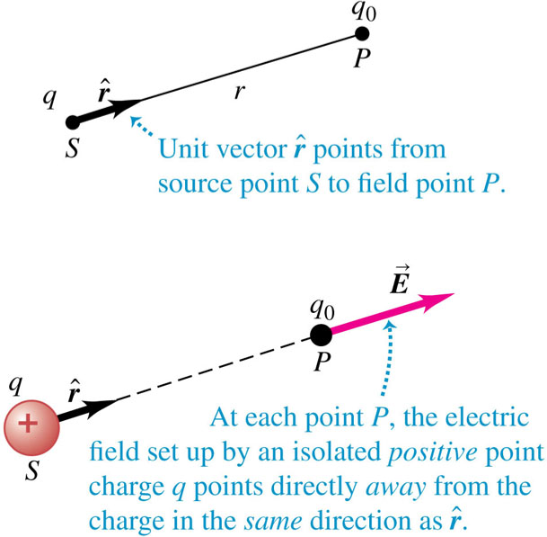
The Electric Field of a Point Charge

Slide 10
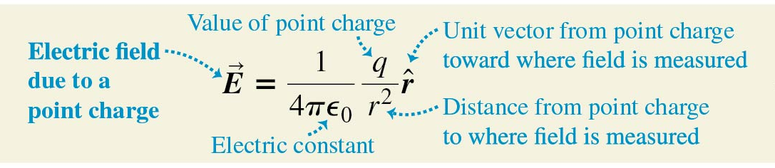
The Electric Field of a Point Charge, continued
Using a unit vector that points away from the origin, we can write a vector equation that gives both the magnitude and the direction of the electric field:

Slide 11
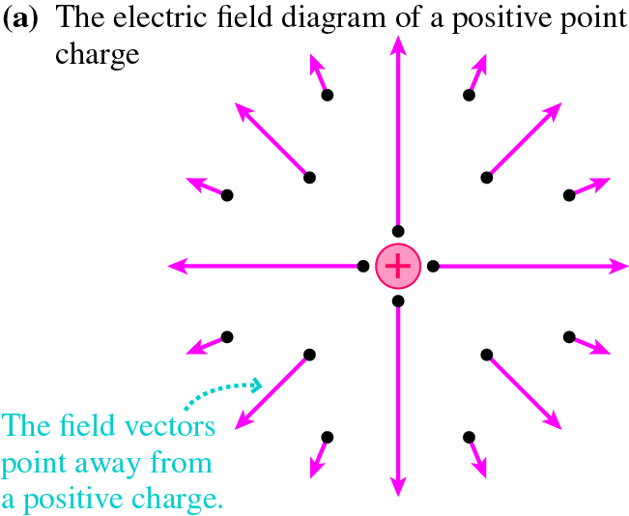
Electric Field of a positive Point Charge
A point charge q produces an electric field at all points in space. Electric field diagrams will show a sample of vectors, but there is an electric field vector at every point whether one is shown or not.
The field strength decreases with increasing distance.
The field produced by a positive point charge points away from the charge.

Slide 12
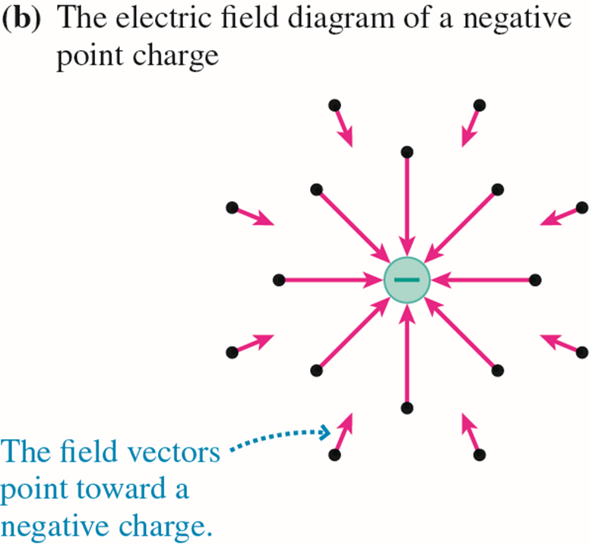
Electric Field of a negative Point Charge
A point charge q produces an electric field at all points in space.
The field strength decreases with increasing distance.
The field produced by a negative point charge points toward the charge.

Slide 13
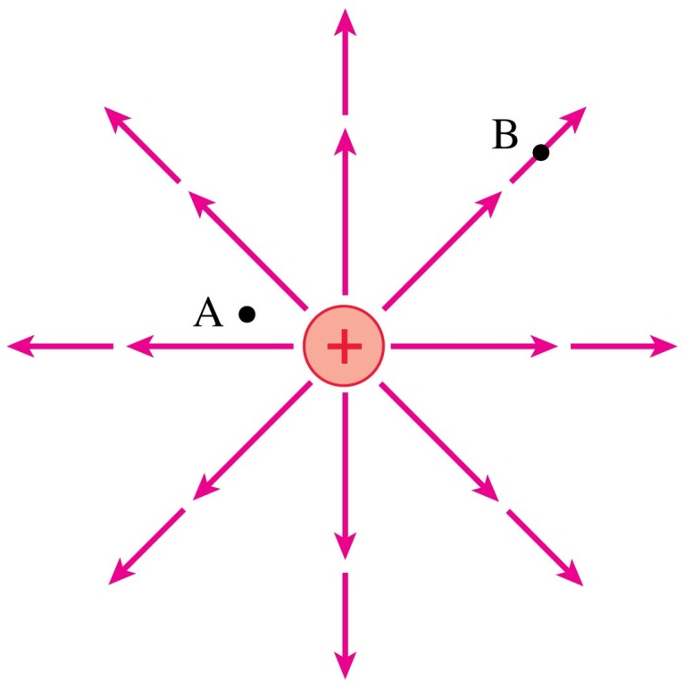
ATTENTION QUIZ # 1
At which point is the electric field stronger?
  A. Point A
  B. Point B
  C. Not enough information to tell
Notes:
Answer: A

Slide 14

ATTENTION QUIZ # 1
At which point is the electric field stronger?
  A. Point A
  B. Point B
  C. Not enough information to tell

Slide 15
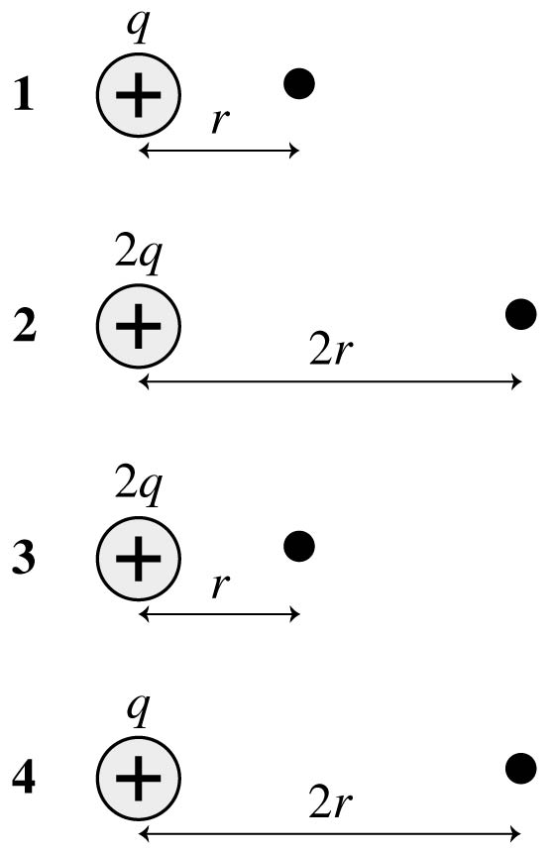
ATTENTION QUIZ # 1
Rank in order, from largest to smallest, the magnitudes of the electric field at the black dot.
  A. 3, 2, 1, 4
  B. 3, 2, 1, 4
  C. 1, 4, 2, 3
  D. 3, 1, 2, 4
Notes:
Answer: D

Slide 16
ATTENTION QUIZ # 1
Rank in order, from largest to smallest, the magnitudes of the electric field at the black dot.
  A. 3, 2, 1, 4
  B. 3, 2, 1, 4
  C. 1, 4, 2, 3
  D. 3, 1, 2, 4
Notes:
Answer: D

Slide 17
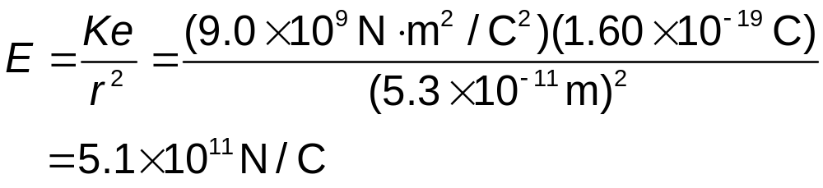
Finding the Electric Field of a Proton
The electron in a hydrogen atom orbits the proton at a radius of 0.053 nm. What is the electric field due to the proton at the position of the electron?
SOLVE The proton’s charge is q = e. At the distance of the electron, the magnitude of the field is:

Slide 18
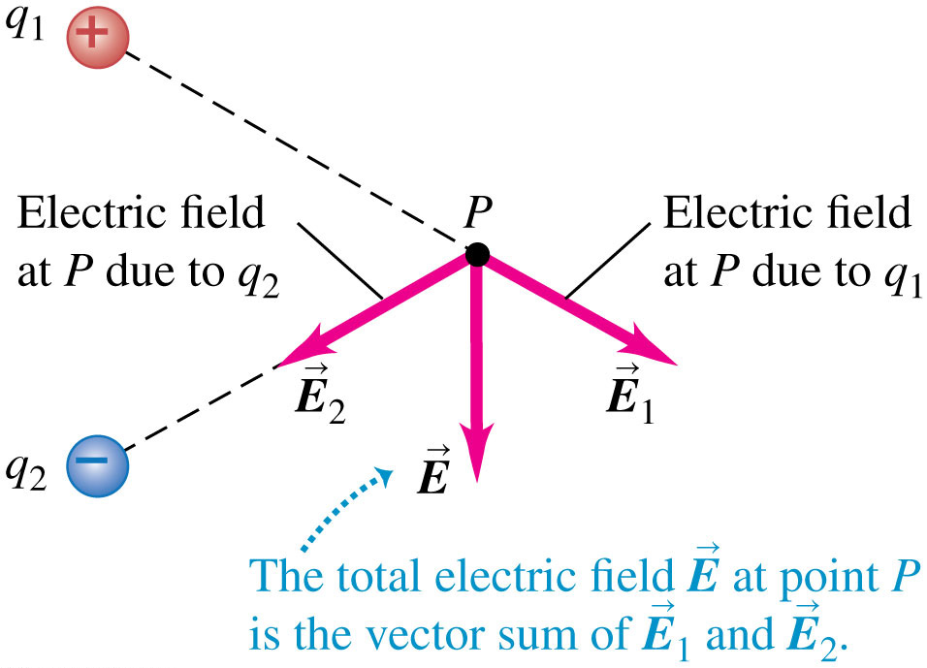
Superposition of Electric Fields
The total electric field at a point is the vector sum of the fields due to all the charges present.

Slide 19
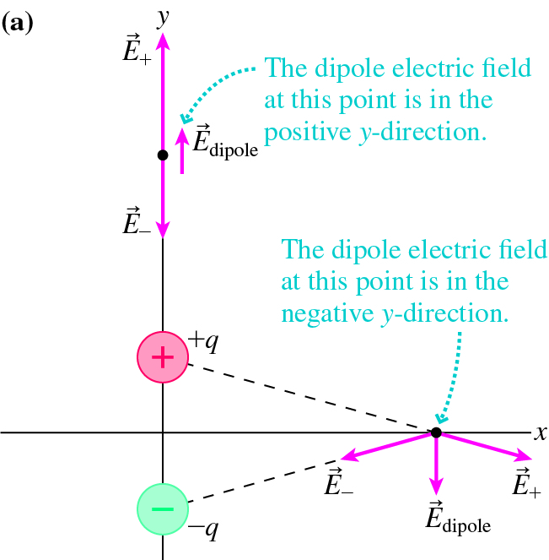
ELECTRIC FIELD OF A DIPOLE
For an electric dipole, we can find the electric field at any point by a vector addition of the fields of the two charges.

Slide 20
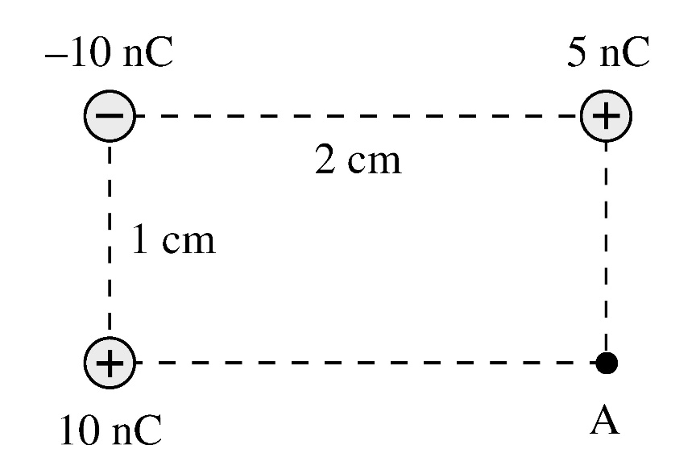
Example Problem
Determine the magnitude and the direction of the electric field at point A.
Notes:
Answer: Sum the x and y components of the electric fields at A due to each of the three charges. The x component of the field due to the upper left charge is –k(10E-9)/(r^2)*cos(theta) where r^2 = 0.01^2+0.02^2 = 5E-4 m^2 and theta = atan(0.5) = 27 degrees, so Ex1 = 1.6E5 N/C to the left. Ey1 = -k(10E-9)/r^2*sin(theta) = 8.0E4 N/C up. Ex due to the upper right charge is zero. Ey due to this charge is Ey2 = k(5E-9)/(0.01^2) = 4.5E5 N/C down. Ex to the lower left charge is Ex3 = k(10E-9)/(0.02^2) = 2.25E5 N/C to the right. Ey3 = 0. Adding we get Ex = Ex3-Ex1 = 6.5E4 N/C to the right and Ey = 8E4-4.5E5 = 3.7E5 N/C down. The total field is sqrt(Ex^2+Ey^2) = 3.8E5 N/C and the direction is atan(Ey/Ex) = 80 degrees below the horizontal and to the right.

Slide 21

WHAT’S NEXT?
Attempt the Try It Yourself Tutorials and Problems.
Move on to the electric field lines discussion.
Check your understanding of the material by completing MasteringPhysics dynamic module.
Get ready for the quiz!

