Slide 1

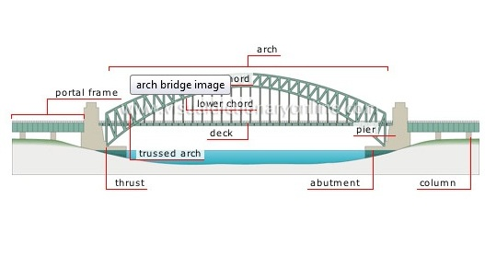

Statics and Torque

Slide 2
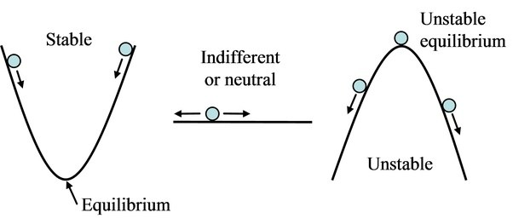
Stable and Unstable equilibrium
For a single body,
For a body moved out of equilibrium:
If the arising forces tend to return the body to equilibrium position,
If the arising forces tend to move the body AWAY from the equilibrium position,
the body is in equilibrium
If the $\sum{All Forces}=0$,
If the ∑▒〖𝐴𝑙𝑙 𝐹𝑜𝑟𝑐𝑒𝑠〗=0,
this is called a ‘stable equilibrium’
this is called a ‘unstable equilibrium’

Slide 3
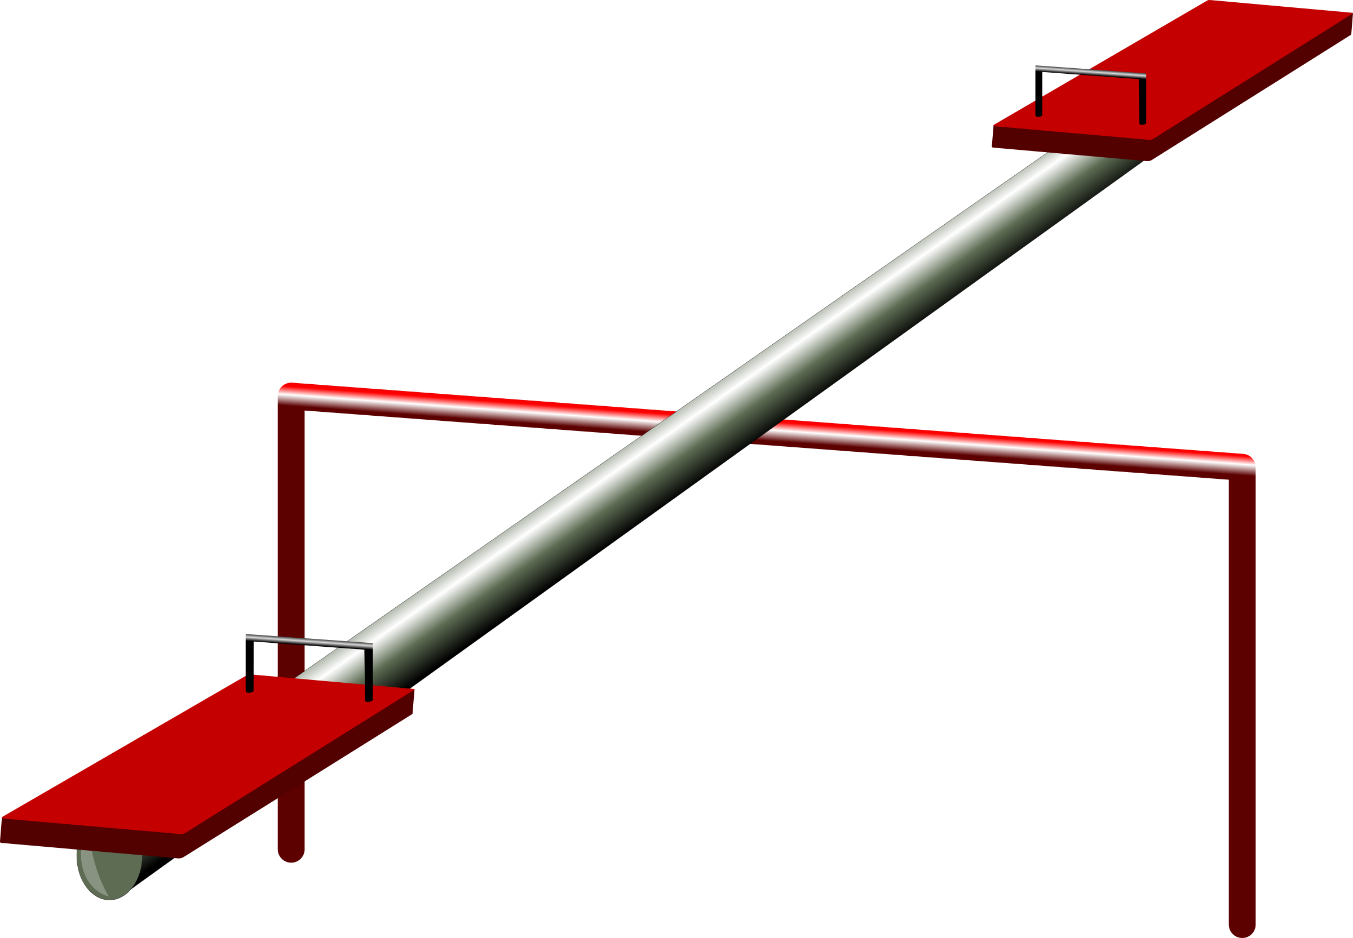
Conditions for the equilibrium
Torque:
Positive if rotates the body clockwise,
For statics,
Equilibrium conditions:
$$\sum_{all torques}{τ}=0$$
∑2_(𝑎𝑙𝑙 𝑡𝑜𝑟𝑞𝑢𝑒𝑠)▒𝜏=0
$$\sum_{all forces}{F_{x}}=0$$
∑2_(𝑎𝑙𝑙 𝑓𝑜𝑟𝑐𝑒𝑠)▒𝐹_𝑥 =0
$$\sum_{all forces}{F_{y}}=0$$
∑2_(𝑎𝑙𝑙 𝑓𝑜𝑟𝑐𝑒𝑠)▒𝐹_𝑦 =0
$$τ=\vec{F}×\vec{d}=Fd\sin{θ}$$
𝜏=𝐹 ⃗×𝑑 ⃗=𝐹𝑑 sin⁡𝜃
Otherwise - negative
pivot point location is optional,
choose wisely

Slide 4






Equilibrium example using seesaw
$$F_{1}$$
$$N$$
$$F_{2}$$
Seesaw has mass M
Weight = Mg
No forces in x direction
In y:
$$\sum_{all forces}{F_{y}}=0$$
∑2_(𝑎𝑙𝑙 𝑓𝑜𝑟𝑐𝑒𝑠)▒𝐹_𝑦 =0
$$0=N−Mg−F_{1}−F_{2}$$
0=𝑁−𝑀𝑔−𝐹_1−𝐹_2
In torques:
$$\sum_{all torques}{τ}=0$$
∑2_(𝑎𝑙𝑙 𝑡𝑜𝑟𝑞𝑢𝑒𝑠)▒𝜏=0
$$0=F_{2}d_{2}−F_{1}d_{1}$$
0=𝐹_2 𝑑_2−𝐹_1 𝑑_1
$$\sum_{all forces}{F_{x}}=0$$
∑2_(𝑎𝑙𝑙 𝑓𝑜𝑟𝑐𝑒𝑠)▒𝐹_𝑥 =0
Note that distance from pivot to Mg=0
Mass=M
$$d_{1}$$
$$Pivot$$
$$d_{2}$$

Slide 5






Mechanical Advantage
$$F_{2}$$
$$F_{1}$$
$$N$$
$$d_{2}$$
Level is a simple device
That provides mechanical advantage:
Force amplification
You apply $F_{2}$
You apply 𝐹_2
Get $F_{1}$
Get 𝐹_1
From equilibrium conditions:
$$F_{2}d_{2}−F_{1}d_{1}$$
𝐹_2 𝑑_2−𝐹_1 𝑑_1
$$F_{1}=F_{2}\frac{d_{2}}{d_{1}}$$
𝐹_1=𝐹_2 𝑑_2/𝑑_1
Since $d_{2}>d_{1}$
Since 𝑑_2>𝑑_1
$$F_{1}>F_{2}$$
𝐹_1>𝐹_2
$$d_{1}$$
$$Fulcrum$$

