Slide 1

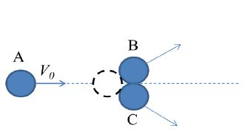

Linear momentum, impulse, conservation and collisions

Slide 2
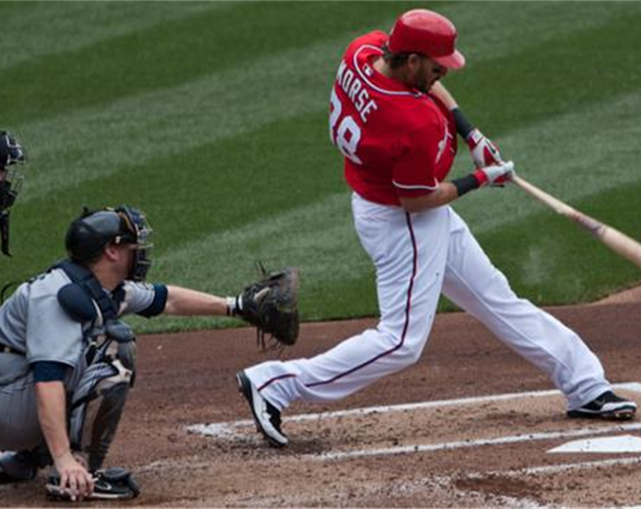
The need for linear momentum and impulse
In many situations, such as a bat hitting a ball, we cannot use Newton’s second law to solve problems because we know very little about the complicated forces involved.
Let’s introduce momentum and impulse, and the conservation of momentum, to solve such problems.
The law of conservation of momentum is valid even in
situations when Newton’s second law is not applicable,
such as bodies moving at high speeds or objects on a
very small scale

Slide 3
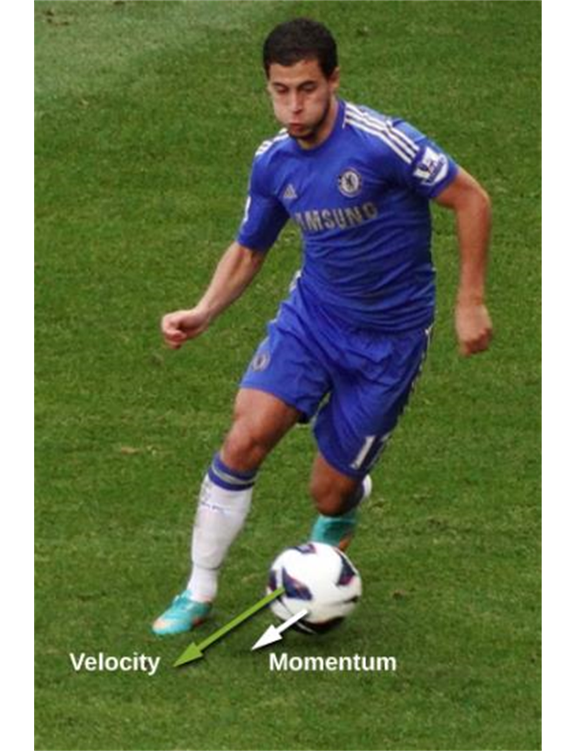

Linear momentum, definition
The linear momentum of a particle
Note:
Linear momentum is a vector quantity
Direction of linear momentum is the same
SI units – kg-m/s
Most of the time we will work with momentum in terms of
its components
$p_{x}=mv_{x}$
𝑝_𝑥=𝑚𝑣_𝑥
$$p_{y}=mv_{y}$$
𝑝_𝑦=𝑚𝑣_𝑦
$$p_{z}=mv_{z}$$
𝑝_𝑧=𝑚𝑣_𝑧
is the product of its mass and its velocity:
as the particle’s velocity

Slide 4
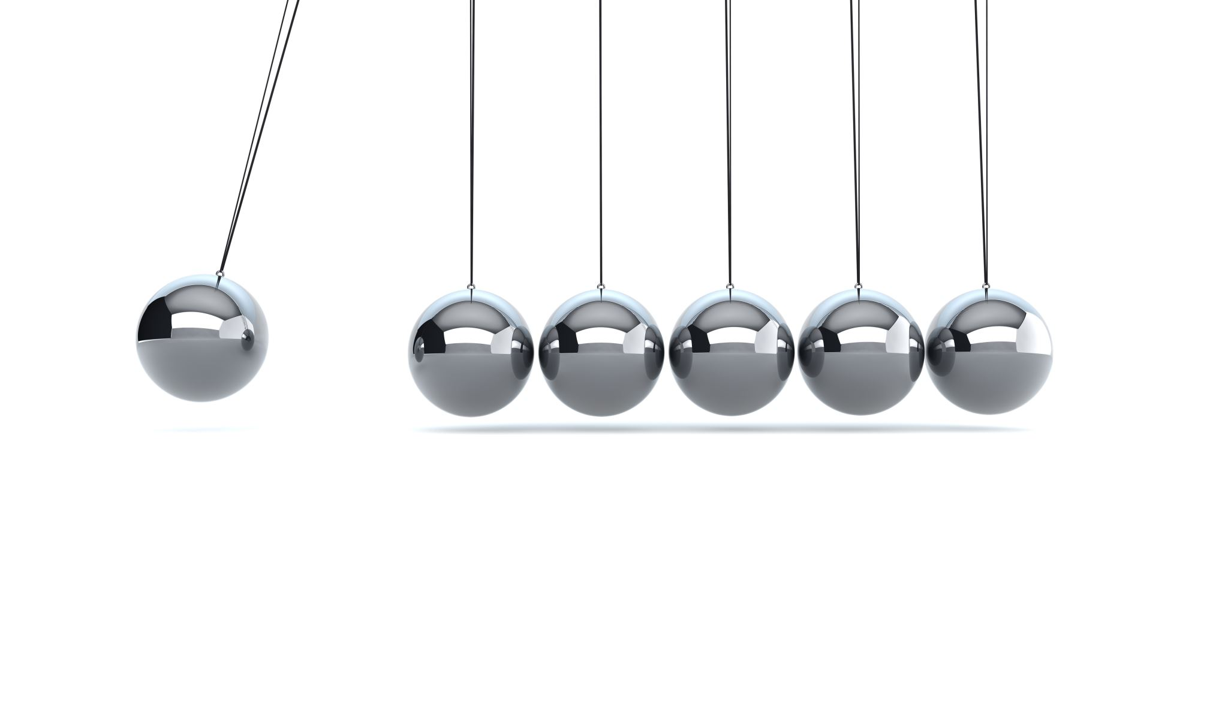
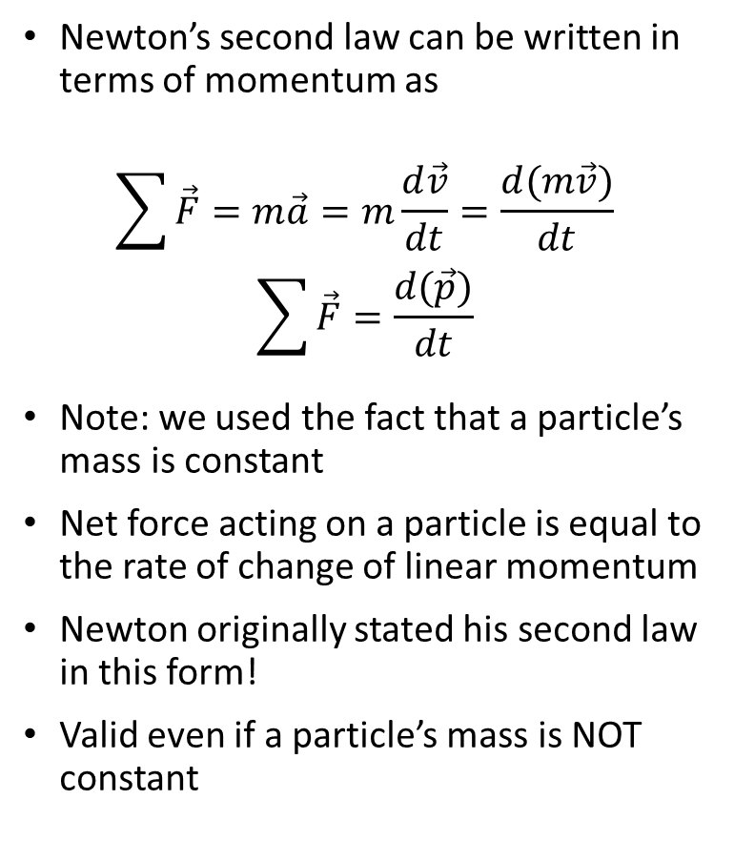
Newton’s second law and linear momentum
Newton’s second law can be written in terms of momentum as
$$\sum{\vec{F}}=m\vec{a}=m\frac{d\vec{v}}{dt}=\frac{d(m\vec{v})}{dt}$$
$$\sum{\vec{F}}=\frac{d(\vec{p})}{dt}$$
Note: we used the fact that a particle’s mass is constant
Net force acting on a particle is equal to the rate of change of linear momentum
Newton originally stated his second law in this form!
Valid even if a particle’s mass is NOT constant

Slide 5
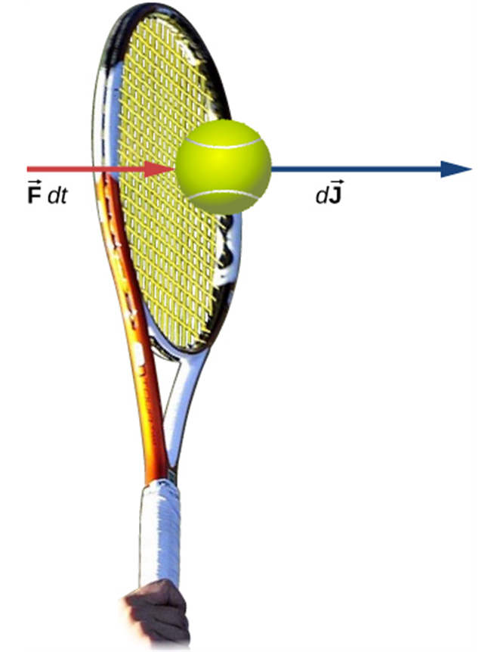
Impulse and impulse-momentum theorem
Start with the Newton’s second law
$$\sum{\vec{F}}=\frac{d(\vec{p})}{dt} or\frac{Δ\vec{p}}{Δt}$$
∑1▒𝐹 ⃗ =(𝑑(𝑝 ⃗))/𝑑𝑡 𝑜𝑟 (Δ𝑝 ⃗)/Δ𝑡
$$\sum{\vec{F}}dt=d\vec{p}$$
∑1▒𝐹 ⃗ 𝑑𝑡=𝑑𝑝 ⃗
$$\int_{t_{i}}^{t_{f}}{\sum{\vec{F}}dt}=\int_{\vec{p_{i}}}^{\vec{p_{f}}}{d\vec{p}}=\vec{p_{f}}−\vec{p_{i}}$$
∫2_(𝑡_𝑖)^(𝑡_𝑓)▒〖∑1▒𝐹 ⃗ 𝑑𝑡〗=∫2_(𝑝_𝑖 ) ⃗^(𝑝_𝑓 ) ⃗▒〖𝑑𝑝 ⃗ 〗=(𝑝_𝑓 ) ⃗−(𝑝_𝑖 ) ⃗
Call this quantity Impulse:
Impulse-momentum theorem:
$$\vec{J}= \vec{p_{f}}−\vec{p_{i}}$$
𝐽 ⃗= (𝑝_𝑓 ) ⃗−(𝑝_𝑖 ) ⃗
and integrate it over the time:
$$\vec{J}=\int_{t_{i}}^{t_{f}}{\sum{\vec{F}}dt}$$
𝐽 ⃗=∫2_(𝑡_𝑖)^(𝑡_𝑓)▒〖∑1▒𝐹 ⃗ 𝑑𝑡〗
The change in momentum of a particle during a time interval
is equal to the impulse of the net force
acting on the particle during that interval.

Slide 6
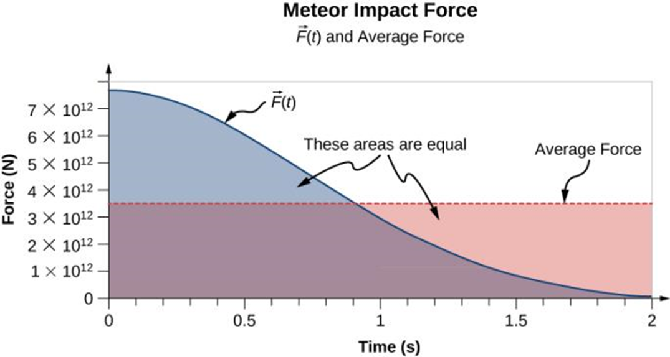
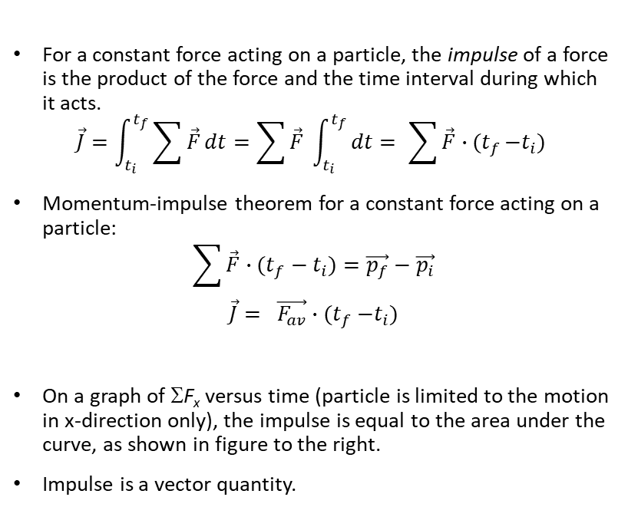
Impulse, details
For a constant force acting on a particle, the impulse of a force is the product of the force and the time interval during which it acts.
$$\vec{J}=\int_{t_{i}}^{t_{f}}{\sum{\vec{F}}dt}=\sum{\vec{F}} \int_{t_{i}}^{t_{f}}{dt={ \sum{\vec{F}}∙(t}_{f}−t_{i}) }$$
Momentum-impulse theorem for a constant force acting on a particle:
$${\sum{\vec{F}}∙(t}_{f}−t_{i})=\vec{p_{f}}−\vec{p_{i}}$$
$$\vec{J}= \vec{F_{av}}{∙(t}_{f}−t_{i})$$
On a graph of ΣF_{x} versus time (particle is limited to the motion in x-direction only), the impulse is equal to the area under the curve, as shown in figure to the right.
Impulse is a vector quantity.

Slide 7
Momentum and kinetic energy
Changes in momentum depend on time over which the net force acts, but changes in kinetic energy depend on the distance over which the net force acts.
Momentum is a vector while kinetic energy is a scalar.
What if you need to catch a 0.50 kg ball moving with a 4.0 m/s speed
or a 0.10 kg ball moving at 20.0 m/s?
Note that the momenta are the same while the kinetic energies are not.
Impulse required to stop a ball is the same in each case, but work is not!

Slide 8
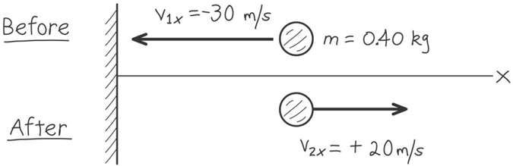
Let’s consider an example
Suppose you throw a ball with a mass of 0.40 kg against a brick wall. It hits the wall moving horizontally and to the left at 30 m/s and rebounds horizontally and to the right at 20 m/s. Find the impulse of the net force on the ball during the collision. If the ball is in contact with the wall for 0.010 s, find the average horizontal force that the wall exerts on the ball during the impact.

Slide 9

Concept of an isolated system
Isolated system - the one in which objects interact only
with each other but not with anything else.
Internal forces – the forces that particles of a system
exert on each other.
Note that the internal forces exist in Newton’s 3rd Law
pairs

Slide 10
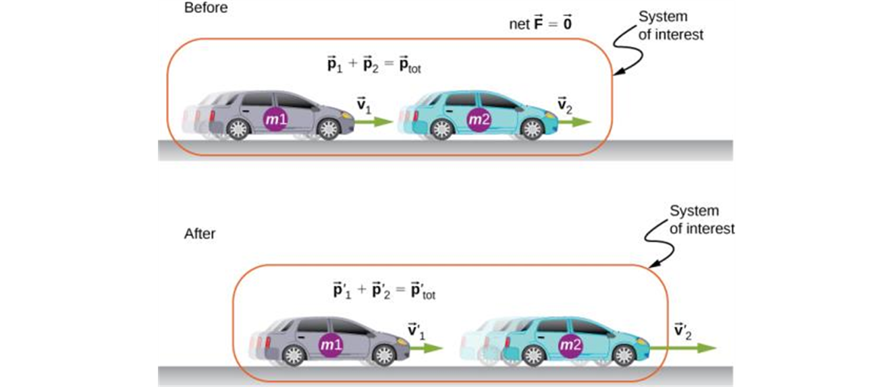
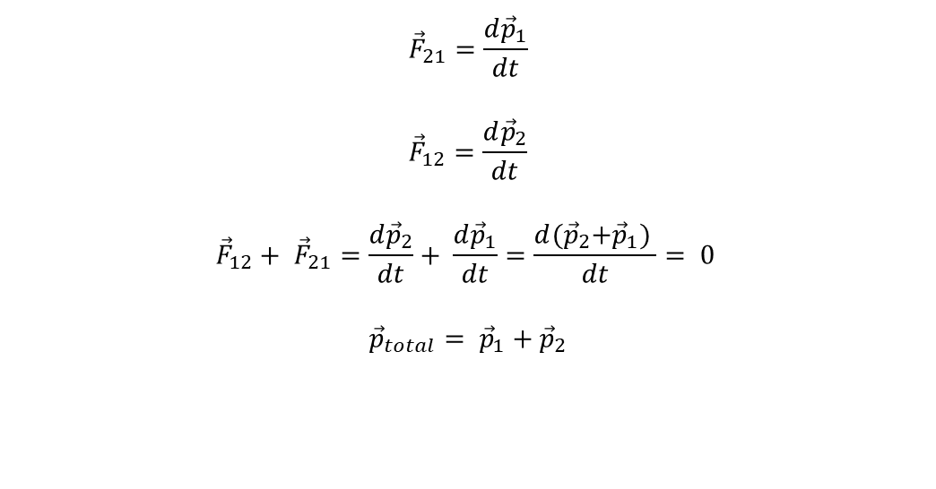
Principle of conservation of linear momentum
$${\vec{F}}_{21}=\frac{d{\vec{p}}_{1}}{dt}$$
$${\vec{F}}_{12}=\frac{d{\vec{p}}_{2}}{dt}$$
$${\vec{F}}_{12}+ {\vec{F}}_{21}=\frac{d{\vec{p}}_{2}}{dt}+ \frac{d{\vec{p}}_{1}}{dt}=\frac{d{(\vec{p}}_{2}+{\vec{p}}_{1}) }{dt}= 0$$
$${\vec{p}}_{total}= {\vec{p}}_{1}+{\vec{p}}_{2}$$
The two cars together form the system that is to be analyzed. It is important to remember that the contents (the mass) of the system do not change before, during, or after the objects in the system interact.

Slide 11
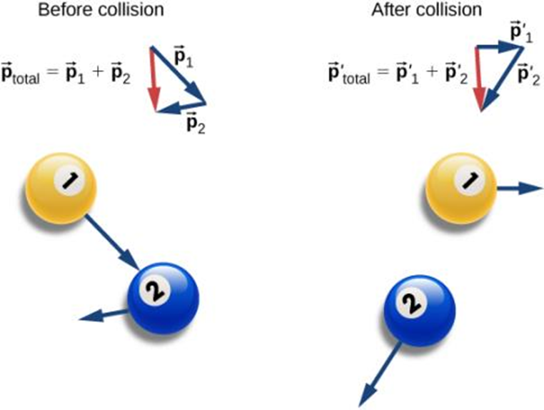
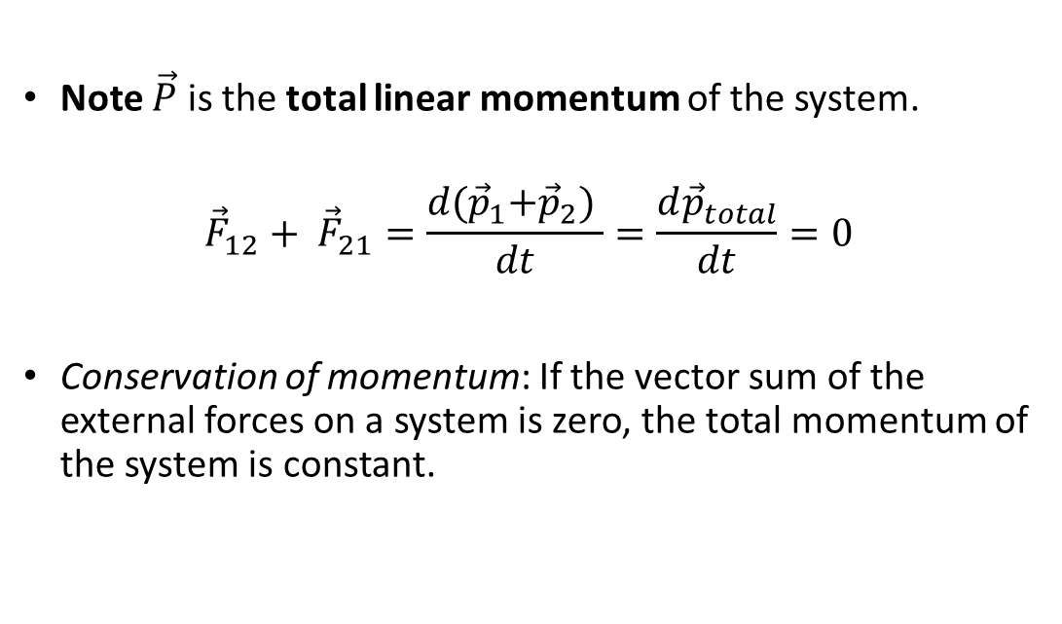
Principle of conservation of momentum, continued
Note $\vec{P}$ is the total linear momentum of the system.
$${\vec{F}}_{12}+ {\vec{F}}_{21}=\frac{d{(\vec{p}}_{1}+{\vec{p}}_{2}) }{dt}=\frac{d{\vec{p}}_{total}}{dt}=0$$
Conservation of momentum: If the vector sum of the external forces on a system is zero, the total momentum of the system is constant.

Slide 12
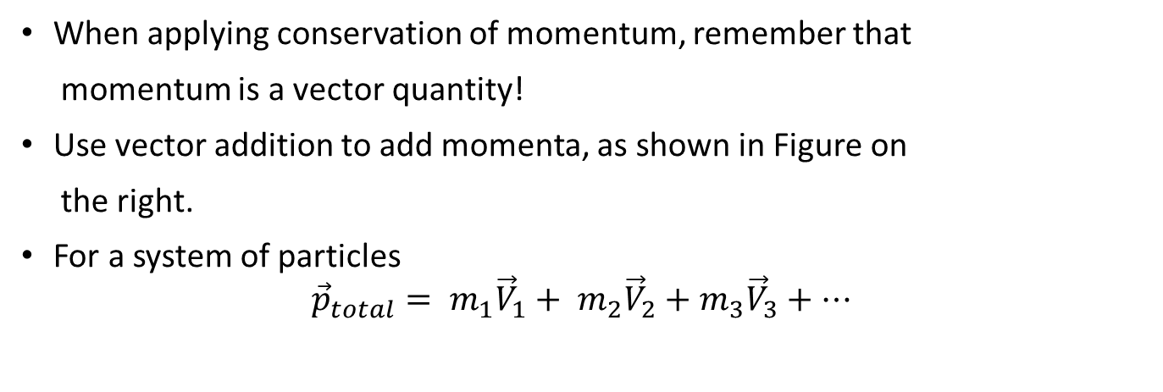
Notes on the Conservation of Momentum
When applying conservation of momentum, remember that
momentum is a vector quantity!
Use vector addition to add momenta, as shown in Figure on
the right.
For a system of particles
$${{\vec{p}}_{total}= m}_{1}{\vec{V}}_{1}+ m_{2}{\vec{V}}_{2}+m_{3}{\vec{V}}_{3}+…$$

Slide 13
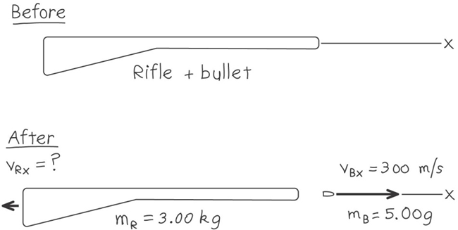
Recoil of a rifle, example
A marksman holds a rifle of mass m_{R} = 3.00 kg loosely in his hands, so as to let it recoil freely when fired. He fires a bullet of mass m_{B} = 5.00 g horizontally with a velocity relative to the ground of v_{B} = 300 m/s. What is the recoil velocity of a rifle? What are the final kinetic energy and momentum of the bullet? Of the rifle?

Slide 14
Collisions: major assumptions
Collision – any strong interaction between bodies that lasts relatively short time.
If the forces between the bodies are much stronger than any external forces, as is the case in most collisions, we can neglect the external forces entirely and treat the colliding bodies as an isolated system.
Total momentum of the system must be conserved in any collision.
If the forces between the bodies are also conservative, the total kinetic energy of the system Is conserved (elastic collisions).
A collision in which the kinetic energy is not conserved is called inelastic collision.
In any collision in which external forces can be neglected, total linear momentum is conserved, that is the total momentum before collision is equal to the total momentum after collision. Kinetic energy may or may not be conserved.

Slide 15
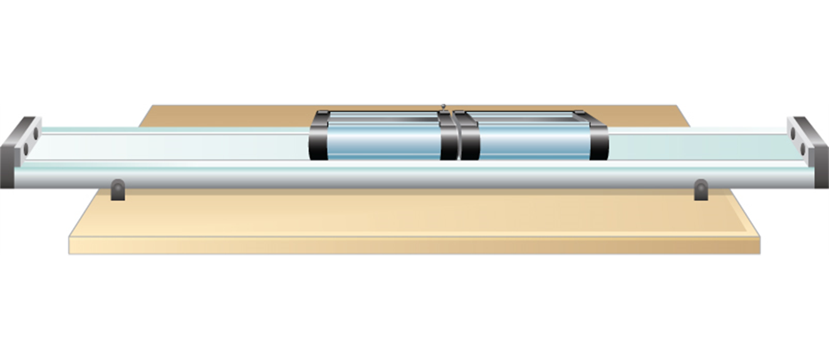
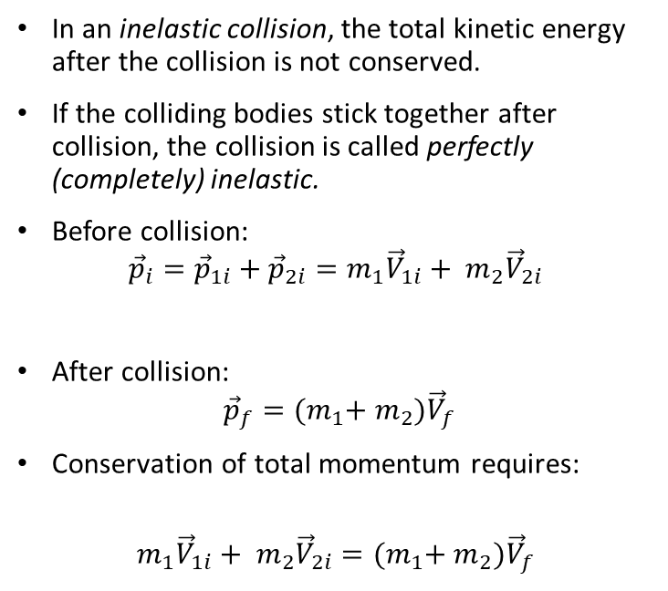
Inelastic collisions
In an inelastic collision, the total kinetic energy after the collision is not conserved.
If the colliding bodies stick together after collision, the collision is called perfectly (completely) inelastic.
Before collision:
$${\vec{p}}_{i}={\vec{p}}_{1i}+{\vec{p}}_{2i}=m_{1}{\vec{V}}_{1i}+ m_{2}{\vec{V}}_{2i}$$
After collision:
$${\vec{p}}_{f}={(m}_{1}+ m_{2}){\vec{V}}_{f}$$
Conservation of total momentum requires:
$$m_{1}{\vec{V}}_{1i}+ m_{2}{\vec{V}}_{2i}={(m}_{1}+ m_{2}){\vec{V}}_{f}$$
Two lab carts collide and stick together after the collision.

Slide 16
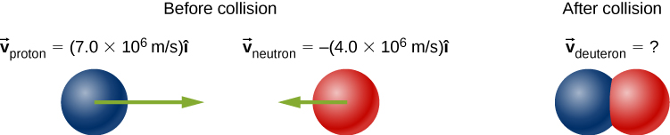
Perfectly inelastic collision, example

Slide 17
Elastic collisions
In an elastic collision, the total kinetic energy of the system is the same :
Before collision:
$${\vec{p}}_{i}={\vec{p}}_{1i}+{\vec{p}}_{2i}=m_{1}{\vec{V}}_{1i}+ m_{2}{\vec{V}}_{2i}$$
𝑝 ⃗_𝑖=𝑝 ⃗_1𝑖+𝑝 ⃗_2𝑖=𝑚_1 𝑉 ⃗_1𝑖+ 𝑚_2 𝑉 ⃗_2𝑖
After collision:
$${\vec{p}}_{f}= {\vec{p}}_{1f}+{\vec{p}}_{2f}=m_{1}{\vec{V}}_{1f}+ m_{2}{\vec{V}}_{2f}$$
𝑝 ⃗_𝑓= 𝑝 ⃗_1𝑓+𝑝 ⃗_2𝑓=𝑚_1 𝑉 ⃗_1𝑓+ 𝑚_2 𝑉 ⃗_2𝑓
Conservation of momentum:
$$m_{1}{\vec{V}}_{1i}+ m_{2}{\vec{V}}_{2i}=m_{1}{\vec{V}}_{1f}+ m_{2}{\vec{V}}_{2f}$$
𝑚_1 𝑉 ⃗_1𝑖+ 𝑚_2 𝑉 ⃗_2𝑖=𝑚_1 𝑉 ⃗_1𝑓+ 𝑚_2 𝑉 ⃗_2𝑓
Energy is conserved:
$${\frac{1}{2}m}_{1}{{\vec{V}}_{1i}}^{2}+ {\frac{1}{2}m}_{2}{{\vec{V}}_{2i}}^{2}={\frac{1}{2}m}_{1}{{\vec{V}}_{1f}}^{2}+ {\frac{1}{2}m}_{2}{{\vec{V}}_{2f}}^{2}$$
〖1/2 𝑚〗_1 〖𝑉 ⃗_1𝑖〗^2+ 〖1/2 𝑚〗_2 〖𝑉 ⃗_2𝑖〗^2=〖1/2 𝑚〗_1 〖𝑉 ⃗_1𝑓〗^2+ 〖1/2 𝑚〗_2 〖𝑉 ⃗_2𝑓〗^2
after the collision as before.

Slide 18

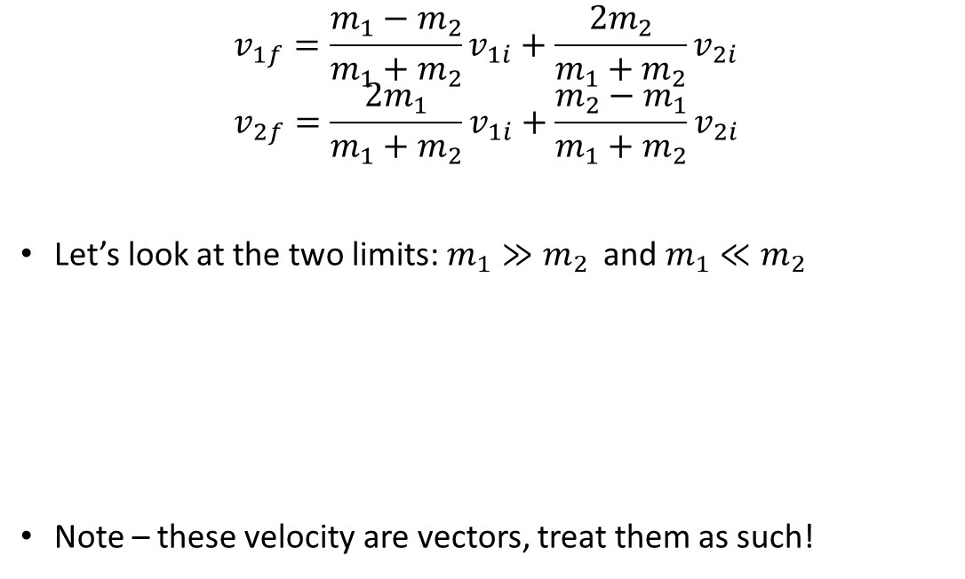
Head-on (1D) elastic collisions
$$v_{1f}=\frac{m_{1}−m_{2}}{m_{1}+m_{2}}v_{1i}+\frac{2m_{2}}{m_{1}+m_{2}}v_{2i}$$
$$v_{2f}=\frac{2m_{1}}{m_{1}+m_{2}}v_{1i}+\frac{m_{2}−m_{1}}{m_{1}+m_{2}}v_{2i}$$
Let’s look at the two limits: $m_{1}≫m_{2}$ and $m_{1}≪m_{2}$
Note – these velocity are vectors, treat them as such!

Slide 19

Head-on (1D) elastic collisions, another interesting case
What if the two masses are equal, and one of the objects is stationary before impact?

Slide 20
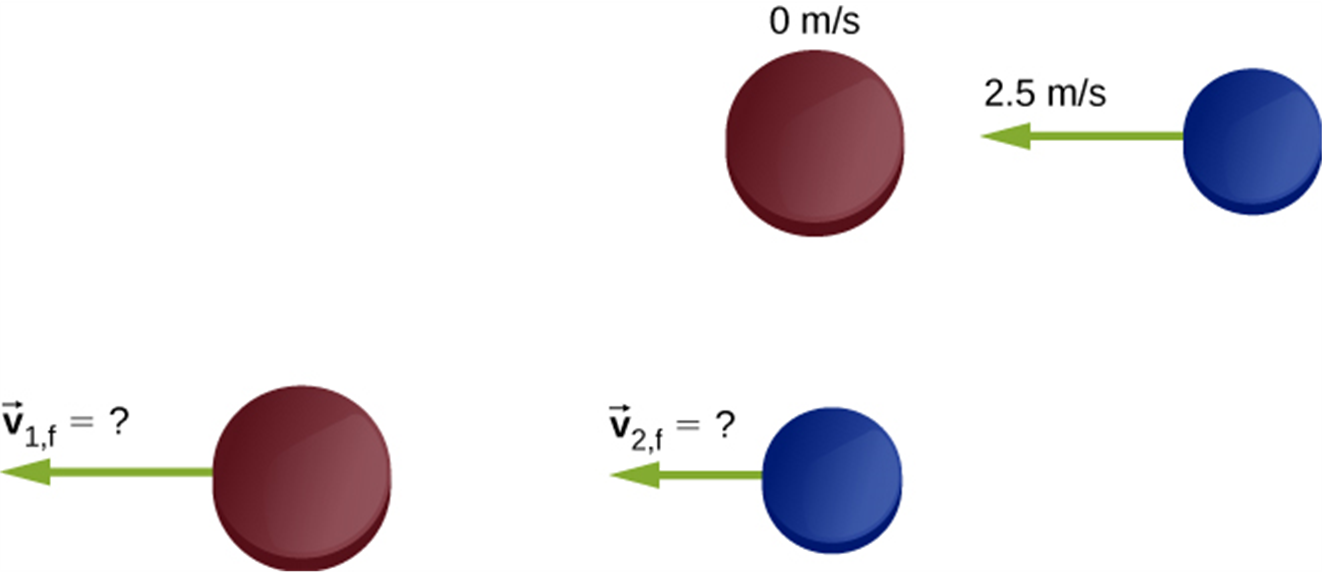
Elastic collisions, an example
Two different hockey pucks colliding. The top diagram shows the pucks the instant before the collision, and the bottom diagram show the pucks the instant after the collision. The net external force is zero.

