Slide 1

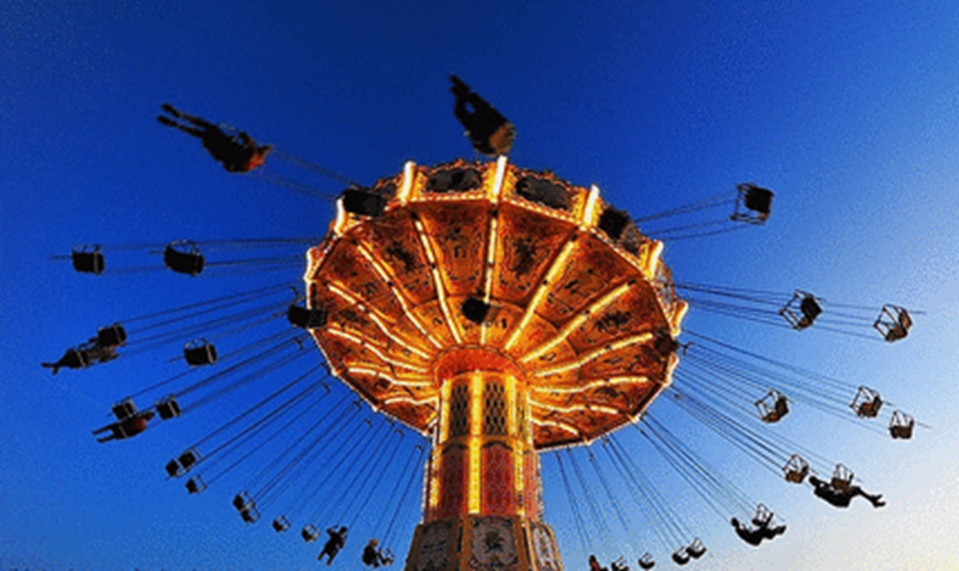

Work done by a constant force

Slide 2
Defining work
Alternative approach to mechanics – based on the concepts of work and energy.
Free Body Diagram and the Newton’s Second Law are great tools, but things can get very complicated due to their vector nature (and if forces are NOT constant).
Work and energy are scalar quantities, easier to deal with in comparison with forces and accelerations that are vectors.
Formulation of principle of conservation of energy – one of the most powerful tools in physics and beyond (chemistry, biology, etc.).
But there is a price to pay – we generally lose information about direction of the motion.

Slide 3
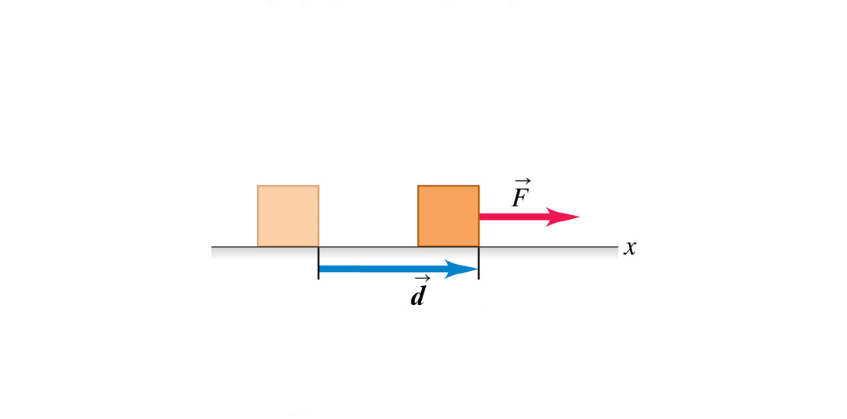
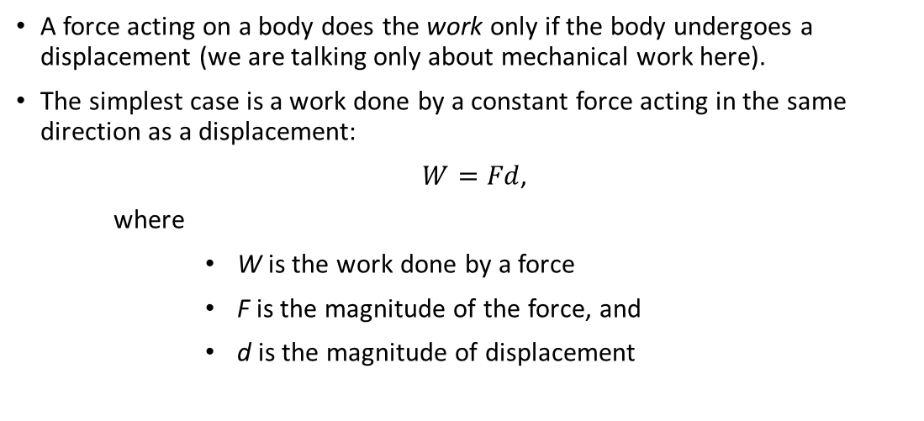
Work done by a constant force - definition
A force acting on a body does the work only if the body undergoes a displacement (we are talking only about mechanical work here).
The simplest case is a work done by a constant force acting in the same direction as a displacement:
$W=Fd$,
where
      W is the work done by a force
      F is the magnitude of the force, and
      d is the magnitude of displacement
Do not confuse W (work) with w (weight)!

Slide 4
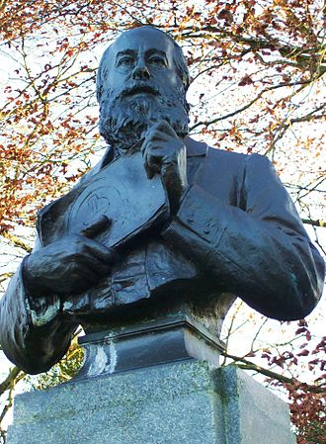
Details:
Work is a scalar quantity – does not have direction
SI Units from the definition are $\left[N∙m\right]=[J]$ - called Joule
SI Units from the definition are [𝑁∙𝑚]=[𝐽] - called Joule
Work can be positive, negative, or zero
James Prescott Joule, an English physicist who established that the various forms of energy—mechanical, electrical, and heat can be changed one into another.

Slide 5
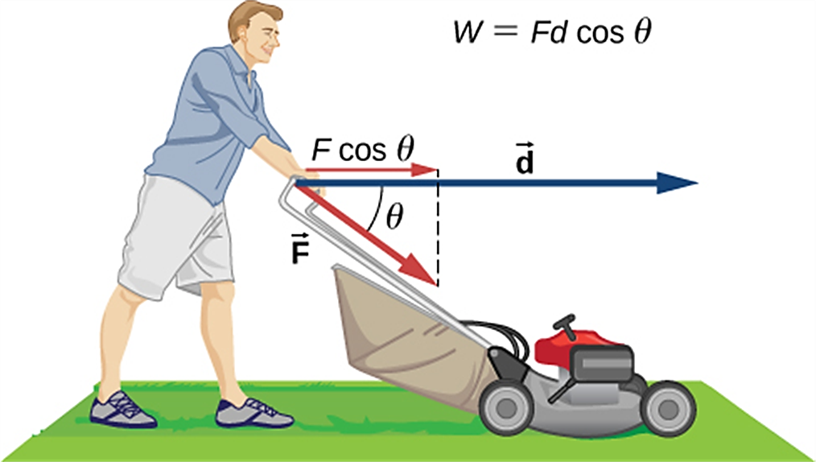
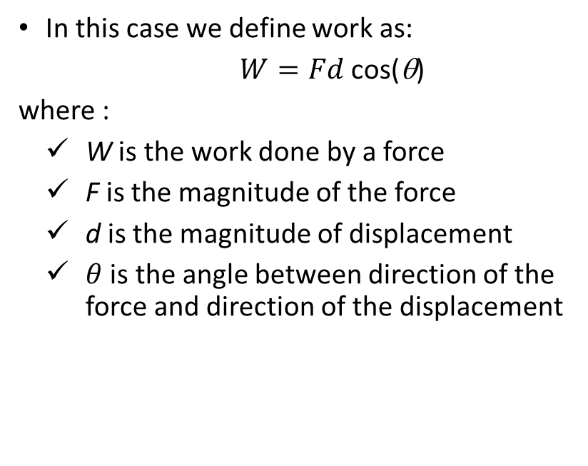
What if a constant force does NOT act along the direction of the displacement?
In this case we define work as:
$W=Fd$ cos(θ)
where :
  W is the work done by a force
  F is the magnitude of the force
  d is the magnitude of displacement
  $θ$ is the angle between direction of the force and direction of the displacement

Slide 6
Did you notice something familiar?
The definition has the form of the scalar (dot) product of two vectors!
In fact, we can rewrite it as
$$W=\vec{F}∙\vec{d}$$
𝑊=𝐹 ⃗∙𝑑 ⃗
Interestingly, we combine two vector quantities to produce a scalar.
Note, this definition only applies to work done by a constant force along a straight-line displacement.
If the force acts along the direction of displacement (θ = 0), we go back W = F d
Note that we well also explore force times the time and force times distance and the sine of the angle in subsequent chapters ☺

Slide 7
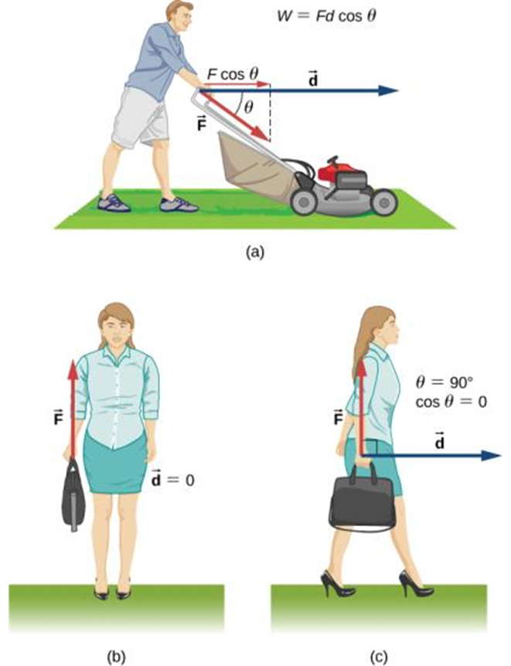
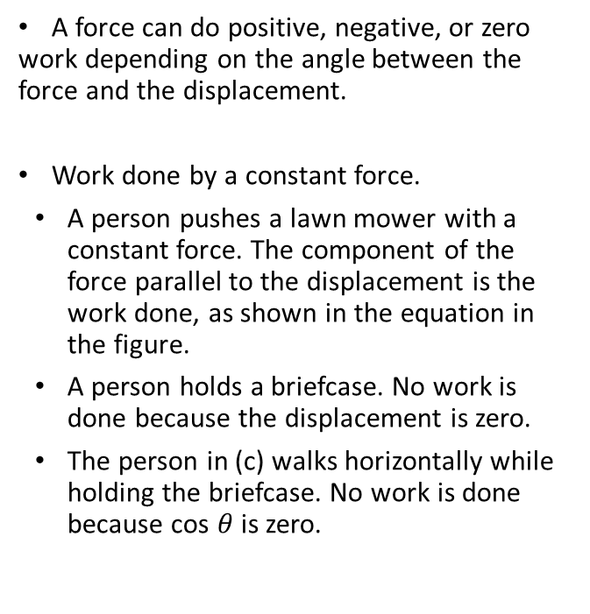
Positive, negative, and zero work
A force can do positive, negative, or zero work depending on the angle between the force and the displacement.
Work done by a constant force.
A person pushes a lawn mower with a constant force. The component of the force parallel to the displacement is the work done, as shown in the equation in the figure.
A person holds a briefcase. No work is done because the displacement is zero.
The person in (c) walks horizontally while holding the briefcase. No work is done because cos $θ$ is zero.

Slide 8
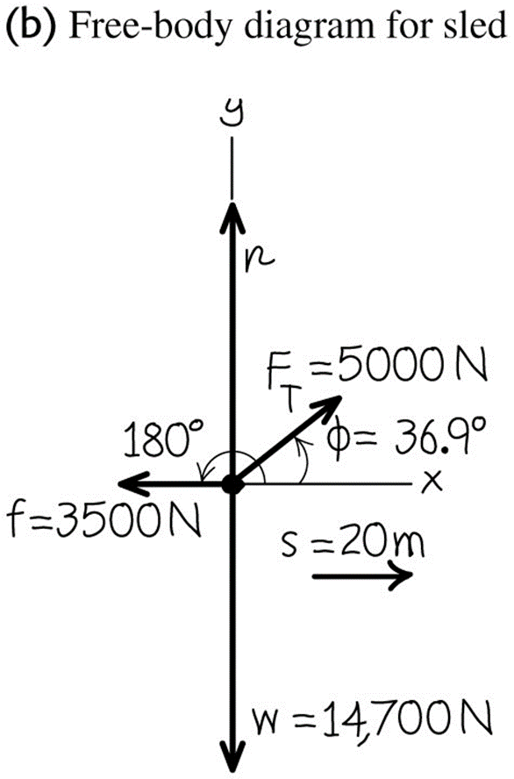
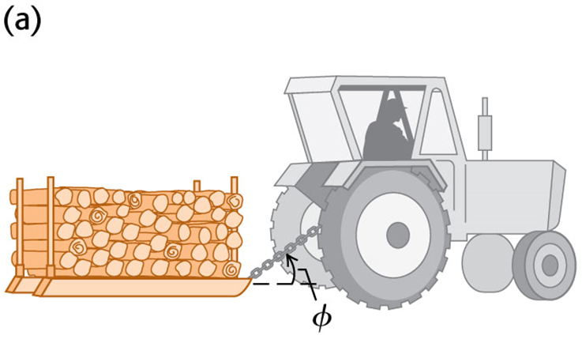
Sample problem: Work done by several forces
Farmer Benton hitches his tractor to a sled loaded with firewood and pulls it s=20 m along leveled ground.
The total weight of the sled and load is 14,700 N.
There is a 3,500 N friction force opposing the sled’s motion.
Find the work done by each force acting on the sled and the total work done by all forces.
The tractor exerts a constant 5,000 N force at an angle of 36.9º above the horizontal.

Slide 9
Solution
Work done by tension:
$$W_{T}=F_{T}s\cos\left(φ\right)=\left(5,000 N\right)\left(20 m\right)\cos\left({36.9}^{o}\right)=80,000 J$$
𝑊_𝑇=𝐹_𝑇 𝑠 cos⁡(𝜙)=(5,000 𝑁)(20 𝑚) cos⁡(〖36.9〗^𝑜 )=80,000 𝐽
Work done by weight:
$$W_{w}=ws\cos\left(φ\right)=\left(14,700 N\right)\left(20 m\right)\cos\left({90}^{o}\right)=0 J$$
𝑊_𝑤=𝑤𝑠 cos⁡(𝜙)=(14,700 𝑁)(20 𝑚) cos⁡(90^𝑜 )=0 𝐽
Work done by normal force (notice that we do not need to know its magnitude):
$$W_{n}=ns\cos\left({90}^{o}\right)=0 J$$
𝑊_𝑛=𝑛𝑠 cos⁡(90^𝑜 )=0 𝐽
Work done by friction:
$$W_{f}=fs\cos\left(φ\right)=\left(3,500 N\right)\left(20 m\right)\cos\left(180\right)=−70,000 J$$
𝑊_𝑓=𝑓𝑠 cos⁡(𝜙)=(3,500 𝑁)(20 𝑚) cos⁡(180)=−70,000 𝐽
Total work done by all forces (note that we add scalars here):
$${ W}_{net}=W_{T}+W_{w}+W_{f}+W_{n}=10,000 J$$
〖 𝑊〗_𝑛𝑒𝑡=𝑊_𝑇+𝑊_𝑤+𝑊_𝑓+𝑊_𝑛=10,000 𝐽

Slide 10
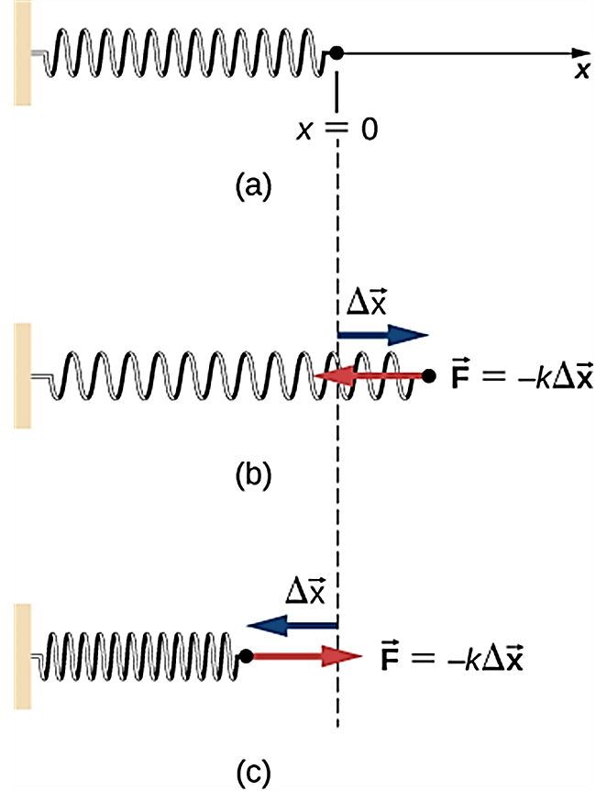
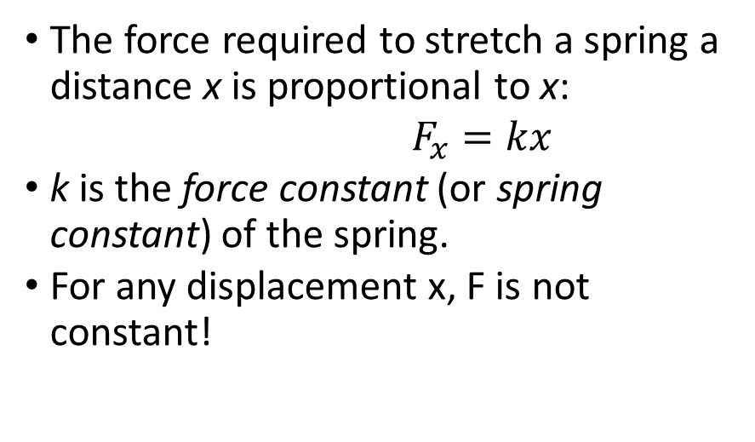
Work done by spring force
  The force required to stretch a spring a distance x is proportional to x:
  $F_{x}=kx$
  k is the force constant (or spring constant) of the spring.
  For any displacement x, F is not constant!
(a) The spring exerts no force at its equilibrium position. The spring exerts a force in the opposite direction to (b) an extension or stretch, and (c) a compression.
Note: the SI unit of spring constant is N/m

Slide 11
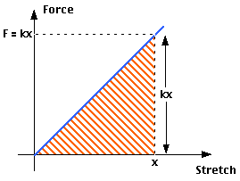
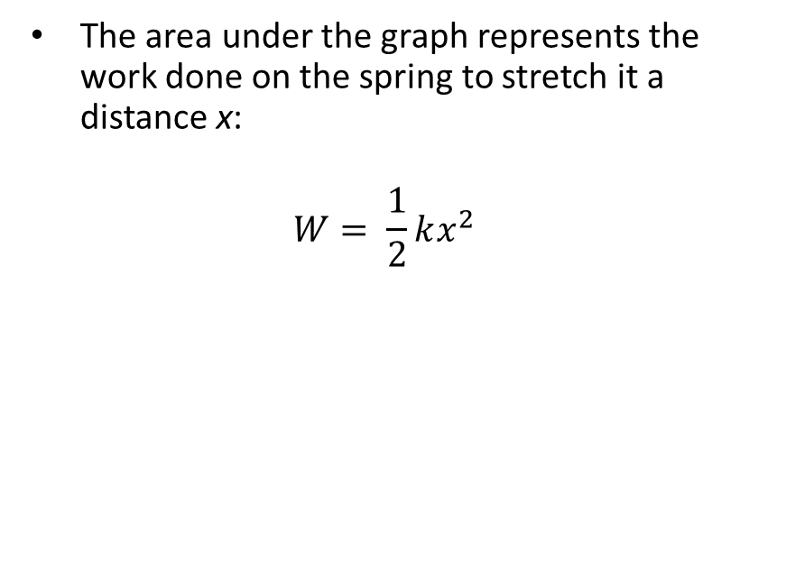
Work done by spring force, continued
  The area under the graph represents the work done on the spring to stretch it a distance x:
  $$W= \frac{1}{2}kx^{2}$$

Slide 12
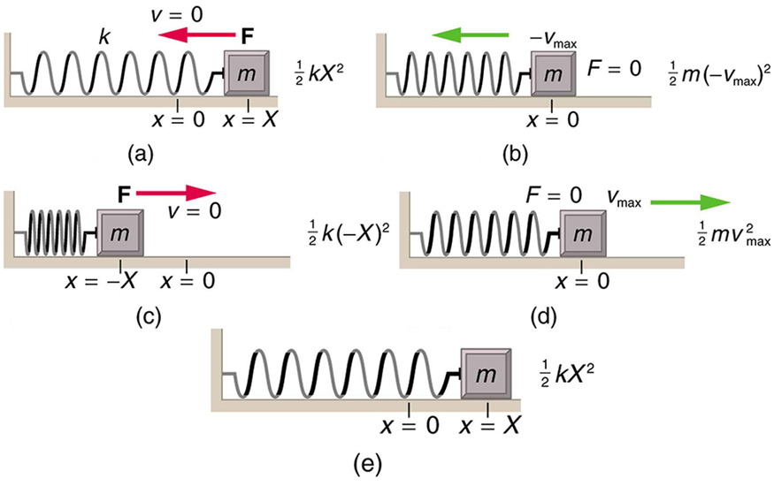
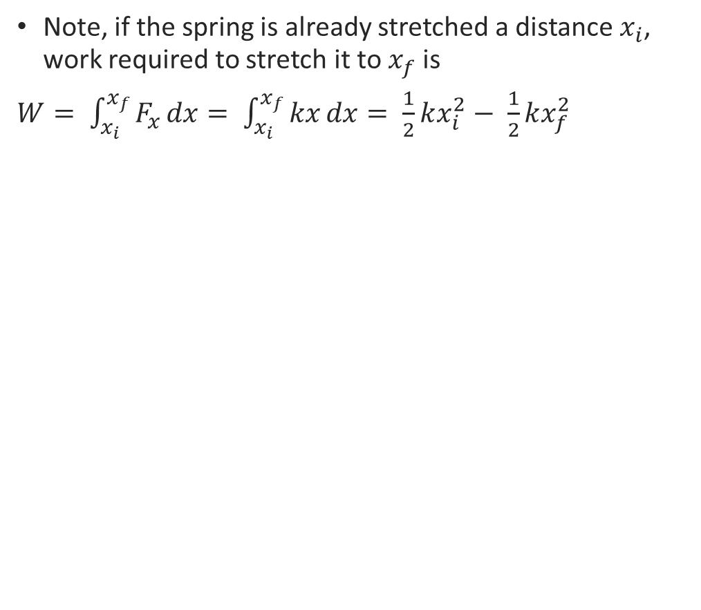
Work needed to stretch a spring – generalization, given for completness
Note, if the spring is already stretched a distance $x_{i}$, work required to stretch it to $x_{f}$ is
$W= \int_{x_{i}}^{x_{f}}{F_{x}}dx= \int_{x_{i}}^{x_{f}}{kx}dx= \frac{1}{2}kx_{i}^{2}− \frac{1}{2}kx_{f}^{2}$

Slide 13
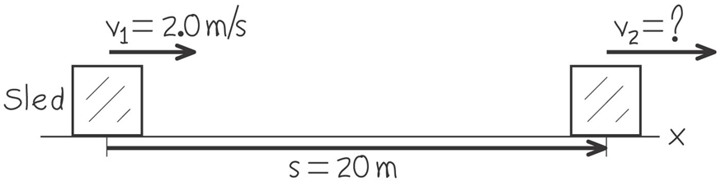
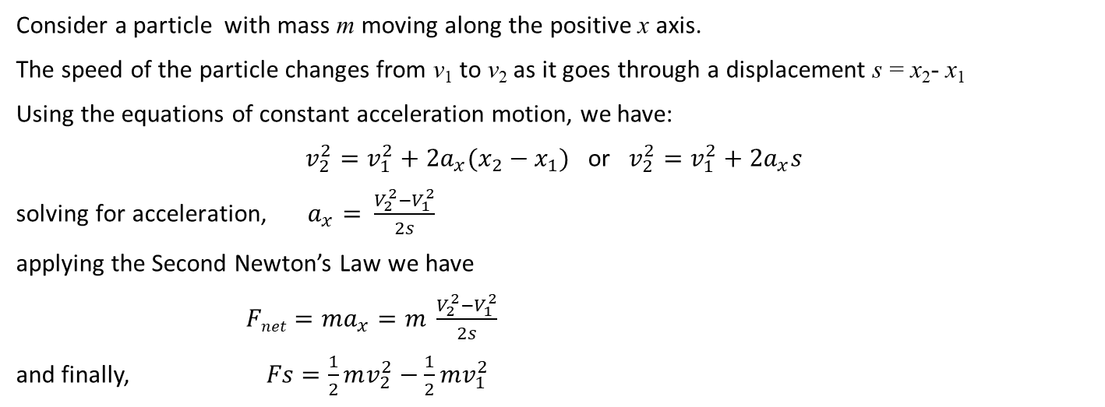
Let’s see how work done on a particle changes its speed
Consider a particle with mass m moving along the positive x axis.
The speed of the particle changes from v₁ to v₂ as it goes through a displacement s = x₂- x₁
Using the equations of constant acceleration motion, we have:
$v_{2}^{2}=v_{1}^{2}+2a_{x}(x_{2}−x_{1})$ or $v_{2}^{2}=v_{1}^{2}+2a_{x}s$
${\text{solving} \text{for} \text{acceleration}\text{,} a}_{x}= \frac{V_{2}^{2}−V_{1}^{2}}{2s}$
applying the Second Newton’s Law we have
$Fnet=ma_{x}=m \frac{V_{2}^{2}−V_{1}^{2}}{2s}$
and finally, $Fs=\frac{1}{2}mv_{2}^{2}−\frac{1}{2}mv_{1}^{2}$

Slide 14
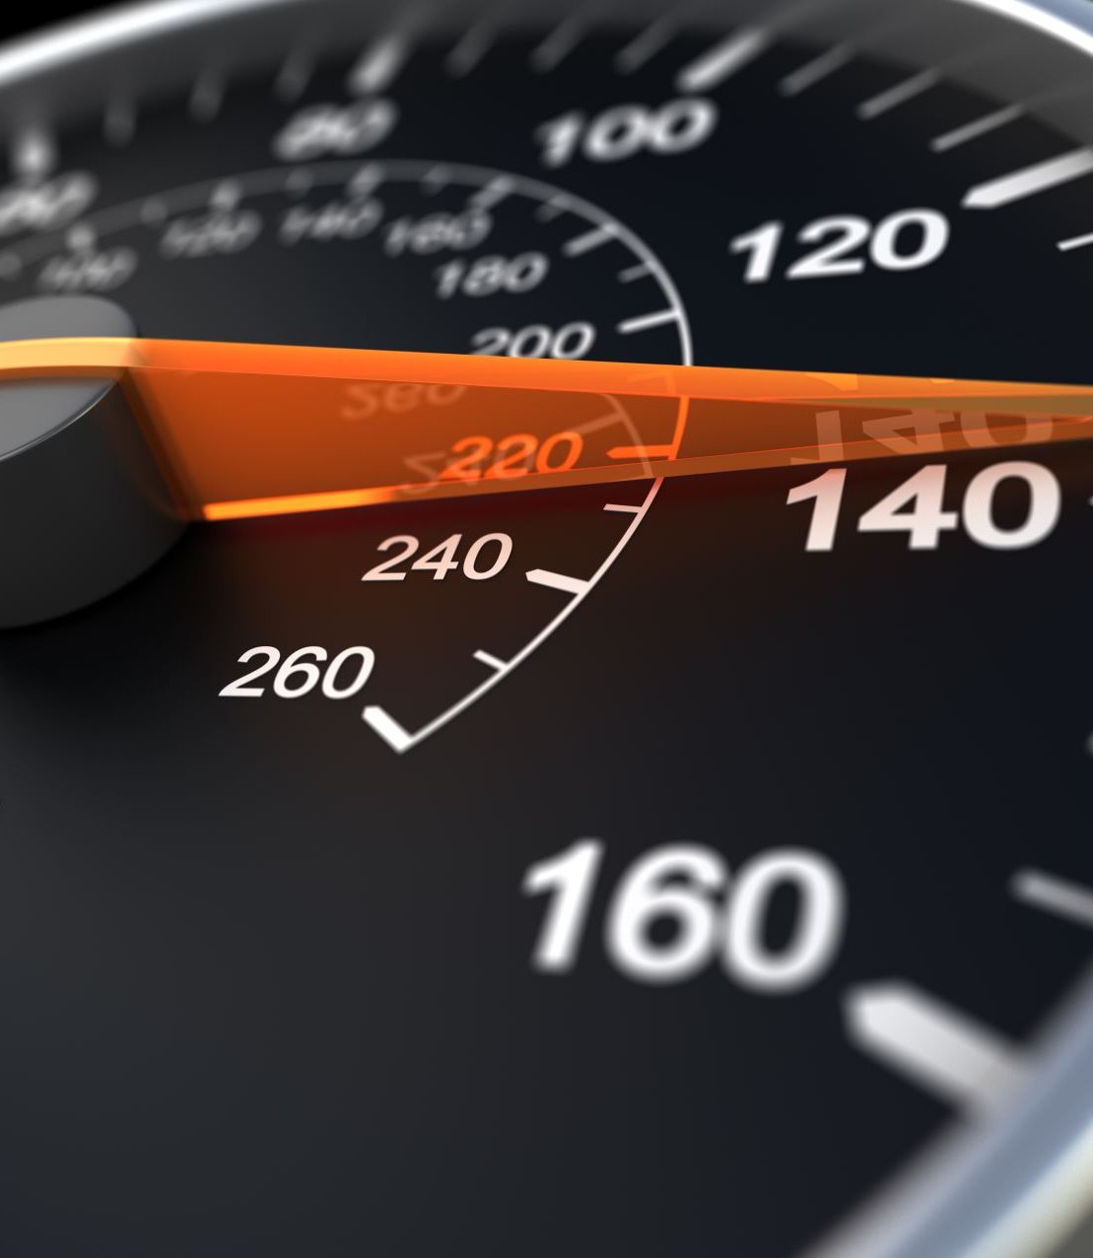
Kinetic energy
Let’s look at the last equation again:
F_{net}$s=\frac{1}{2}mv_{2}^{2}−\frac{1}{2}{mv}_{1}^{2}$
F_{net} 𝑠=1/2 𝑚v_2^2−1/2 mv_1^2
We already know that
The quantity on the right is called kinetic energy K of the particle:
$K=\frac{1}{2}mv^{2}$
𝐾=1/2 𝑚𝑣^2
Now we can rewrite the equation above as
$$W_{net}=K_{2}−K_{1}$$
𝑊_𝑛𝑒𝑡=𝐾_2−𝐾_1
This result is known as the work – energy theorem.
THEOREM:
The term on the left is work done by the force $F_{net}$
The term on the left is work done by the force 𝐹_𝑛𝑒𝑡

Slide 15
More on kinetic energy
Kinetic energy is a scalar
SI units are the same as of work – joules
Kinetic energy is always positive
Positive work done on a particle causes the particle’s kinetic energy (and speed) to increase
Negative work done on a particle causes the particle’s kinetic energy (and speed) to decrease
Kinetic energy can be thought of as the amount of work a particle can do as it comes to a complete stop
(imagine slamming a chair into a wall) The kinetic energy abruptly goes to zero as the chair does work (and damage) to the wall

Slide 16
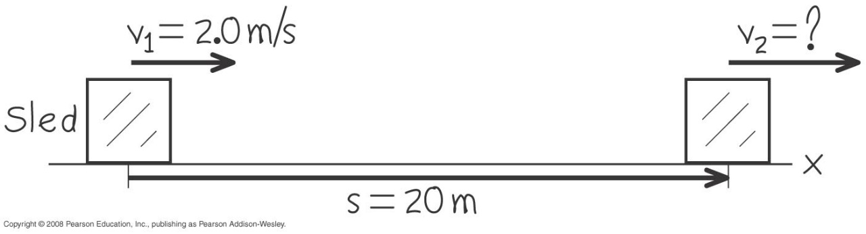
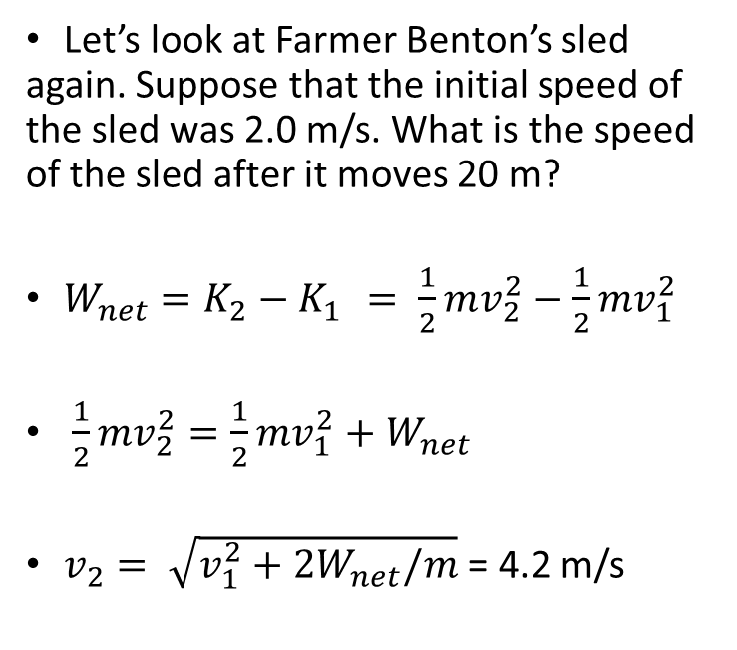
Using work – kinetic energy theorem
Let’s look at Farmer Benton’s sled again. Suppose that the initial speed of the sled was 2.0 m/s. What is the speed of the sled after it moves 20 m?
$W_{net}=K_{2}−K_{1 }= \frac{1}{2}mv_{2}^{2}−\frac{1}{2}mv_{1}^{2}$
$\frac{1}{2}mv_{2}^{2}=\frac{1}{2}mv_{1}^{2}+W_{net}$
$v_{2}= \sqrt{v_{1}^{2}+2W_{net}/m}$ = 4.2 m/s

