Slide 1

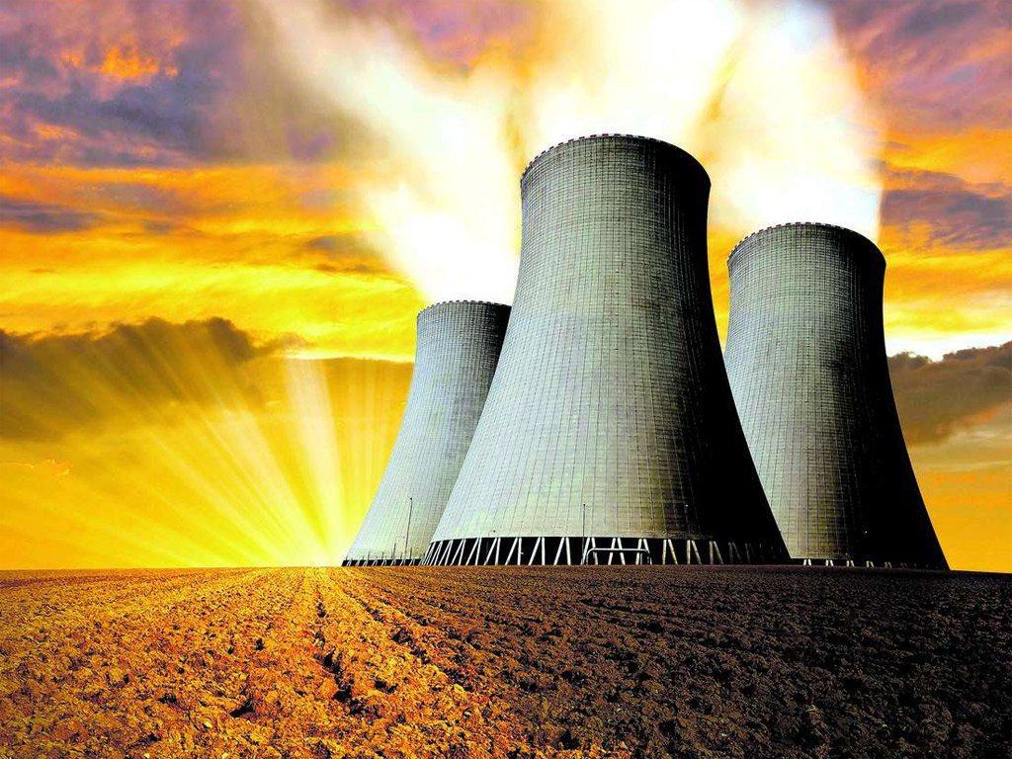

Power

Slide 2
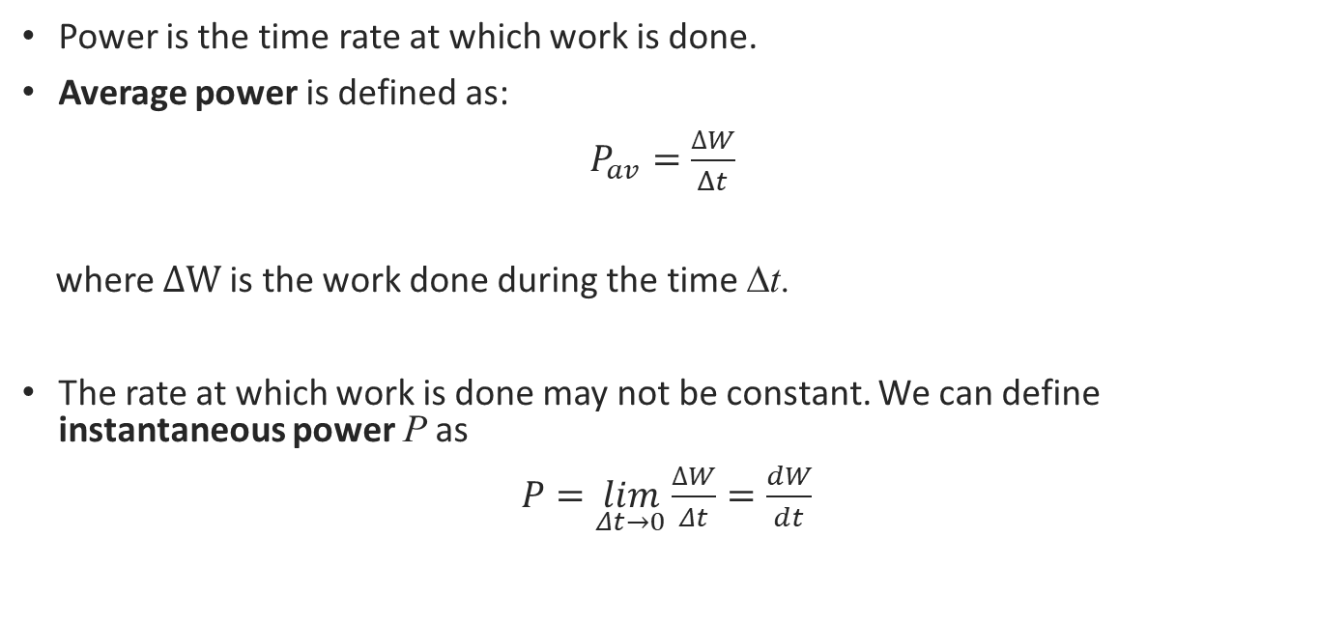
Definitions
Power is the time rate at which work is done.
Average power is defined as:
$P_{av}=\frac{∆W}{Δt}$
where $∆W$ is the work done during the time Δt.
The rate at which work is done may not be constant. We can define instantaneous power P as
$P=\lim_{Δt→0}\frac{∆W}{Δt}=\frac{dW}{dt}$

Slide 3
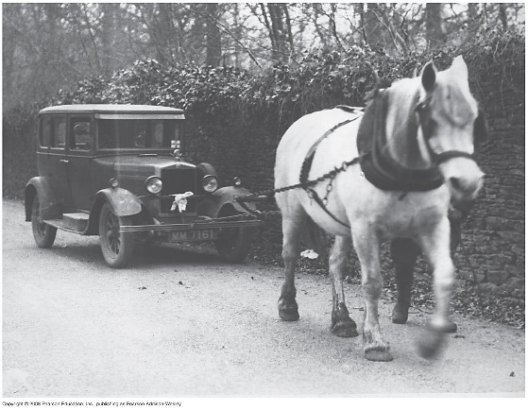
Power is:
Power is a scalar quantity
The SI unit of power is the watt (W): from the definition of power
1 W = 1 J/s
Sometimes another unit (non-SI) , horsepower (hp) is used:
1 hp = 746 W
So, what does a lightbulb rating of 100-W means? This lightbulb will convert 100 J of electric energy into light and heat at each second!
Look up a power rating of your favorite electric device, estimate the amount of time it is in operation, and estimate the amount of electrical energy (in joules) it uses up in a month.

Slide 4
Power continued:
The unit of power is often used to define a unit of energy or work.
1 kWh = (10³ J/s)(3600 s) = 3.6 x 10⁶ J
In mechanics, it is sometimes convenient to express power in terms of force and velocity.
Here, $F_{∥}$ is the component of the force parallel to the displacement.
Here, 𝐹_∥ is the component of the force parallel to the displacement.
$$P=\vec{F}⋅\vec{V}$$
P=F ⃗⋅V ⃗
For example, the kilowatt-hour (kWh) is the unit of electrical energy commonly used:
Average power: $P_{av}=\frac{F_{∥}Δx}{Δt}=F_{∥}\frac{Δx}{Δt}=F_{∥}V_{av}$,
Average power: 𝑃_𝑎𝑣=(𝐹_∥ Δx)/Δt=𝐹_∥ Δx/Δt=𝐹_∥ 𝑉_𝑎𝑣,

Slide 5

Instantaneous power
Instantaneous power P is the limit of the expression for average power as $Δt→0$:
Instantaneous power P is the limit of the expression for average power as 𝛥𝑡→0:
$P=F_{∥}V$
𝑃=𝐹_∥ 𝑉
And finally, we can express power in terms of a scalar product:
$$P=\vec{F}⋅\vec{V}$$
𝑃=𝐹 ⃗⋅𝑉 ⃗

Slide 6
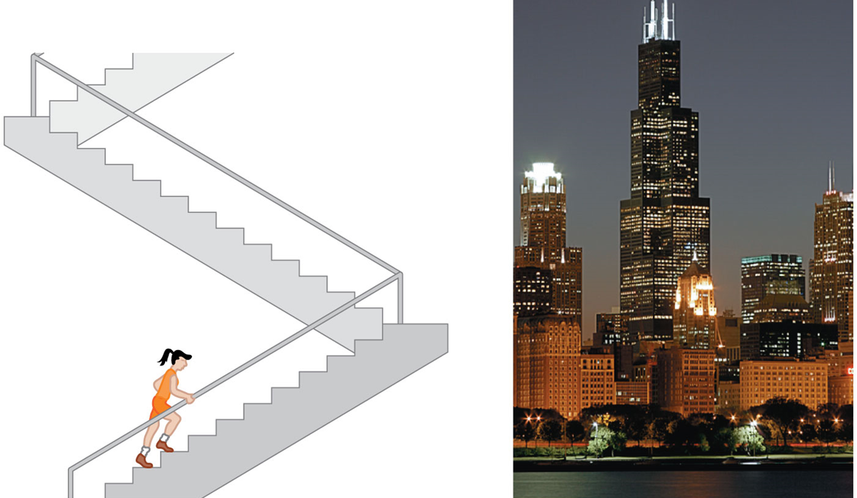
Example
As part of a charity fund-raising drive, a Chicago marathon runner with mass 50.0 kg runs up the stairs to the top of the 443-m tall Willis Tower.
The amount of work she needs to do to lift herself is equal to the product of her weight and the height:
W = mgh = (50.0 kg)(9.80 m/s2)(443 m) = 2.17 x 10⁵ J
The time, in seconds is 900 s, so the average power is:
$P_{av}=\frac{2.17×{10}^{5}J}{900 s}=241 W=0.323 hp$
𝑃_𝑎𝑣=(2.17×10^5 𝐽)/(900 𝑠)=241 𝑊=0.323 ℎ𝑝
To lift herself to the top in 15.0 minutes, what must be her average power output in watts? In horsepower?

