Slide 1

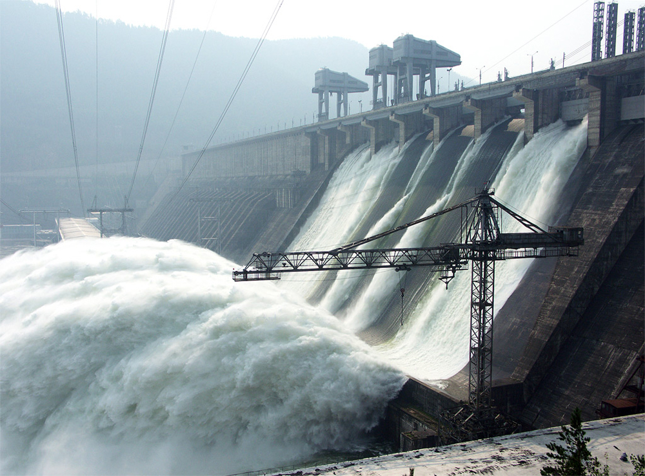

Potential Energy (Gravitational and Elastic) and Energy Conservation

Slide 2
Conservative and non-conservative forces
The work done between two points by any conservative force
is independent of the path between the two points.
is zero if the starting and ending points are the same.
can be expressed in terms of a potential energy function.
$W_{con}=U_{i}−U_{f}$,
𝑊_𝑐𝑜𝑛=𝑈_𝑖−𝑈_𝑓,
where $U_{i}$ is the potential energy
where 𝑈_𝑖 is the potential energy
A force (such as friction) that is not conservative is called
Potential energy function:
a nonconservative force, or a dissipative force.
Examples of conservative forces: gravitational and spring forces

Slide 3
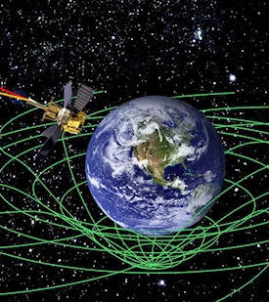
_{Gravitational potential energy}
Energy associated with position inside gravitational field is called
Work done by gravitational force as the mass m is lowered from y₂ to y₁:
$$Wg=\left(mg\right)\left(y_{1}−y_{2}\right)=mgy_{1}−mgy_{2}$$
W_{𝑔}=(𝑚𝑔)(𝑦_1−𝑦_2 )=𝑚𝑔𝑦_1−𝑚𝑔𝑦_2
Compared to the definition of potential energy, it follows that
$$U_{g }=mgy$$
𝑈_(𝑔 )=𝑚𝑔𝑦
gravitational potential energy.

Slide 4
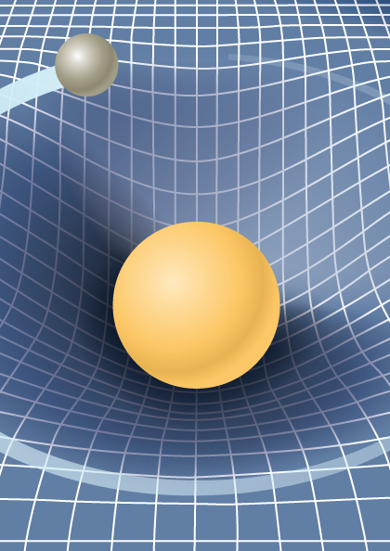
Gravitational potential energy
Gravitational potential energy is a scalar.
SI units of gravitational potential energy are joules (see the definition)
Gravitational potential energy is shared between a body and the Earth.
Zero level of gravitational potential energy is arbitrary since only the change in potential energy has physical meaning.
Could be positive, negative, or zero.
We can use the same expression for gravitational potential energy whether the body’s path is curved or straight.
Work done by gravitational force can be expressed as:
$$W_{g}=U_{1}−U_{2}$$
𝑊_𝑔=𝑈_1−𝑈_2

Slide 5
Concept of a system
A region in space
A body
A collection of bodies
Has a boundary that clearly separates
May exchange energy with its surroundings through:
Work done on the system by its surroundings
Heat transfer
Radiant energy
Electrical energy flow (current)
Mass transfer
An isolated system is the one that
the system
and its surroundings.
does NOT exchange energy with its environment.
A system is a portion of the universe
that has been chosen
for studying the changes that take place within it
in response to varying conditions.
A system may be complex,
such as a planet,
or relatively simple,
as the liquid within a glass.

Slide 6
Conservation of mechanical energy
Let’s remember the Work – Kinetic Energy theorem:
$$W_{net}=K_{f}−K_{i}$$
𝑊_𝑛𝑒𝑡=𝐾_𝑓−𝐾_𝑖
Now let’s remember the definition of the potential energy:
$W_{con}=U_{i}−U_{f}$
𝑊_𝑐𝑜𝑛=𝑈_𝑖−𝑈_𝑓
If the only work done on the body is done by a conservative force(s)
$$W_{net}=W_{con}$$
𝑊_𝑛𝑒𝑡=𝑊_𝑐𝑜𝑛
$K_{f}−K_{i}=U_{i}−U_{f}$
𝐾_𝑓−𝐾_𝑖=𝑈_𝑖−𝑈_𝑓
or $K_{f}+U_{f}=K_{i}+U_{i}$
or 𝐾_𝑓+𝑈_𝑓=𝐾_𝑖+𝑈_𝑖
Total mechanical energy of an isolated system is conserved
$E_{i}=E_{f}$
𝐸_𝑖=𝐸_𝑓
where E is the total mechanical energy of the system $E=K+U$
where E is the total mechanical energy of the system 𝐸=𝐾+𝑈
if the only forces acting within the system are conservative.

Slide 7
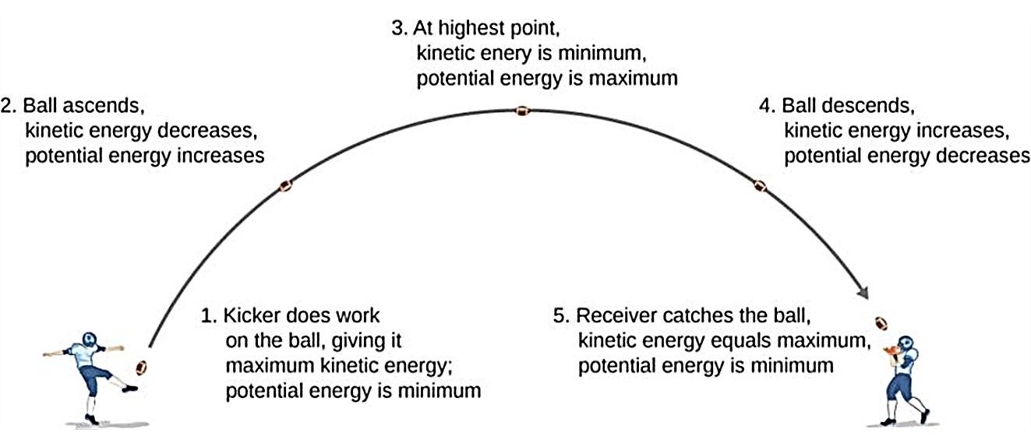
Example of energy conservation
As a football starts its descent toward the wide receiver, gravitational potential energy is converted back into kinetic energy.

Slide 8
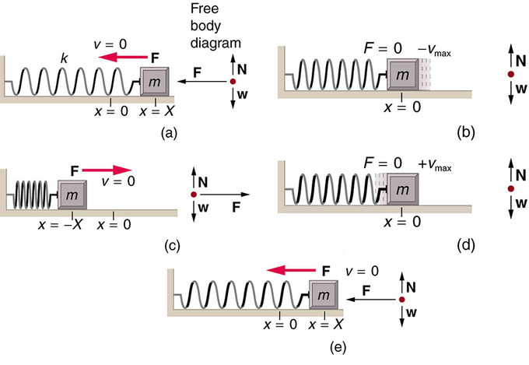
Elastic potential energy
  Figures below show how a spring does work on a block as it is stretched and compressed.

Slide 9
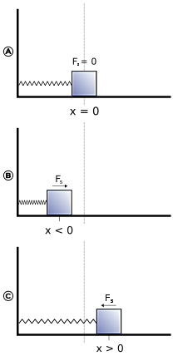
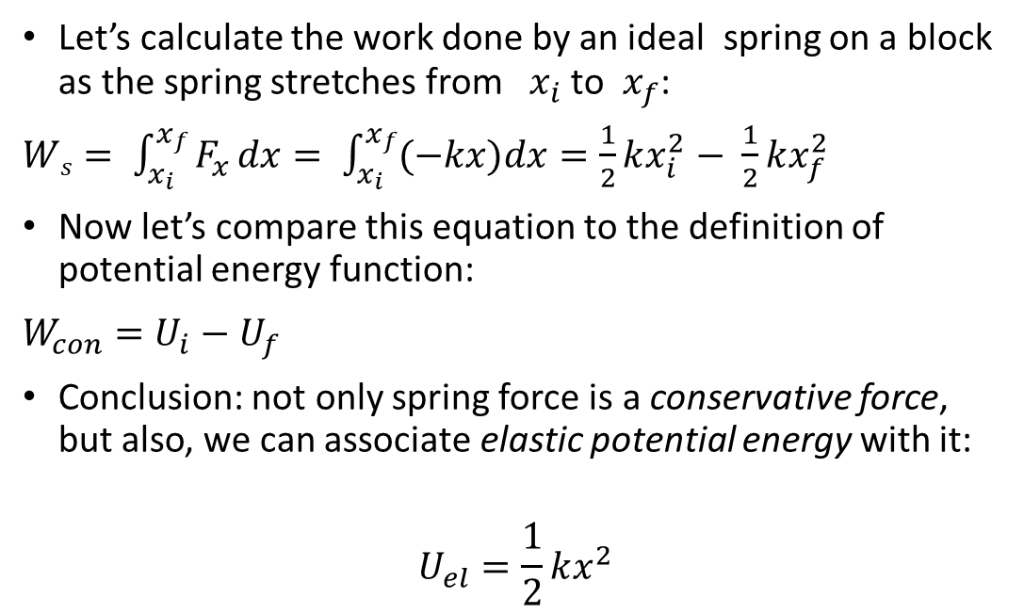
Elastic potential energy, continued
Let’s calculate the work done by an ideal spring on a block as the spring stretches from$x_{i}$ to $x_{f}$:
$Ws= \int_{x_{i}}^{x_{f}}{F_{x}}dx= \int_{x_{i}}^{x_{f}}{(−kx})dx=\frac{1}{2}kx_{i}^{2}− \frac{1}{2}kx_{f}^{2}$
Now let’s compare this equation to the definition of potential energy function:
$W_{con}=U_{i}−U_{f}$
Conclusion: not only spring force is a conservative force, but also, we can associate elastic potential energy with it:
$$U_{el}=\frac{1}{2}kx^{2}$$

Slide 10
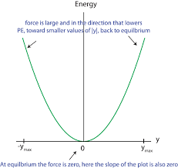
Elastic potential energy, details
  A body is elastic if it returns to its original shape after being deformed.
  Elastic potential energy is the energy stored in an elastic body, such as a spring.
  Figure at the right shows a graph of the elastic potential energy for an ideal spring. Note that the elastic potential energy is always positive.
  Also note that the elastic potential energy is set to zero at the equilibrium position of the spring.
  SI units are J (joules).

Slide 11
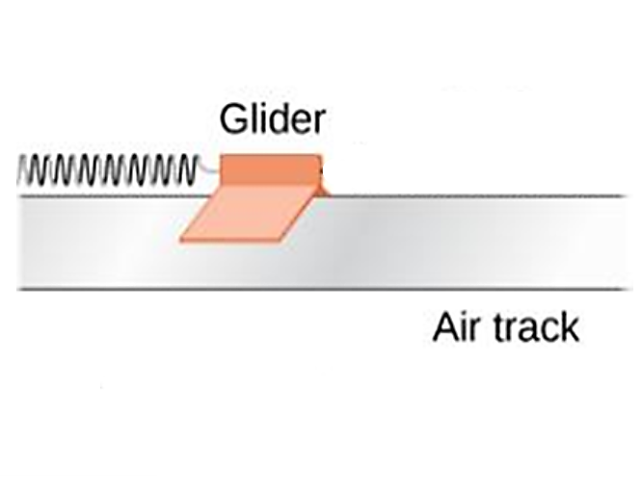
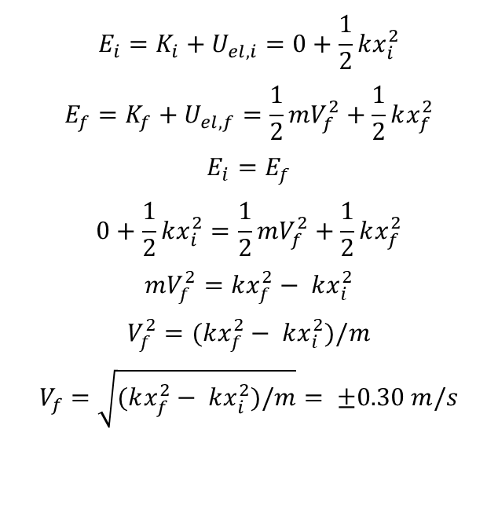
Applying elastic potential energy
$$E_{i}=K_{i}+U_{el,i}=0+\frac{1}{2}kx_{i}^{2}$$
$$E_{f}=K_{f}+U_{el,f}=\frac{1}{2}mV_{f}^{2}+\frac{1}{2}kx_{f}^{2}$$
$$E_{i}=E_{f}$$
$$0+\frac{1}{2}kx_{i}^{2}=\frac{1}{2}mV_{f}^{2}+\frac{1}{2}kx_{f}^{2}$$
$$mV_{f}^{2}=kx_{f}^{2}− kx_{i}^{2}$$
$$V_{f}^{2}=(kx_{f}^{2}− kx_{i}^{2})/m$$
$$V_{f}=\sqrt{(kx_{f}^{2}− kx_{i}^{2})/m}= ±0.30 m/s$$
A glider with a mass of 0.200 kg sits on a frictionless horizontal air track, connected to a spring with a spring constant of 5.00 N/m. You pull on the glider stretching the spring by 0.100 m and then release it with no initial velocity. The glider begins to move back toward the equilibrium position (x = 0). What is its velocity when x = 0.080 m?

Slide 12
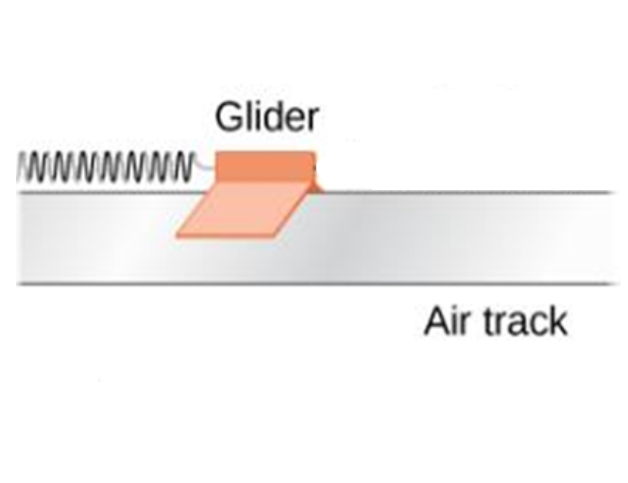
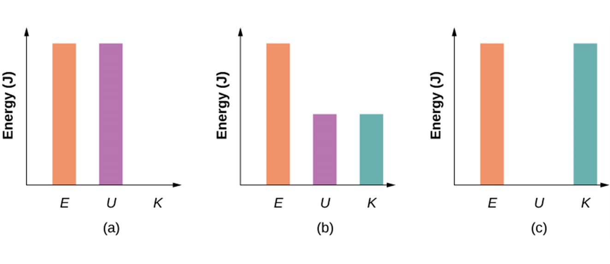
Applying elastic potential energy, continued
Bar graphs representing the total energy (E), potential energy (U), and kinetic energy (K) of the glider-spring system in different positions.
a. The total energy of the system equals the potential energy and the kinetic energy is zero, which is found at the point of the maximum stretch/compression od the spring.
b. The glider is midway between the spring’s maximum stretch and equilibrium points, so the kinetic energy plus potential energy bar graphs equal the total energy.
c. The glider is at the equilibrium point of the spring, so the kinetic energy bar graph is the highest and equal to the total energy of the system.

Slide 13
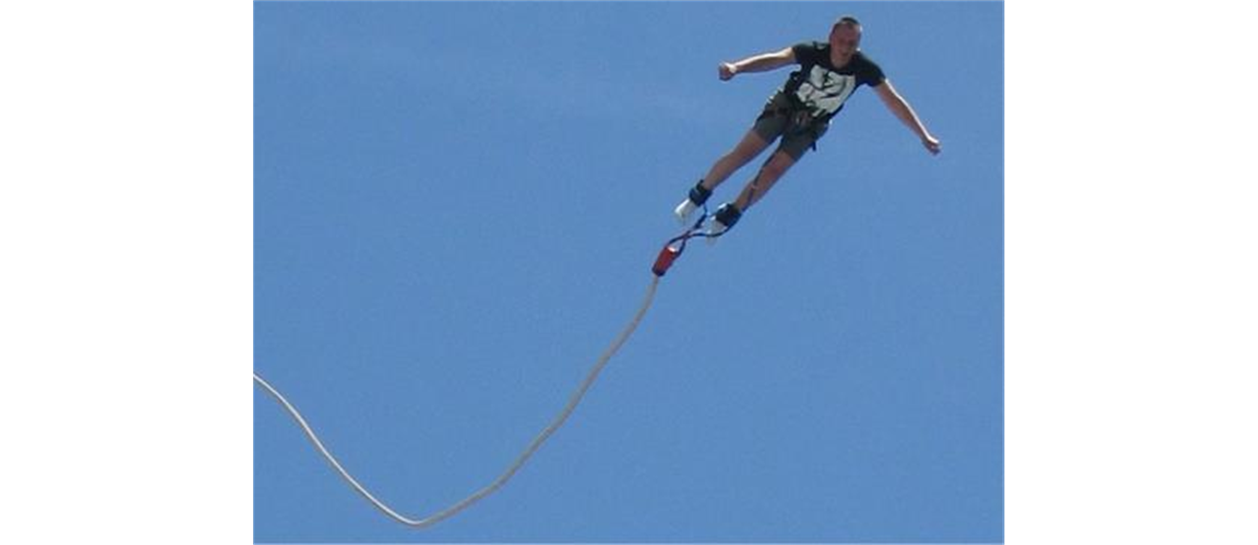
Note on the application of elastic potential energy
When a situation involves both gravitational and elastic forces, the total potential energy is the sum of the gravitational potential energy and the elastic potential energy: U = U_{g} + U_{el}.
A bungee jumper transforms gravitational potential energy at the start of the jump into elastic potential energy at the bottom of the jump.

Slide 14
Non-conservative forces and the conservation of energy principle
Work done by a non-conservative force
Applying the work-kinetic theorem
$$W_{net}=K_{f}−K_{i}$$
𝑊_𝑛𝑒𝑡=𝐾_𝑓−𝐾_𝑖
$$W_{con}+W_{nc}=K_{f}−K_{i}$$
𝑊_𝑐𝑜𝑛+𝑊_𝑛𝑐=𝐾_𝑓−𝐾_𝑖
$U_{i}−U_{f}$ $+W_{nc}=K_{f}−K_{i}$
𝑈_𝑖−𝑈_𝑓 +𝑊_𝑛𝑐=𝐾_𝑓−𝐾_𝑖
$W_{nc}={(K}_{f}+U_{f})−{(K}_{i}{+U}_{i})$= $E_{f}−E_{i}$
𝑊_𝑛𝑐=〖(𝐾〗_𝑓+𝑈_𝑓)−〖(𝐾〗_𝑖 〖+𝑈〗_𝑖)= 𝐸_𝑓−𝐸_𝑖
cannot be described with the potential energy function.
we can conclude that the non-conservative forces
do NOT conserve the total mechanical energy of the system E:
Result:

Slide 15
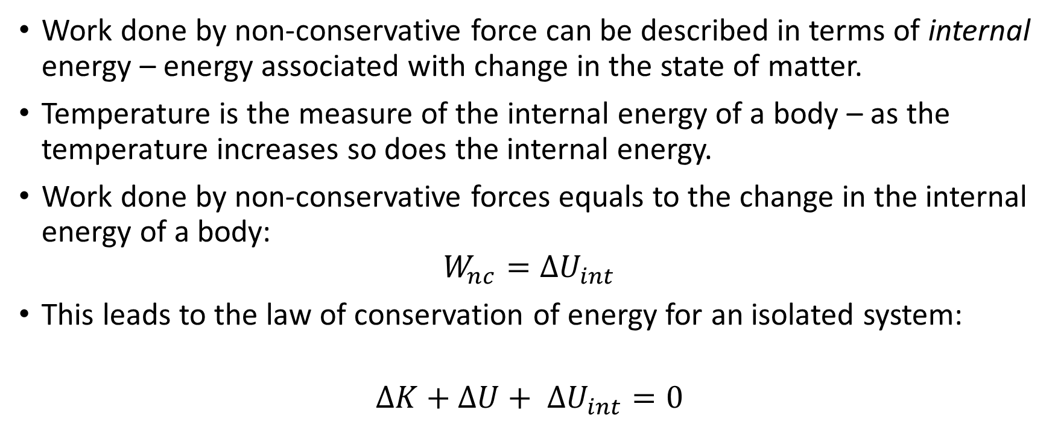
Work done by non-conservative force and internal energy
Work done by non-conservative force can be described in terms of internal energy – energy associated with change in the state of matter.
Temperature is the measure of the internal energy of a body – as the temperature increases so does the internal energy.
Work done by non-conservative forces equals to the change in the internal energy of a body:
$$W_{nc}={ΔU}_{int}$$
This leads to the law of conservation of energy for an isolated system:
$${ΔK+ΔU+ ΔU}_{int}=0$$
Note that the law of conservation of energy does not include work – it allows us to think purely in terms of energy

