Slide 1

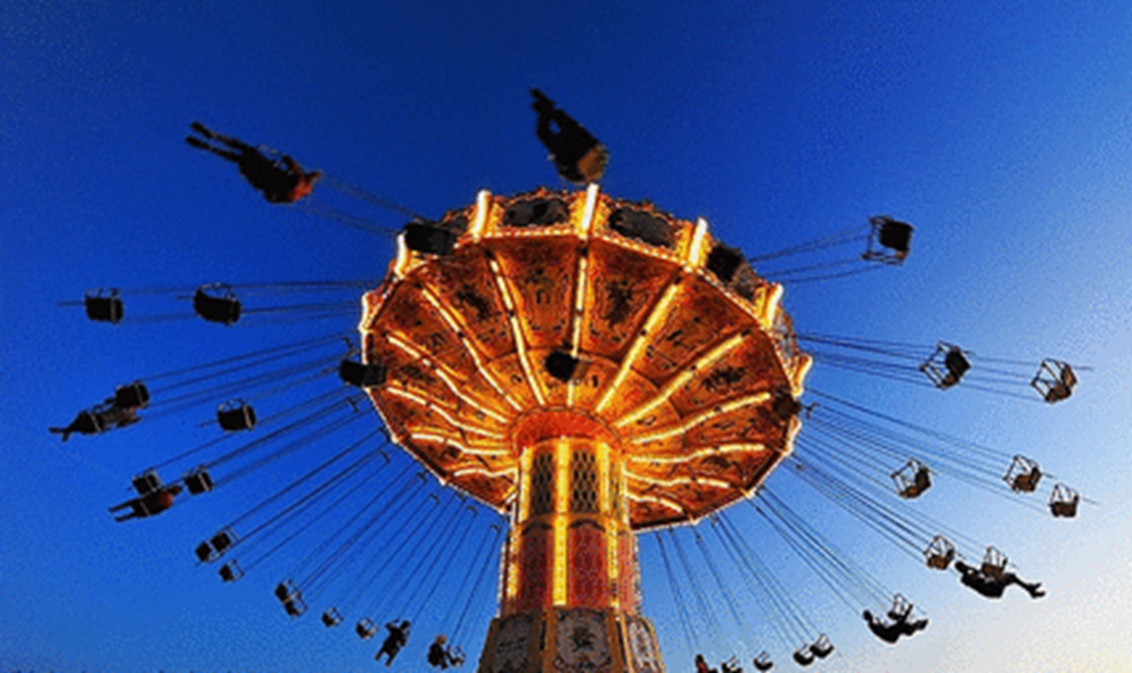

Circular motion

Slide 2
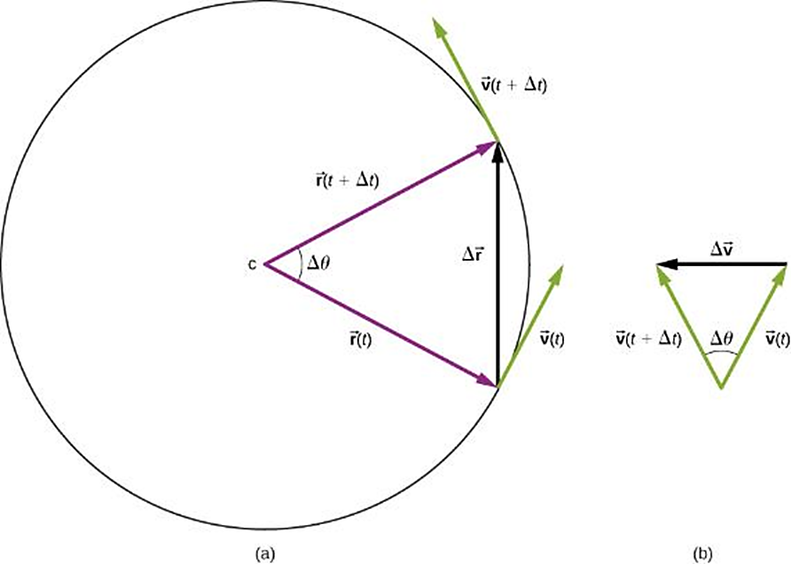
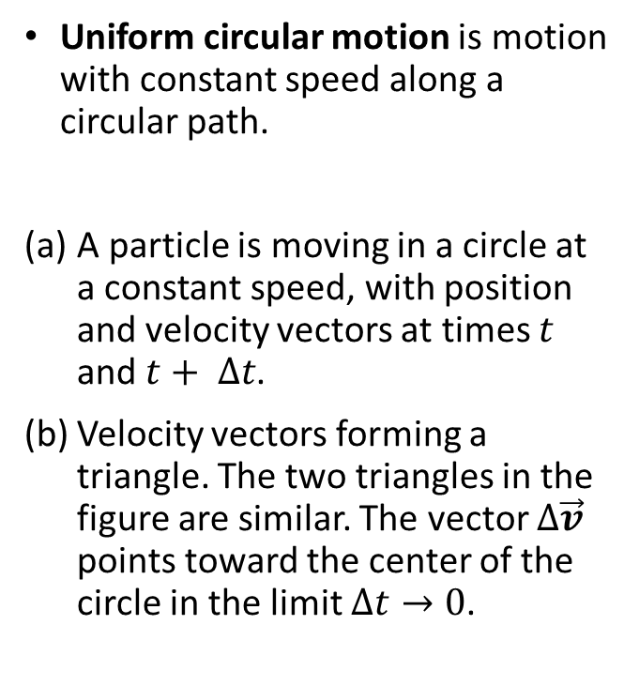
Motion in a Circle - Uniform
Uniform circular motion is motion with constant speed along a circular path.
A particle is moving in a circle at a constant speed, with position and velocity vectors at times $t$ and $t+ ∆t$.
Velocity vectors forming a triangle. The two triangles in the figure are similar. The vector $∆\vec{v}$ points toward the center of the circle in the limit $∆t→0$.

Slide 3





Acceleration for Uniform Circular Motion
A particle is moving in a circle at a constant speed, with position and velocity vectors at times $t$ and $t+ ∆t$.
Velocity vectors forming a triangle. The two triangles in the figure are similar. The vector $∆\vec{v}$ points toward the center of the circle in the limit $∆t→0$.
$$a_{cp}=\frac{v^{2}}{R}$$

Slide 4
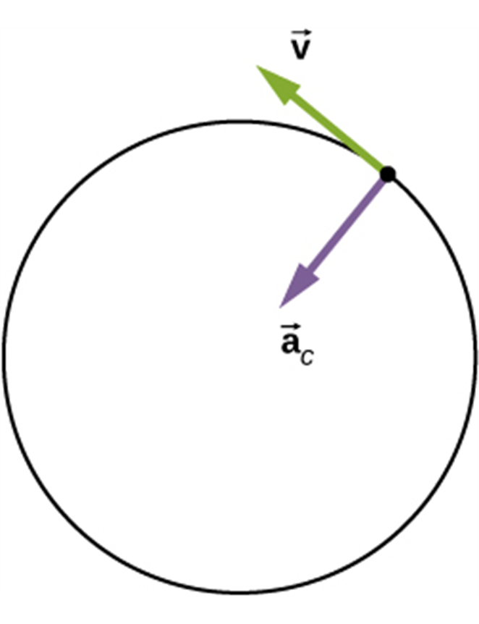
Acceleration for Uniform Circular Motion, Continued
For uniform circular motion,
the instantaneous acceleration
always points toward the
center of the circle and is
called the centripetal
acceleration.
The magnitude of the acceleration is a_{c} = v²/R.
The period T is the time for one revolution, from it, a_{c} = 4π²R/T ².

Slide 5
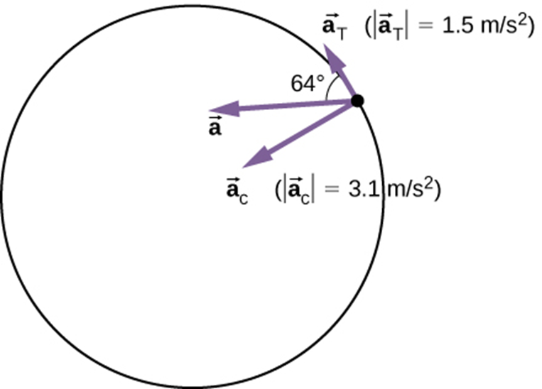
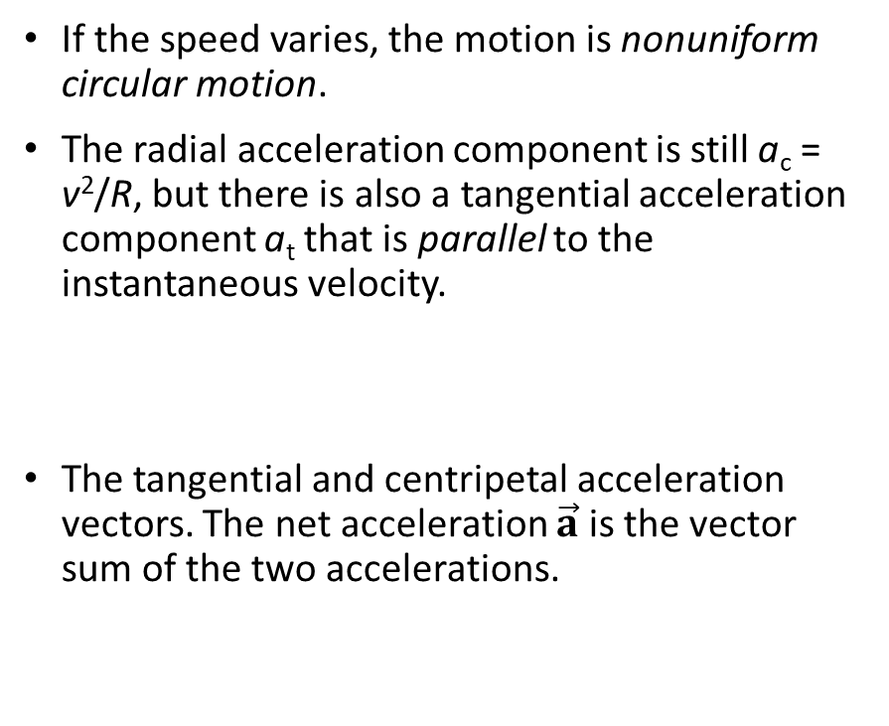
Non-uniform Circular Motion
If the speed varies, the motion is nonuniform circular motion.
The radial acceleration component is still a_{c} = v²/R, but there is also a tangential acceleration component a_{t} that is parallel to the instantaneous velocity.
The tangential and centripetal acceleration vectors. The net acceleration $\vec{a}$ is the vector sum of the two accelerations.

