Slide 1

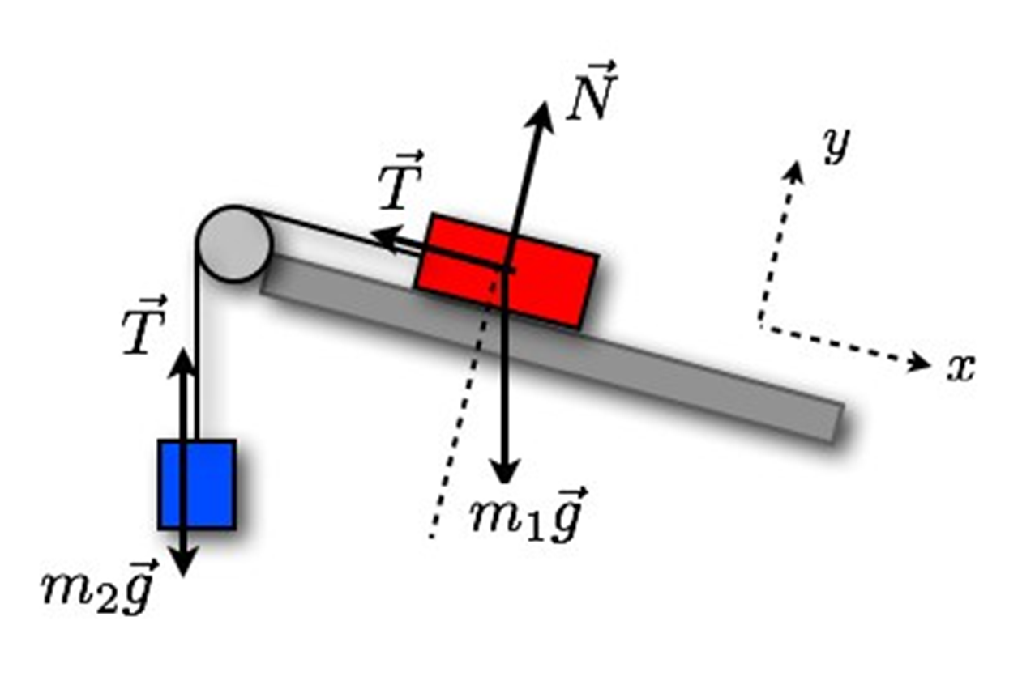

Free Body Diagramm

Slide 2
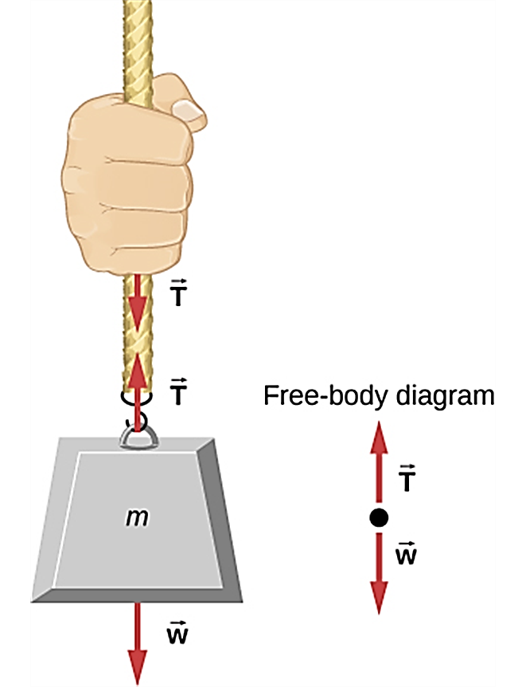
Assumptions
Tension always acts along a rope or string and
Has the same magnitude at each point of the rope.
Ropes, strings, springs are massless.
  And indestructible unless specified. See chapter 5.3

Slide 3
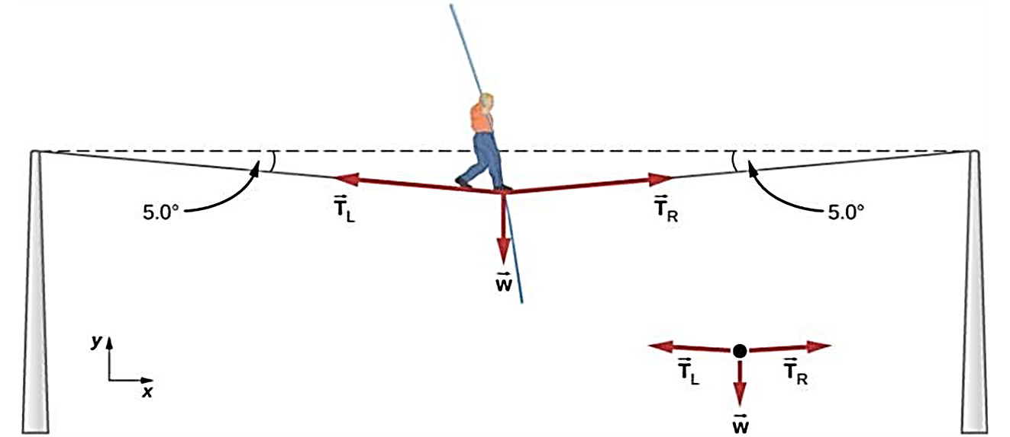
Free Body Diagram in 4 Steps:
Isolate a body.
Draw and label all the forces acting on the body.
Include critical angles and directions.
Choose coordinate axes.

Slide 4
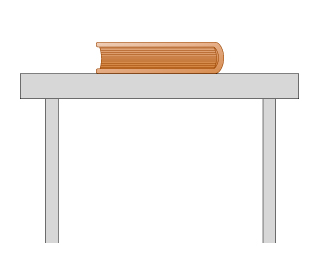
Step 1: Isolate a body
Draw a body as a point or a box somewhere convenient.
  You want to abstract the problem from the actual image/drawing and create it into the schematic.

Slide 5
Step 2: Draw and Label All the Forces Acting on the Body
There are 5 forces to remember about: W A N T F?☺
Weight: vertically downward, applied to the center of a body.
Applied: as stated in a problem.
Normal: perpendicular to the surface in contact and away from the surface. Applied to the middle point of surface in contact.
Tension: along a rope/string/spring and away from the body.
Friction: parallel to the surface in contact, in the direction opposite to the motion or impending motion. Applied to the middle point of surface in contact.

Slide 6
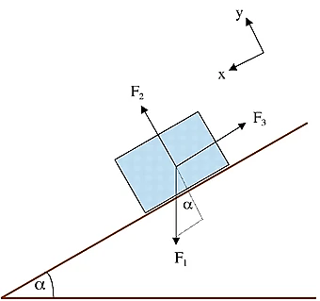
Step 3: Include critical angles and directions
Angles stated in a problem need to be represented on the free body diagram, unless (very uncommon) irrelevant.
Note: in case of a body on an inclined plane, the angle of the incline typically translates into the angle between the direction of the normal force and direction of the weight.

Slide 7
Step 4: Choose the x- and y- Coordinate Axes
If an object is accelerating, choose the x-axis in the direction of acceleration, with the y-axis perpendicular to x-axis.
If an object is moving with constant velocity, choose the x-axis in the direction of velocity, with the y-axis perpendicular to x-axis.
If an object is at rest, but in contact with a surface, choose the x-axis along the surface, with the y-axis perpendicular to x-axis.
If an object is at rest, but is not in contact with any surfaces, any choice will do.
Note: make sure you are using the right-hand coordinate system!

Slide 8
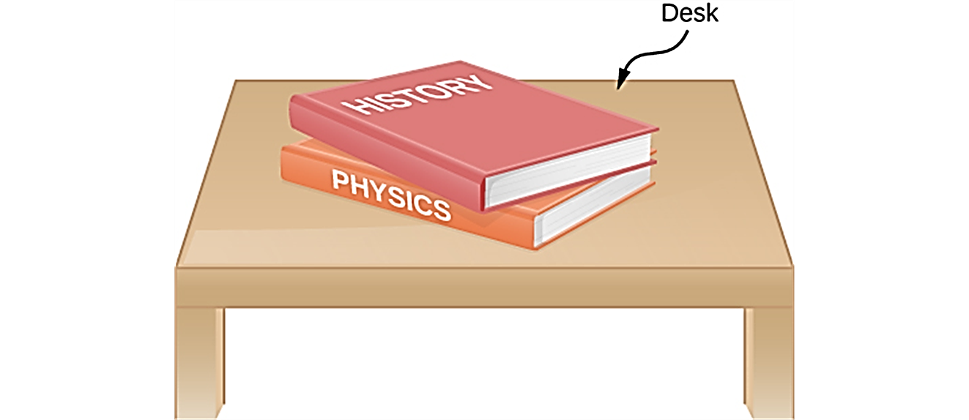
Exercise 1: Object at Rest on a Horizontal Plane
This is a simple choice, and up and down directions don’t matter here, make the convenient choice so that there are fewest components of the forces to be found.

Slide 9
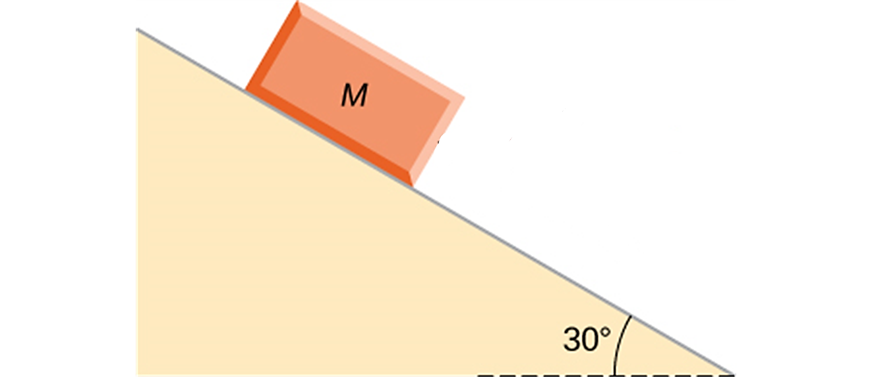
Exercise 2: Object on an Inclined Plane
Coordinates system can be at the angle!

Slide 10
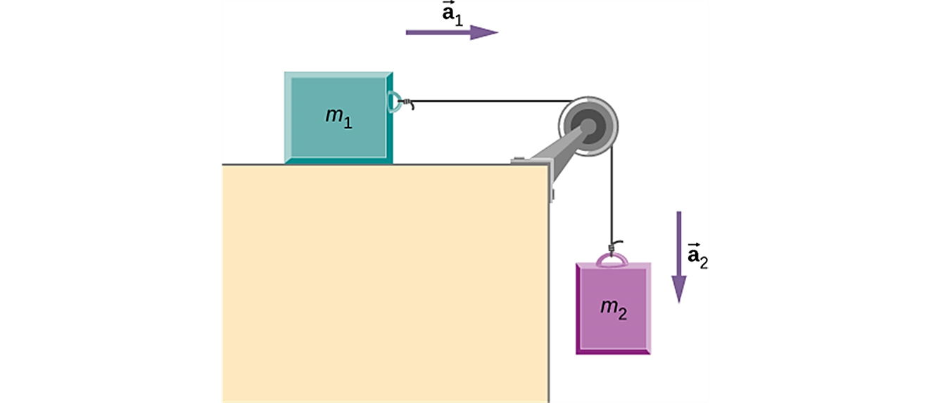
Exercise 3: Connected Bodies
Hints:
  Do the FBD for each body separately!
  Pulley redirects the force

