Slide 1

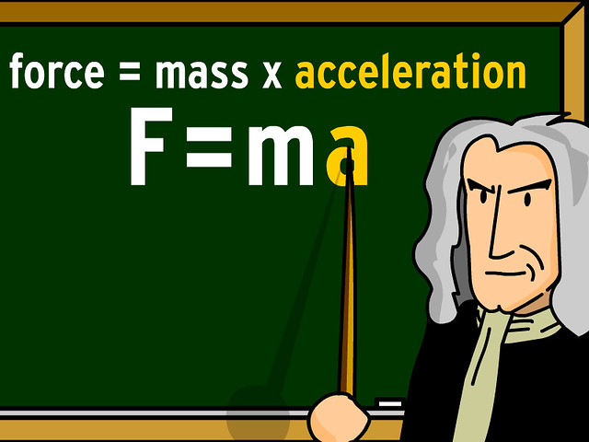

Newton’s Laws

Slide 2
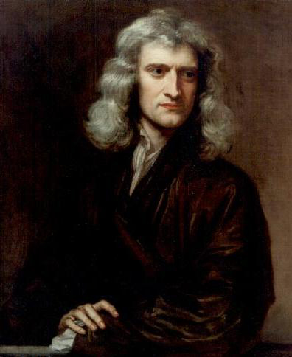
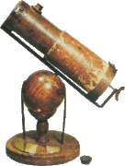
Newton’s Laws of Motion
Isaac Newton (1642–1727) published his amazing work, Philosophiae Naturalis Principia Mathematica, in 1687. It proposed scientific laws that still apply today to describe the motion of objects (the laws of motion).
Newton formulated the law of gravity, invented calculus, and made great contributions to the theories of light and color. He’s also the inventor of the reflector telescope.

Slide 3
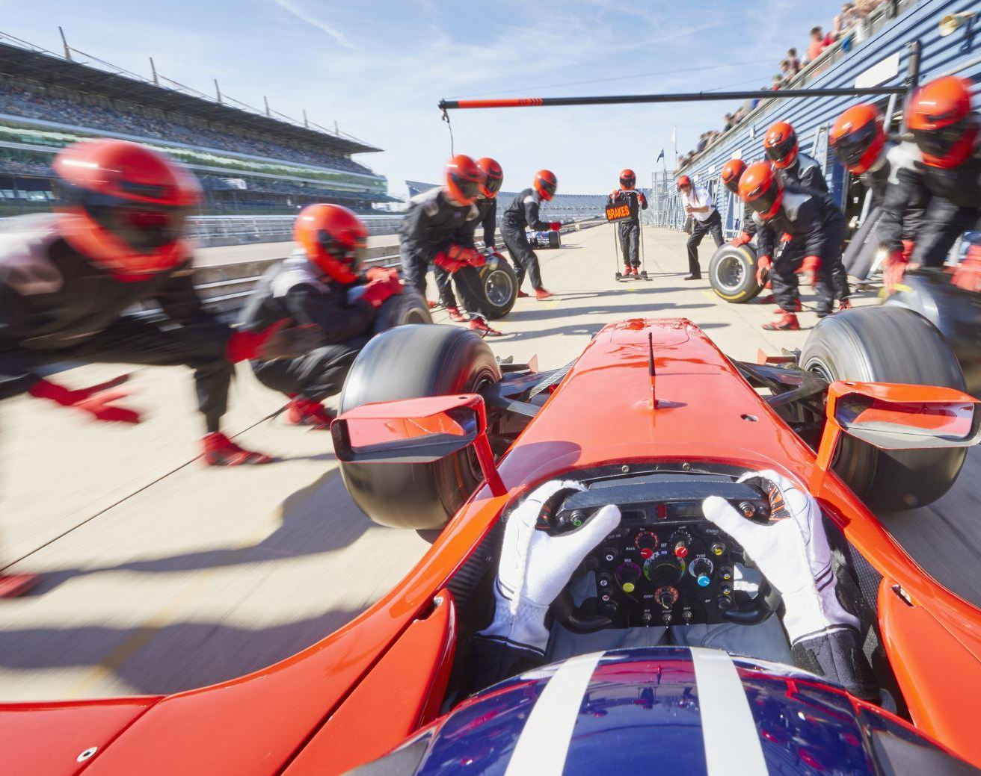
Introduction
We’ve seen how to use kinematics to describe motion in one and two.
But what causes objects to move the way that they do?
With this, we need to switch to the subject of dynamics, the relationship of motion to the forces that cause it.
The principles of dynamics were clearly stated for the first time by Sir Isaac Newton; today we call them Newton’s laws of motion.
Newton did not derive these laws, but rather he has deduced them from a multitude of experiments performed by other scientists.

Slide 4
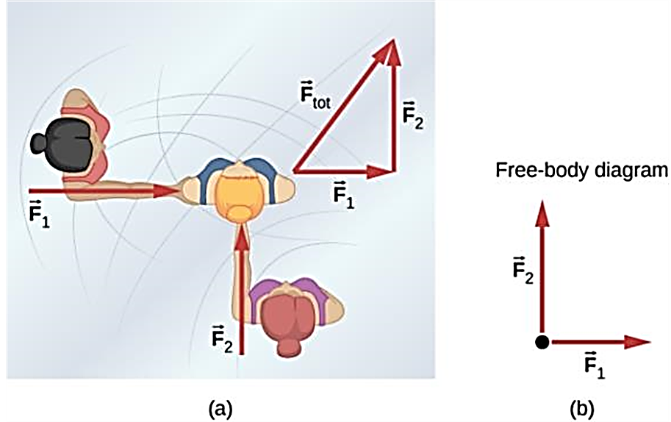
What is a Force?
A push or a pull
An interaction between objects or between an object and its environment
Forces have directions – they are vectors
An overhead view of two ice skaters pushing on a third skater. Forces are vectors and add like other vectors, so the total force on the third skater is in the direction shown.
A free-body diagram representing the forces acting on the third skater.

Slide 5
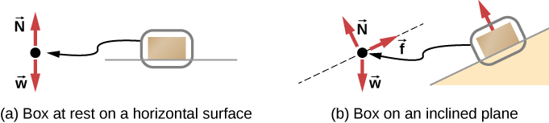
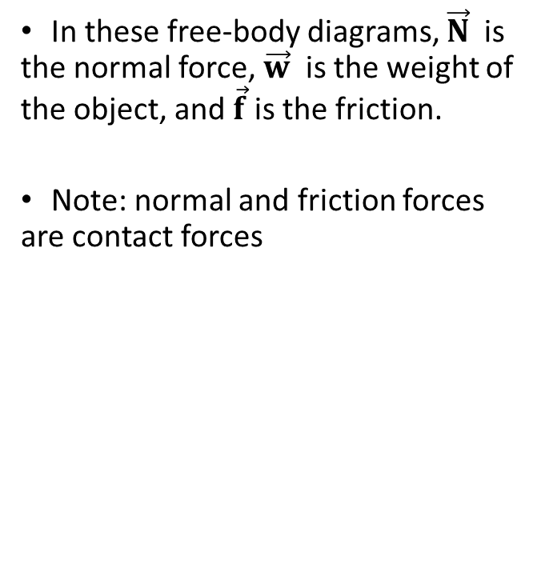
There Are Five Common Types of Forces: Normal, Weight, Applied, Friction, Tension
In these free-body diagrams, $\vec{N}$is the normal force, $\vec{w}$ is the weight of the object, and $\vec{f}$ is the friction.
Note: normal and friction forces are contact forces

Slide 6

The Fundamental Forces of Nature
According to current understanding, all forces are expressions of four distinct fundamental forces:
  gravitational interactions
  electromagnetic interactions
  the weak interaction
  the strong interaction
Physicists have taken steps to unify weak and EM. Ultimately, all interactions may unite as predicted by a GUT – Grand Unification Theory.

Slide 7
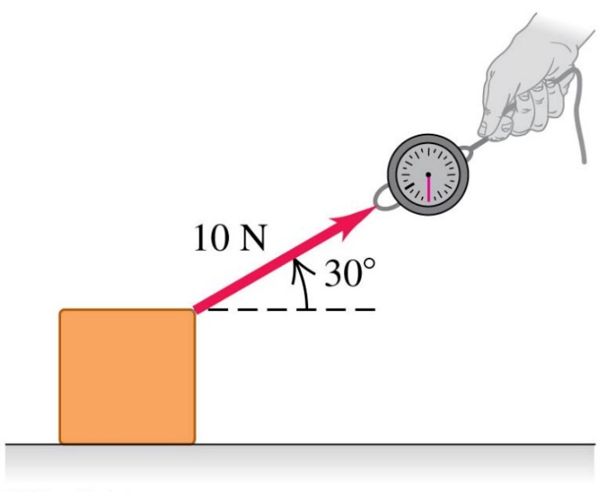
Drawing Force Vectors
The figure shows a spring balance being used to measure a pull that we apply to a box.
We draw a vector to represent the applied force.
The length of the vector shows the magnitude; the longer the vector, the greater the force magnitude.

Slide 8
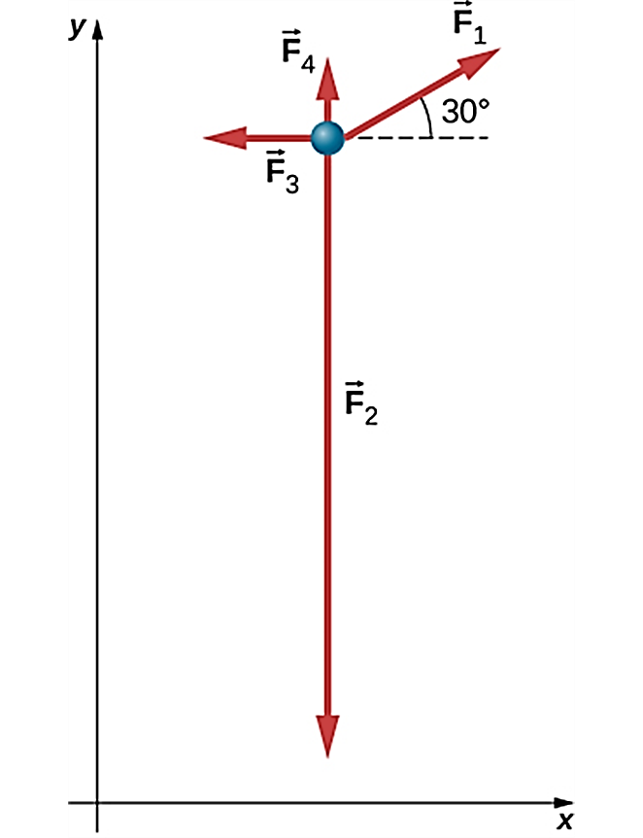
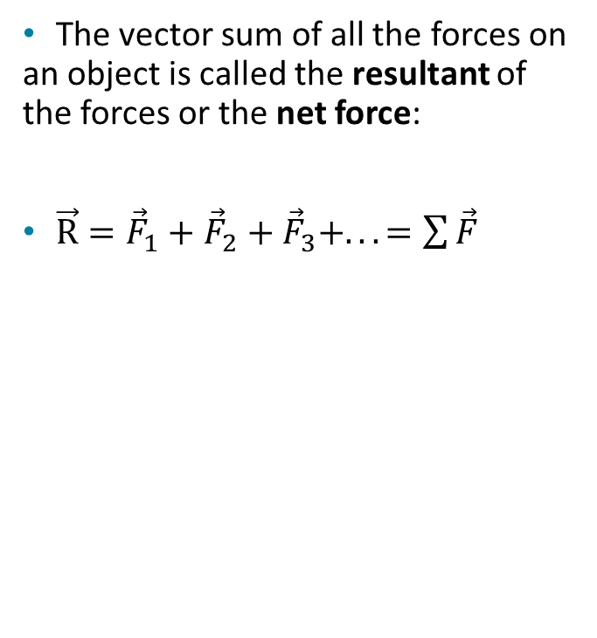
Net Force
The vector sum of all the forces on an object is called the resultant of the forces or the net force:
$\vec{R}={\vec{F}}_{1}+{\vec{F}}_{2}+{\vec{F}}_{3}+...=\sum{\vec{F}}$

Slide 9
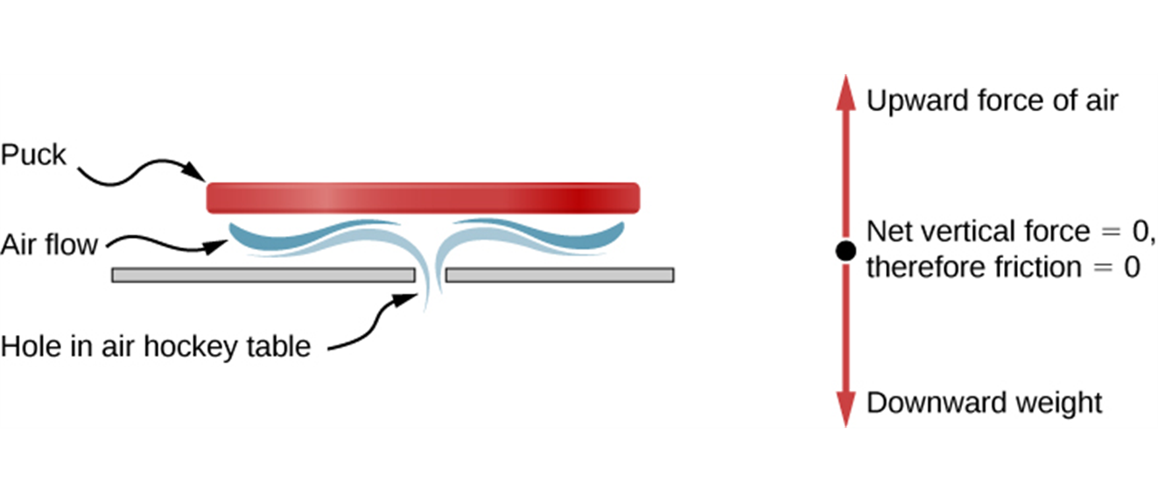
Net Force Causes Acceleration
An air hockey table is useful in illustrating Newton’s laws. When the air is off, friction quickly slows the puck; but when the air is on, it minimizes contact between the puck and the hockey table, and the puck glides far down the table.

Slide 10
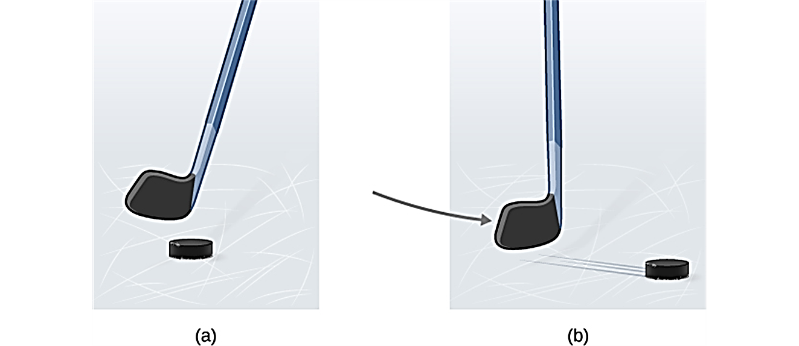
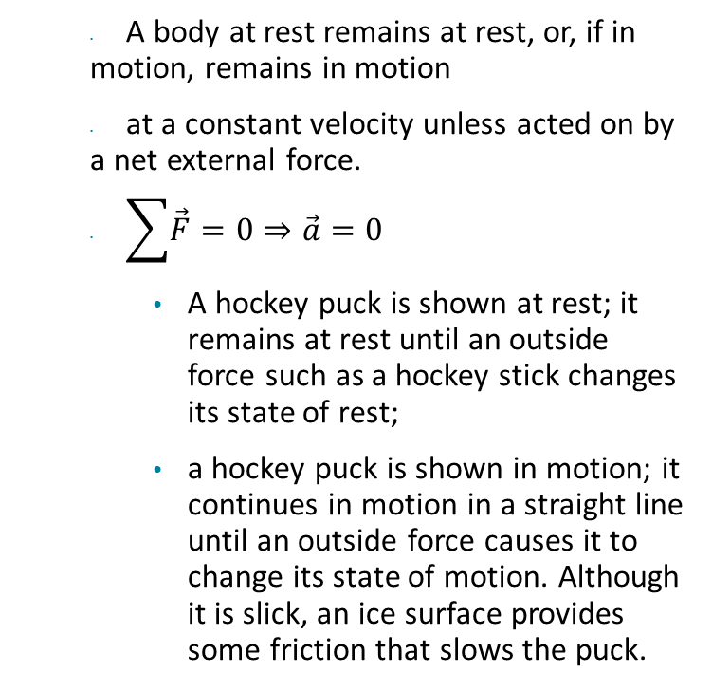
Newton's First Law
A body at rest remains at rest, or, if in motion, remains in motion
at a constant velocity unless acted on by a net external force.
$\sum{\vec{F}}=0⇒\vec{a}=0$
A hockey puck is shown at rest; it remains at rest until an outside force such as a hockey stick changes its state of rest;
a hockey puck is shown in motion; it continues in motion in a straight line until an outside force causes it to change its state of motion. Although it is slick, an ice surface provides some friction that slows the puck.

Slide 11
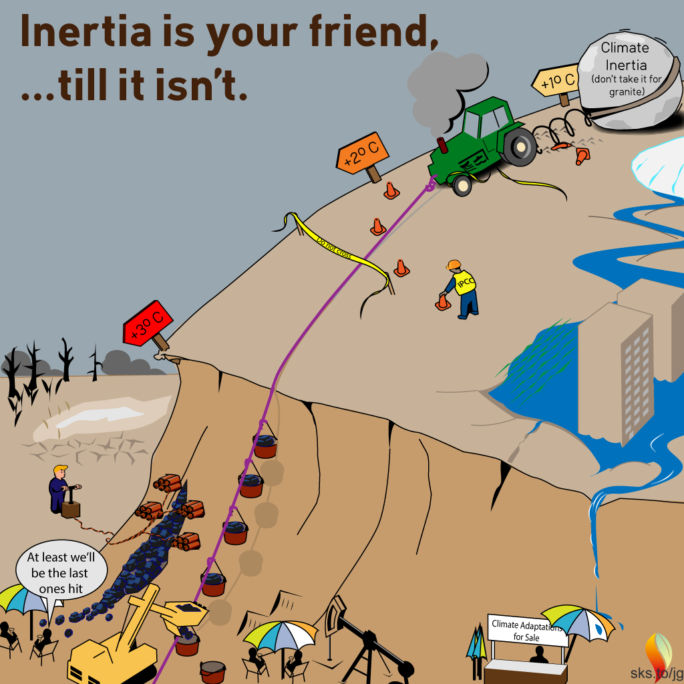
Inertia
Newton’s First Law is often called “the Law of Inertia”.
Inertia is a tendency of a body to resist acceleration.
Mass is a quantitative measure of inertia.
Note: when the two objects are fastened together, the experiments show that their composite mass is the sum of their individual masses.

Slide 12
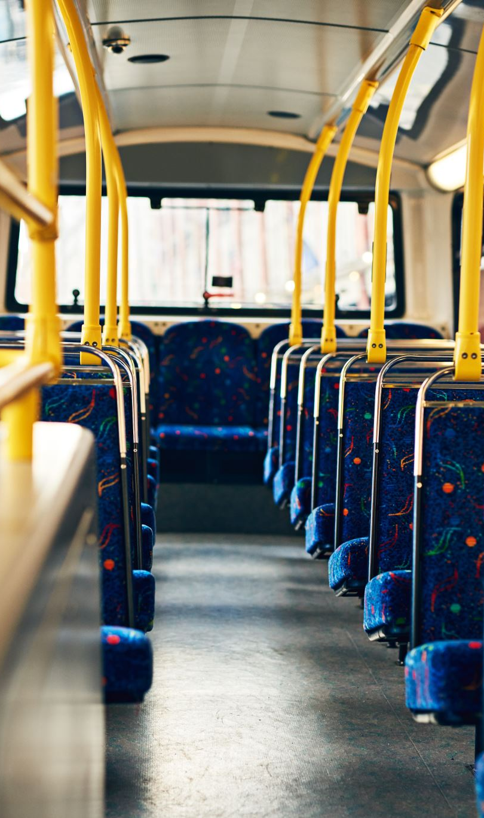
When Is Newton's First Law Valid?
Suppose you are in a bus that is traveling on a straight road and speeding up.
If you could stand in the aisle on roller skates, you would start moving backward relative to the bus as the bus gains speed.
It looks as though Newton’s first law is not obeyed; there is no net force acting on you, yet your velocity changes.
The bus is accelerating with respect to the earth and is not a suitable frame of reference for Newton’s first law.
A frame of reference in which Newton’s first law is valid is called an inertial frame of reference.

Slide 13
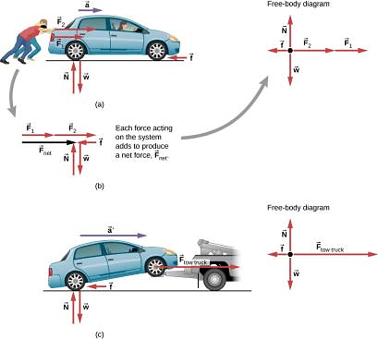
Force and Acceleration
The acceleration of an object is directly proportional to the net external force acting on the object.
Different forces exerted on the same mass produce different accelerations.
Two students push a stalled car. All external forces acting on the car are shown.
The forces acting on the car are transferred to a coordinate plane (free-body diagram) for simpler analysis.
The tow truck can produce greater external force on the same mass, and thus greater acceleration.

Slide 14
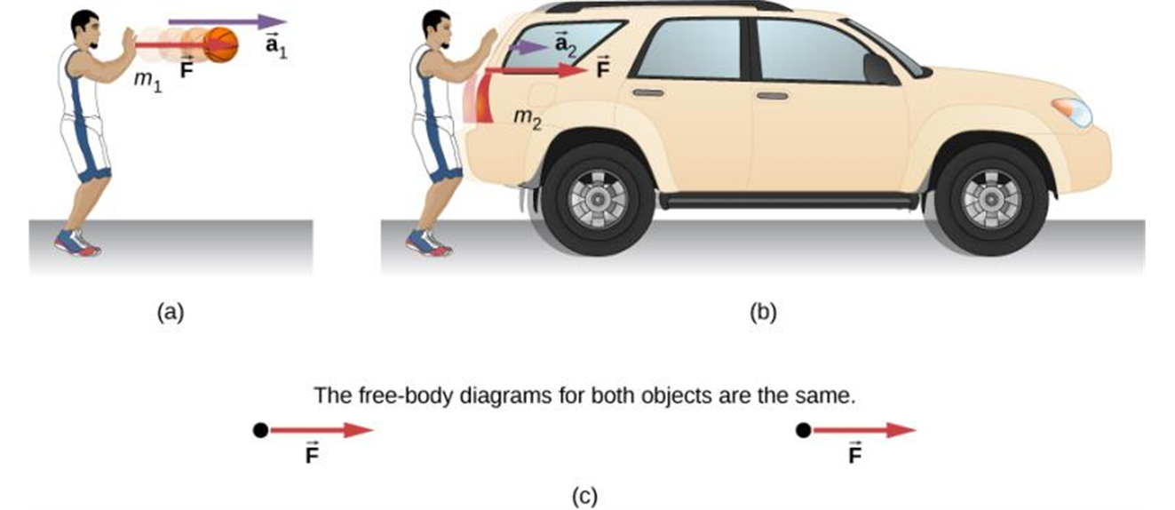
Mass and Acceleration
The acceleration of an object is inversely proportional to the object’s mass if the net external force remains fixed.
The same force exerted on systems of different masses produces different accelerations.
A basketball player pushes on a basketball to make a pass. (Ignore the effect of gravity on the ball.)
The same player exerts an identical force on a stalled SUV and produces far less acceleration.
The free-body diagrams are identical, permitting direct comparison of the two situations. A series of patterns for free-body diagrams will emerge as you do more problems and learn how to draw them in Drawing Free-Body Diagrams.

Slide 15
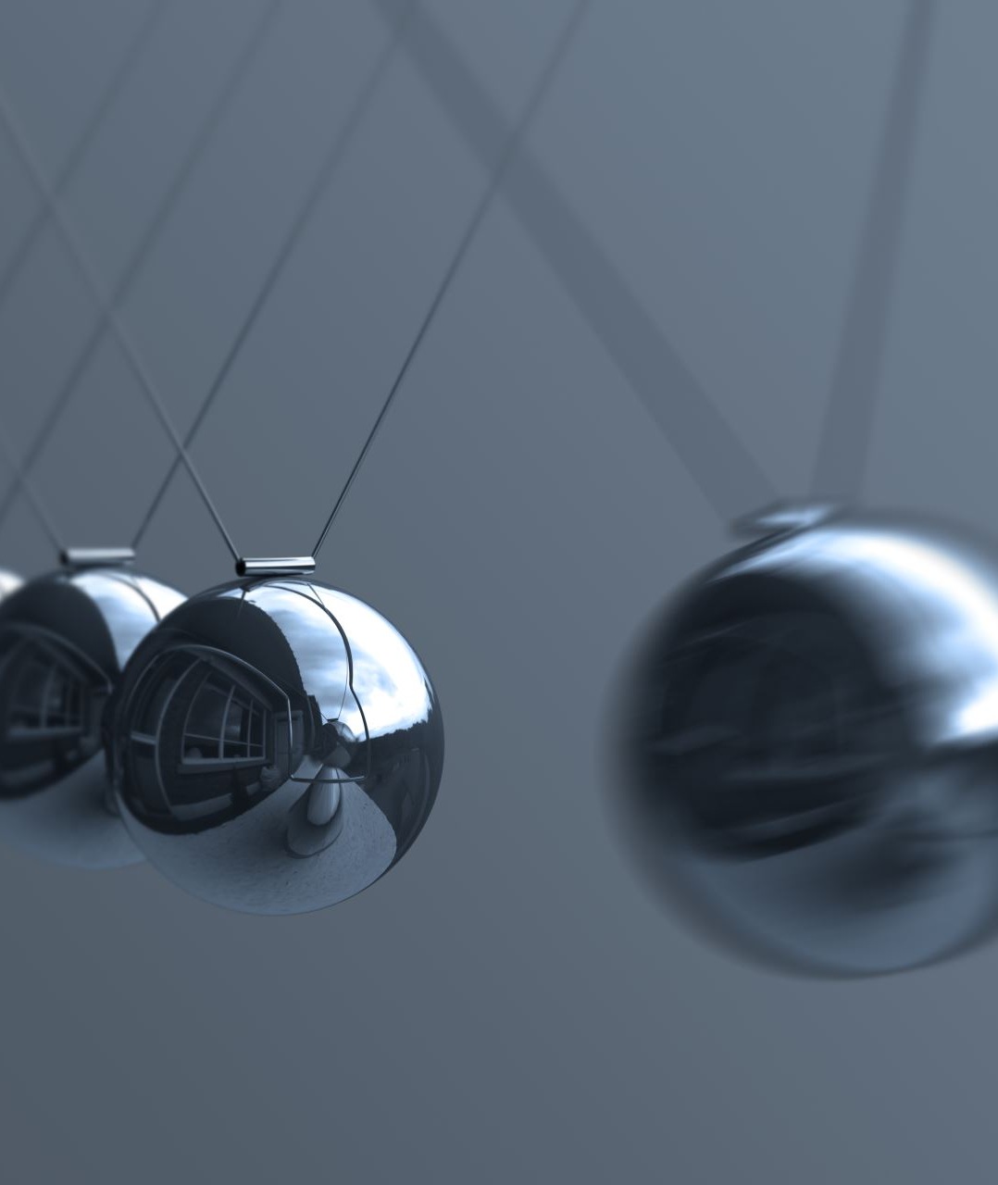
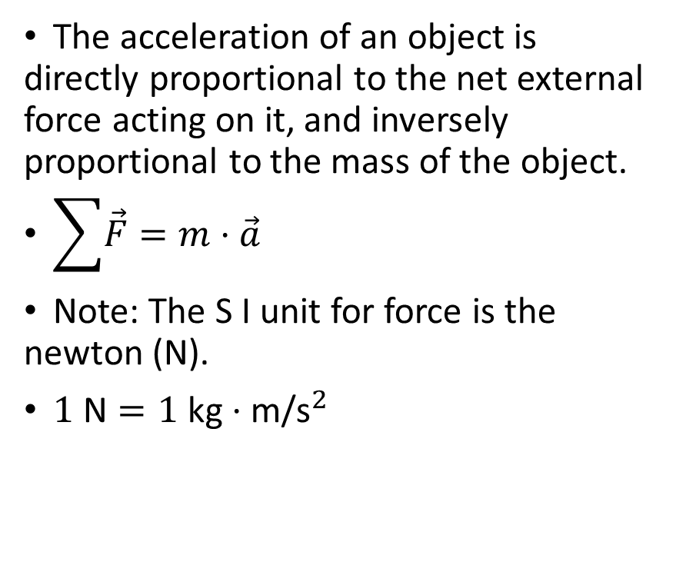
Newton's Second Law of Motion
The acceleration of an object is directly proportional to the net external force acting on it, and inversely proportional to the mass of the object.
$\sum{\vec{F}}=m⋅\vec{a}$
Note: The S I unit for force is the newton (N).
$1 \text{N}=1 \text{kg}⋅\text{m}\text{/}{\text{s}}^{2}$

Slide 16
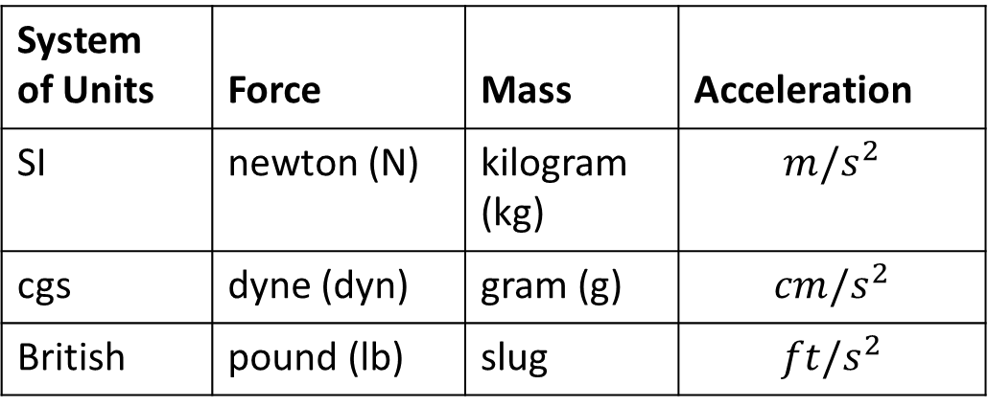
Systems of Units
We will use the SI system.
Other systems (we don’t use them in this class!)
  In the British system, force is measured in pounds, distance in feet, and mass in slugs.
  In the cgs system, mass is in grams, distance in centimeters, and force in dynes.
System of Units | Force | Mass | Acceleration
SI | newton (N) | kilogram (kg) | $$m/s^{2}$$
cgs | dyne (dyn) | gram (g) | $$cm/s^{2}$$
British | pound (lb) | slug | $$ft/s^{2}$$

Slide 17
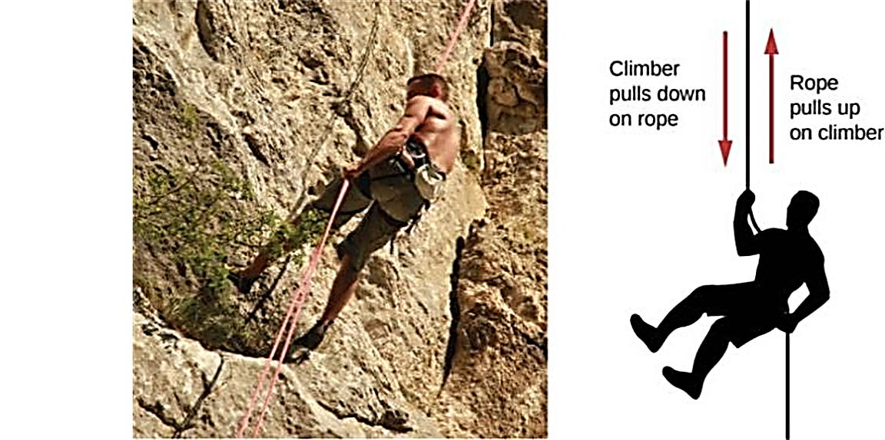
Newton's Third Law
Whenever one body exerts a force on a second body, the first body experiences a force that is equal in magnitude and opposite in direction to the force that it exerts.
When the mountain climber pulls down on the rope, the rope pulls up on the mountain climber.

Slide 18
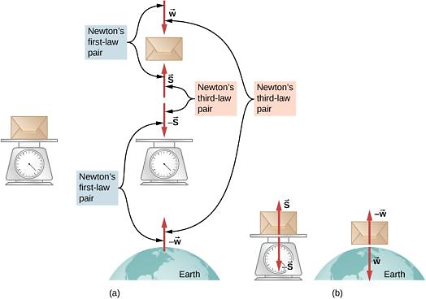
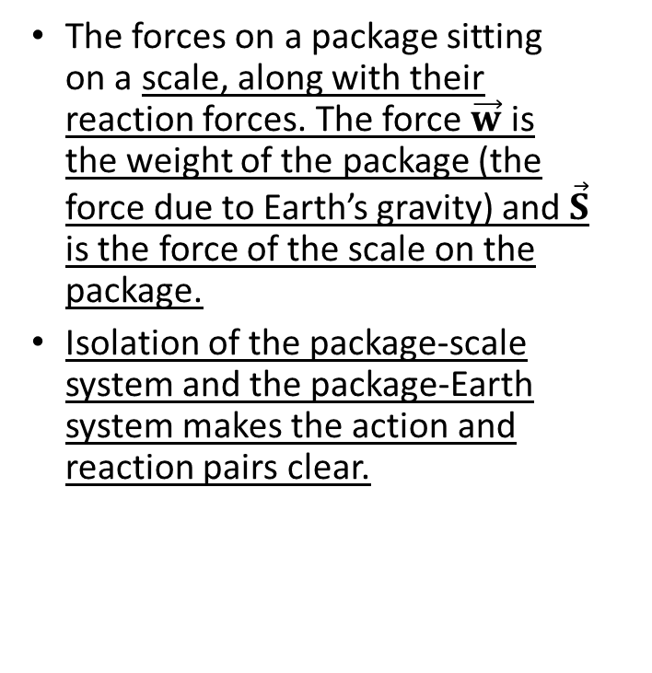
Newton’s Third Law – another example
The forces on a package sitting on a scale, along with their reaction forces. The force $\vec{w}$ is the weight of the package (the force due to Earth’s gravity) and $\vec{S}$ is the force of the scale on the package.
Isolation of the package-scale system and the package-Earth system makes the action and reaction pairs clear.

