Slide 1
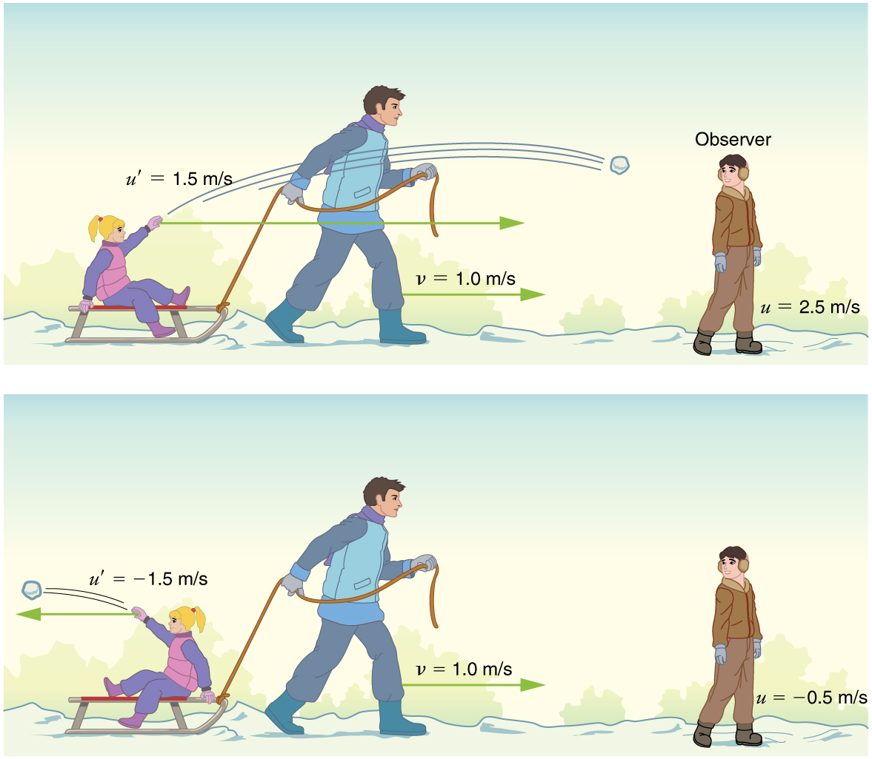


VELOCITY Addition

Slide 2
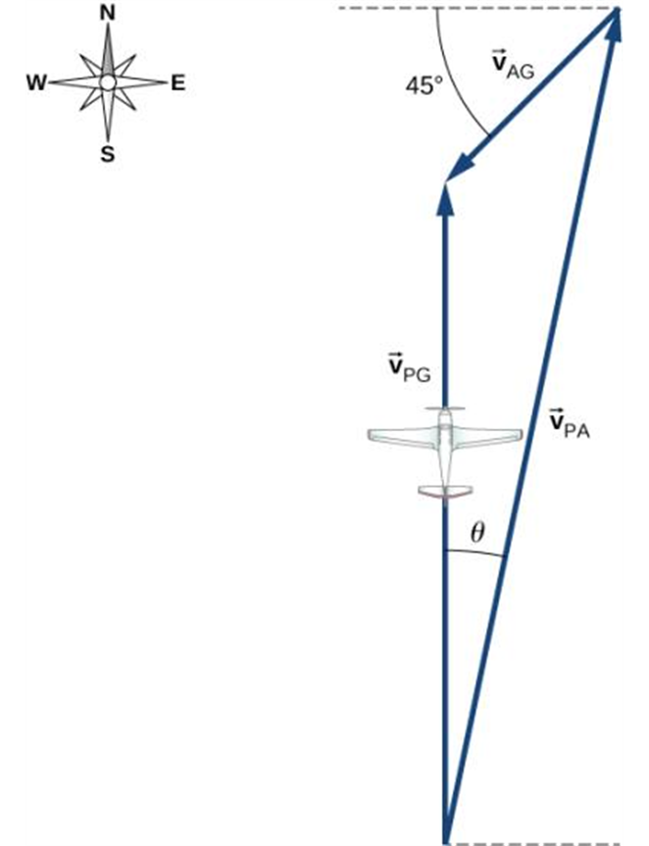
Relative Velocity
Wind
The velocity of a moving body seen by a particular observer is called the velocity relative to that observer, or simply the relative velocity.
A frame of reference is a coordinate system plus a time scale.
Relative velocity is extremely important as there is no ‘absolute’ velocity.
Coordinate system definition

Slide 3
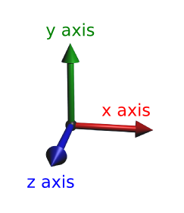
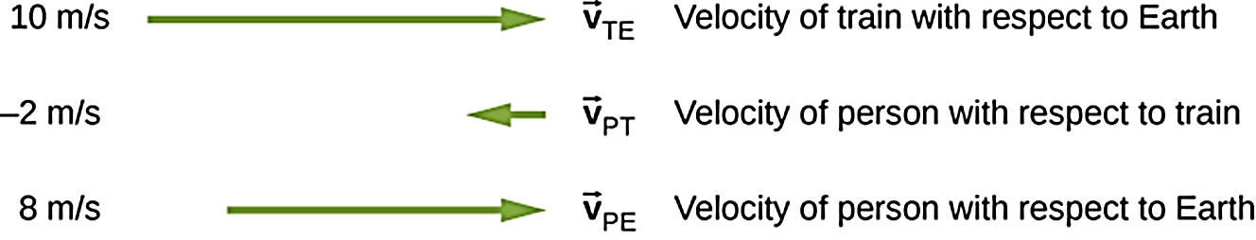
Velocity Addition in One Dimension
Train T is moving relative to reference frame E in x direction, we denote the velocity of P relative to frame E as ${\vec{v}}_{TE}$
Train T is moving relative to reference frame E in x direction, we denote the velocity of P relative to frame E as 𝑣 ⃗_𝑇𝐸
If person P is moving relative to frame T, the velocity is now ${\vec{v}}_{PT}$. Then the x-velocity of P relative to frame E is ${\vec{v}}_{PE}={\vec{v}}_{TE}+{\vec{v}}_{PT}$
If person P is moving relative to frame T, the velocity is now 𝑣 ⃗_𝑃𝑇. Then the x-velocity of P relative to frame E is 𝑣 ⃗_𝑃𝐸=𝑣 ⃗_𝑇𝐸+𝑣 ⃗_𝑃𝑇
Earth reference frame E

Slide 4
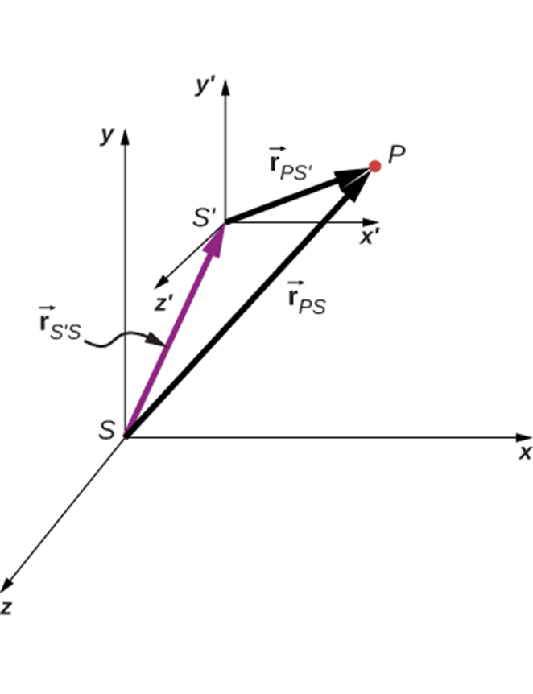
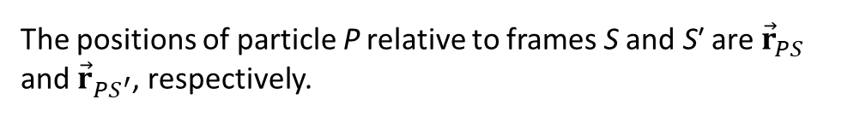
Velocity Addition in Two or Three Dimensions
The vector addition can be extended to 2, 3 and higher dimensions if needed, the vector sum can always be done by individual components to get the result.
The positions of particle P relative to frames S and S′ are ${\vec{r}}_{PS}$ and ${\vec{r}}_{{PS}^{′}}$, respectively.

Slide 5
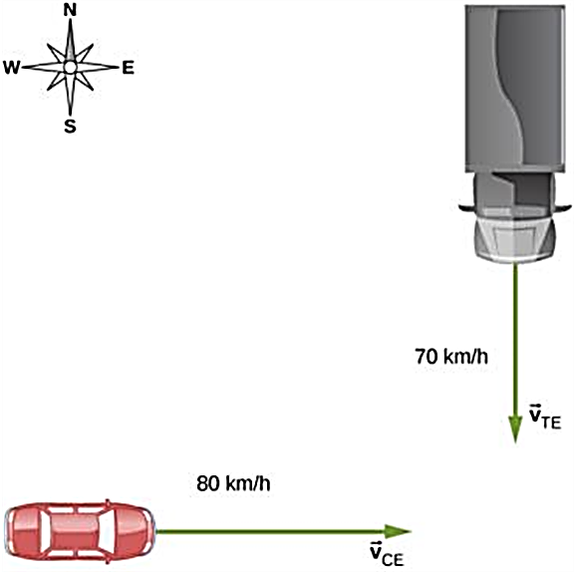
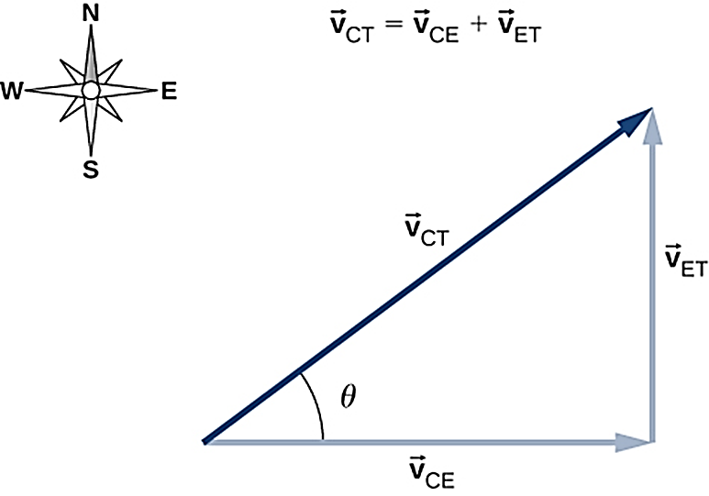
Velocity Addition Example in Two Dimensions
A car travels east toward an intersection while a truck travels south toward the same intersection.
Vector diagram of the vector equation ${\vec{v}}_{CT} = {\vec{v}}_{CE} + {\vec{v}}_{ET}$.

