Slide 1

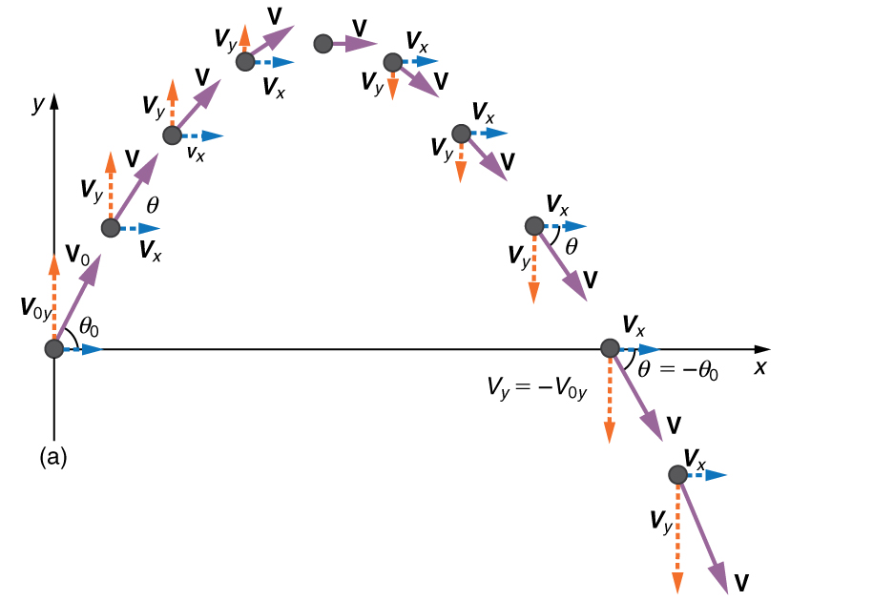

Projectile Motion

Slide 2
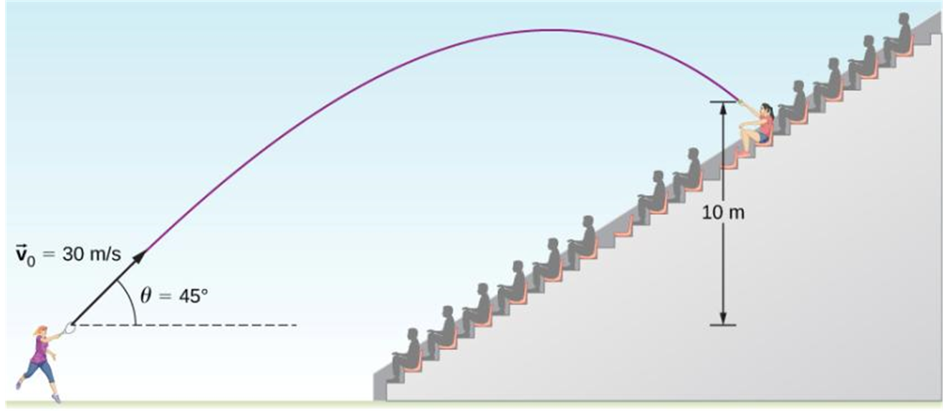
Projectile Motion Definition
A projectile is any object that given an initial velocity follows a path determined by the effects of gravity and air resistance.
We will begin by neglecting the air resistance at first (no effects of the curvature and rotation of the Earth are viewed in this course).

Slide 3
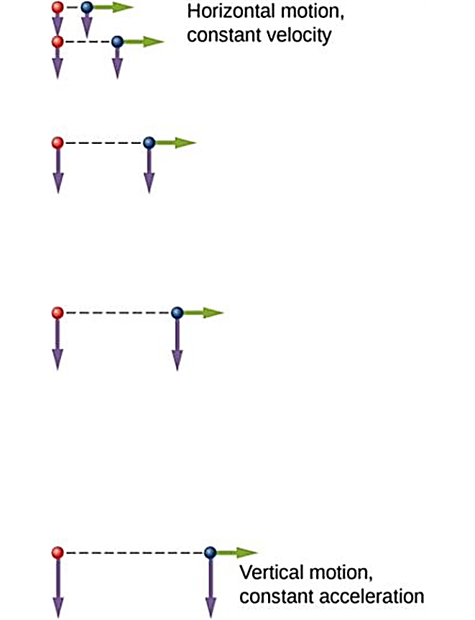
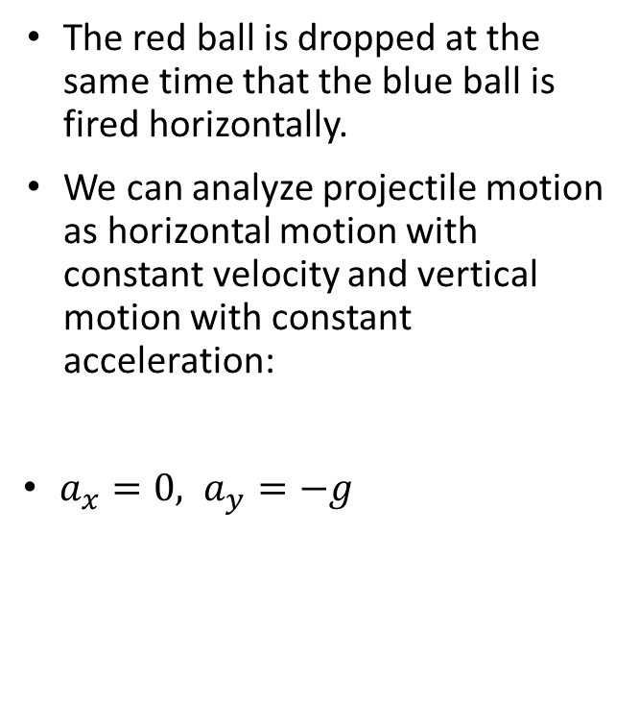
The X- and Y-Motion Are Separable
The red ball is dropped at the same time that the blue ball is fired horizontally.
We can analyze projectile motion as horizontal motion with constant velocity and vertical motion with constant acceleration:
$a_{x}=0, a_{y}=−g$

Slide 4
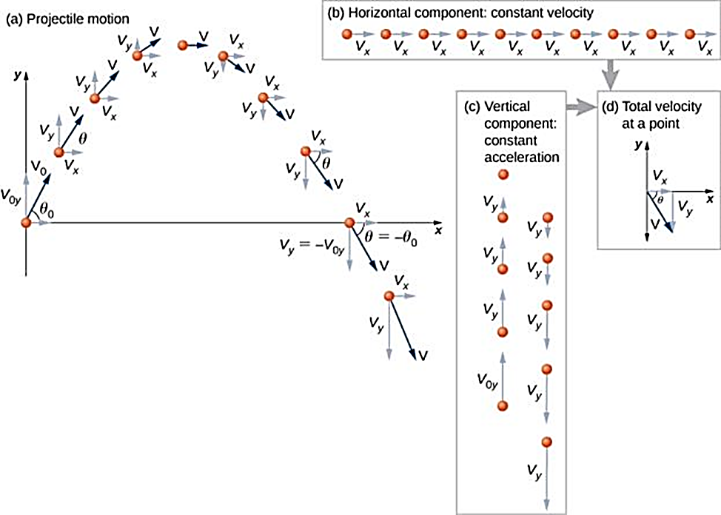
Projectile Motion: Superposition
If air resistance is negligible, the trajectory of a projectile is a combination of horizontal motion with constant velocity and vertical motion with constant acceleration.
We analyze two-dimensional projectile motion by breaking it into two independent one-dimensional motions along the vertical and horizontal axes.
The horizontal motion is simple, because a_{x} = 0 and v_{x} is a constant.
The velocity in the vertical direction begins to decrease as the object rises. At its highest point, the vertical velocity is zero. As the object falls toward Earth again, the vertical velocity increases again in magnitude but points in the opposite direction to the initial vertical velocity.
The x and y motions are recombined to give the total velocity at any given point on the trajectory.

Slide 5
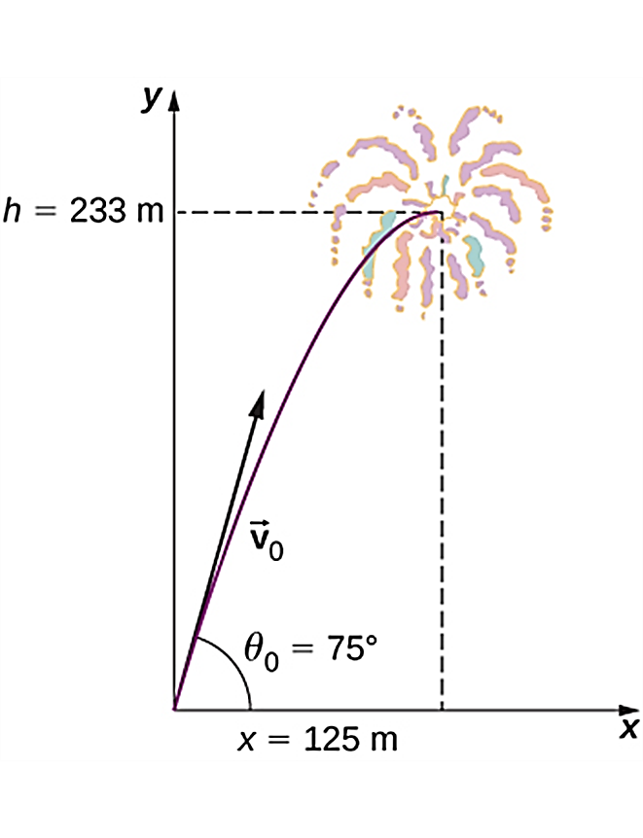
Projectile Motion – Initial Velocity
The initial velocity components of a projectile (such as fireworks shell) are related to the initial speed and initial angle. As the initial velocity is a vector, different representations can be used for it, say component form. Or only one component and the angle, etc.
The trajectory of a fireworks shell. The fuse is set to explode the shell at the highest point in its trajectory, which is found to be at a height of 233 m and 125 m away horizontally.

Slide 6

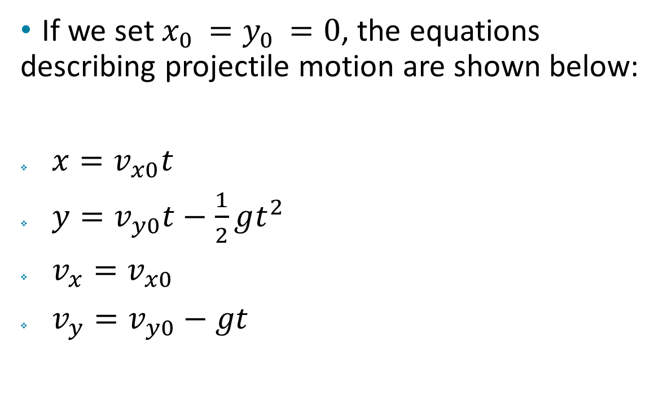
The Equations for Projectile Motion
If we set $x_{0 }=y_{0 }=0$, the equations describing projectile motion are shown below:
$x=v_{x0}t$
$y=v_{y0}t−\frac{1}{2}gt^{2}$
$v_{x}=v_{x0}$
$v_{y}=v_{y0}−gt$

Slide 7
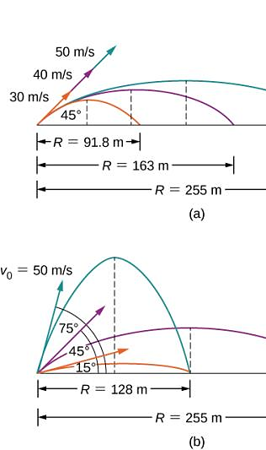
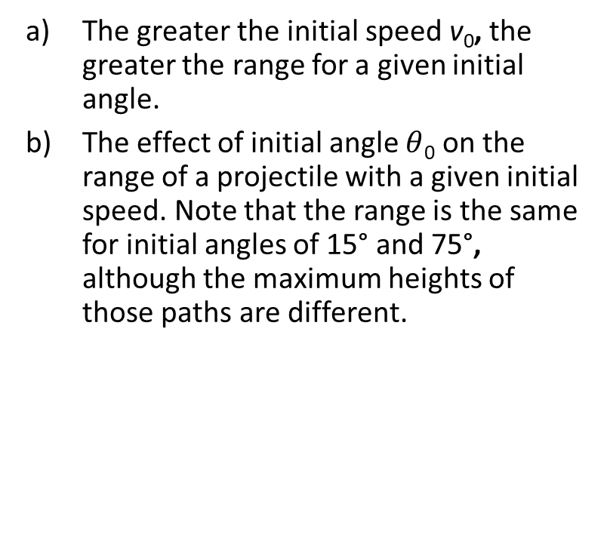
Trajectories of Projectiles on Level Ground
The greater the initial speed v₀, the greater the range for a given initial angle.
The effect of initial angle $θ$₀ on the range of a projectile with a given initial speed. Note that the range is the same for initial angles of 15° and 75°, although the maximum heights of those paths are different.

Slide 8
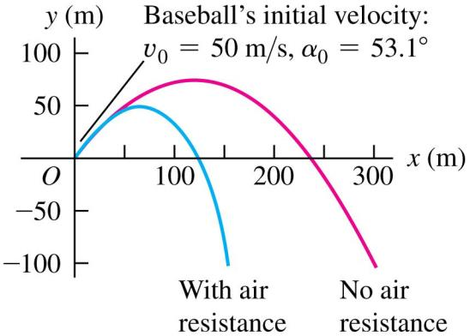
The Effects of Air Resistance
Calculations become more complicated.
Acceleration is not constant.
Effects can be very large.
Maximum height and range decrease.
Trajectory is no longer a parabola.

