Slide 1

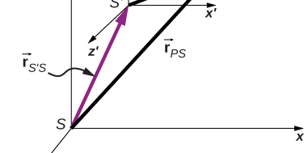

Vector addition and subtraction

Slide 2
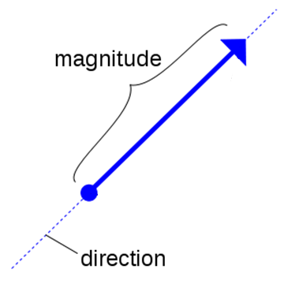
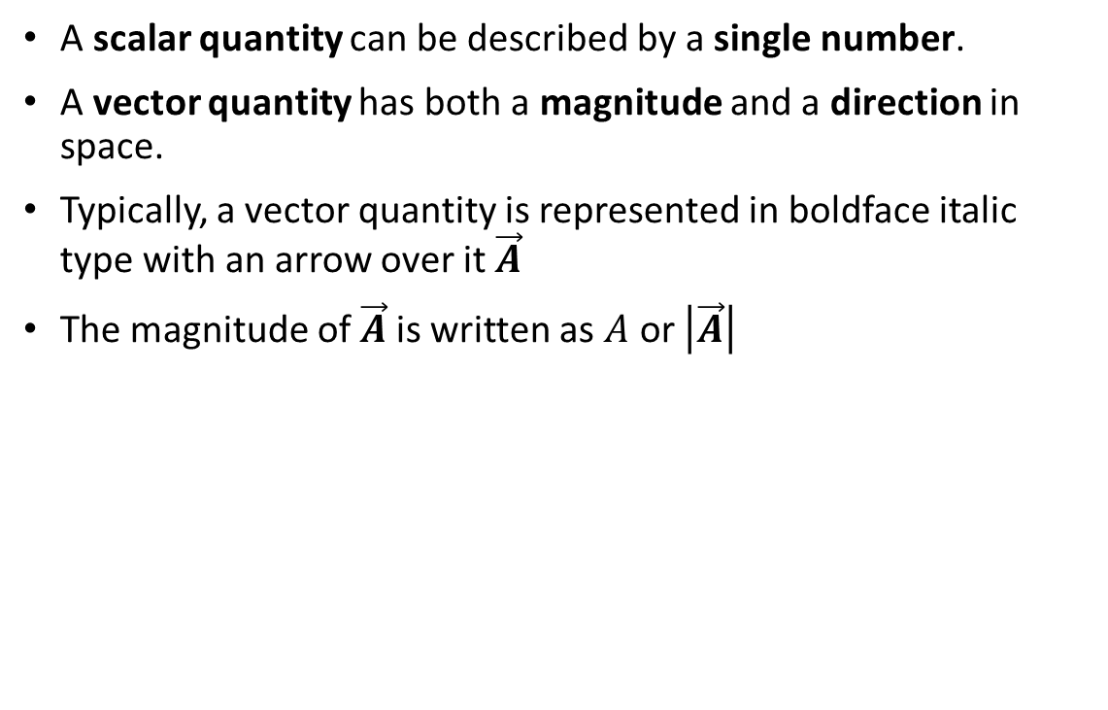
Vectors and Scalars
A scalar quantity can be described by a single number.
A vector quantity has both a magnitude and a direction in space.
Typically, a vector quantity is represented in boldface italic type with an arrow over it $\vec{A}$
The magnitude of $\vec{A}$is written as $A$ or $\left|\vec{A}\right|$

Slide 3
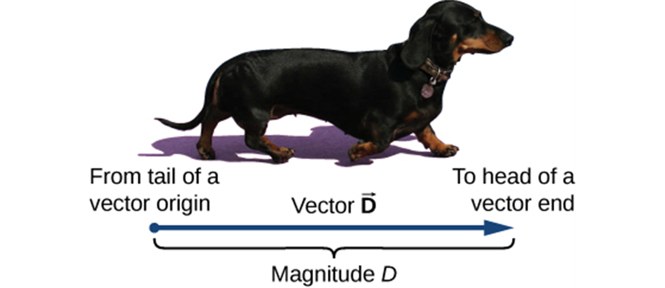
Drawing Vectors
We draw a vector from the initial point or origin (called the “tail” of a vector) to the end or terminal point (called the “head” of a vector), marked by an arrowhead. Magnitude is the length of a vector and is always a positive scalar quantity. (credit: modification of work by Cate Sevilla)

Slide 4
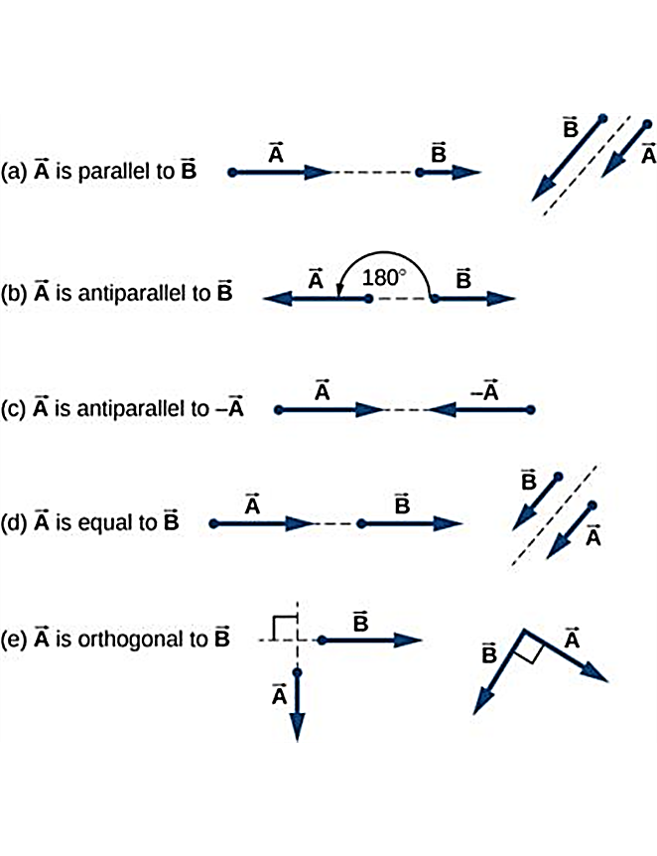
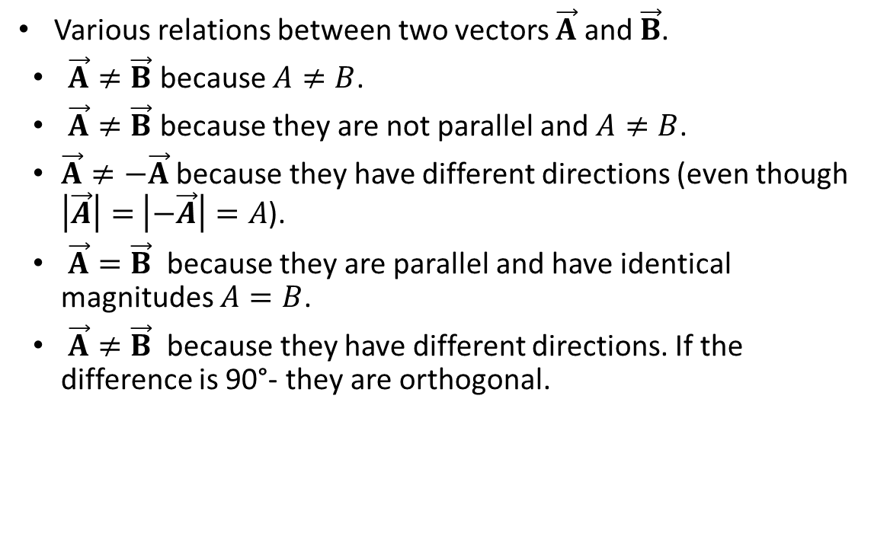
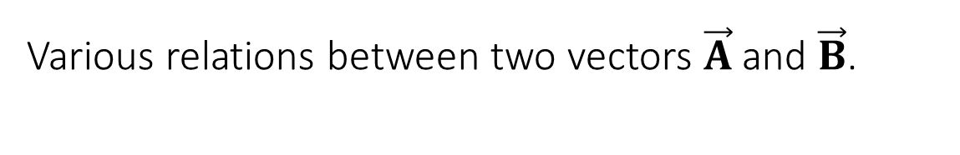
Various relations between two vectors $\vec{A}$ and $\vec{B}$.
Various relations between two vectors $\vec{A}$ and $\vec{B}$.
$\vec{A}≠\vec{B}$ because $A≠B$.
$\vec{A}≠\vec{B}$ because they are not parallel and $A≠B$.
$\vec{A}≠−\vec{A}$ because they have different directions (even though $\left|\vec{A}\right|=$ $\left|−\vec{A}\right|=A$).
$\vec{A}=\vec{B}$ because they are parallel and have identical magnitudes $A=B$.
$\vec{A}≠\vec{B}$ because they have different directions. If the difference is 90°- they are orthogonal.

Slide 5
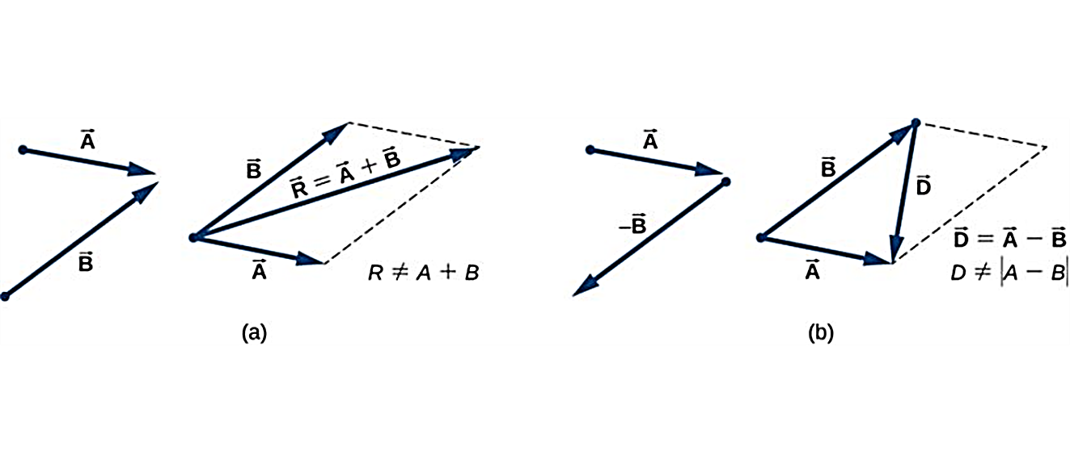
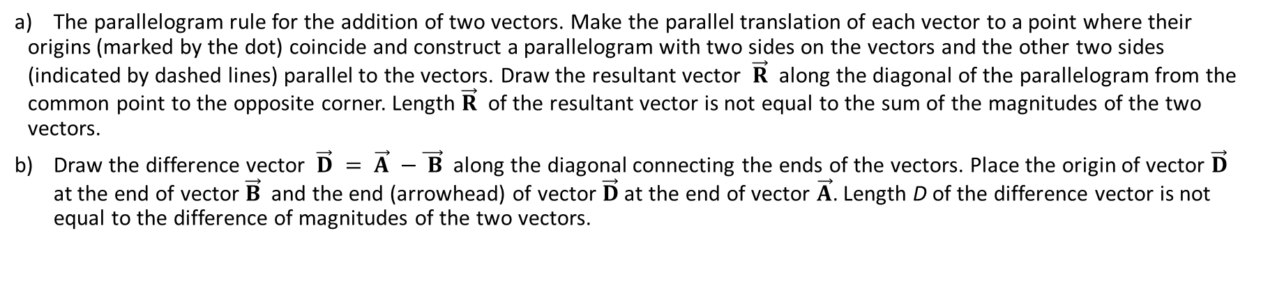
Adding/Subtracting Two Vectors Graphically (Parallelogram Method)
The parallelogram rule for the addition of two vectors. Make the parallel translation of each vector to a point where their origins (marked by the dot) coincide and construct a parallelogram with two sides on the vectors and the other two sides (indicated by dashed lines) parallel to the vectors. Draw the resultant vector $\vec{R}$ along the diagonal of the parallelogram from the common point to the opposite corner. Length $\vec{R}$ of the resultant vector is not equal to the sum of the magnitudes of the two vectors.
Draw the difference vector $\vec{D} = \vec{A} −\vec{ B}$ along the diagonal connecting the ends of the vectors. Place the origin of vector $\vec{D}$ at the end of vector $\vec{B}$ and the end (arrowhead) of vector $\vec{D}$ at the end of vector $\vec{A}$. Length D of the difference vector is not equal to the difference of magnitudes of the two vectors.

Slide 6
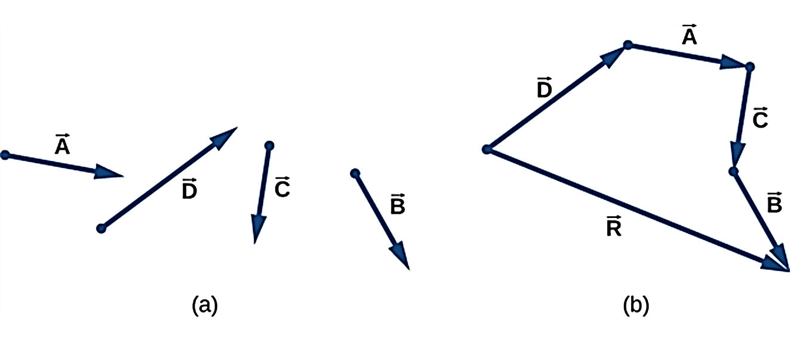
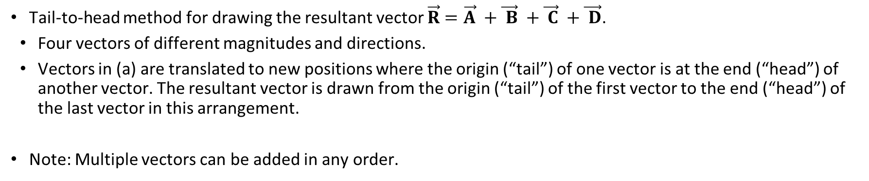
Adding Vectors (Tail to Head Method)
Tail-to-head method for drawing the resultant vector $\vec{R}=\vec{A} +\vec{ B} +\vec{ C} +\vec{ D}$.
Four vectors of different magnitudes and directions.
Vectors in (a) are translated to new positions where the origin (“tail”) of one vector is at the end (“head”) of another vector. The resultant vector is drawn from the origin (“tail”) of the first vector to the end (“head”) of the last vector in this arrangement.
Note: Multiple vectors can be added in any order.

Slide 7
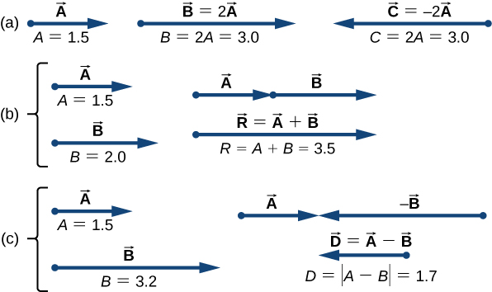
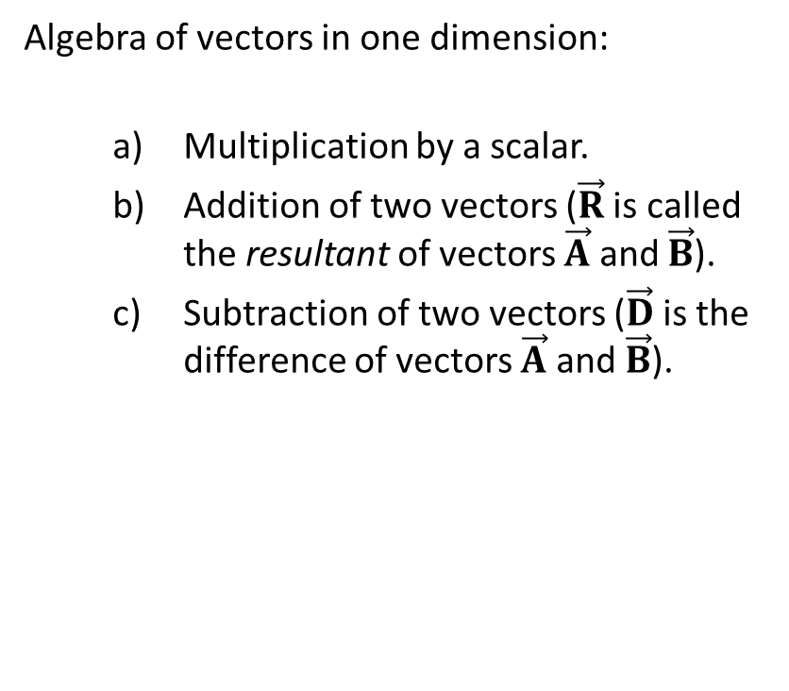
Vectors in One Dimension
Algebra of vectors in one dimension:
  Multiplication by a scalar.
  Addition of two vectors ($\vec{R}$ is called the resultant of vectors $\vec{A}$ and $\vec{B}$).
  Subtraction of two vectors ($\vec{D}$ is the difference of vectors $\vec{A}$ and $\vec{B}$).

Slide 8
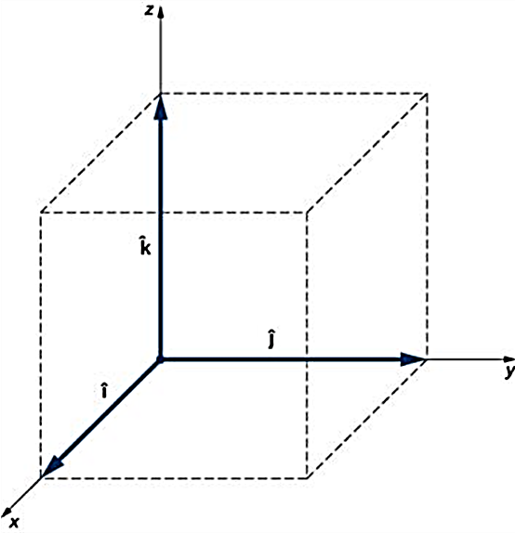
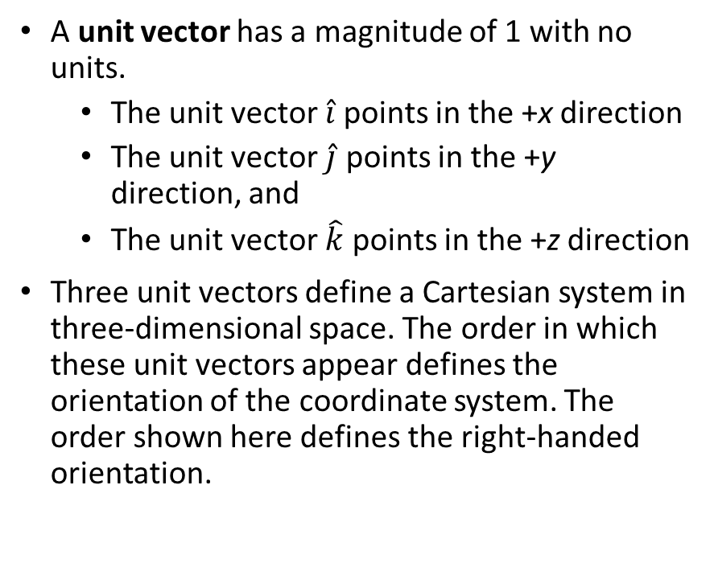
Unit Vectors
A unit vector has a magnitude of 1 with no units.
  The unit vector $\hat{i}$ points in the +x direction
  The unit vector $\hat{j}$ points in the +y direction, and
  The unit vector $\hat{k}$ points in the +z direction
Three unit vectors define a Cartesian system in three-dimensional space. The order in which these unit vectors appear defines the orientation of the coordinate system. The order shown here defines the right-handed orientation.

Slide 9
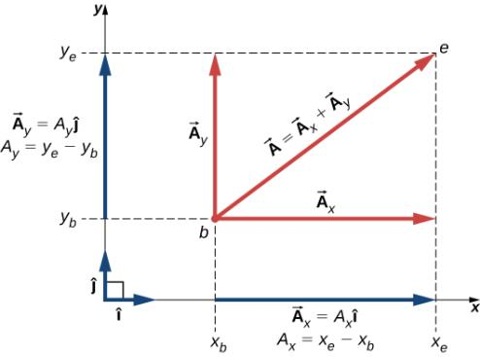
Components of a Vector in the Cartesian coordinates
Adding vectors graphically provides limited accuracy and thus is not used often.
Vector components provide a general method for adding, subtracting and multiplying vectors.
Any vector can be represented by an x-component A_{x} and a y-component A_{y}.

Slide 10
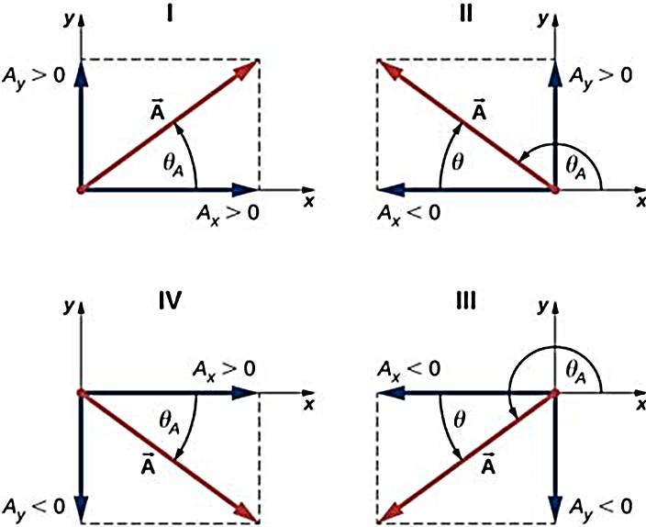
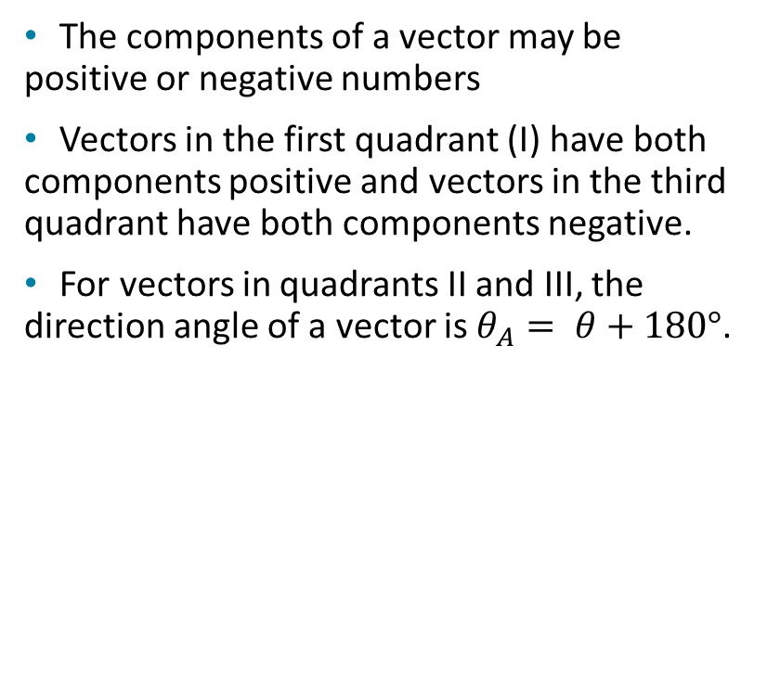
Positive and Negative Components
The components of a vector may be positive or negative numbers
Vectors in the first quadrant (I) have both components positive and vectors in the third quadrant have both components negative.
For vectors in quadrants II and III, the direction angle of a vector is $θ_{A}= θ+180°$.

Slide 11
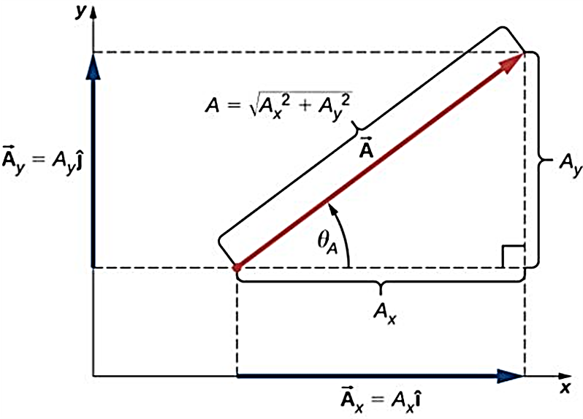
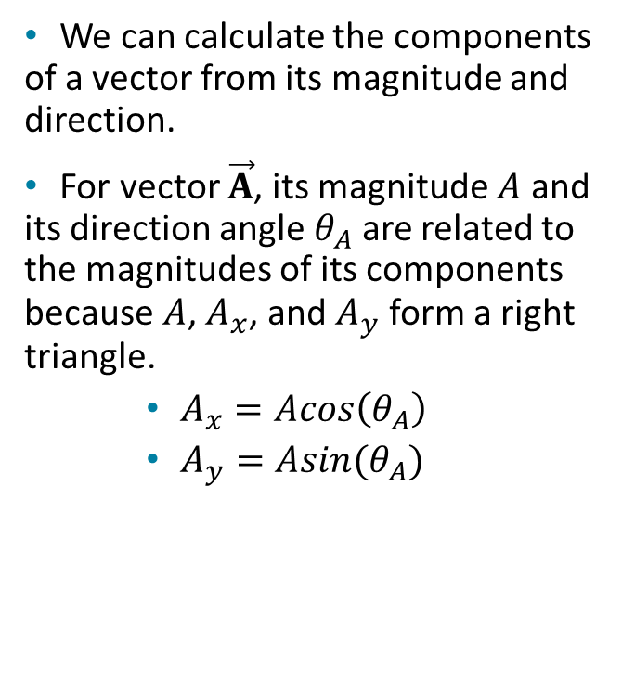
Finding Components
We can calculate the components of a vector from its magnitude and direction.
For vector $\vec{A}$, its magnitude $A$ and its direction angle $θ_{A}$ are related to the magnitudes of its components because $A$, $A_{x}$, and $A_{y}$ form a right triangle.
    $A_{x}=Acos\left(θ_{A}\right)$
    $A_{y}=Asin(θ_{A})$

Slide 12

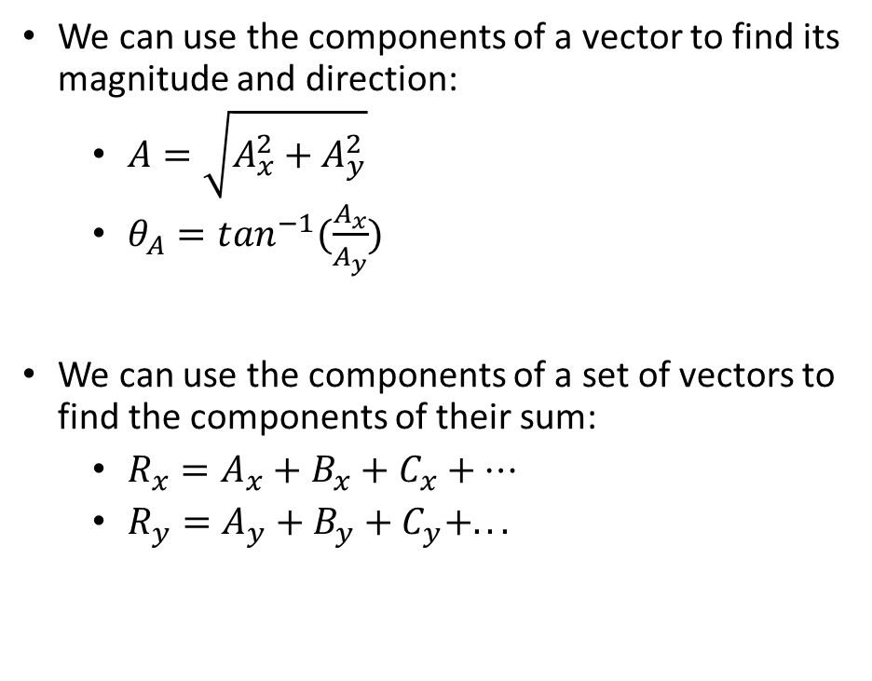
Calculations Using Components
We can use the components of a vector to find its magnitude and direction:
  $A=\sqrt{A_{x}^{2}+A_{y}^{2}}$
  $θ_{A}=\tan^{−1}(\frac{A_{x}}{A_{y}})$
We can use the components of a set of vectors to find the components of their sum:
  $R_{x}=A_{x}+B_{x}+C_{x}+…$
  $R_{y}=A_{y}+B_{y}+C_{y}+...$

Slide 13
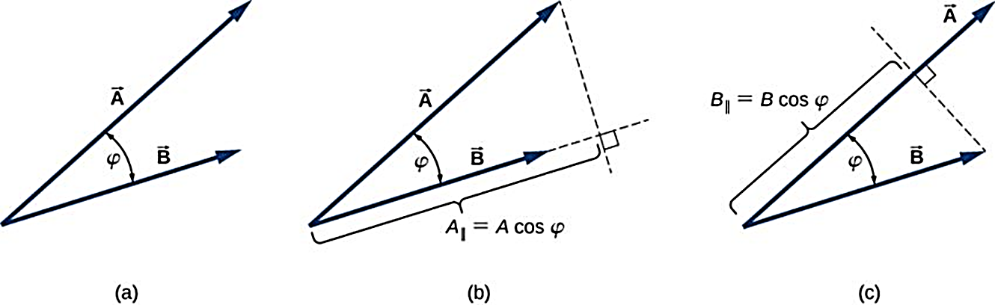
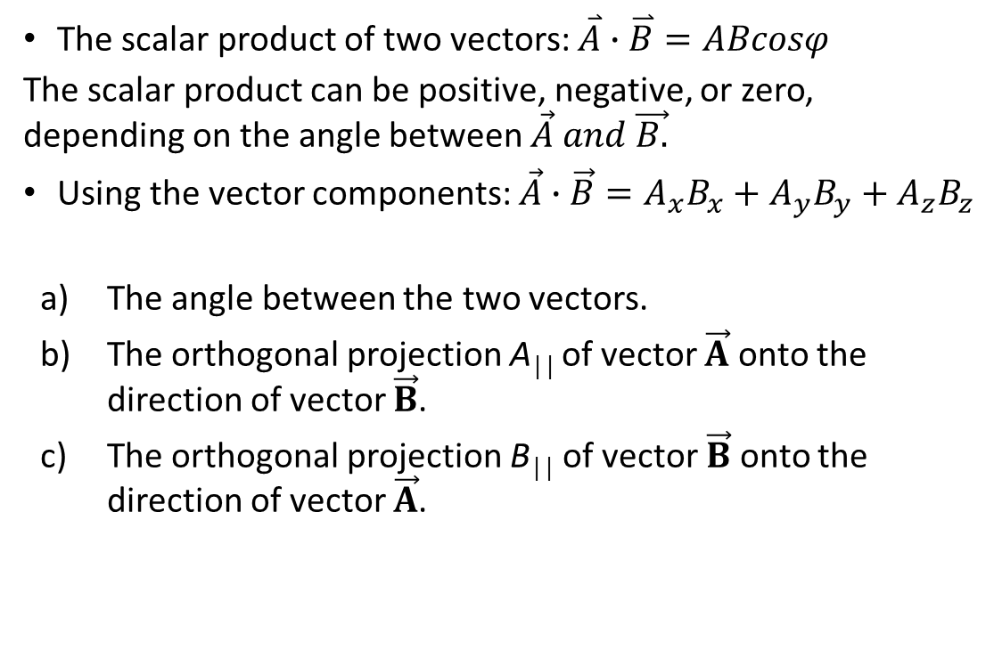
The Scalar Product: Definition
The scalar product of two vectors: $\overset{⃑}{A}∙\overset{⃑}{B}=ABcosφ$
The scalar product can be positive, negative, or zero, depending on the angle between $\vec{A} and \vec{B.}$
Using the vector components: $\vec{A}∙\vec{B}=A_{x}B_{x}+A_{y}B_{y}+A_{z}B_{z}$
The angle between the two vectors.
The orthogonal projection A││ of vector $\vec{A}$ onto the direction of vector $\vec{B}$.
The orthogonal projection B││ of vector $\vec{B}$ onto the direction of vector $\vec{A}$.

