Slide 1

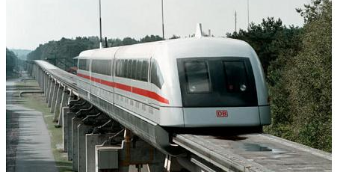

MOTION ALONG A STRAIGHT LINE

Slide 2
Introduction
Kinematics is the study of motion.
Velocity and acceleration are physical quantities that characterize motion.
Displacement, speed and average
velocity are also quantities describing motion.

Slide 3
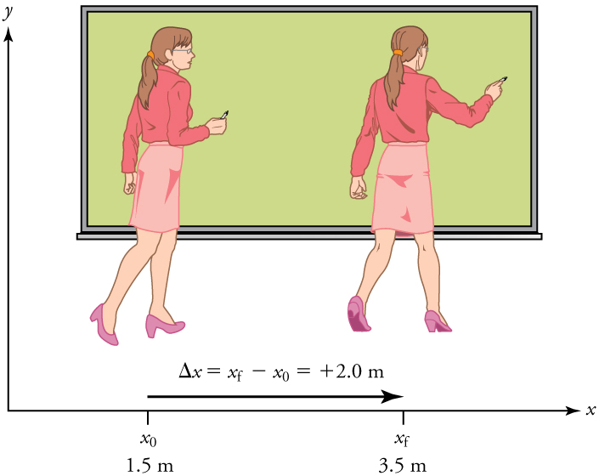
Displacement, time and average velocity
A particle moving along the x-axis has a coordinate x.
The change in the particle’s coordinate is $Δx=x_{2}−x_{1}$
The change in the particle’s coordinate is Δ𝑥=𝑥_2−𝑥_1
The average x-velocity of the particle is $v_{av, x}=\frac{∆x}{∆t}=\frac{x_{f}−x_{i}}{t_{f}−t_{i}}$
The average x-velocity of the particle is 𝑣_(𝑎𝑣, 𝑥)=∆𝑥/∆𝑡=(𝑥_𝑓−𝑥_𝑖)/(𝑡_𝑓−𝑡_𝑖 )
A professor paces left and right while lecturing. Her position relative to Earth is given by x.
The +2.0-m displacement of the professor relative to Earth is represented by an arrow pointing to the right.
Note:
a. Both displacement and average velocities are vector quantities.
b. SI units of displacement are m.
c. SI units of average velocity are m/s.

Slide 4
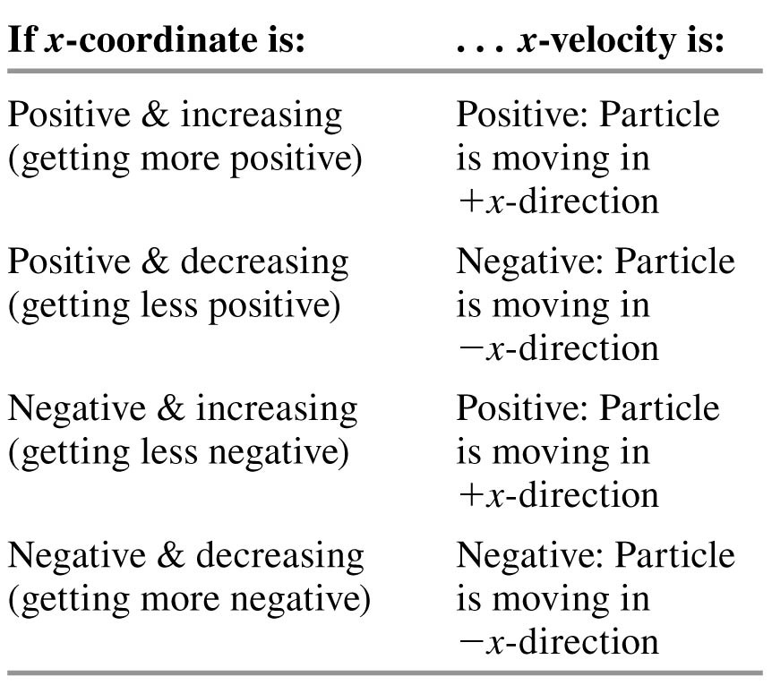
Velocity vector sign

Slide 5
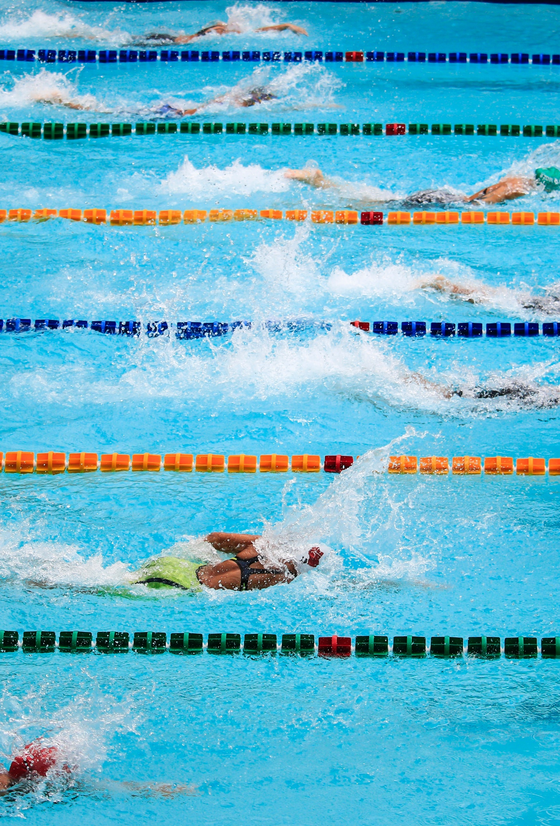
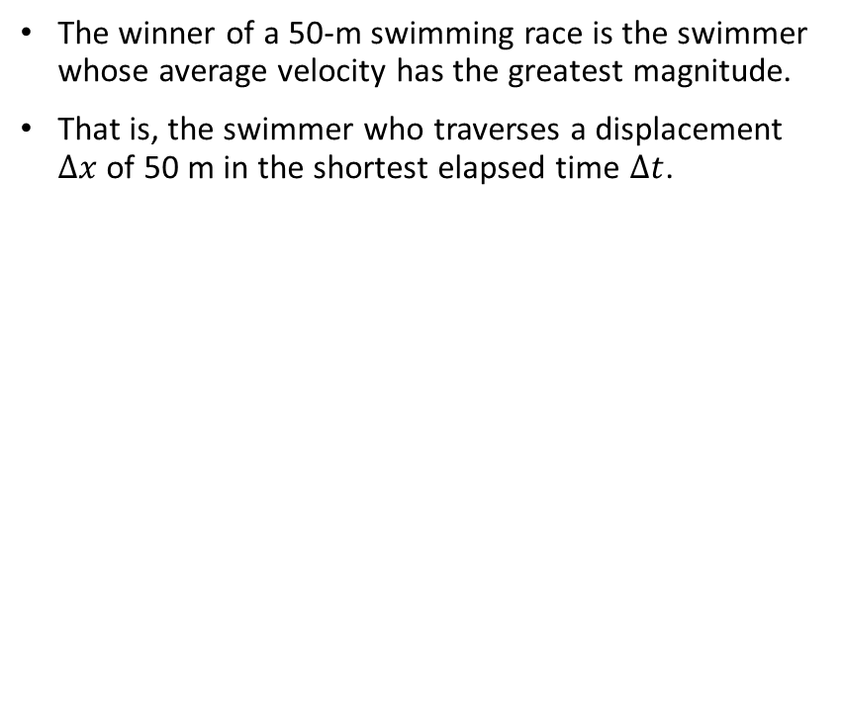
Average velocity
The winner of a 50-m swimming race is the swimmer whose average velocity has the greatest magnitude.
That is, the swimmer who traverses a displacement $Δx$ of 50 m in the shortest elapsed time $Δt$.

Slide 6

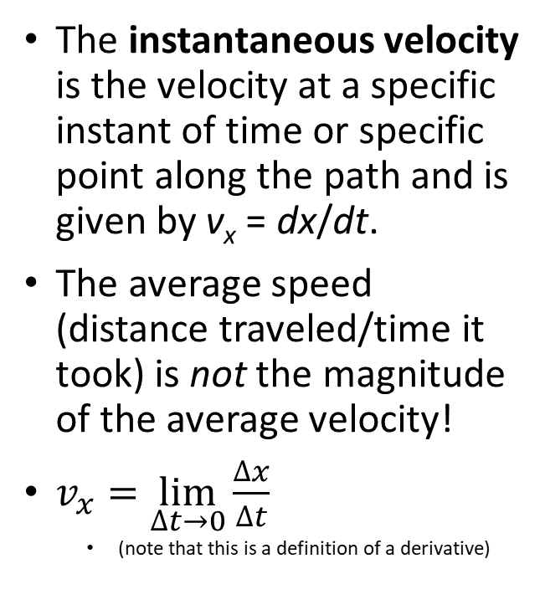
Instantaneous velocity
The instantaneous velocity is the velocity at a specific instant of time or specific point along the path and is given by v_{x} = dx/dt.
The average speed (distance traveled/time it took) is not the magnitude of the average velocity!
$v_{x}=\lim_{∆t→0}{\frac{∆x}{∆t}}$
  (note that this is a definition of a derivative)

Slide 7
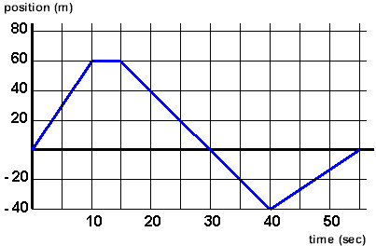
A position-time graph
This graph depicts object’s position versus time. The average velocity is the slope of a line connecting the initial and final points.

Slide 8
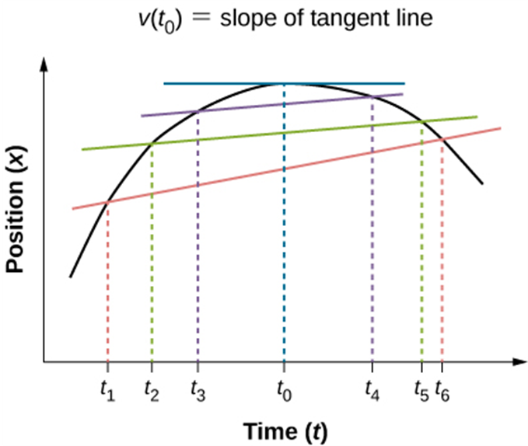

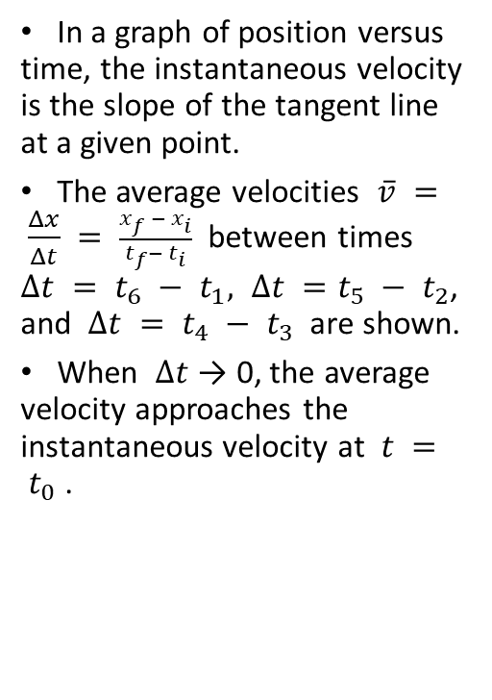
Finding velocity on an $x−t$ graph
In a graph of position versus time, the instantaneous velocity is the slope of the tangent line at a given point.
The average velocities $\overline{v} = \frac{Δx}{Δt} = \frac{x_{f }− x_{i}}{t_{f}−{ t}_{i}}$ between times $∆t = t_{6} − t_{1}, ∆t =t_{5} − t_{2}$, and $∆t = t_{4} −{ t}_{3}$ are shown.
When $∆t$ → 0, the average velocity approaches the instantaneous velocity at $t = t_{0}$ .

Slide 9
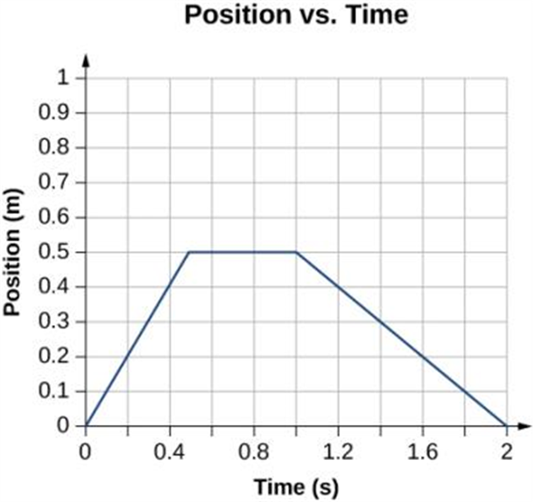
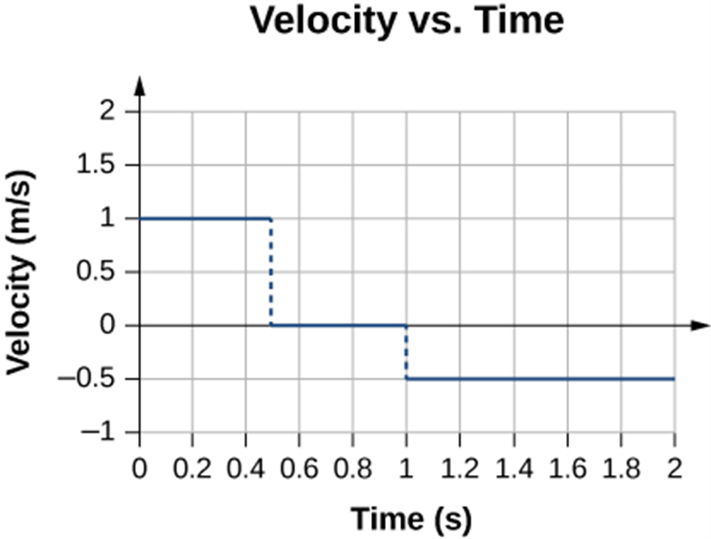
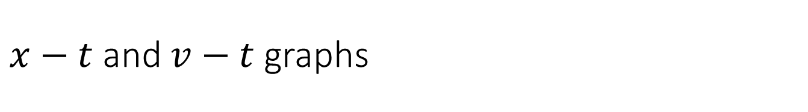
$x−t$ and $v−t$ graphs
The object starts out in the positive direction, stops for a short time, and then reverses direction, heading back toward the origin. Notice that the object comes to rest instantaneously, which would require an infinite force. Thus, the graph approximates the motion in the real world.
The velocity is positive for the first part of the trip, zero when the object is stopped, and negative when the object reverses direction.

Slide 10
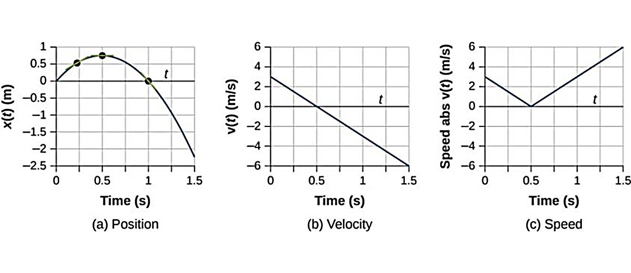
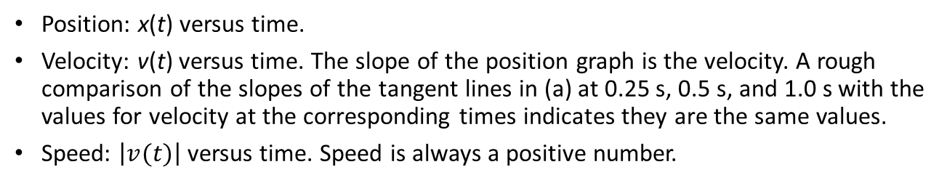
Another example
Position: x(t) versus time.
Velocity: v(t) versus time. The slope of the position graph is the velocity. A rough comparison of the slopes of the tangent lines in (a) at 0.25 s, 0.5 s, and 1.0 s with the values for velocity at the corresponding times indicates they are the same values.
Speed: $\left|v(t)\right|$ versus time. Speed is always a positive number.

Slide 11

Average acceleration
Acceleration describes the rate of change of velocity with time.
The average x-acceleration is $a_{av, x}=\frac{∆v_{x}}{∆t}=\frac{v_{xf}−v_{xi}}{t_{f}−t_{i}}$
The average x-acceleration is 𝑎_(𝑎𝑣, 𝑥)=(∆𝑣_𝑥)/∆𝑡=(𝑣_𝑥𝑓−𝑣_𝑥𝑖)/(𝑡_𝑓−𝑡_𝑖 )

Slide 12
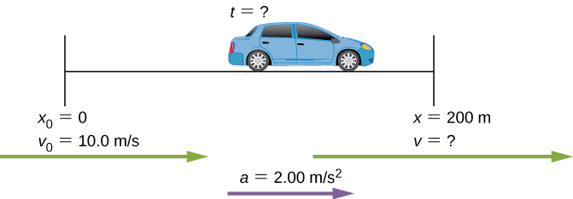
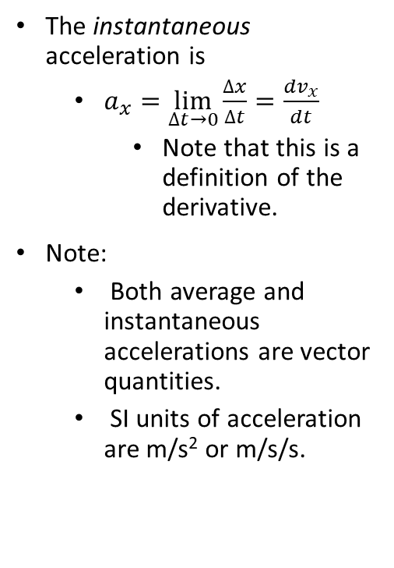
Instantaneous acceleration
The instantaneous acceleration is
  $a_{x}=\lim_{∆t→0}{\frac{∆x}{∆t}}=\frac{dv_{x}}{dt}$
    Note that this is a definition of the derivative.
Note:
  Both average and instantaneous accelerations are vector quantities.
  SI units of acceleration are m/s² or m/s/s.

Slide 13
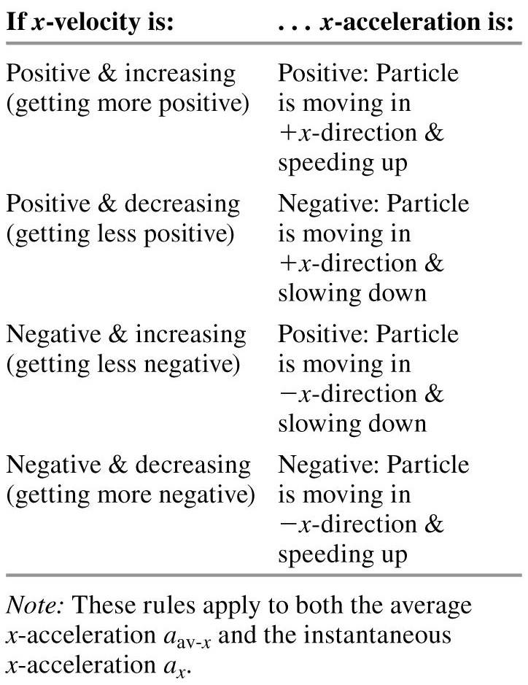
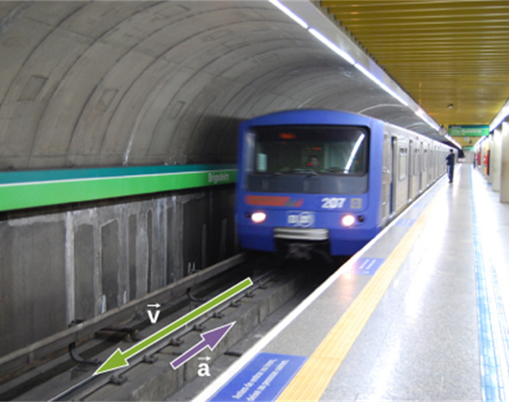
Find a sign of acceleration vector
A subway train in Sao Paulo, Brazil, decelerates as it comes into a station. It is accelerating in a direction opposite to its direction of motion.
    (credit: Yusuke Kawasaki)

Slide 14
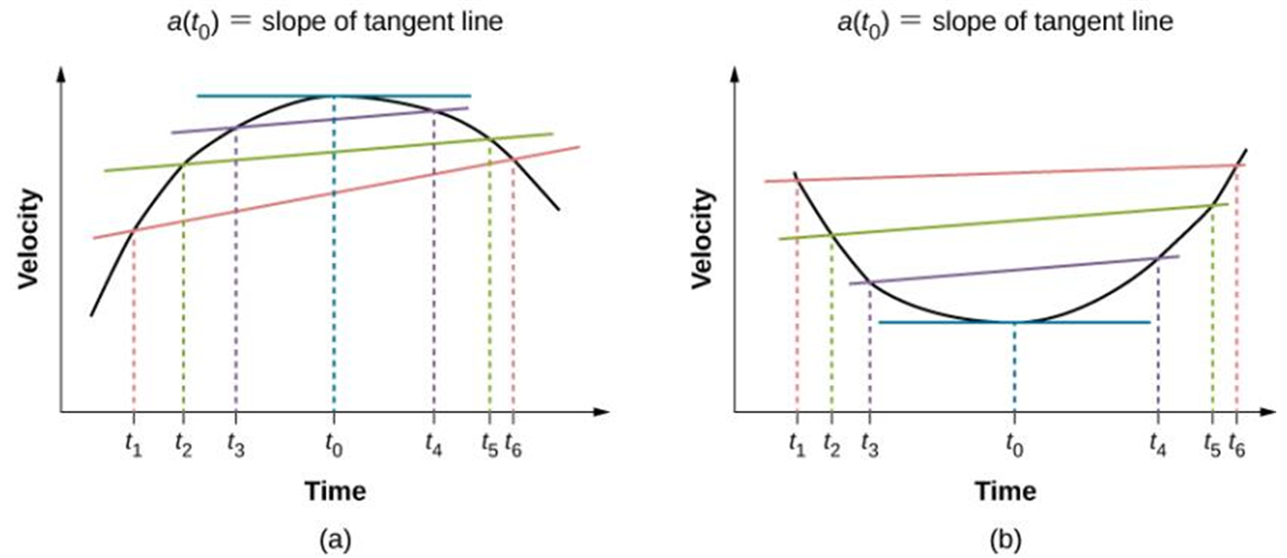

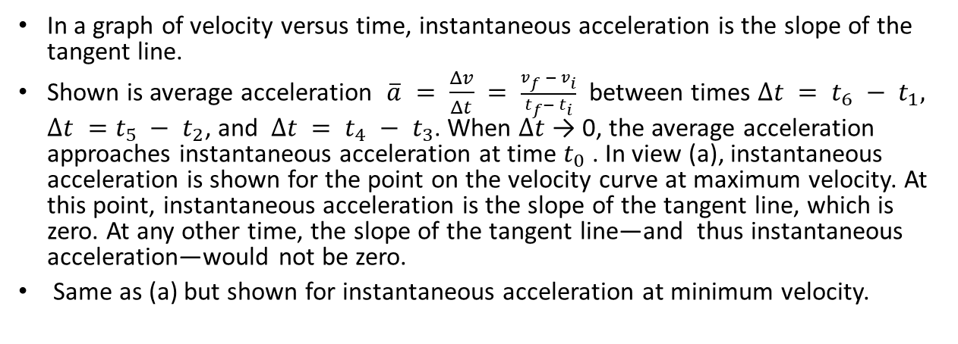
Finding acceleration on a $vx−t$ graph
In a graph of velocity versus time, instantaneous acceleration is the slope of the tangent line.
Shown is average acceleration $\overline{a} = \frac{Δv}{Δt} = \frac{v_{f }− v_{i}}{t_{f}−{ t}_{i}}$ between times $∆t = t_{6} − t_{1}, ∆t =t_{5} − t_{2}$, and $∆t = t_{4} −{ t}_{3}$. When $∆t$ → 0, the average acceleration approaches instantaneous acceleration at time $t_{0}$. In view (a), instantaneous acceleration is shown for the point on the velocity curve at maximum velocity. At this point, instantaneous acceleration is the slope of the tangent line, which is zero. At any other time, the slope of the tangent line—and thus instantaneous acceleration—would not be zero.
Same as (a) but shown for instantaneous acceleration at minimum velocity.

Slide 15
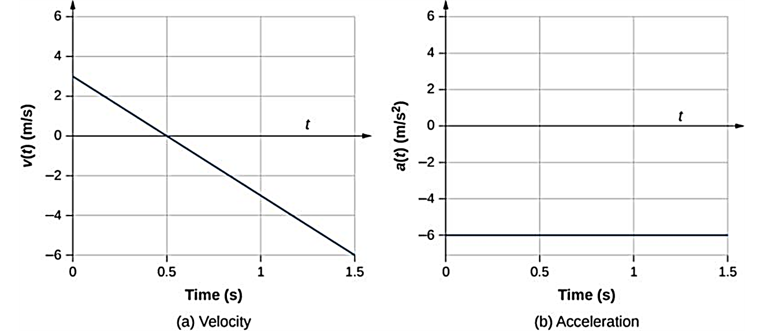
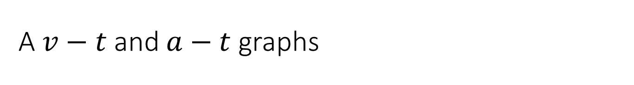
A $v−t$and $a−t$ graphs
(a, b) The velocity-versus-time graph is linear and has a negative constant slope (a) that is equal to acceleration, shown in (b).

Slide 16
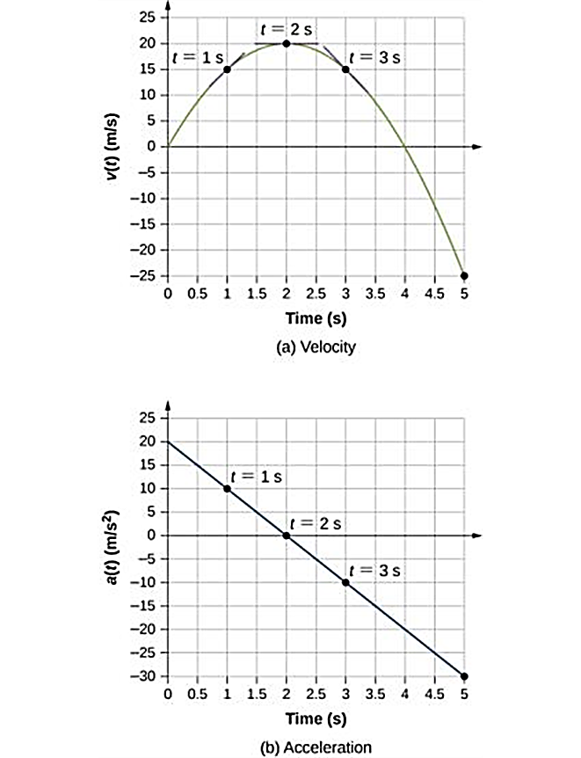
More plots
Velocity versus time. Tangent lines are indicated at times 1, 2, and 3 s. The slopes of the tangents lines are the accelerations. At t = 3 s, velocity is positive. At t = 5 s, velocity is negative, indicating the particle has reversed direction.
Acceleration versus time. Comparing the values of accelerations given by the black dots with the corresponding slopes of the tangent lines (slopes of lines through black dots) in (a), we see they are identical.

Slide 17
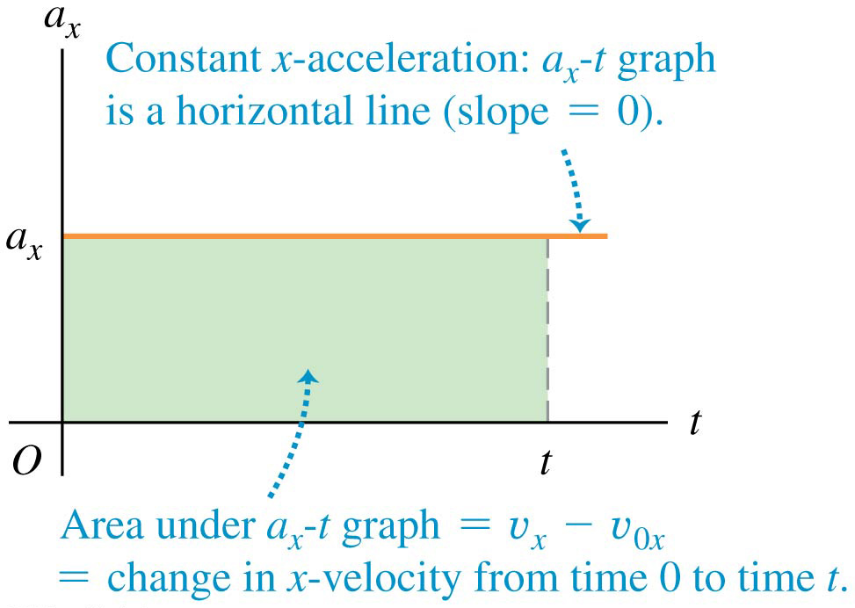
Motion with constant acceleration

Slide 18
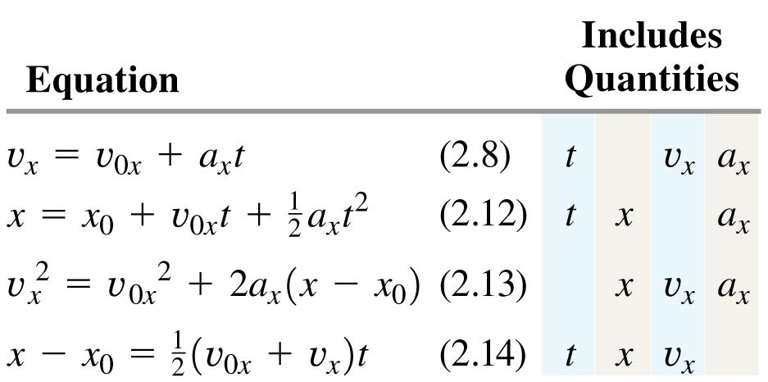
The equations of motion with constant acceleration
The four equations shown here apply to any straight-line motion with constant acceleration a_{x}.

