Slide 1

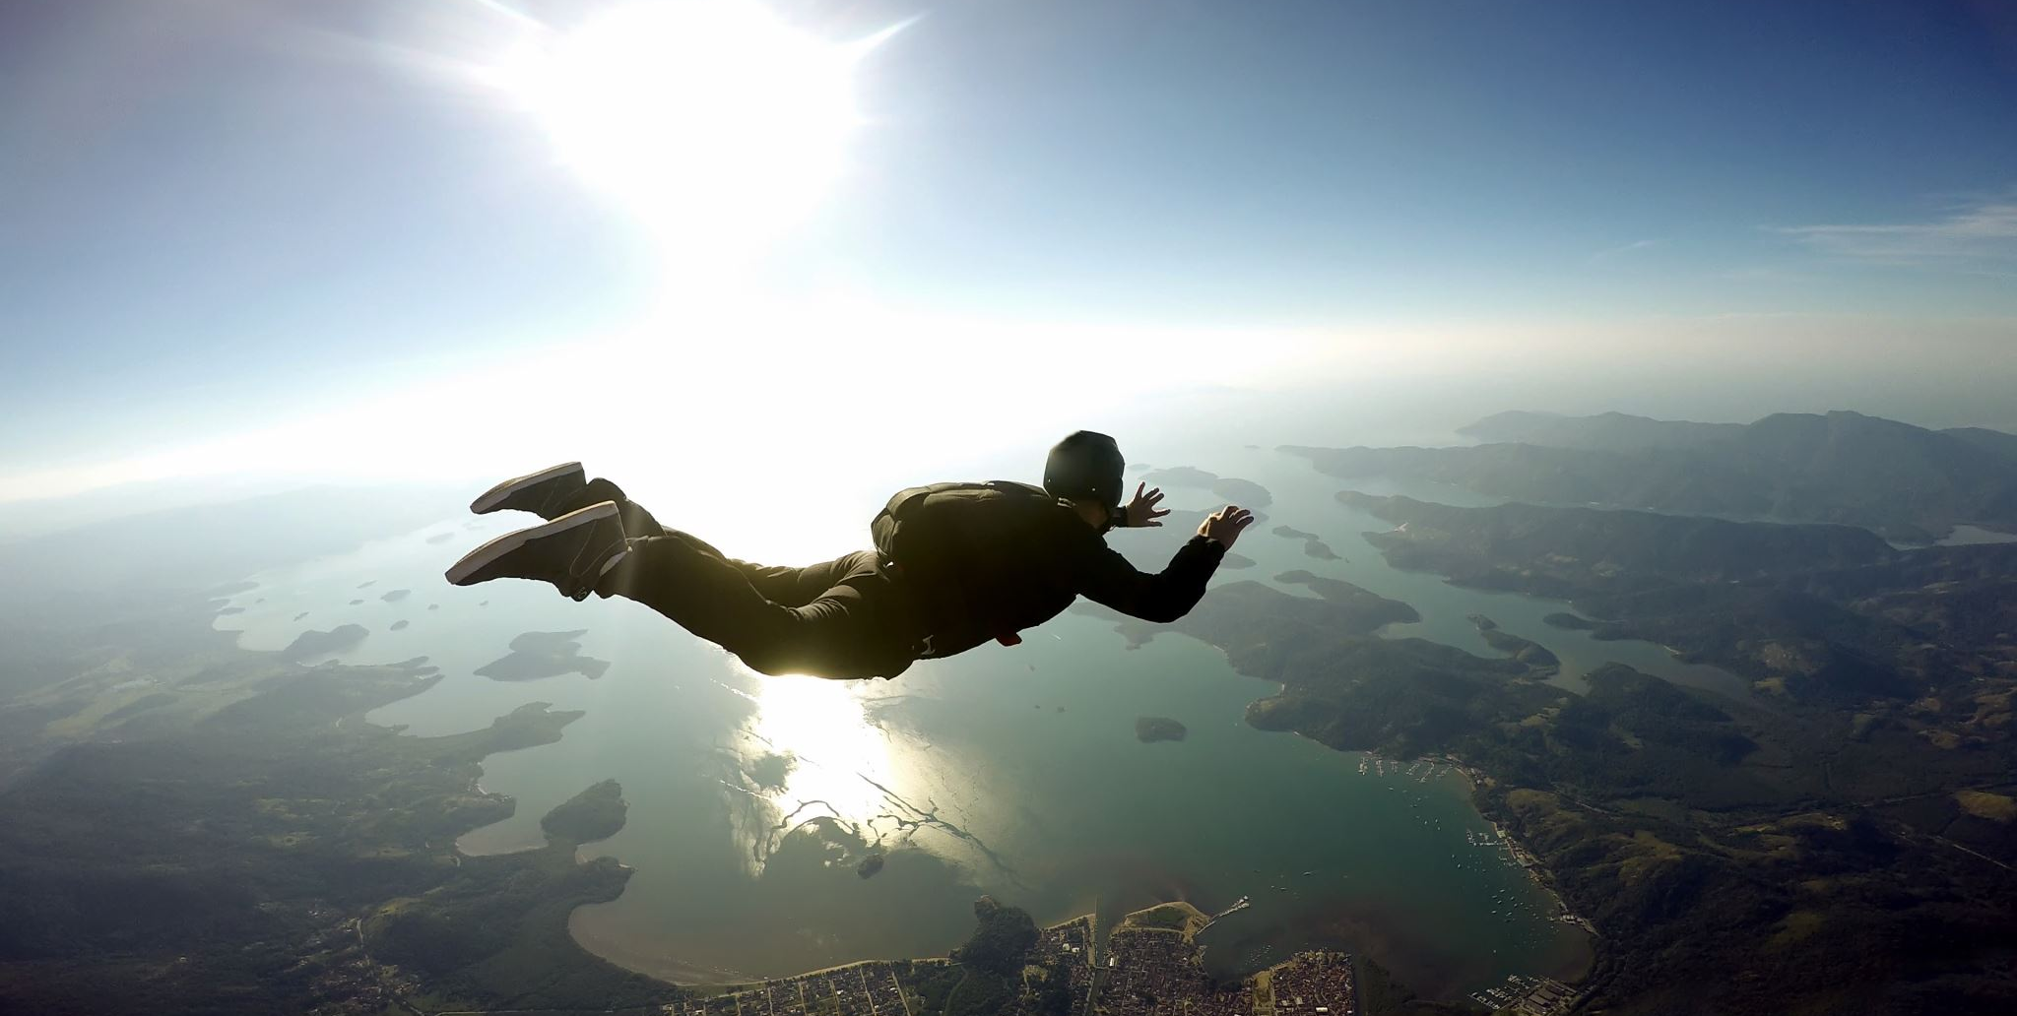

Free fall

Slide 2
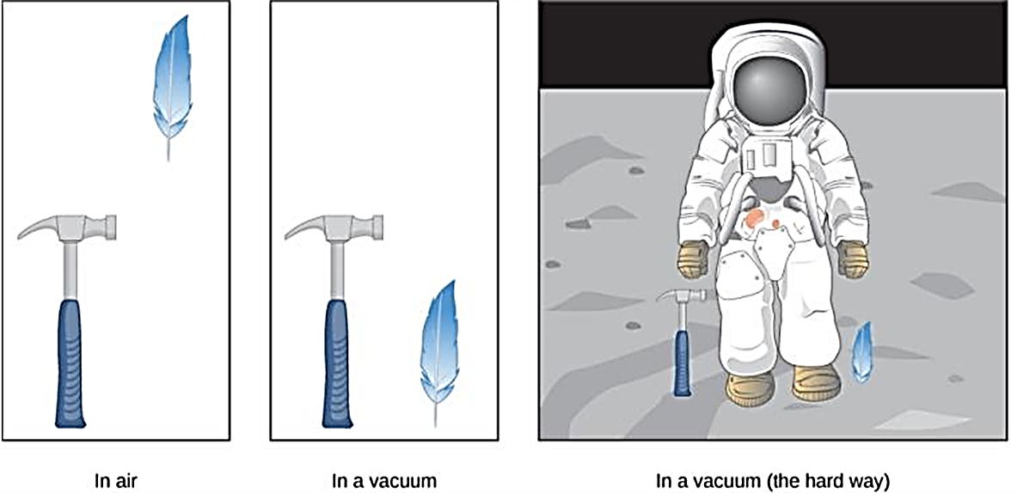
A Free fall
Free fall is the motion of an object under the influence of only gravity.
If there is no air resistance, the magnitude of the downward acceleration for any freely falling object is
    g = 9.806 m/s² ~ 10 m/s².
  A hammer and a feather fall with the same constant acceleration if air resistance is negligible. This is a general characteristic of gravity not unique to Earth, as astronaut David R. Scott demonstrated in 1971 on the Moon, where the acceleration from gravity is only 1.67 m/s² and there is no atmosphere.

Slide 3
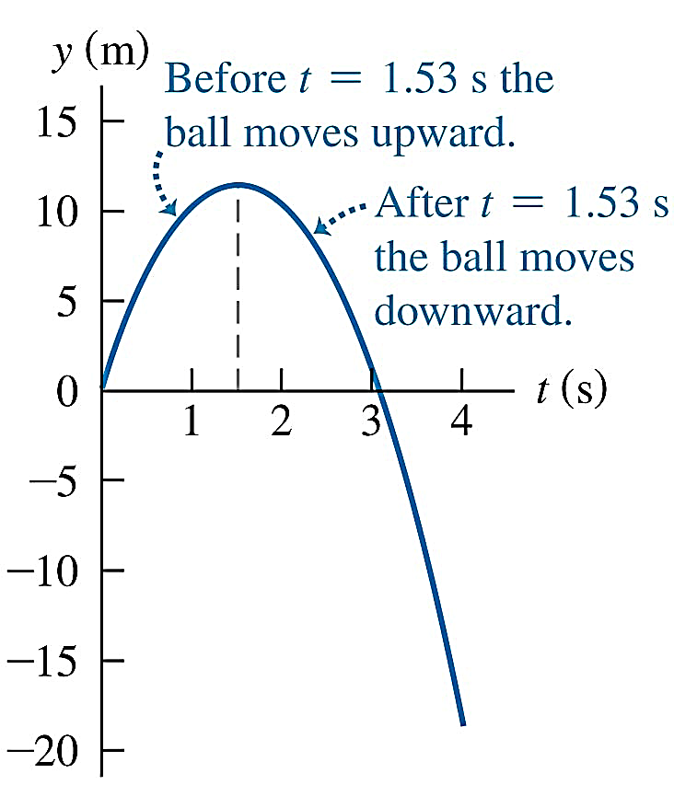
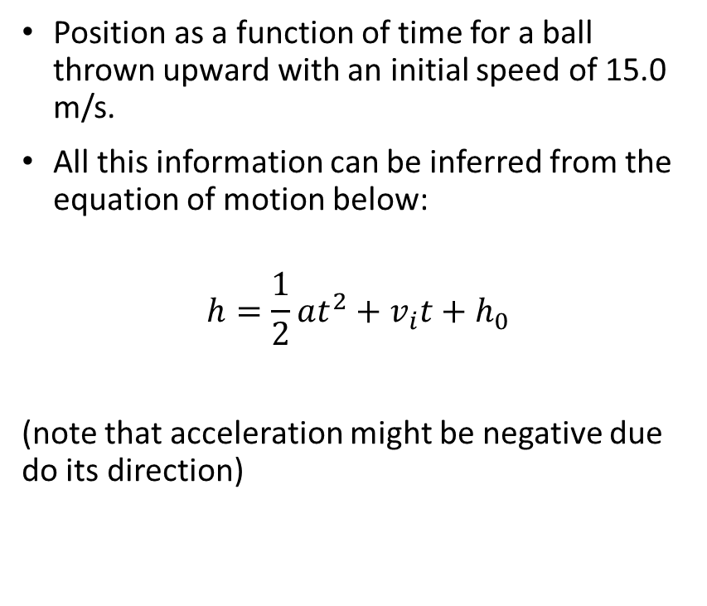
Up-and-down motion in free fall
Position as a function of time for a ball thrown upward with an initial speed of 15.0 m/s.
All this information can be inferred from the equation of motion below:
$$h=\frac{1}{2}at^{2}+v_{i}t+h_{0}$$
(note that acceleration might be negative due do its direction)

Slide 4
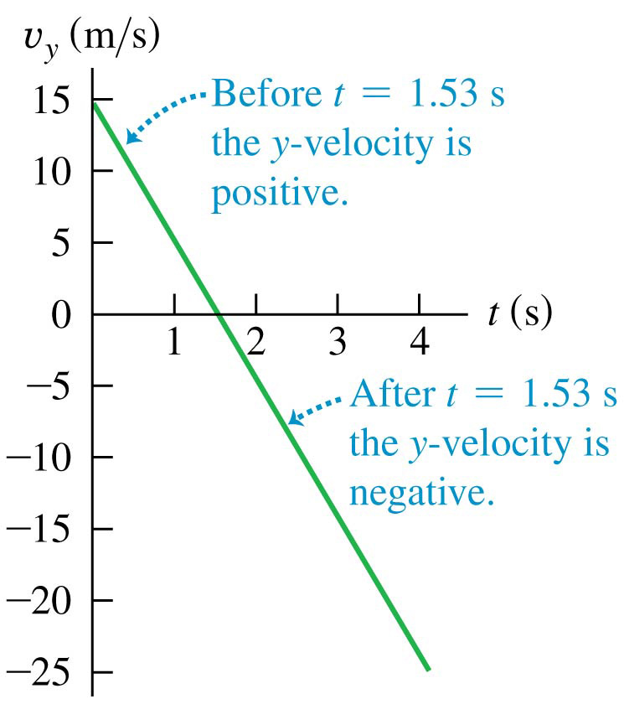
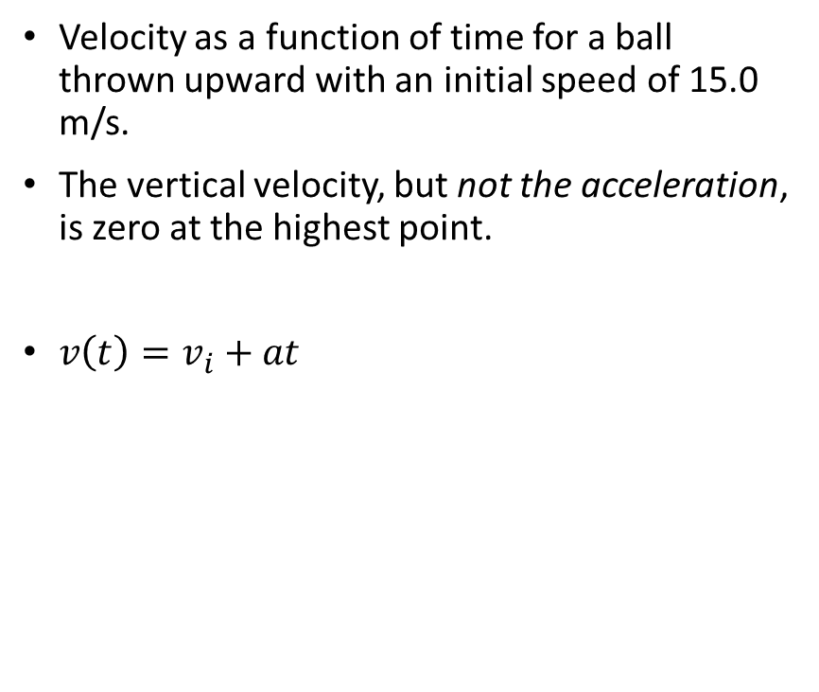
Up-and-down motion in free fall
Velocity as a function of time for a ball thrown upward with an initial speed of 15.0 m/s.
The vertical velocity, but not the acceleration, is zero at the highest point.
$v\left(t\right)=v_{i}+at$

