Slide 1
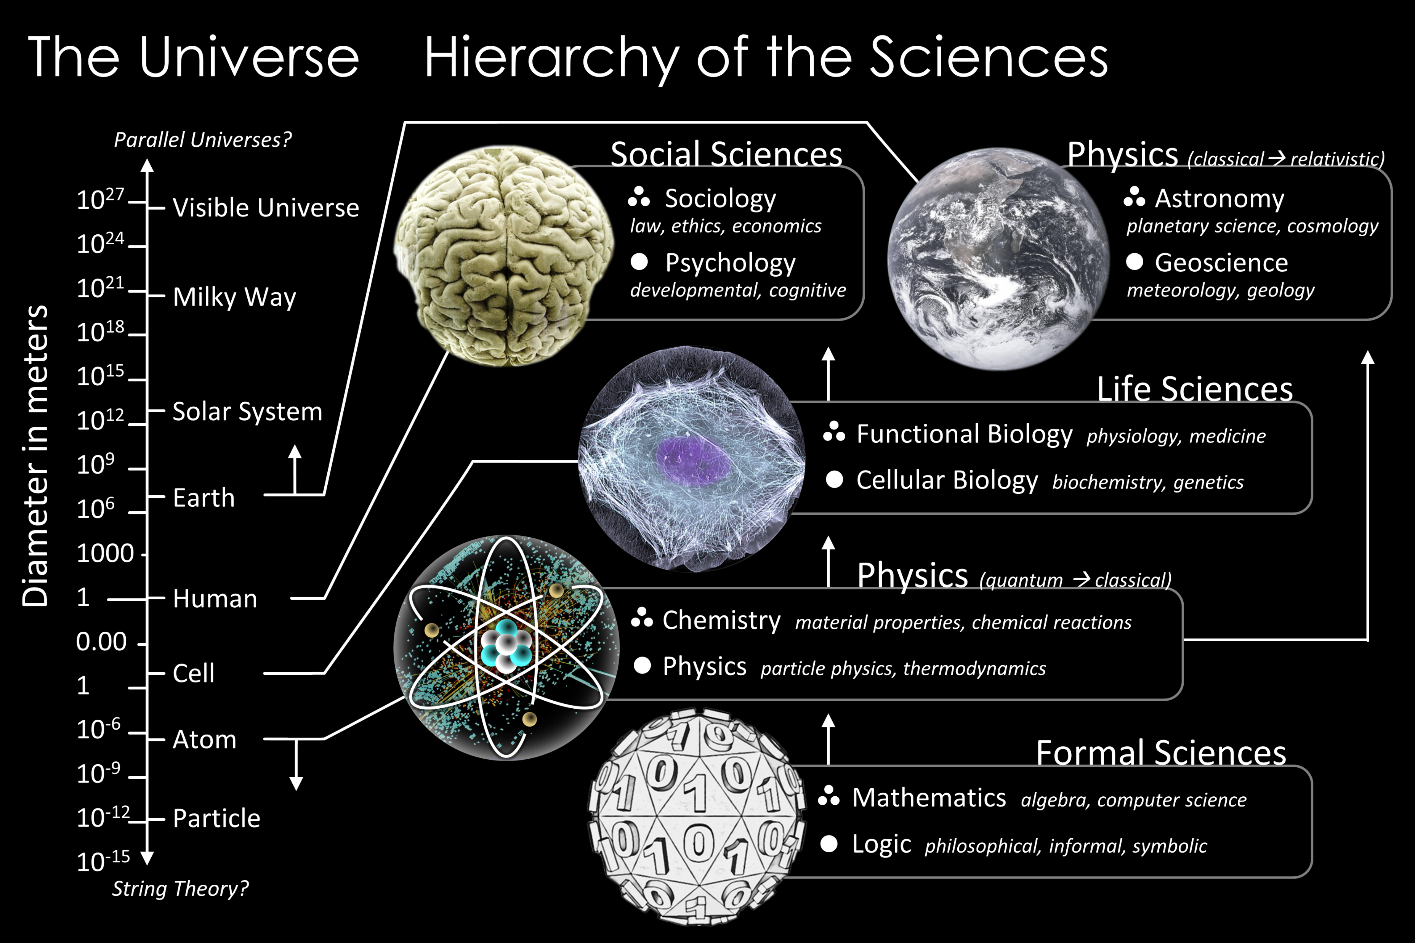


Introduction: The Nature of Science and Physics

Slide 2
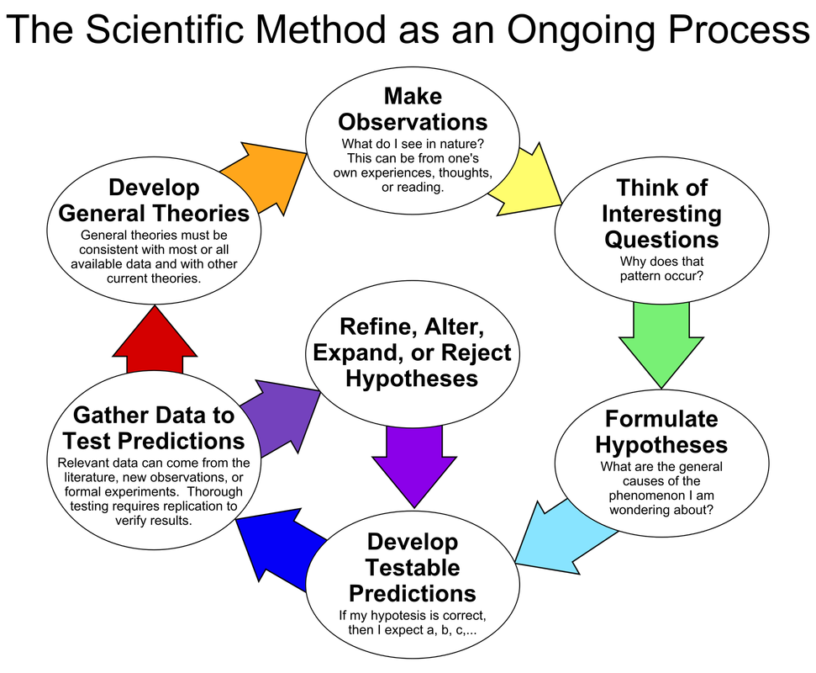
Scientific method
Science is not merely a body of knowledge, but a method by which we attempt to understand nature and how it behaves. This method begins with many observations over time.
From the trends found through observations/experiments, scientists can model the particular phenomena we want to understand. Such models are always approximations of nature, subject to further testing.
When they are first proposed, new models or ideas are sometimes called hypotheses - testable predictions!
Experiments can be done by anyone and anywhere given the proper procedure!

Slide 3
The Nature of Physics
Physics is an experimental science in which physicists seek patterns that relate the phenomena of nature, expressed in mathematical terms.
A model is a representation of something that is often too difficult (or impossible) to display directly. While a model is justified with experimental proof, it is only accurate under limited situations.
A theory is an explanation for patterns in nature that is supported by scientific evidence and verified multiple times by various groups of researchers.
A law uses concise language to describe a generalized pattern in nature that is supported by scientific evidence and repeated experiments. Often, a law can be expressed in the form of a single mathematical equation.

Slide 4
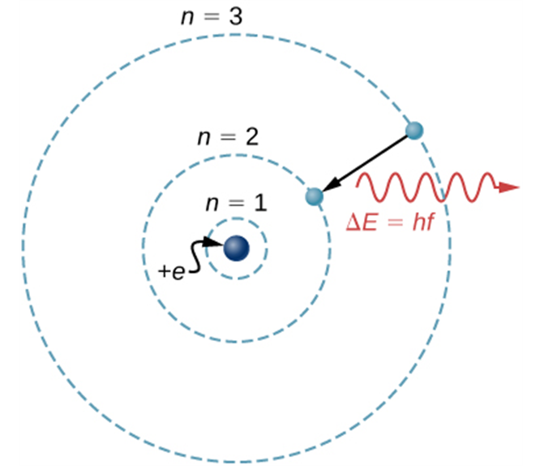
Idealized Models
Model: simplified version of a physical system which is otherwise too complicated to analyze in full detail.
For example, the Bohr model of a single-electron atom shows the electron orbiting the nucleus in one of several possible circular orbits. Like all models, it captures some, but not all, aspects of the physical system.

Slide 5
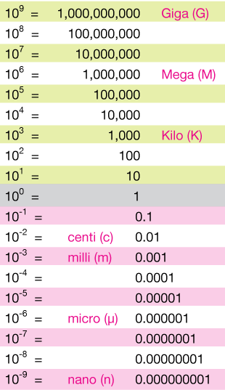
Scientific notation refresher
Physics uses very large and small numbers
Scientific notation is most useful to right them down
2.5 x 10¹² means to take 2.5, move the decimal 12 places to the right and fill in the open gaps with zeros to make 2,500,000,000,000 or 2.5 trillion.
In scientific notation, the number on the left is always a single digit followed by a decimal point and the correct (see significant figures) number of digits after the decimal.
-3.2 x 10⁻⁵ means to take the negative number -3.2, and move the decimal 5 places to the left, filling in the open gaps with zeros to make -0.000032.
Notice that the minus sign to the left of the 3.2 has nothing to do with the exponent, and simply indicates a negative number.
Mass of the Sun is 2 10³⁰ kg (note that x is typically omitted)
HINT: Don’t treat prefixes as separate units, there should be no ‘conversion factors’, but rather take that prefix is a name for a certain power instead.

Slide 6
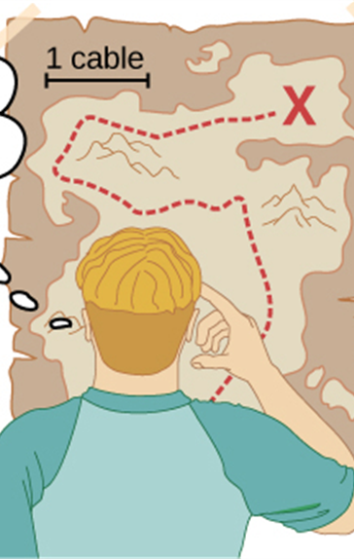
Standards and Units
Experiments require measurements.
Physical quantity - any number that describes physical phenomenon quantitatively.
Generally, we separate fundamental and derived physical quantities.
Length, time, and mass are three fundamental quantities of physics.
The International System (SI for Système International) is the most widely used system of units.
In SI units, length is measured in meters, time in seconds, and mass in kilograms.

Slide 7
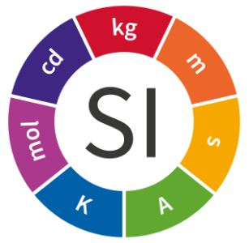
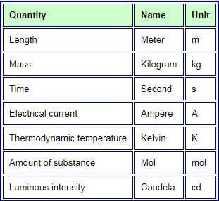

SI units - introduction
1 m³ of water has a mass of about 1 ton or 1000 kg under normal conditions. 1000 cm³ of water is 1 liter or 1 kg.
Three temperature scales are in general use:
Fahrenheit (F); water freezes at 32 °F and boils at 212 °F.
Celsius (C); water freezes at 0 °C and boils at 100 °C.
Kelvin (or absolute) (K); water freezes at 273 K and boils at 373 K.
All molecular motion ceases at about −459 °F = −273 °C = 0 K, a temperature called absolute zero.
The full conversion formulas are:
K = °C + 273
°C = (5/9) × (°F – 32)
°F = (9/5) × °C + 32
Notes:
Talk about

Slide 8
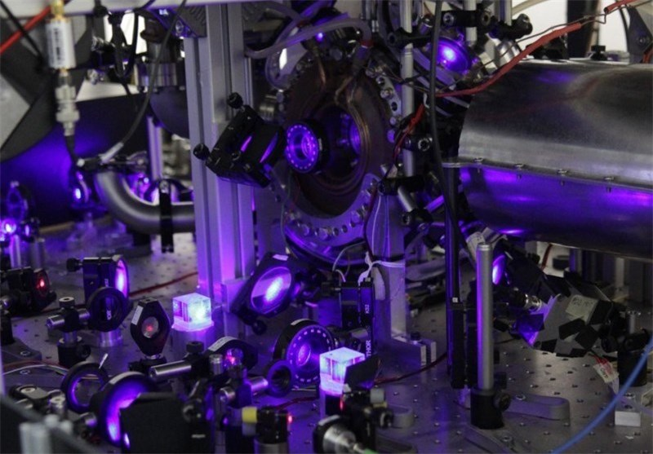
Time
1 second is now defined exactly as time required for 9,192,631,770 cycles of the radiation from cesium atom.
An atomic clock such as this one uses the vibrations of cesium atoms to keep time to a precision of better than a microsecond per year. The fundamental unit of time, the second, is based on such clocks.

Slide 9
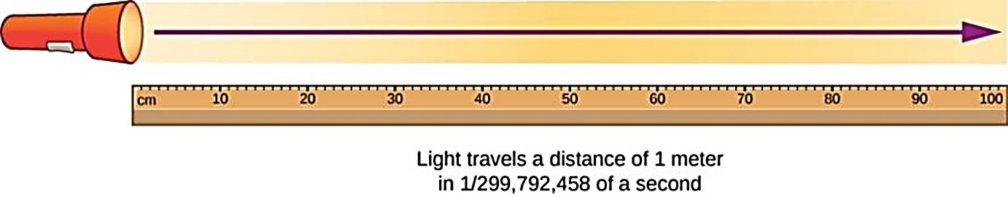
Length
1 meter = the distance light travels in a vacuum in 1/299,792,458 second.

Slide 10
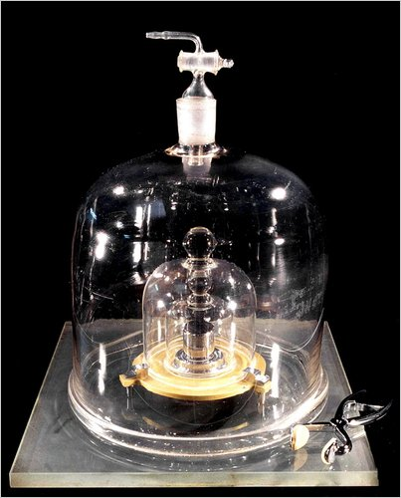
Mass
Initially was named different but unpopular name was changed to kilogram. Despite the prefix, it’s the fundamental unit, not the gram!!
1 kilogram (old definition) = mass of a particular cylinder of platinum-iridium allow kept at the International Bureau of Weights and Measures at Sevres (France).
The kilogram is now defined in terms of the Planck constant, h with its agreed value to be set as 6.626,070,15 × 10⁻³⁴ kg m² s^{–1}
https://www.youtube.com/watch?v=c_e1wITe_ig

Slide 11
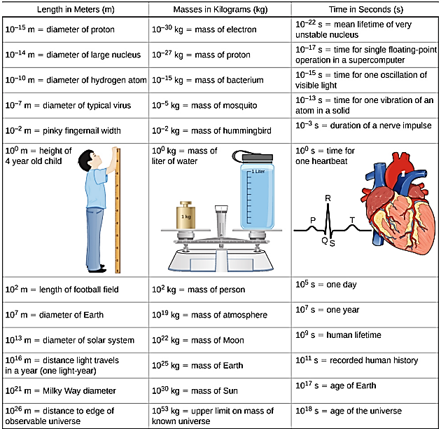
Some examples on the magnitudes of different units
(See also Table 1.2)

Slide 12
Unit Consistency and Conversions
An equation must be dimensionally consistent. Terms to be added or equated must always have the same units. (Be sure you’re adding “apples to apples.”)
Always carry units through calculations.
Convert to standard units as necessary, by forming a ratio of the same physical quantity in two different units, and using it as a multiplier.
For example, to find the number of seconds in 3 min, we write:
$$3 min=\left(3 min\right)\frac{60 s}{1 min}=180 s$$
For example, to find the number of seconds in 3 min, we write:
3 𝑚𝑖𝑛=(3 𝑚𝑖𝑛) (60 𝑠)/(1 𝑚𝑖𝑛)=180 𝑠

Slide 13
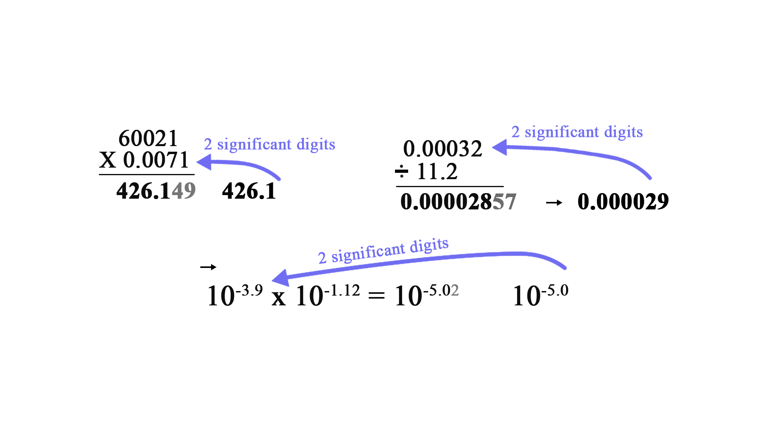
Uncertainty and Significant Figures
The uncertainty of a measured quantity is indicated by its number of significant figures.
For multiplication and division, the answer can have no more significant figures than the smallest number of significant figures in the factors.
For addition and subtraction, the number of significant figures is determined by the term having the fewest digits to the right of the decimal point.

Slide 14
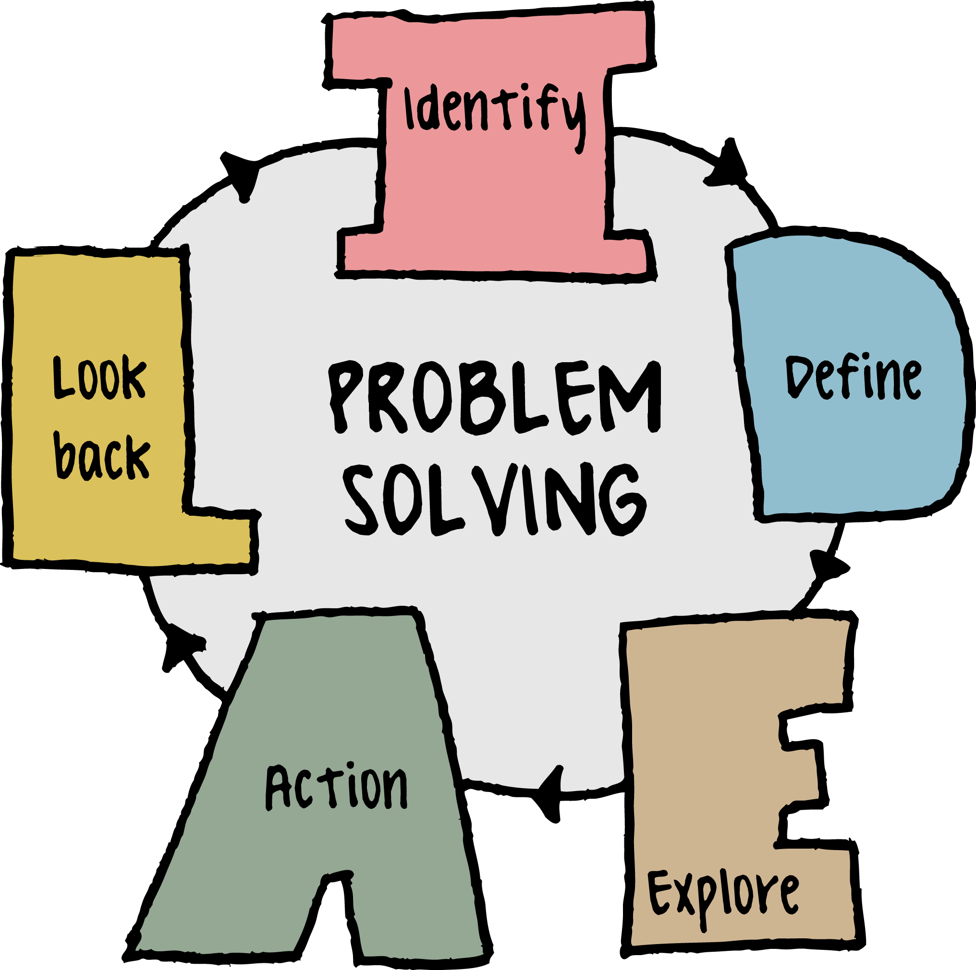
Solving Problems in Physics
Typically, we will follow these steps:
Identify the relevant concepts, target variables
Identify known quantities, as stated or implied in the problem (a “given” section?).
Set Up the problem: draw a sketch and choose the equation(s) that you’ll use.
Execute the solution: This is where you “do the math.”
Evaluate your answer: Compare your answer with your estimates, and reconsider things if there’s a discrepancy. Does the answer make sense?

