Slide 1

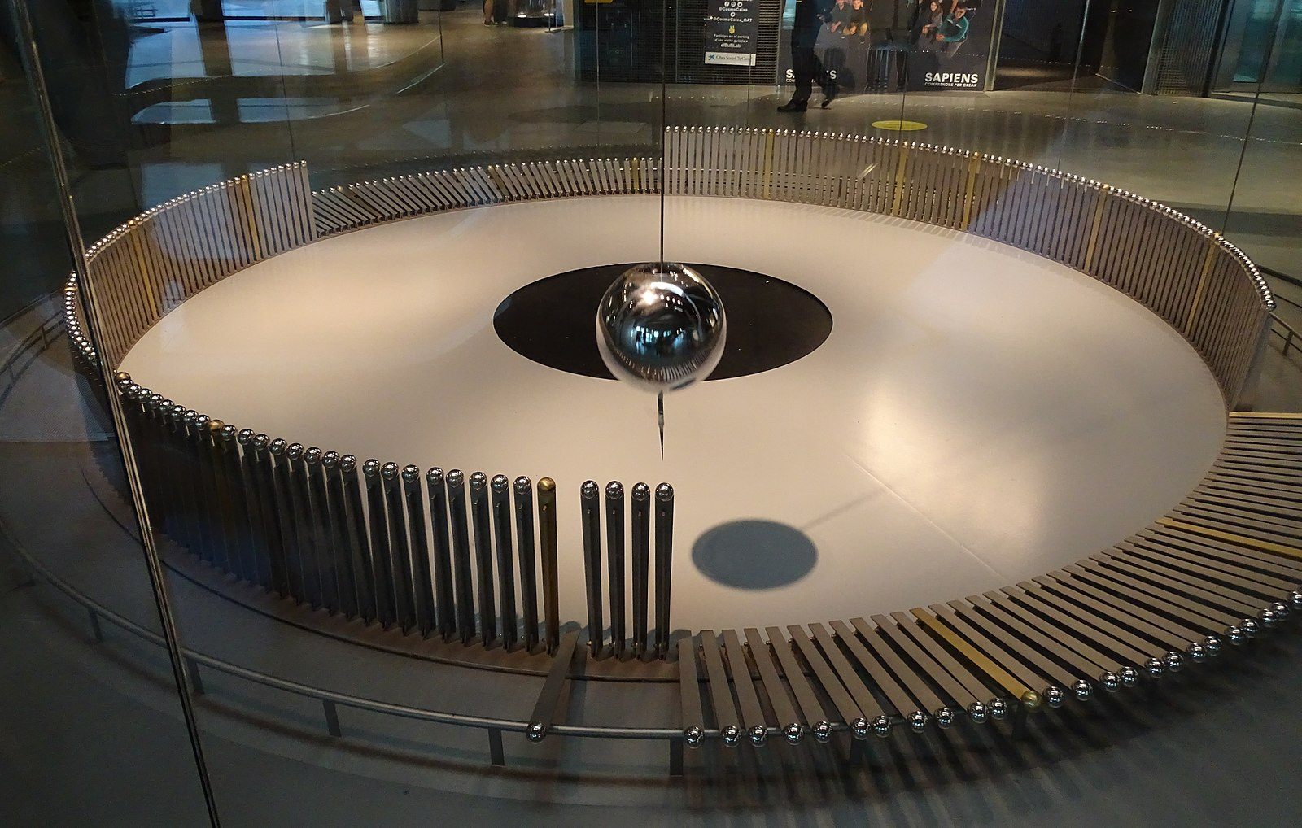

Oscillatory motion

Slide 2
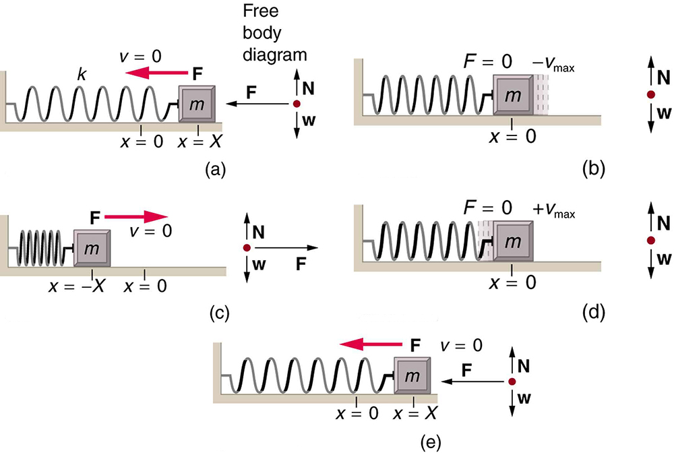
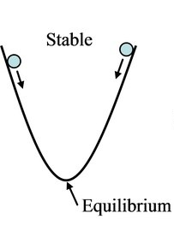
Stable equilibrium and restoring force
For a spring with spring constant k
For a body moved out of equilibrium:
From the definition of $ω=2πf$
From the definition of 𝜔=2𝜋𝑓
A is the amplitude, $φ$ is the starting phase
A is the amplitude, 𝜙 is the starting phase
towards equilibrium position
$ma=−kx$
𝑚𝑎=−𝑘𝑥
$$f=\frac{1}{2π}ω=\frac{1}{2π}\sqrt{\frac{k}{m}}$$
𝑓=1/2𝜋 𝜔=1/2𝜋 √(𝑘/𝑚)
$$\frac{d^{2}x}{dt^{2}}=−\frac{k}{m}x$$
(𝑑^2 𝑥)/(𝑑𝑡^2 )=−𝑘/𝑚 𝑥
$$x=A\sin{(ωt+φ)}$$
where $ω=\sqrt{\frac{k}{m}}$
𝑥=𝐴 sin⁡〖(𝜔𝑡+𝜙)〗
where 𝜔=√(𝑘/𝑚)
$$T=\frac{1}{f}=2π\sqrt{\frac{m}{k}}$$
𝑇=1/𝑓=2𝜋√(𝑚/𝑘)
$$v=\frac{dx}{dt}=ωA\cos{(ωt+φ)}$$
𝑣=𝑑𝑥/𝑑𝑡=𝜔𝐴 cos⁡〖(𝜔𝑡+𝜙)〗
$$a=\frac{dv}{dt}=−ω^{2}A\sin{(ωt+φ)}$$
𝑎=𝑑𝑣/𝑑𝑡=−𝜔^2 𝐴 sin⁡〖(𝜔𝑡+𝜙)〗

Slide 3
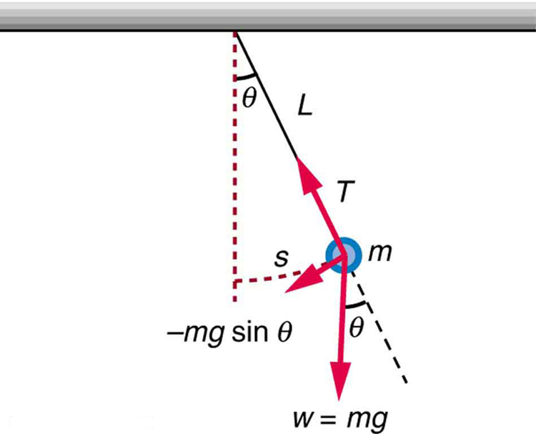
Stable equilibrium and restoring force
For a string of length L with mass m
For a body moved out of equilibrium:
From the definition of $ω=2πf$
From the definition of 𝜔=2𝜋𝑓
A is the amplitude, $φ$ is the starting phase
A is the amplitude, 𝜙 is the starting phase
towards equilibrium position
$τ=mL^{2}α=−Lmg\sin{θ}$
𝜏=𝑚𝐿^2 𝛼=−𝐿𝑚𝑔 sin⁡𝜃
$$f=\frac{1}{2π}ω=\frac{1}{2π}\sqrt{\frac{g}{L}}$$
𝑓=1/2𝜋 𝜔=1/2𝜋 √(𝑔/𝐿)
$$\frac{d^{2}θ}{dt^{2}}=−\frac{g}{L}θ$$
(𝑑^2 𝜃)/(𝑑𝑡^2 )=−𝑔/𝐿 𝜃
$$θ=A\sin{(ωt+φ)}$$
where $ω=\sqrt{\frac{g}{L}}$
𝜃=𝐴 sin⁡〖(𝜔𝑡+𝜙)〗
where 𝜔=√(𝑔/𝐿)
$$T=\frac{1}{f}=2π\sqrt{\frac{L}{g}}$$
𝑇=1/𝑓=2𝜋√(𝐿/𝑔)
Velocity=$\frac{dθ}{dt}=ωA\cos{(ωt+φ)}$
Velocity=𝑑𝜃/𝑑𝑡=𝜔𝐴 cos⁡〖(𝜔𝑡+𝜙)〗
Acceleration$α=\frac{d^{2}θ}{dt^{2}}=−ω^{2}A\sin{(ωt+φ)}$
Acceleration 𝛼=(𝑑^2 𝜃)/(𝑑𝑡^2 )=−𝜔^2 𝐴 sin⁡〖(𝜔𝑡+𝜙)〗

Slide 4
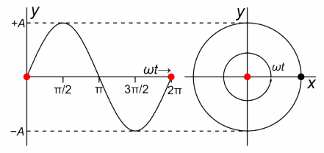
Uniform Circular Motion and Simple Harmonic Motion
An easy way to produce simple harmonic motion by using uniform circular motion.
The point travels around the circle at constant angular velocity ω
The point P is analogous to an object on the merry-go-round.
The projection of the position of P onto a fixed axis undergoes simple harmonic motion
It is analogous to the shadow of the object.
Position $y=R sin(ωt+φ)$
Position 𝑦=𝑅 sin(𝜔𝑡+𝜙)

