Slide 1

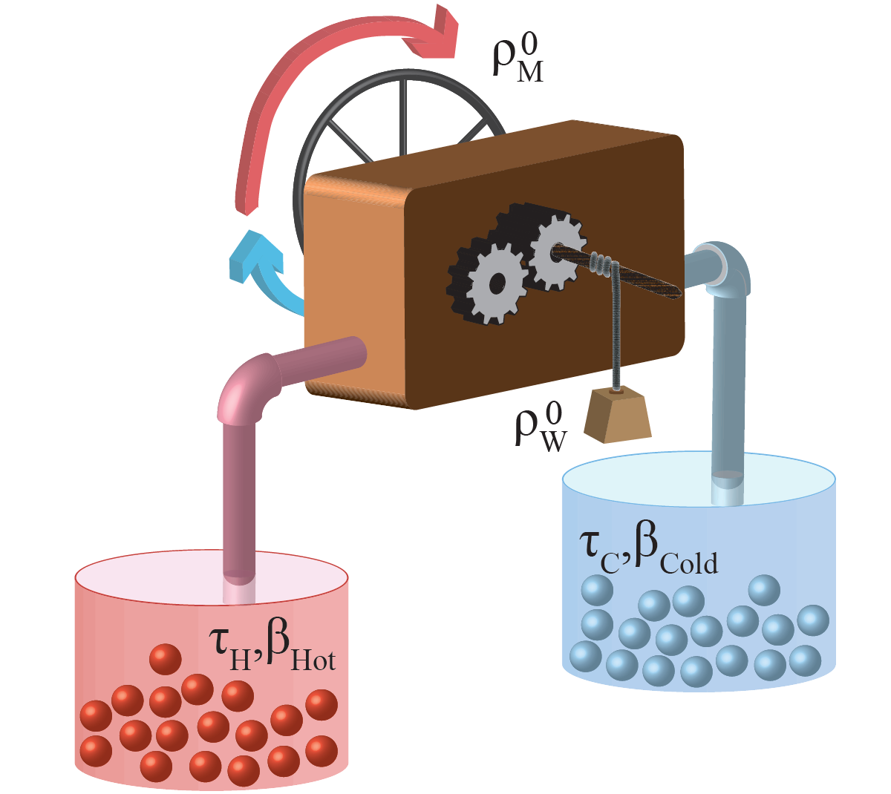

Heat Engines and Pumps

Slide 2
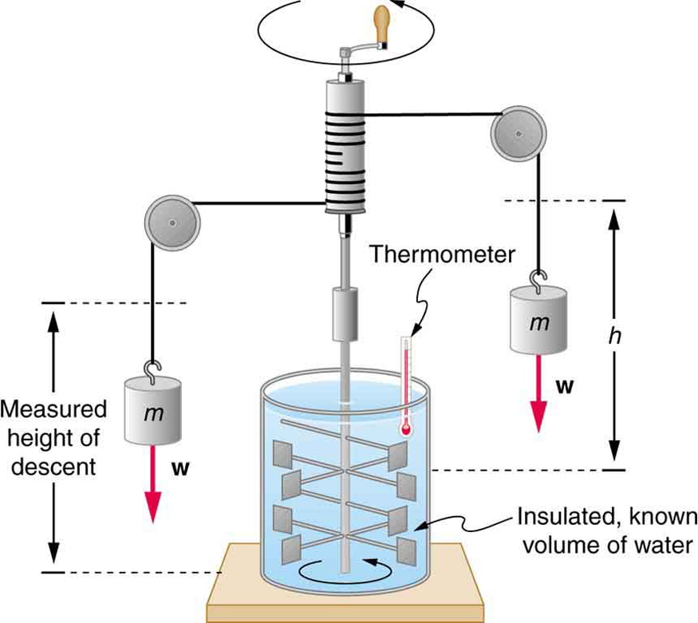
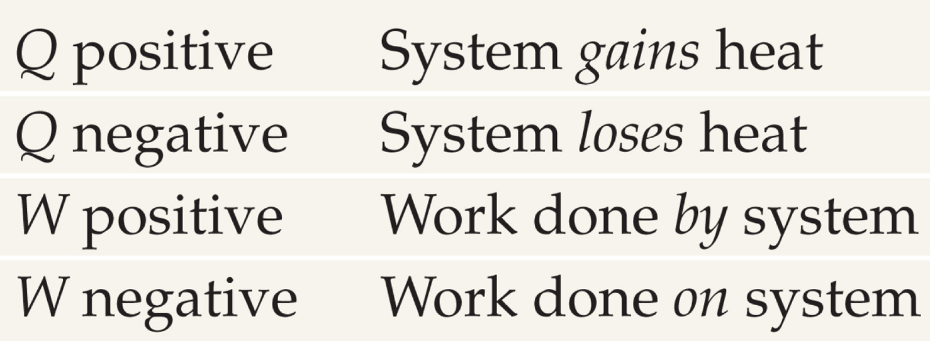
Joule’s Experiment and the First Law of Thermodynamics
Joule performed a series of experiments
In one such experiment, a falling mass turns a paddle in an insulated beaker of water,
Joule’s experiments led to Kelvin’s statement
Both work and heat represent transfers of energy into or out of a system.
If energy is added to a system either as work or heat,
The increase in the internal energy of a system is equal to the amount of heat added to a system minus the amount of work done by the system.
The internal energy of the system is the sum
An increase in internal energy may show up as an increase in temperature,
Internal energy is a property of the system uniquely determined by the state of the system.
showing that mechanical work could raise the temperature of a system.
producing an increase in temperature.
of the first law of thermodynamics.
the internal energy of the system increases accordingly.
$$U = Q – W$$
Δ𝑼 = 𝑸 – 𝑾
of the kinetic and potential energies of the atoms and molecules making up the system.
or as a change in phase, or any other increase in the kinetic and/or potential energy of the atoms or molecules making up the system.
Notes:
Is adding heat the only way of increasing the temperature? Two pullys

Slide 3
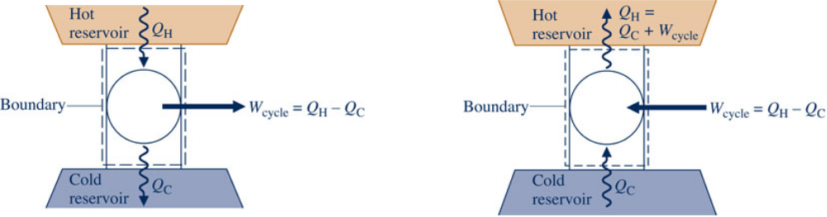
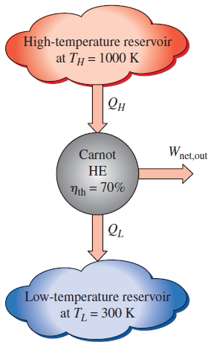
Thermal Efficiency
Consider systems undergoing a power cycle and a refrigeration or heat pump cycle,
The Kelvin temperature is defined so that:
$${\left(\frac{Q_{C}}{Q_{H}}\right)}_{\begin{aligned}&\text{rev} \\ &\text{cycle}\end{aligned}}=\frac{T_{C}}{T_{H}}$$
(𝑄_C/𝑄_H )_█(&"rev" @&"cycle" )=𝑇_C/𝑇_H
Any heat engine:
$$η_{th}=1−\frac{Q_{L}}{Q_{H}}$$
𝜂_𝑡ℎ=1−𝑄_𝐿/𝑄_𝐻
Carnot heat engine:
$$η_{th,rev}=1−\frac{T_{L}}{T_{H}}$$
𝜂_(𝑡ℎ,𝑟𝑒𝑣)=1−𝑇_𝐿/𝑇_𝐻
By comparison,
each while exchanging energy by heat transfer with hot and cold reservoirs:
$η_{th}=η_{th,rev}$ for reversible heat engine
𝜂_𝑡ℎ=𝜂_(𝑡ℎ,𝑟𝑒𝑣) for reversible heat engine
$η_{th}<η_{th,rev}$ for irreversible heat engine
𝜂_𝑡ℎ<𝜂_(𝑡ℎ,𝑟𝑒𝑣) for irreversible heat engine
Note:
$η_{th}>η_{th,rev}$ for impossible heat engine
𝜂_𝑡ℎ>𝜂_(𝑡ℎ,𝑟𝑒𝑣) for impossible heat engine

Slide 4
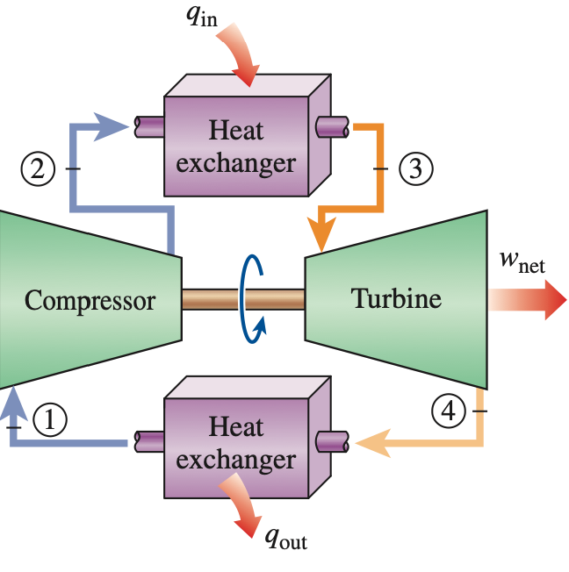
Thermal Efficiency Summary
Thermal efficiency:
Kelvin Temperature scale →
Carnot Engine efficiency
$$η=\frac{T_{hot}−T_{cold}}{T_{hot}}$$
𝜼=(𝑻_𝒉𝒐𝒕−𝑻_𝒄𝒐𝒍𝒅)/𝑻_𝒉𝒐𝒕
Coefficients of Performance
Refrigerator
Objective: Remove heat from a cold space
$$COP_{R}=\frac{Q_{cold}}{Q_{hot}−Q_{cold}}\overset{\text{CARNOT}}{⇒}\frac{T_{cold}}{T_{hot}−T_{cold}}$$
𝑪𝑶𝑷_𝑹=𝑸_𝒄𝒐𝒍𝒅/(𝑸_𝒉𝒐𝒕−𝑸_𝒄𝒐𝒍𝒅 ) ⇒┴"CARNOT" 𝑻_𝒄𝒐𝒍𝒅/(𝑻_𝒉𝒐𝒕−𝑻_𝒄𝒐𝒍𝒅 )
Heat Pump
Objective: Transfer heat to a hot space
$$COP_{R}=\frac{Q_{hot}}{Q_{hot}−Q_{cold}}\overset{\text{CARNOT}}{⇒}\frac{T_{hot}}{T_{hot}−T_{cold}}$$
𝑪𝑶𝑷_𝑹=𝑸_𝒉𝒐𝒕/(𝑸_𝒉𝒐𝒕−𝑸_𝒄𝒐𝒍𝒅 ) ⇒┴"CARNOT" 𝑻_𝒉𝒐𝒕/(𝑻_𝒉𝒐𝒕−𝑻_𝒄𝒐𝒍𝒅 )
Any Heat Engine:
$${\left(η_{th}\right)}_{Heat Engine}=\frac{q_{in}−q_{out}}{q_{in}}$$
(𝜼_𝒕𝒉 )_(𝑯𝒆𝒂𝒕 𝑬𝒏𝒈𝒊𝒏𝒆)=(𝒒_𝒊𝒏−𝒒_𝒐𝒖𝒕)/𝒒_𝒊𝒏
Notes:
Is adding heat the only way of increasing the temperature? Two pullys

