Slide 1
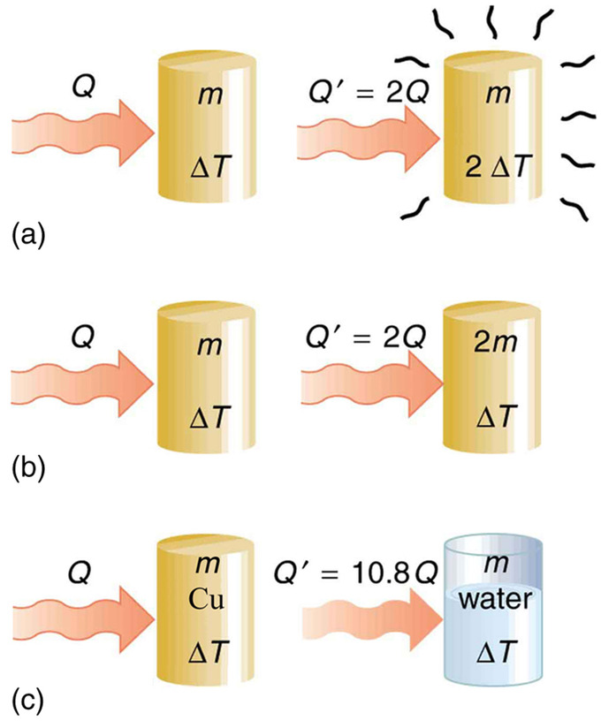


Heat Capacity and Latent Heat

Slide 2
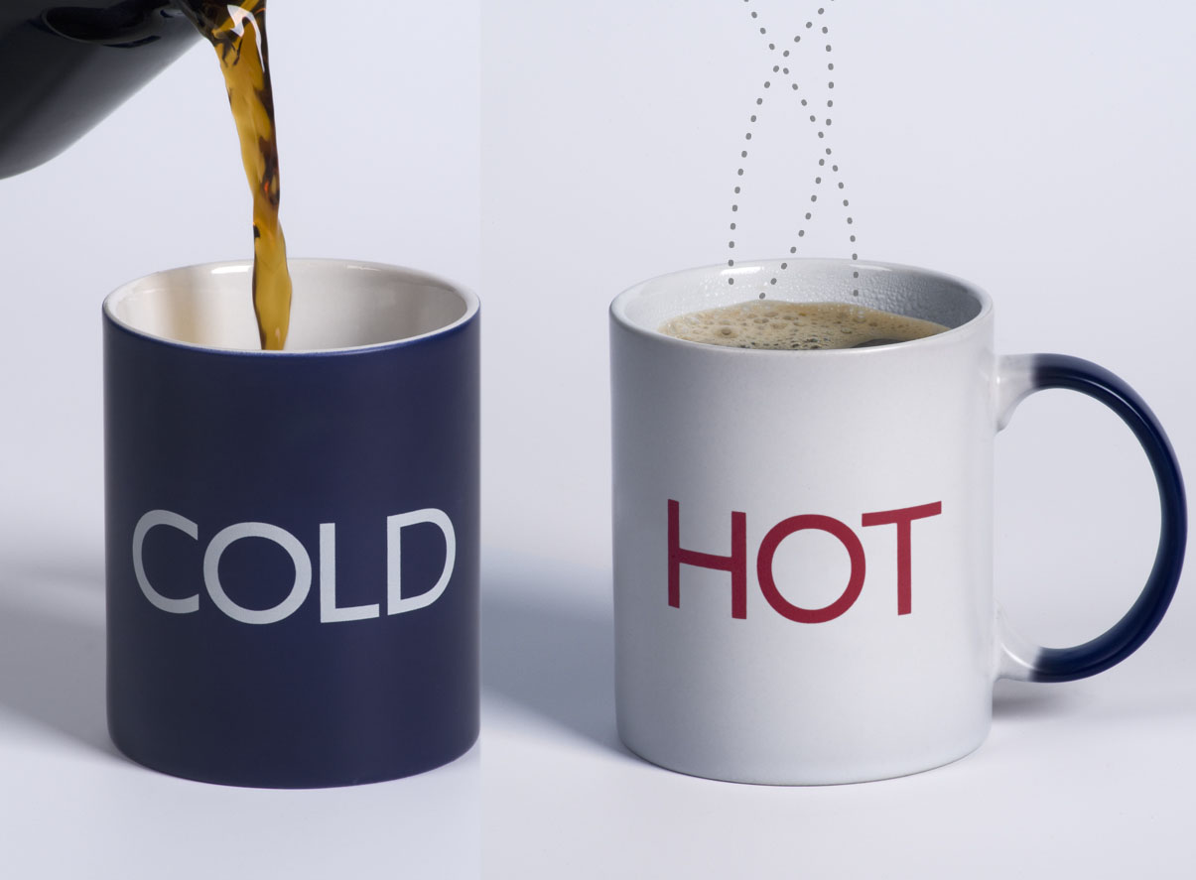
Heat
What happens when objects or fluids at different temperatures come in contact?
The colder object gets hotter, and the hotter object gets colder.
Until thermal equilibrium is reached
What flows between the objects to account for this?
The term heat is used.
Unit: Joule (SI unit), calorie
1 cal = 4.1868 J
Heat is not a new ‘form’ of energy
Specifically, heat is kinetic energy
Transfers by collisions between atoms
Heat flow
We say that heat flows from a warmer material to colder
Not the other way around!

Slide 3
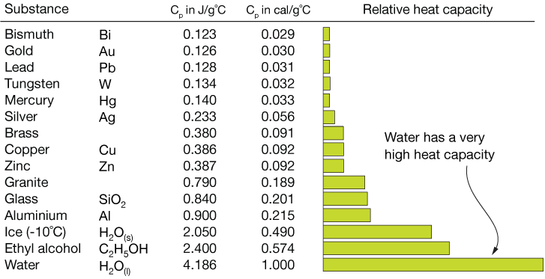
Specific Heat Capacity
The specific heat capacity of a material
is the quantity of heat needed to change a unit mass of the material
For example:
The specific heat capacity of water is 1 cal/g⋅C°, meaning that
it takes 1 calorie (or 4.1868 J) of heat to raise the temperature of 1 gram of water by 1°C.
Amount of heat
$$Q = mcT$$
𝑸 = 𝒎𝒄Δ𝑻
Where:
Q = quantity of heat
m = mass
c = specific heat capacity
ΔT = change in temperature
To change 1 gram by 1 Celsius degree.
by a unit amount in temperature.
absorbed/released by a material for $ΔT$:
absorbed/released by a material for ΔT:

Slide 4
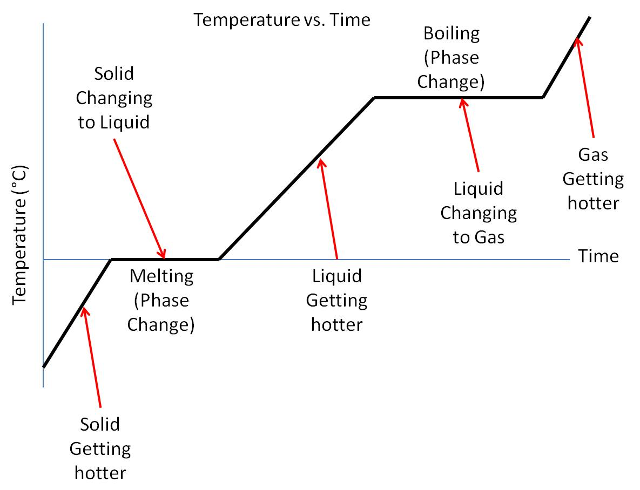
Phase Changes and Latent Heat
When an object goes through a first order phase transition,
The amount of heat needed per unit mass to produce a phase change
Latent, or hidden, as energy enters or leaves
The latent heat of melting/freezing
$$Q=mL_{f}$$
𝑸=𝒎𝑳_𝒇
The latent heat of vaporization
$$Q=mL_{v}$$
𝑸=𝒎𝑳_𝒗
Careful with the sign of Q!
Can be positive or negative
If heat is absorbed, is positive
If heat is dissipated, is negative
heat is added or removed without changing the temperature.
Instead, the state of matter changes.
For example: solid to liquid, liquid to vapor, vapor to plasma.
is called the latent heat.
without changing system temperature.

