Slide 1
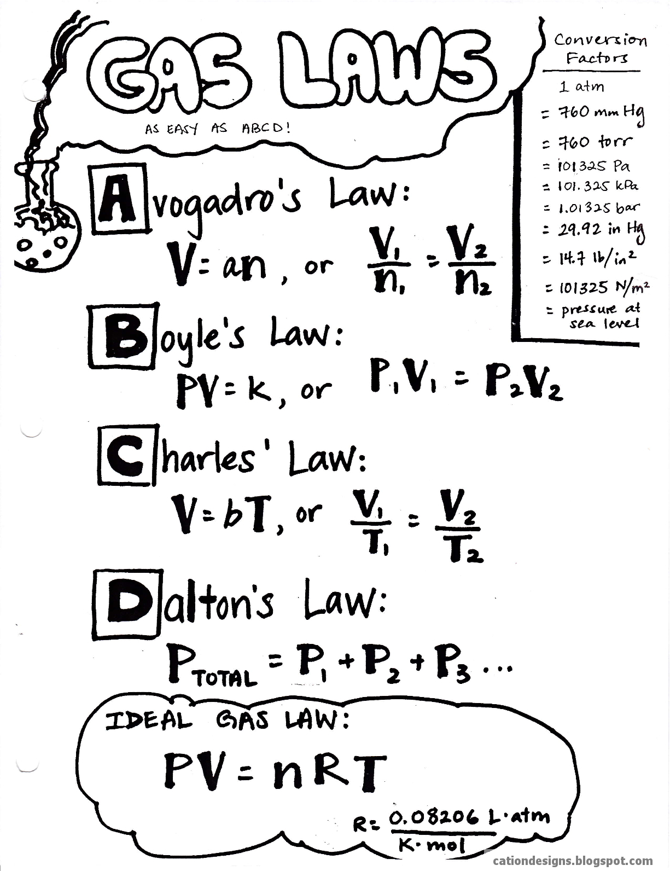


Temperature, Kinetic Theory, and the Gas Laws

Slide 2
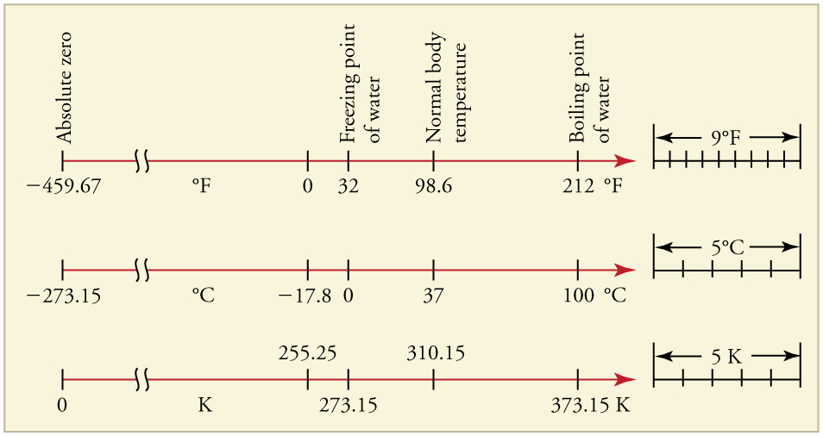
The Kelvin, Celsius and Fahrenheit
From Celsius to Fahrenheit
$$T_{F}=\frac{9}{5}T_{C}+32$$
𝑇_𝐹=9/5 𝑇_𝐶+32
$$\text{From} \text{Fahrenheit} \text{to} \text{Celsius}$$
"From Fahrenheit to Celsius"
$$T_{C}=\frac{5}{9}\left(T_{F}−32\right)$$
𝑇_C=5/9 (𝑇_𝐹−32)
From Celsius to Kelvins
$$T_{K}=T_{C}+273$$
𝑇_𝐾=𝑇_𝐶+273
From Kelvins to Celsius
$$T_{C}=T_{K}−273$$
𝑇_𝐶=𝑇_𝐾−273
The zero point on the Fahrenheit scale
The zero point on the Celsius scale
Is based on the temperature of a mixture of salt and ice in a saturated salt solution.
is the freezing point of water.
Absolute Zero:
http://www.youtube.com/watch?v=JHXxPnmyDbk
Comparing the Celsius and Kelvin Scale:
http://www.youtube.com/watch?v=-G9FdNqUVBQ

Slide 3
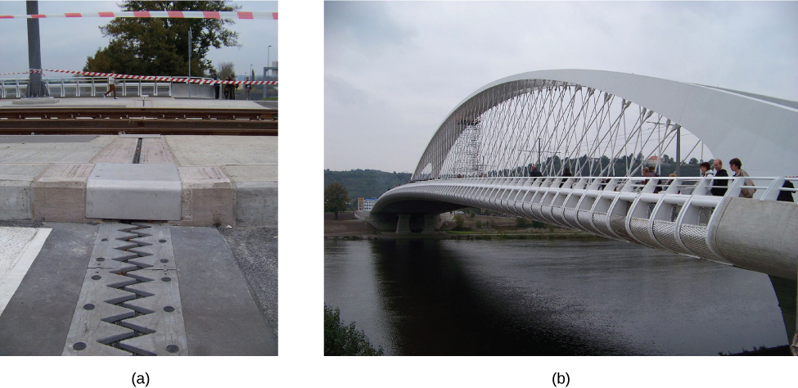
Thermal Expansion
The change in length, ΔL
$$ΔL=αLΔT$$
𝚫𝑳=𝜶𝑳𝚫𝑻
Where:
ΔL is the change in length L
ΔT is the change in temperature
α is the coefficient of linear expansion, which varies slightly with temperature.
is proportional to initial length and the change in temperature
For small temperature changes,
the change in area ΔA is given by
$$ΔA=2αAΔT$$
𝚫𝑨=𝟐𝜶𝑨𝚫𝑻
The change in volume ΔV is very nearly
$$ΔV=βVΔT$$
𝚫𝑽=𝜷𝑽𝚫𝑻
where β is the coefficient of volume expansion
$$ΔV=3αVΔTΔ$$
Δ𝑉=3𝛼𝑉Δ𝑇Δ
This equation is usually written as
$$β≈3α$$
𝛽≈3𝛼

Slide 4
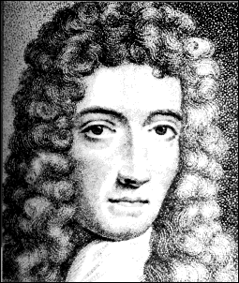
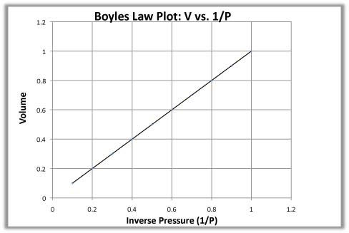
Boyle’s Law
The pressure and volume of a gas
$$P1V1=P2V2$$
𝑷_{𝟏}𝑽_{𝟏}=𝑷_{𝟐}𝑽_{𝟐}
Where:
P₁ represents the initial pressure
V₁ represents the initial volume,
P₂ represents the final pressure
V₂ represents the final volume
And:
are inversely proportional at constant mass & temp

Slide 5
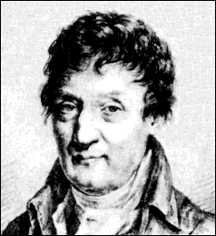
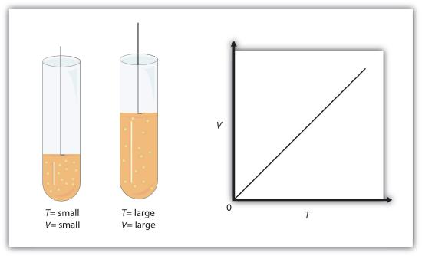
Charles’ Law
The volume and absolute temperature (K) of a gas
are directly proportional (an increase in temp leads to an increase in volume)
at constant mass & pressure
$$\frac{V_{1}}{T_{1}}=\frac{V_{2}}{T_{2}}$$
𝑽_𝟏/𝑻_𝟏 =𝑽_𝟐/𝑻_𝟐
Where:
T₁ represents the initial temperature
V₁ represents the initial volume,
And:
T₂ represents the final temperature
V₂ represents the final volume

Slide 6
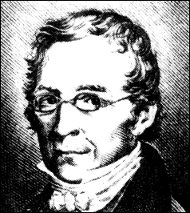
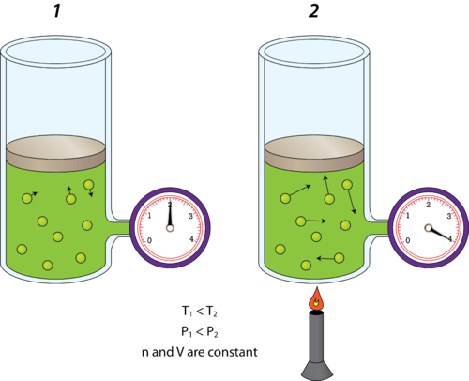
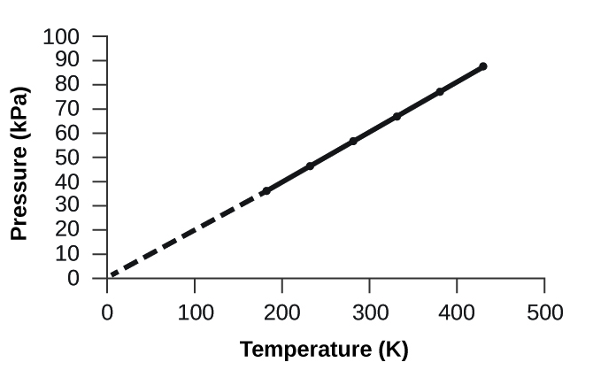
Gay-Lussac’s Law
The pressure and absolute temperature (K) of a gas
are directly proportional (as temperature rises, so does pressure)
at constant mass & volume
$$\frac{P_{1}}{T_{1}}=\frac{P_{2}}{T_{2}}$$
𝑷_𝟏/𝑻_𝟏 =𝑷_𝟐/𝑻_𝟐
Where:
P₁ represents the initial pressure
T₁ represents the initial temperature
And:
P₂ represents the final pressure
T₂ represents the final temperature

Slide 7
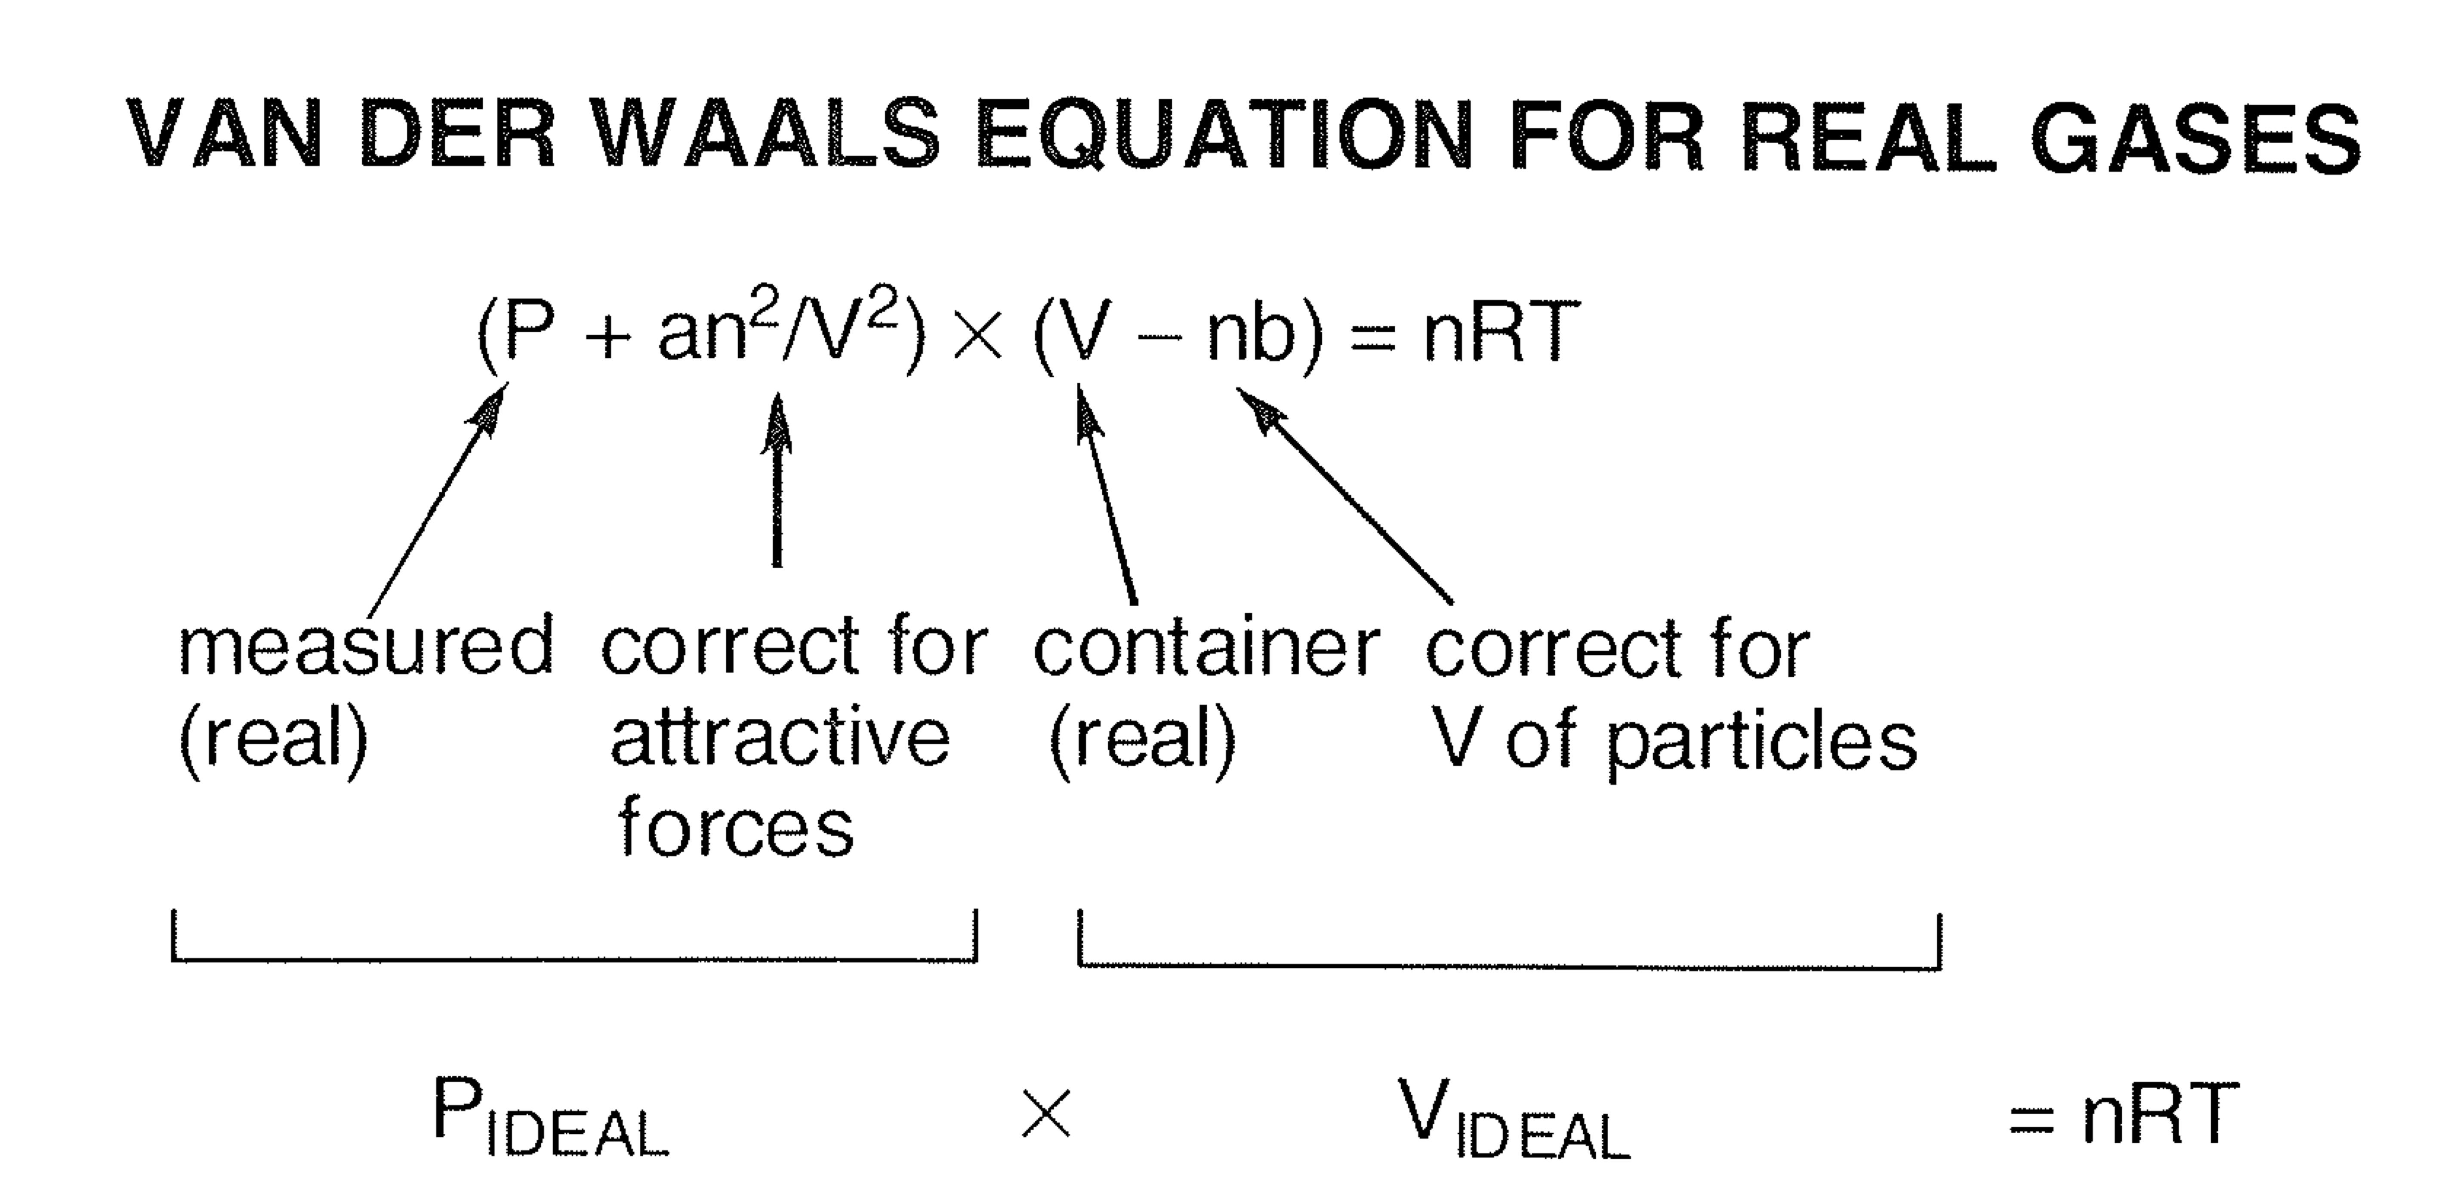
Ideal Gas Law
This is the Ideal Gas Law form at higher level physics courses ☺
The ideal gas law states
$$PV=Nk_{B}T$$
𝑷𝑽=𝑵𝒌_𝑩 𝑻
Where:
P is the absolute pressure of a gas
V is the volume it occupies
N is the number of atoms and/pr molecules in the gas
T is its absolute temperature.
The constant $k_{B}$ is called the Boltzmann constant
The constant 𝑘_𝐵 is called the Boltzmann constant
in honor of Austrian physicist Ludwig Boltzmann (1844–1906)
and has the value $k_{B}=1.38×{10}^{−23} J/K$.
and has the value 𝑘_𝐵=1.38×10^(−23) 𝐽/𝐾.
Another formulation:
$$PV=nRT$$
𝑃𝑉=𝑛𝑅𝑇
$n$ is number of mols
𝑛 is number of mols
$R=k_{B}∙N_{A}=8.3144598\left(48\right)\frac{J}{mol∙K}$
𝑅=𝑘_𝐵∙𝑁_𝐴=8.3144598(48) 𝐽/(𝑚𝑜𝑙∙𝐾)
Avogadro’s number: $N_{A}=6.02214076×{10}^{23}\frac{atoms}{mol}$
Avogadro’s number: 𝑁_𝐴=6.02214076×10^23 𝑎𝑡𝑜𝑚𝑠/𝑚𝑜𝑙

Slide 8
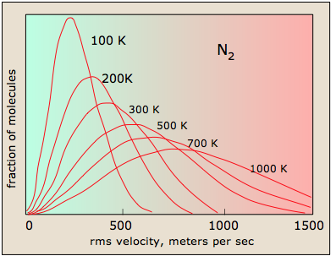
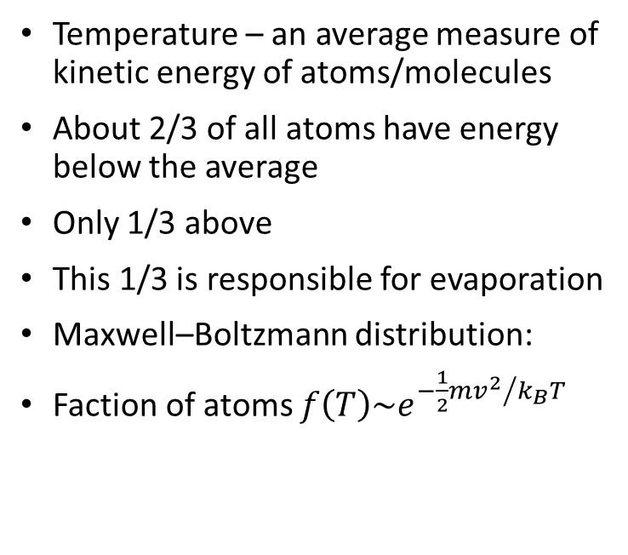
Kinetic Theory
Temperature – an average measure of kinetic energy of atoms/molecules
About 2/3 of all atoms have energy below the average
Only 1/3 above
This 1/3 is responsible for evaporation
Maxwell–Boltzmann distribution:
Faction of atoms $f\left(T\right)\sim e^{{−\frac{1}{2}mv^{2}}/{k_{B}T}}$

