Slide 1

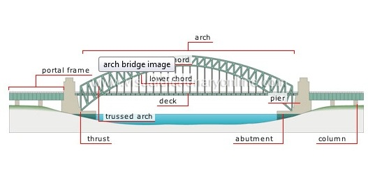

Fluids – statics and dynamics

Slide 2
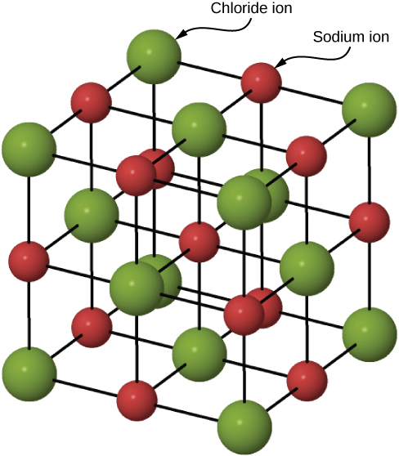
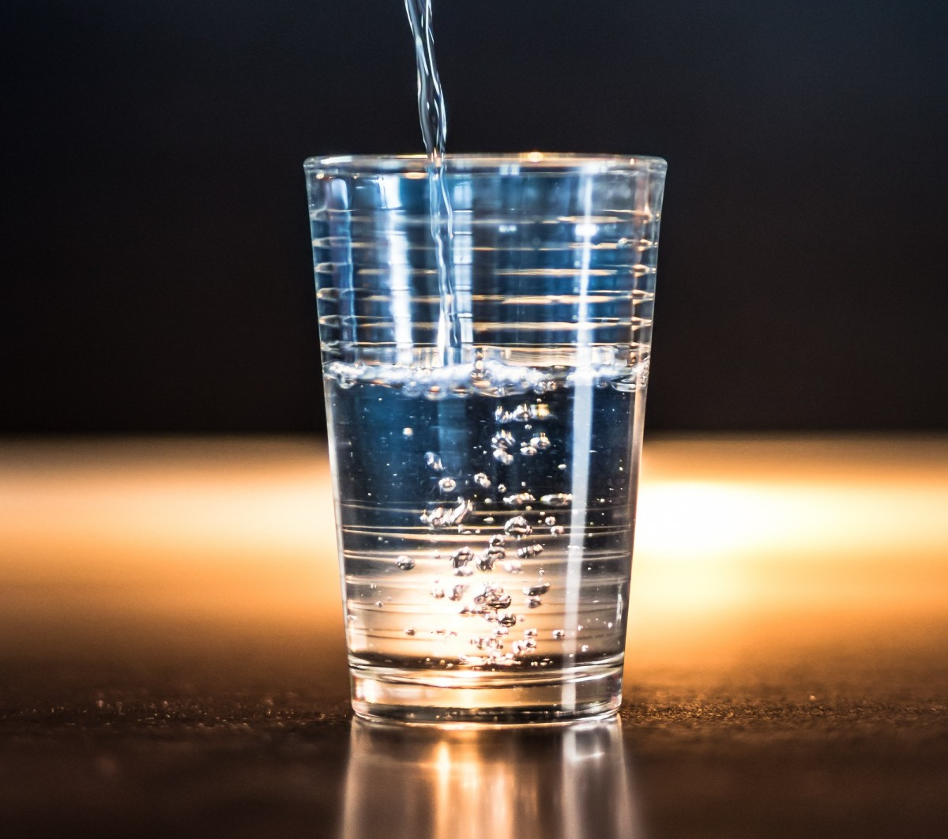
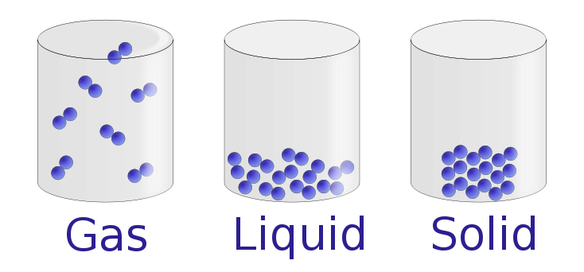
Phases of Matter
Solids:
Atoms in close contact in a lattice
Fixed volume and shape
Fixed density
Liquids:
Atoms move freely but stay together
Fixed volume
Takes shape of the container
Density changes under extreme conditions
they can’t move, only vibrate
Gases:
Atoms move freely
Are not bound
Can have any volume
Density changes easily

Slide 3
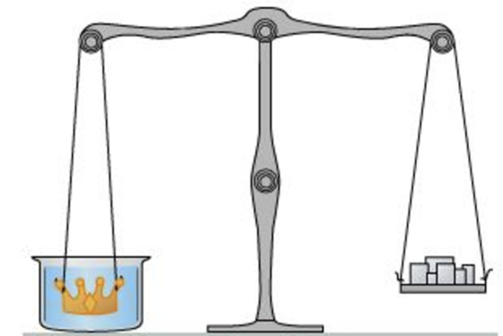
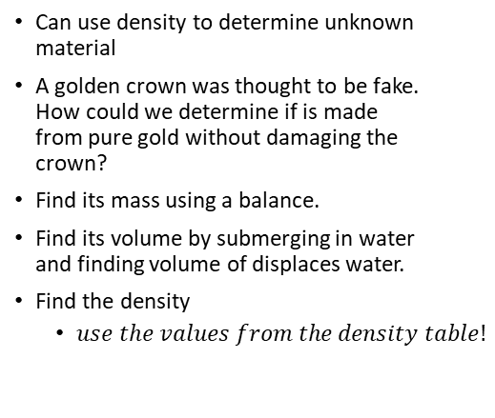
Density – introduction.
Density
$$ρ=\frac{m}{V}$$
𝜌=𝑚/𝑉
Where:
$ρ$ = density
𝜌 = density
m = mass
V = Volume
Objects or liquids with lower density float
when floating in/on top of liquids with higher density
Can use density to determine unknown material
A golden crown was thought to be fake. How could we determine if is made from pure gold without damaging the crown?
Find its mass using a balance.
Find its volume by submerging in water and finding volume of displaces water.
Find the density
  $use the values from the density table!$

Slide 4
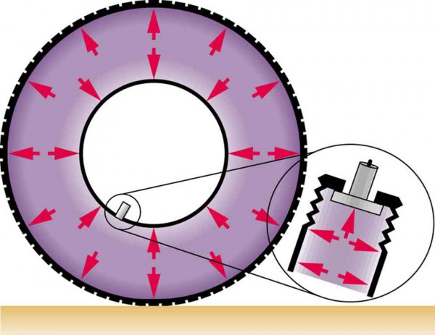
Pressure
The molecules in a fluid are free to move
They sometimes collide with the sides of their container
The more the molecules collide with the walls, the more force is felt
Pressure
$$P=\frac{F}{A}$$
𝑃=𝐹/𝐴
P = Pressure
F = Force perpendicular to surface
A = Area of surface
Unit:
1 Pa is very small, so we usually use
Where:
$\frac{N}{m^{2}} = Pa$ (Pascal)
𝑁/𝑚^2 = 𝑃𝑎 (Pascal)
kPa or atm
Atmospheric Pressure at Sea Level
$1.013×{10}^{5}$ Pa = 1 atmosphere (1 atm)
1.013×10^5 Pa = 1 atmosphere (1 atm)
In a fluid/gas, the pressure is exerted perpendicularly to all surfaces
A static fluid/gas cannot produce a force parallel to a surface since it is not moving parallel to surface

Slide 5
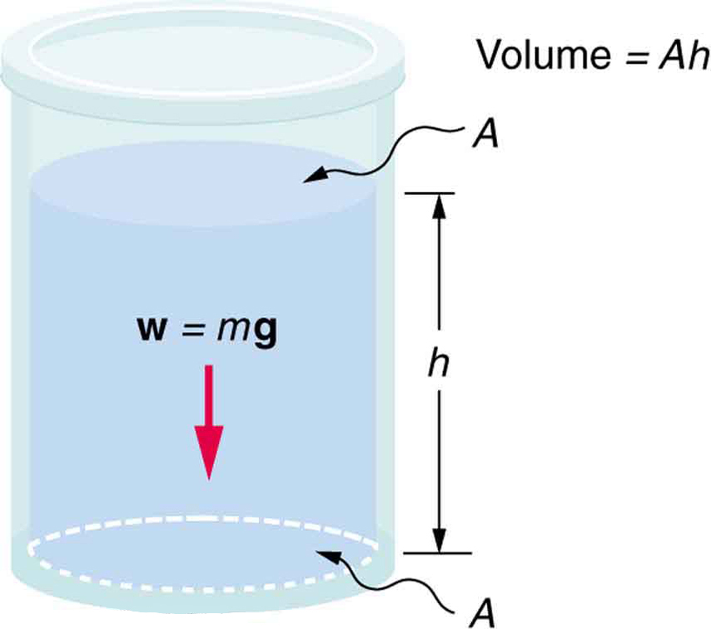
Pressure and Depth
Pressure at the bollom
$$P=\frac{F}{A}=\frac{mg}{A}$$
𝑃=𝐹/𝐴=𝑚𝑔/𝐴
For the column of a liquid,
$$P=ρgh$$
𝑃=𝜌𝑔ℎ
$$=\frac{ρVg}{A}$$
=𝜌𝑉𝑔/𝐴
$$=\frac{ρAhg}{A}$$
=𝜌𝐴ℎ𝑔/𝐴
If the pressure is known at a certain depth,
This assumes ρ is constant with depth
This is a good estimate for liquids, but not for gasses unless h is small
the pressure at higher depth can be found by adding $ρgh$
the pressure at higher depth can be found by adding 𝜌𝑔ℎ
Notes:
There are horizontal forces also, but they will cancel each other.

Slide 6
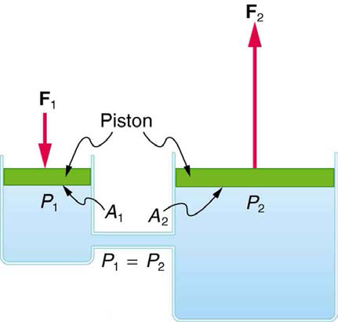
Pascal’s Principle
Pascal’s Principle
A change in pressure applied to an enclosed fluid is transmitted undiminished to all portions of the fluid and the walls of its container.
Basis of hydraulics
Since $P=\frac{F}{A}$,
Since 𝑃=𝐹/𝐴,
$$\frac{F_{1}}{A_{1}}=\frac{F_{2}}{A_{2}}$$
𝐹_1/𝐴_1 =𝐹_2/𝐴_2
if we change the area, the force is changed
For the image:
$$F_{2}>F_{1}$$
𝐹_2>𝐹_1
Notes:
The fluid has no where to go. It flows in the container, but cannot go anywhere so the whole pressure increases.

Slide 7
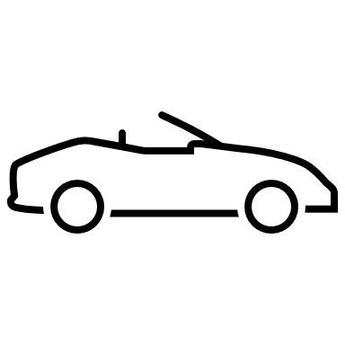
Sample problem:
What force F must be applied to piston 1 in order to support the 850-kg car on piston 2?
$$P=\frac{F}{A}$$
𝑃=𝐹/𝐴
$$F_{car}=850 kg\left(9.8\frac{m}{s^{2}}\right)=8330 N$$
𝐹_𝑐𝑎𝑟=850 𝑘𝑔(9.8 𝑚/𝑠^2 )=8330 𝑁
$$A_{2}=π{\left(0.150 m\right)}^{2}=0.0705858 m^{2}$$
𝐴_2=𝜋(0.150 𝑚)^2=0.0705858 𝑚^2
$$F_{A}= ?$$
𝐹_𝐴= ?
$$A_{1}=π{\left(0.0085m\right)}^{2}=0.00022698 m^{2}$$
𝐴_1=𝜋(0.0085𝑚)^2=0.00022698 𝑚^2
$$\frac{F}{A}=\frac{F}{A}$$
𝐹/𝐴=𝐹/𝐴
$$\frac{8330 N}{0.0705858 m^{2}}=\frac{F}{0.00022698 m^{2}}$$
(8330 𝑁)/(0.0705858 𝑚^2 )=𝐹/(0.00022698 𝑚^2 )
$$F=26.7 N$$
𝐹=26.7 𝑁
The piston 1 has a diameter of 17 mm
and the piston at B a diameter of 300 mm.
F
2
1

Slide 8
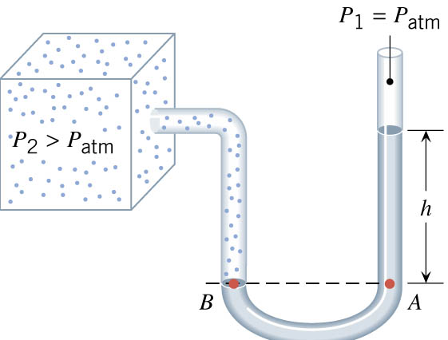
Measuring Pressure
Gauge Pressure
Used by pressure gauges
Measures pressure relative to atmospheric pressure
Absolute Pressure
Sum of gauge pressure and atmospheric pressure
$$P_{abs}=P_{gauge}+P_{atm}$$
𝑃_𝑎𝑏𝑠=𝑃_𝑔𝑎𝑢𝑔𝑒+𝑃_𝑎𝑡𝑚
Open-Tube Manometer
U-shaped tube with fluid in it
One end is connected to the container of which we want to measure the pressure
The other end is open to the air
$$P_{2}=ρgh+P_{atm}$$
𝑃_2=𝜌𝑔ℎ+𝑃_𝑎𝑡𝑚
$$P_{2}=P_{abs}$$
𝑃_2=𝑃_𝑎𝑏𝑠
$$P_{2}−P_{atm}=P_{gauge}$$
𝑃_2−𝑃_𝑎𝑡𝑚=𝑃_𝑔𝑎𝑢𝑔𝑒
Using the liquid column
$$P_{gauge}=ρgh$$
𝑃_𝑔𝑎𝑢𝑔𝑒=𝜌𝑔ℎ

Slide 9
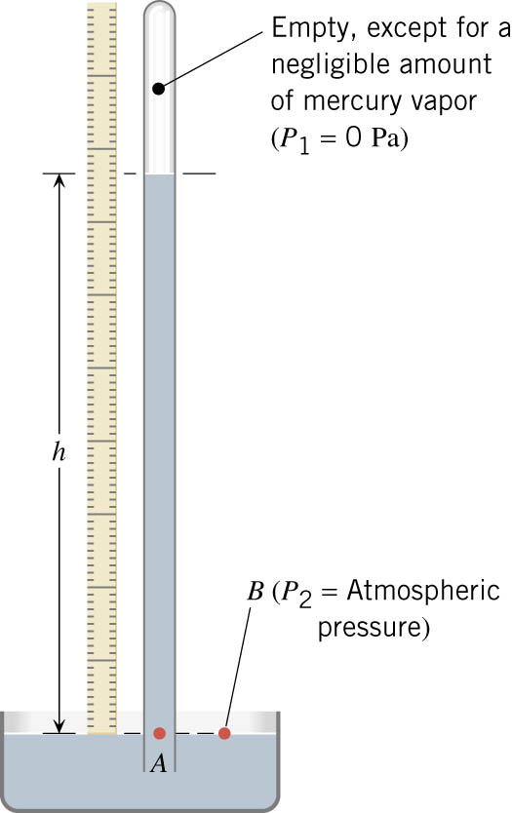
Measuring Pressure 2
Barometer
Used to measure air pressure
A tube with the top sealed and filled with mercury
The bottom is open and sitting in a pool of mercury
Pressure at top = 0 (vacuum)
Pressure at bottom = $P_{atm}$
Pressure at bottom = 𝑃_𝑎𝑡𝑚
$$P=ρgh$$
𝑃=𝜌𝑔ℎ
Notes:
P₂ = ρgh
P₂ = 13600 kg/m³ (9.80m/s²)h
P₂ = 1.33x10⁵ Pa/m h
1 atm is 760 mm if we make P₂ = 1.013x10⁵ Pa
Changes in weather are often due to change in air pressure. Low pressure = bad weather; high pressure = sunny weather

Slide 10
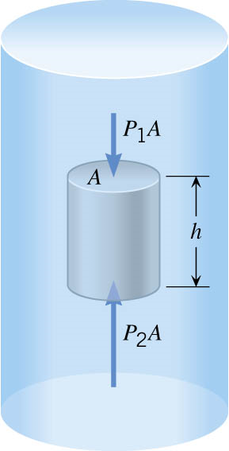
Archimedes’ Principle
Pushing a football under water
The water pushes it up
All fluids push things up
The upward force is buoyant force
$$F_{B}=P_{2}A−P_{1}A$$
𝐹_𝐵=𝑃_2 𝐴−𝑃_1 𝐴
$$F_{B}=\left(P_{2}−P_{1}\right)A$$
𝐹_𝐵=(𝑃_2−𝑃_1 )𝐴
$$P_{2}=P_{1}+ρgh à P_{2}−P_{1}=ρgh$$
𝑃_2=𝑃_1+𝜌𝑔ℎ à 𝑃_2−𝑃_1=𝜌𝑔ℎ
$$F_{B}=\left(ρgh\right)A$$
𝐹_𝐵=(𝜌𝑔ℎ)𝐴
$$ρ=\frac{m}{V} →m=ρV$$
𝜌=𝑚/𝑉 →𝑚=𝜌𝑉
$$V=Ah$$
𝑉=𝐴ℎ
$$m=ρhA$$
𝑚=𝜌ℎ𝐴
$$F_{B}=mg=W_{liquid}$$
𝐹_𝐵=𝑚𝑔=𝑊_𝑙𝑖𝑞𝑢𝑖𝑑
because the pressure is higher at greater depths
Buoyant Force:
Combining, get:
Weight of displaced liquid
Flotation:
Buoyant force < gravity, object sinks
Buoyant force $≥$ gravity, object floats
Buoyant force ≥ gravity, object floats

Slide 11

Specific Gravity
An object will float if its average density < density of the fluid
In other words, it will float if it displaces more fluid than its own weight
Specific Gravity
$$\frac{\overline{ρ}}{ρ_{fl}}=fraction submerged$$
¯𝜌/𝜌_𝑓𝑙 =fraction submerged
If specific gravity < 1 it floats
If specific gravity > 1 it sinks

Slide 12
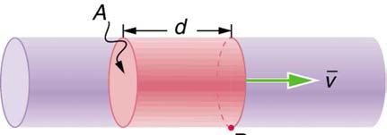
Flow Rate
Flow Rate
$$Q=\frac{V}{t}$$
𝑄=𝑉/𝑡
Q = Flow rate
V = Volume of fluid
t = time
$$Q=\frac{V}{t}=\frac{Ad}{t}=A\overline{v}$$
𝑄=𝑉/𝑡=𝐴𝑑/𝑡=𝐴¯𝑣
A = cross-section area
$\overline{v}$ = average velocity of fluid
¯𝑣 = average velocity of fluid
In terms of fluid velocity:
Since flow rate is constant for a given moving fluid
Continuity equation:
$$ρ_{1}A_{1}{\overline{v}}_{1}=ρ_{2}A_{2}{\overline{v}}_{2}$$
𝜌_1 𝐴_1 ¯𝑣_1=𝜌_2 𝐴_2 ¯𝑣_2
If incompressible (assumed for a liquid)
$$A_{1}{\overline{v}}_{1}=A_{2}{\overline{v}}_{2}$$
𝐴_1 ¯𝑣_1=𝐴_2 ¯𝑣_2
Continuity equation simplified:

Slide 13
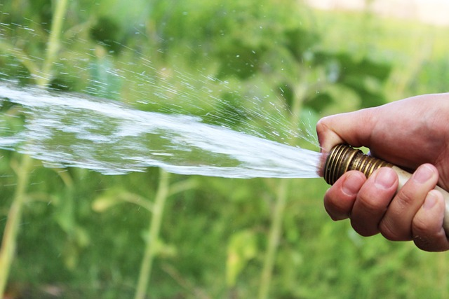
Flow Rate example:
A garden hose has a diameter of 2 cm and water enters it at 0.5 m/s. You block 90% of the end of the hose with your thumb. How fast does the water exit the hose?
v = 5 m/s
Notes:
Incompressible so
$$A_{1}{\overline{v}}_{1}=A_{2}{\overline{v}}_{2}$$
$$\left(π{\left(0.01 m\right)}^{2}\right)\left(0.5\frac{m}{s}\right)=0.1\left(π{\left(0.01 m\right)}^{2}\right)v$$
$$v=5\frac{m}{s}$$

Slide 14
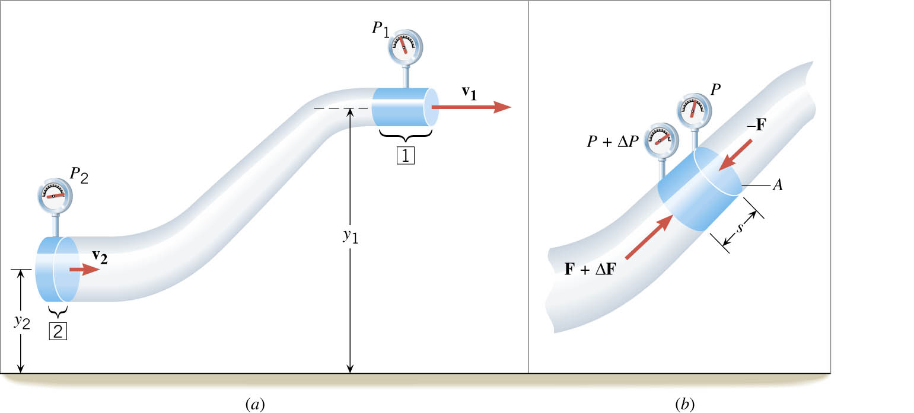
Bernoulli’s Equation
Work:
$$W_{net}=E_{f}−E_{0}$$
𝑊_𝑛𝑒𝑡=𝐸_𝑓−𝐸_0
$$E=KE+PE \\ =\frac{1}{2}{mv}^{2}+mgh$$
𝐸=𝐾𝐸+𝑃𝐸
=1/2 〖𝑚𝑣〗^2+𝑚𝑔ℎ
$$W_{net}=F⋅x$$
𝑊_𝑛𝑒𝑡=𝐹⋅𝑥
$$PV=\frac{F}{A}hA=Fx=W_{net}$$
𝑃𝑉=𝐹/𝐴 ℎ𝐴=𝐹𝑥=𝑊_𝑛𝑒𝑡
On the other hand,
$$W_{net}=\left(P_{2}−P_{1}\right)V$$
𝑊_𝑛𝑒𝑡=(𝑃_2−𝑃_1 )𝑉
KE:
$$KE=\frac{1}{2}mv^{2}=\frac{1}{2}ρVv^{2}$$
𝐾𝐸=1/2 𝑚𝑣^2=1/2 𝜌𝑉𝑣^2
PE:
$$PE=mgh=ρVgh$$
𝑃𝐸=𝑚𝑔ℎ=𝜌𝑉𝑔ℎ
Total energy :
Is work + KE + PE
$$E_{total}=PV+\frac{1}{2}ρVv^{2}+ρVgh$$
𝐸_𝑡𝑜𝑡𝑎𝑙=𝑃𝑉+1/2 𝜌𝑉𝑣^2+𝜌𝑉𝑔ℎ
Write as Energy density:
$$\frac{E_{total}}{V}=P+\frac{1}{2}ρv^{2}+ρgh$$
𝐸_𝑡𝑜𝑡𝑎𝑙/𝑉=𝑃+1/2 𝜌𝑣^2+𝜌𝑔ℎ
$P+\frac{1}{2}ρv^{2}+ρgh$=const
𝑃+1/2 𝜌𝑣^2+𝜌𝑔ℎ=const
Bernoulli’s Equation
$$P_{1}+\frac{1}{2}ρv_{1}^{2}+ρgh_{1}=P_{2}+\frac{1}{2}ρv_{2}^{2}+ρgh_{2}$$
𝑃_1+1/2 𝜌𝑣_1^2+𝜌𝑔ℎ_1=𝑃_2+1/2 𝜌𝑣_2^2+𝜌𝑔ℎ_2
$$\text{To} \text{get} \text{the} \text{power}\text{:}$$
"To get the power:"
$$\text{Or} \text{multiply} \text{by} \text{flow} \text{rate} \text{Q} \text{instead}$$
"Or multiply by flow rate Q instead"
$$Power=\left(P+\frac{1}{2}ρv^{2}+ρgh\right)Q$$
𝑃𝑜𝑤𝑒𝑟=(𝑃+1/2 𝜌𝑣^2+𝜌𝑔ℎ)𝑄
$$\text{Multiply} \text{Bernoulli}\text{’}\text{s} \text{Equation}$$
"Multiply Bernoulli’s Equation"
$$\text{by} \text{volume} \text{and} \text{divide} \text{by} \text{time}$$
"by volume and divide by time"

Slide 15
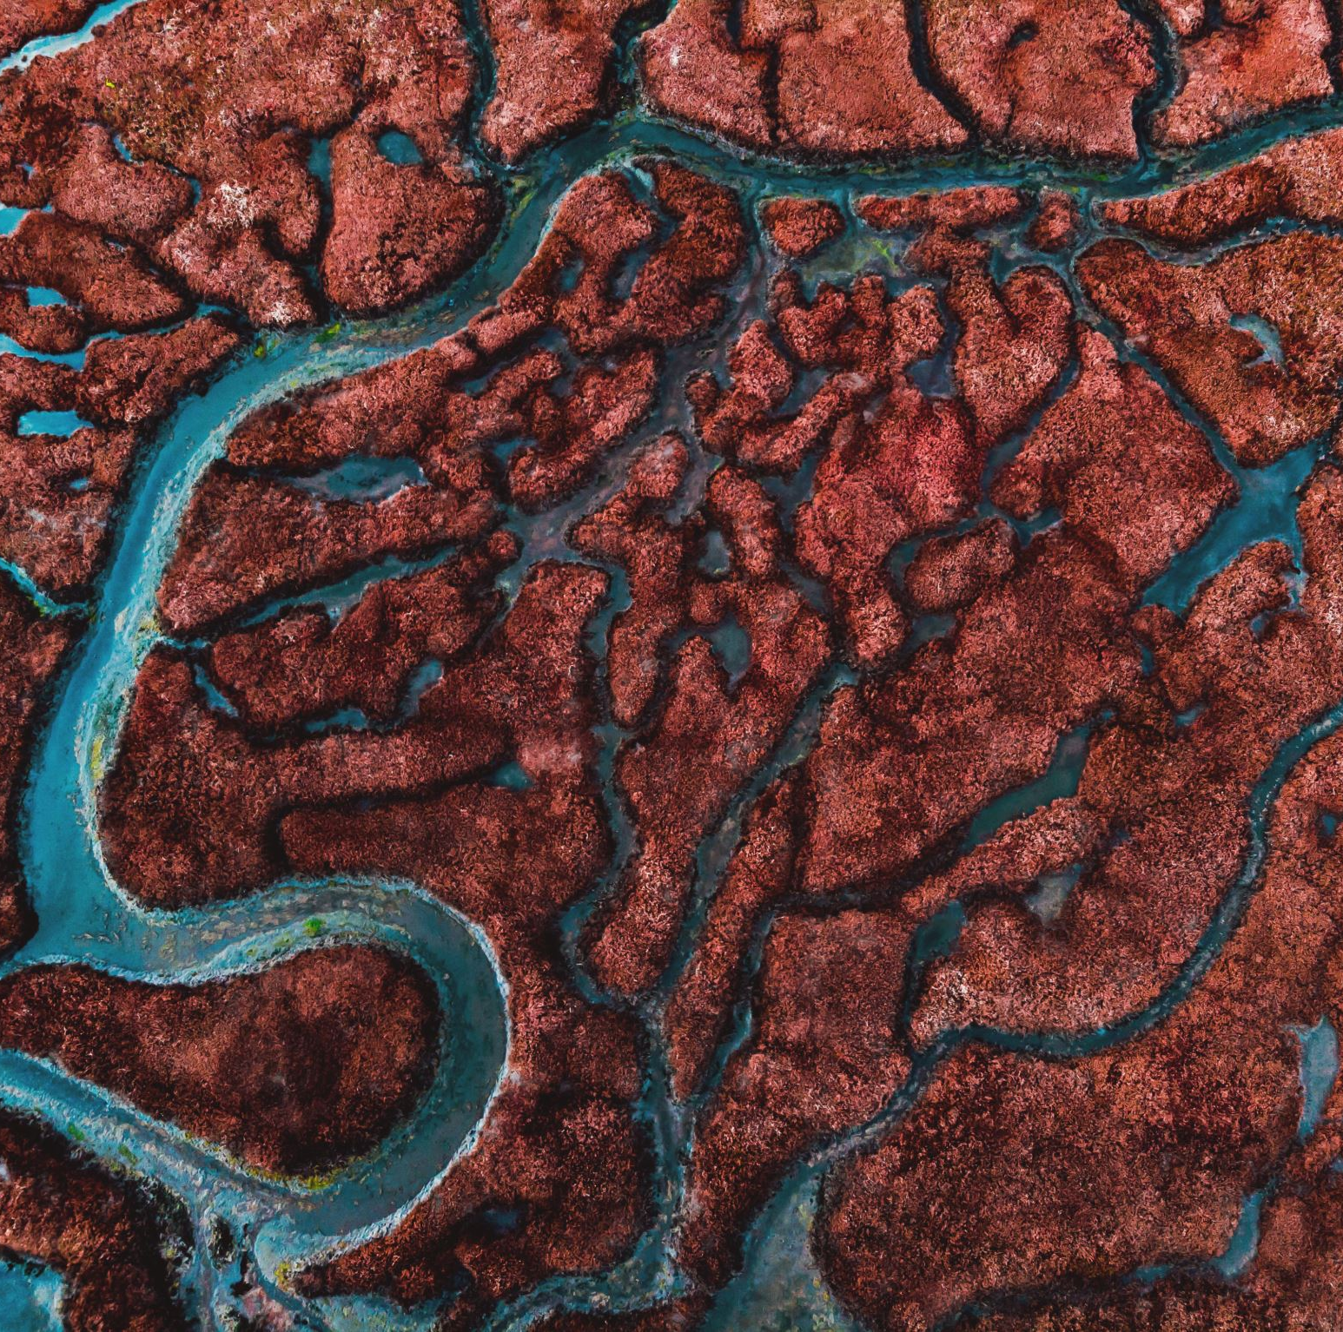
Example: Bernoulli’s Equation
The blood speed in a normal segment of a horizontal artery is 0.15 m/s. An abnormal segment of the artery is narrowed down by an arteriosclerotic plaque to one-half the normal cross-sectional area. What is the difference in blood pressures between the normal and constricted segments of the artery?
35.8 Pa
Notes:
$$P_{1}+\frac{1}{2}ρv_{1}^{2}+ρgh_{1}=P_{2}+\frac{1}{2}ρv_{2}^{2}+ρgh_{2}$$
$$P_{1}−P_{2}=\frac{1}{2}ρv_{2}^{2}−\frac{1}{2}ρv_{1}^{2}$$
$$A_{1}v_{1}=A_{2}v_{2}$$
$$A_{1}0.15\frac{m}{s}=\frac{1}{2}A_{1}v_{2}→v_{2}=0.30\frac{m}{s}$$
$$P_{1}−P_{2}=\frac{1}{2}\left(1060\frac{kg}{m^{3}}\right){\left(0.30\frac{m}{s}\right)}^{2}−\frac{1}{2}\left(1060\frac{kg}{m^{3}}\right){\left(0.15\frac{m}{s}\right)}^{2}$$
$$P_{1}−P_{2}=35.8 Pa$$

Slide 16
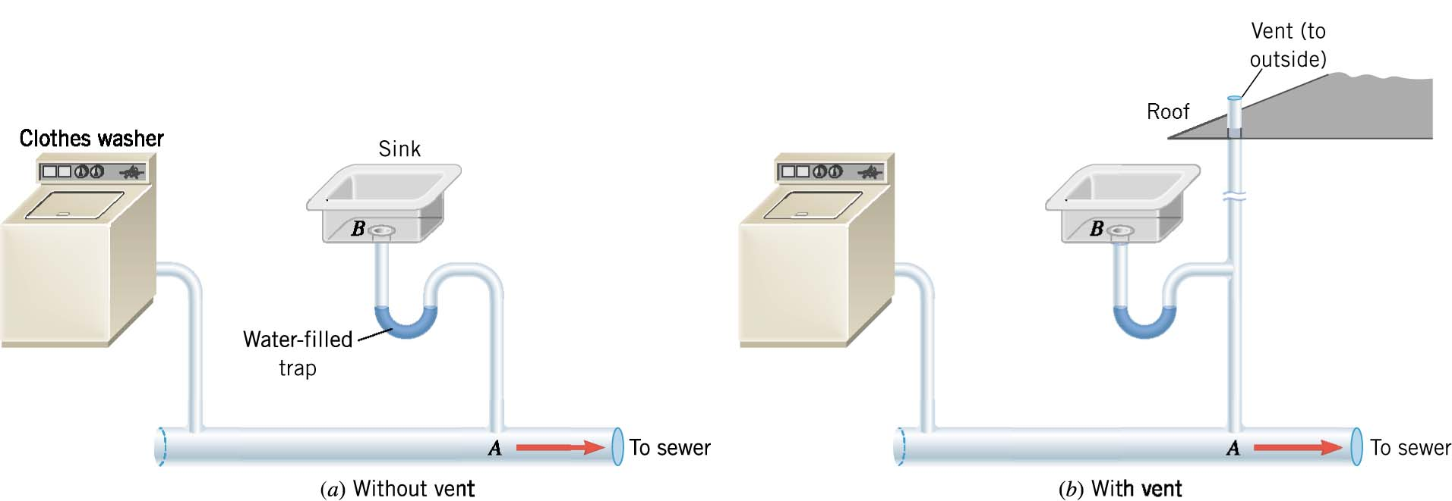
Applications of Bernoulli’s Equation
Why do all houses need a plumbing vent?
Wastewater flows through a sewer line.
Something like a sink is connected to the line, but there is a water trap to keep the sewer gasses from entering the house.
The flowing water in the sewer means the air directly above the flowing water has a lower pressure than the air above the sink.
This pushes the water in the trap down the pipe and sewer gasses enter the house

Slide 17
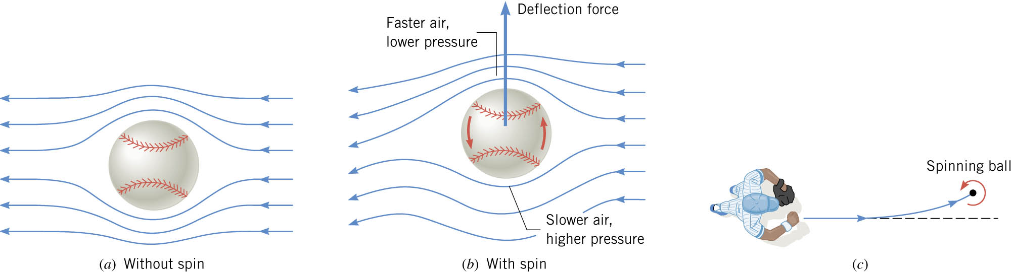
Bernoulli’s Equation in Sports
Discuss how does a curve ball in baseball work
Notes:
Bottom: spin against air flow → slow relative velocity → high pressure
Top: spin with air flow → fast relative velocity → low pressure

Slide 18
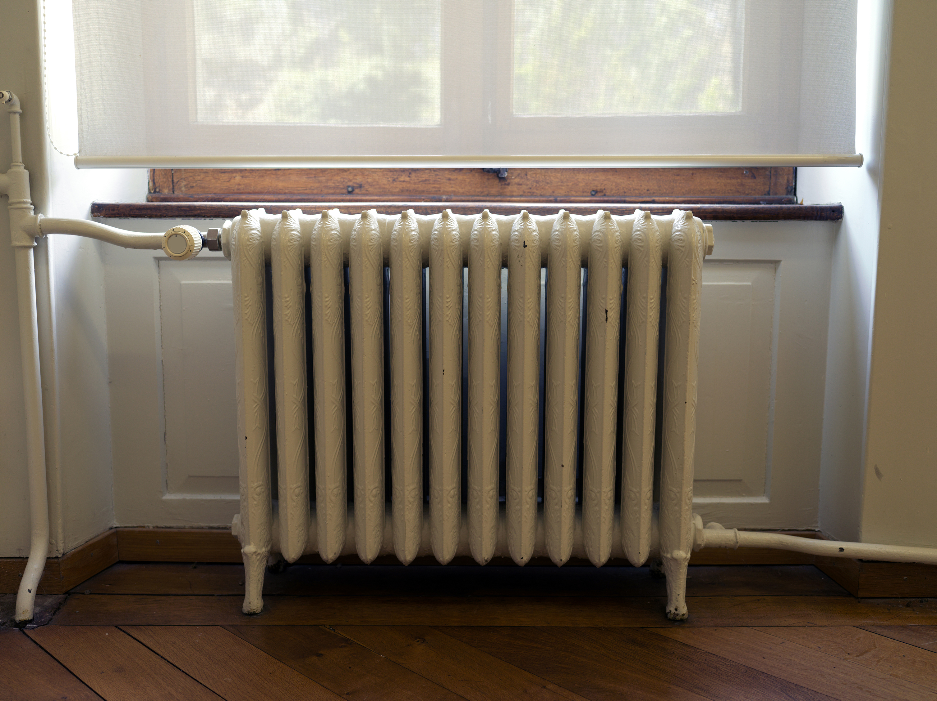
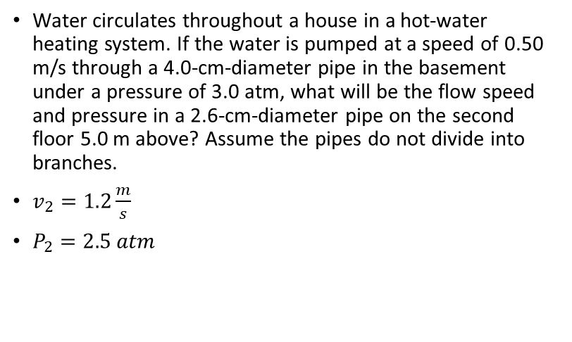
Applications of Bernoulli’s Equation
Water circulates throughout a house in a hot-water heating system. If the water is pumped at a speed of 0.50 m/s through a 4.0-cm-diameter pipe in the basement under a pressure of 3.0 atm, what will be the flow speed and pressure in a 2.6-cm-diameter pipe on the second floor 5.0 m above? Assume the pipes do not divide into branches.
$v_{2}=1.2\frac{m}{s}$
$P_{2}=2.5 atm$
Notes:
Equation of Continuity
$$v_{1}A_{1}=v_{2}A_{2}$$
$$\left(0.50\frac{m}{s}\right)\left(π{\left(0.02 m\right)}^{2}\right)=v_{2}\left(π{\left(0.013 m\right)}^{2}\right)$$
$$v_{2}=1.183\frac{m}{s}$$
Bernoulli’s Equation
$$P_{1}+\frac{1}{2}ρv_{1}^{2}+ρgh_{1}=P_{2}+\frac{1}{2}ρv_{2}^{2}+ρgh_{2}$$
$$\left(3\left(1.01×{10}^{5} Pa\right)\right)+\frac{1}{2}\left(1000\frac{kg}{m^{3}}\right){\left(0.50\frac{m}{s}\right)}^{2}+0=P_{2}+\frac{1}{2}\left(1000\frac{kg}{m^{3}}\right){\left(1.183\frac{m}{s}\right)}^{2}+\left(1000\frac{kg}{m^{3}}\right)\left(9.8\frac{m}{s^{2}}\right)\left(5.0 m\right)$$
$$303125 Pa=P_{2}+49700 Pa$$
$$P_{2}=253425 Pa=2.5 atm$$

Slide 19
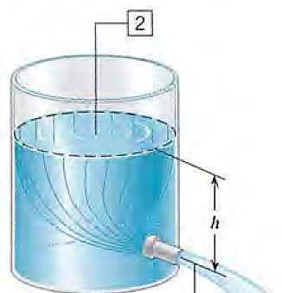
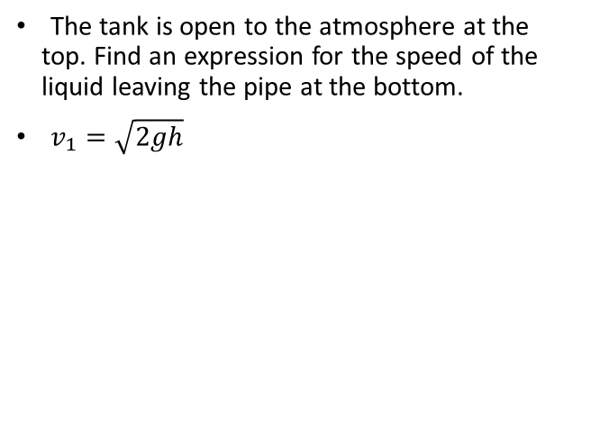
05-06 The Most General Applications of Bernoulli’s Equation
The tank is open to the atmosphere at the top. Find an expression for the speed of the liquid leaving the pipe at the bottom.
$v_{1}=\sqrt{2gh}$
Notes:
$$P_{1}+\frac{1}{2}ρv_{1}^{2}+ρgh_{1}=P_{2}+\frac{1}{2}ρv_{2}^{2}+ρgh_{2}$$
$$1 atm+\frac{1}{2}ρv_{1}^{2}+0=1 atm+0+ρgh$$
$$\frac{1}{2}ρv_{1}^{2}=ρgh$$
$$\frac{1}{2}v_{1}^{2}=gh$$
$$v_{1}=\sqrt{2gh}$$

Slide 20
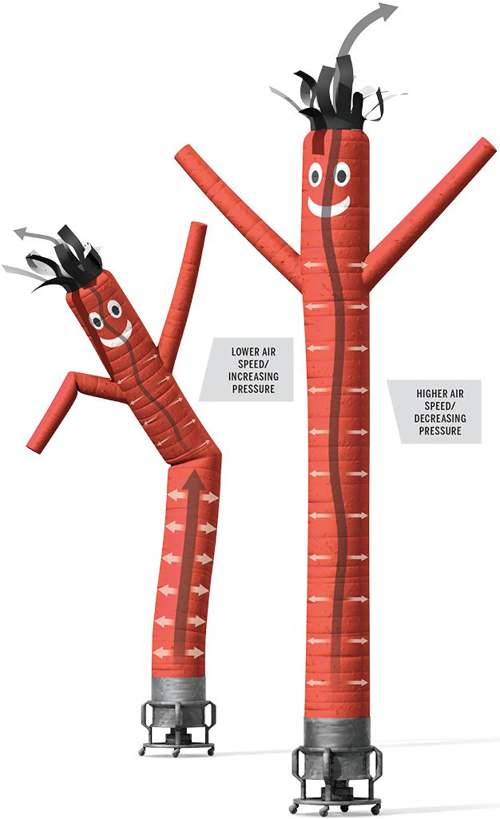
Applications of Bernoulli’s Equation
Air Dancer used to draw attention at used car lots.
The behavior is explained by Bernoulli’s principle.
Initially, the moving air, which behaves as an incompressible flow in the open-ended Air Dancer, creates enough pressure to inflate the tube.
As the tube stands more upright, the turbulent air inside flows more freely and its speed increases until the decreasing pressure can no longer support the mass of the nylon fabric.
The collapsing material creates a kink in the tube, a constriction that causes the air speed to temporarily slow and the pressure to rise again.
The elevated pressure drives the bend upward, sending a shimmy through the Air Dancer and restarting the cycle.

Slide 21
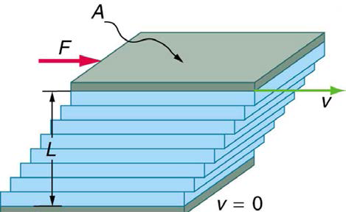
Viscosity, Poiseuille’s Law, and Turbulence
Laminar Flow
Smooth flow in layers that don’t mix
Turbulent Flow
Has eddies and swirls that mix layers of fluid
Turbulent flow is slower than laminar flow
Viscosity
Fluid friction
$$η=\frac{FL}{vA}$$
𝜂=𝐹𝐿/𝑣𝐴
How viscosity is measured
Two plates with fluid between
Top plate moved
Friction causes the fluid to move
Notes:
$η$ is coefficient of viscosity
F is force applied to top plate
L is distance between plates
v is speed that top plate is moved
A is area of plate

Slide 22
Viscosity, Poiseuille’s Law, and Turbulence
Laminar flow in tubes
Difference in pressure causes fluids to flow
$$Q=\frac{P_{2}−P_{1}}{R}$$
𝑄=(𝑃_2−𝑃_1)/𝑅
Where:
Q is flow rate
$P_{1}$ and $P_{2}$ are pressures
𝑃_1 and 𝑃_2 are pressures
R is resistance
Since flow rate depends on pressure
Higher pressure difference,
higher Q
Poiseuille’s law for resistance
$$R=\frac{8ηl}{πr^{4}}$$
𝑅=8𝜂𝑙/(𝜋𝑟^4 )
Where:
$η$ is viscosity
𝜂 is viscosity
l is length of tube
r is radius of tube
Higher resistance, higher pressure difference needed
In blood vessels this is a problem
to maintain constant Q
with plaque on artery walls
Notes:
Resistance is most effected by radius

Slide 23
Viscosity, Poiseuille’s Law, and Turbulence
How to tell if laminar or turbulent flow
Low speed with smooth, streamlined object → laminar
High speed or rough object → turbulent
Reynolds number
Below 2000 → laminar
Above 3000 → turbulent
Between 2000 and 3000 depends on conditions
$$N_{R}=\frac{2ρvr}{η}$$
𝑁_𝑅=2𝜌𝑣𝑟/𝜂
Reynolds number
Notes:
$$N_{R}=Reynolds number$$
$$ρ=fluid density$$
$$v=speed of fluid$$
$$r=radius of tube$$
$$η=viscosity$$

Slide 24
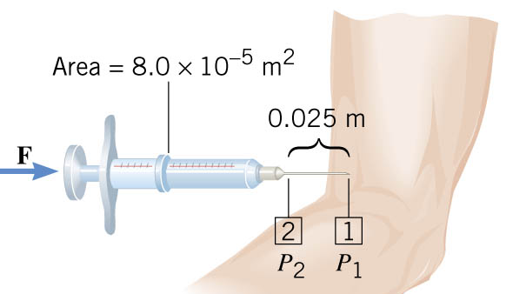
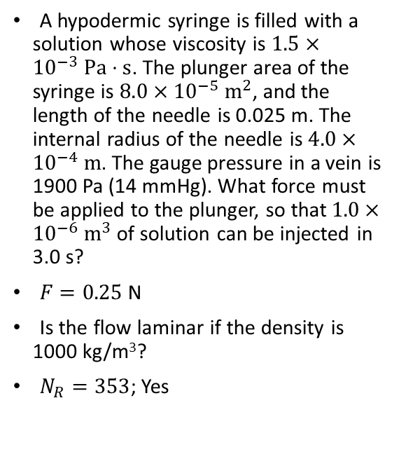
Example:
See slide comments for the detailed solution.
A hypodermic syringe is filled with a solution whose viscosity is $1.5×{10}^{−3} Pa⋅s$. The plunger area of the syringe is $8.0×{10}^{−5} m^{2}$, and the length of the needle is 0.025 m. The internal radius of the needle is $4.0×{10}^{−4} m$. The gauge pressure in a vein is 1900 Pa (14 mmHg). What force must be applied to the plunger, so that $1.0×{10}^{−6} m^{3}$ of solution can be injected in 3.0 s?
$F=0.25$ N
Is the flow laminar if the density is 1000 kg/m³?
$N_{R}=353$; Yes
Notes:
$$η=1.5×{10}^{−3} Pa⋅s, l=0.025 m, r=4.0×{10}^{−4} m, P_{1}=1900 Pa, V=1.0×{10}^{−6} m^{3}, t=3.0 s$$
$$Q=\frac{V}{t}=\frac{1.0×{10}^{−6} m^{3}}{3.0 s}=3.3×{10}^{−7} m^{3}/s$$
$$R=\frac{8ηl}{πr^{4}}=\frac{8\left(1.5×{10}^{−3} Pa⋅s\right)\left(0.025 m\right)}{π{\left(4.0×{10}^{−4} m\right)}^{4}}=3.730×{10}^{9} Pa⋅s/m^{3}$$
$$Q=\frac{P_{2}−P_{1}}{R}$$
$$3.3×{10}^{−7}\frac{m^{3}}{s}=\frac{P_{2}−1900 Pa}{3.730×{10}^{9}\frac{Pa⋅s}{m^{3}}}$$
$$P_{2}−1900 Pa=1243 Pa$$
$$P_{2}=3143 Pa$$
$$P=\frac{F}{A}$$
$$3143 Pa=\frac{F}{8.0×{10}^{−5} m^{2}}$$
$$F=0.25 N$$
Laminar?
$$Q=Av→3.33×{10}^{−7}\frac{m^{3}}{s}=π{\left(4×{10}^{−4} m\right)}^{2}v→v=0.662 m/s$$
$$N_{R}=\frac{2ρvr}{η}=\frac{2\left(1000\frac{kg}{m^{3}}\right)\left(0.662\frac{m}{s}\right)\left(4.0×{10}^{−4} m\right)}{1.5×{10}^{−3} Pa⋅s}=353$$

