Slide 1

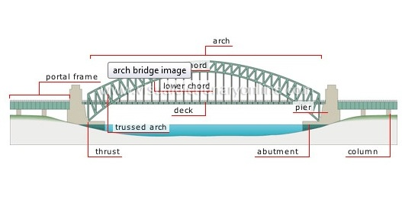

Rotation of a rigid body, moment of inertia, angular momentum and KE

Slide 2
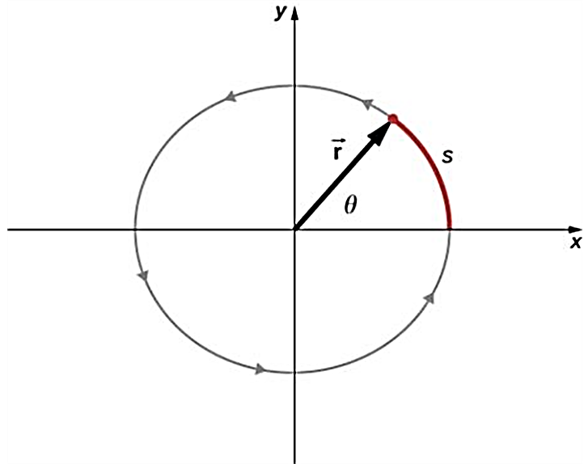
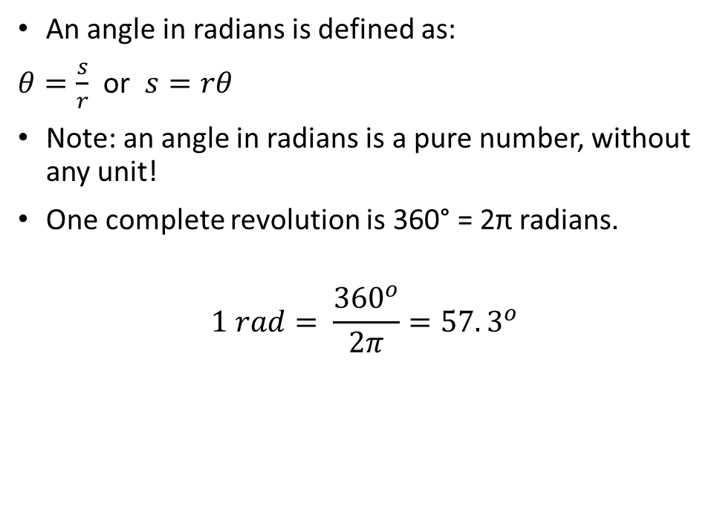
Angle in radians
An angle in radians is defined as:
$θ=\frac{s}{r}$ or $s=rθ$
Note: an angle in radians is a pure number, without any unit!
One complete revolution is 360° = 2π radians.
$$1 rad= \frac{{360}^{o}}{2π}=57.3^{o}$$

Slide 3
Angular displacement and velocity
The angular displacement Δθ of a body:
Δθ = θ₂ – θ₁
The average angular velocity of a body:
$$ω_{av}=\frac{θ_{f}−θ_{i}}{t_{f}−t_{i}}=\frac{∆θ}{∆t}$$
𝜔_𝑎𝑣=(𝜃_𝑓−𝜃_𝑖)/(𝑡_𝑓−𝑡_𝑖 )=∆𝜃/∆𝑡
The instantaneous angular velocity:
$$ω_{z}=\lim_{∆t→0}{\frac{∆θ }{∆t}=}\frac{dθ }{dt}$$
𝜔_𝑧=lim┬(∆𝑡→0)⁡〖(∆𝜃 )/∆𝑡=〗 (𝑑𝜃 )/𝑑𝑡
A counterclockwise rotation is positive; a clockwise rotation is negative.
SI units of angular velocity are rad/s.

Slide 4
Angular acceleration
The average angular acceleration:
$$α_{av}=\frac{ω_{zf}−ω_{zi}}{t_{f}−t_{i}}=\frac{∆ω_{z}}{∆t}$$
𝛼_𝑎𝑣=(𝜔_𝑧𝑓−𝜔_𝑧𝑖)/(𝑡_𝑓−𝑡_𝑖 )=(∆𝜔_𝑧)/∆𝑡
The instantaneous angular acceleration:
$$α=\lim_{∆t→0}{\frac{∆ω_{z} }{∆t}=}\frac{dω_{z} }{dt}=\frac{d^{2}θ}{dt^{2}}$$
𝛼=lim┬(∆𝑡→0)⁡〖(∆𝜔_𝑧 )/∆𝑡=〗 (𝑑𝜔_𝑧 )/𝑑𝑡=(𝑑^2 𝜃)/(𝑑𝑡^2 )
Note that the
SI units of angular acceleration are rad/s²

Slide 5
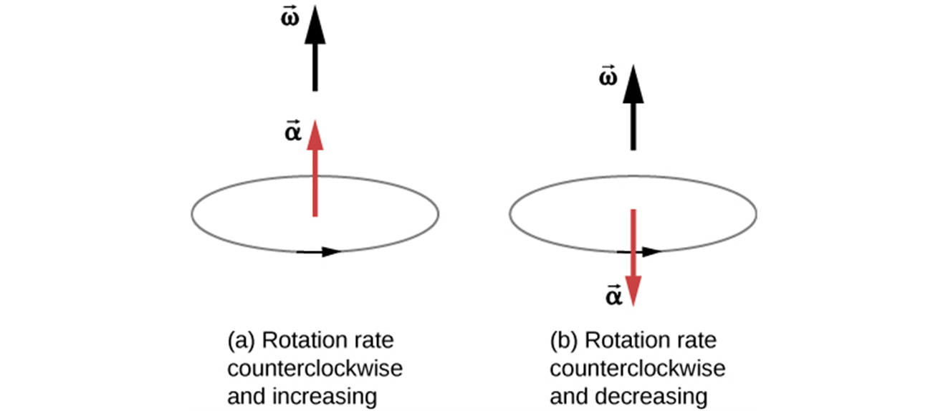
Angular acceleration is a vector
For a fixed rotation axis, the angular acceleration and angular velocity vectors both lie along that axis.
The angular acceleration is in the same direction as the angular velocity, which increases the rotation rate.
The angular acceleration is in the opposite direction to the angular velocity, which decreases the rotation rate.

Slide 6
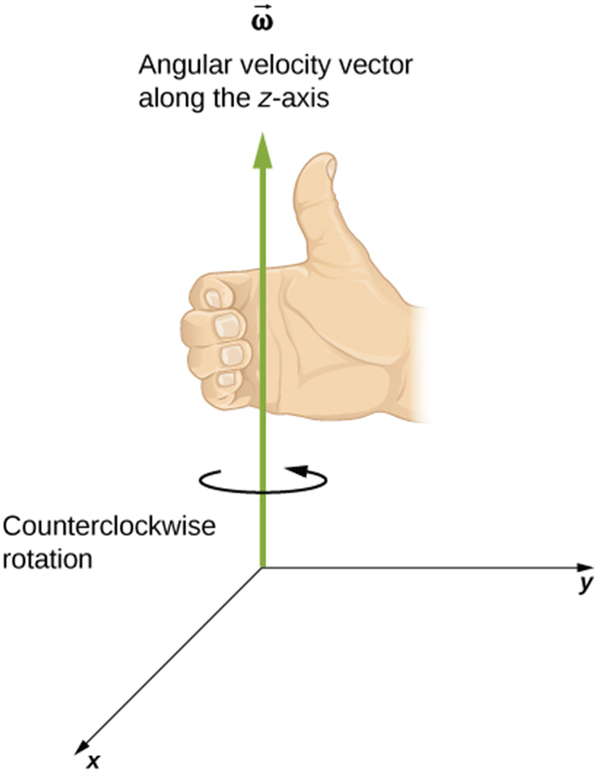
Angular velocity is a vector
Angular velocity is a vector whose direction is given by the right-hand rule as shown in the Figure.

Slide 7
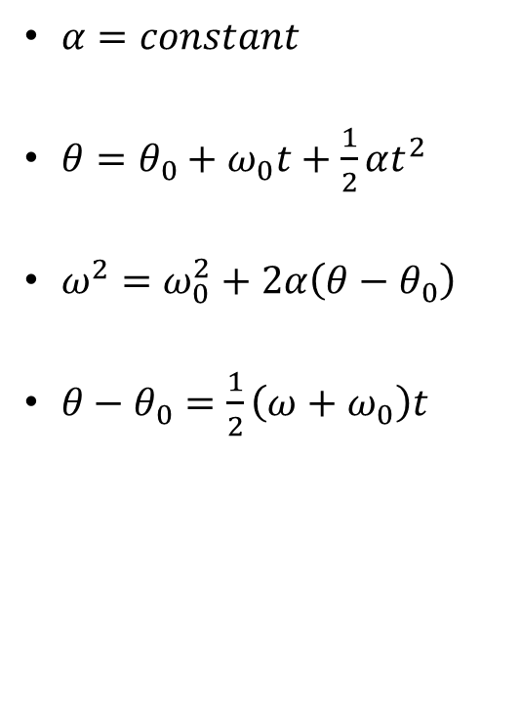
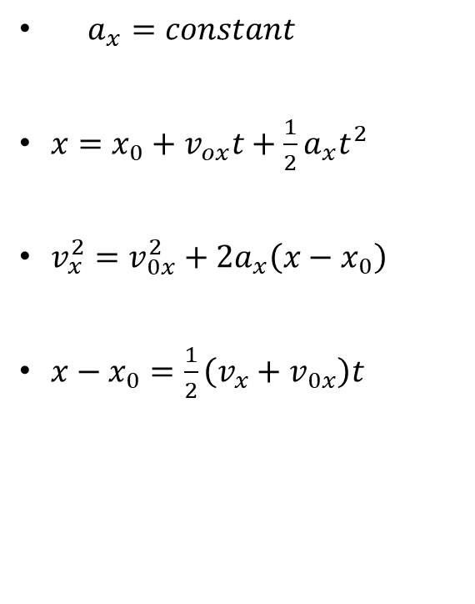
Comparison of linear and angular motion with constant acceleration
The rotational formulas have the same form as the straight-line formulas, as shown below:
$a_{x}=constant$
$x=x_{0}+v_{ox}t+\frac{1}{2}a_{x}t^{2}$
$v_{x}^{2}=v_{0x}^{2}+2a_{x}\left(x−x_{0}\right)$
$x−x_{0}=\frac{1}{2}\left(v_{x}+v_{0x}\right)t$
$α=constant$
$θ=θ_{0}+ω_{0}t+\frac{1}{2}αt^{2}$
$ω^{2}=ω_{0}^{2}+2α\left(θ−θ_{0}\right)$
$θ−θ_{0}=\frac{1}{2}\left(ω+ω_{0}\right)t$

Slide 8

Example: rotation of a disc
You have just finished watching a movie on DVD and the disc is slowing to a stop. The angular velocity of the disc at t = 0 is 27.5 rad/s and its angular acceleration is -10.0 rad/s². What is the disc’s angular velocity at t = 0.300 s? What angle does the disc rotate through during this time?

Slide 9
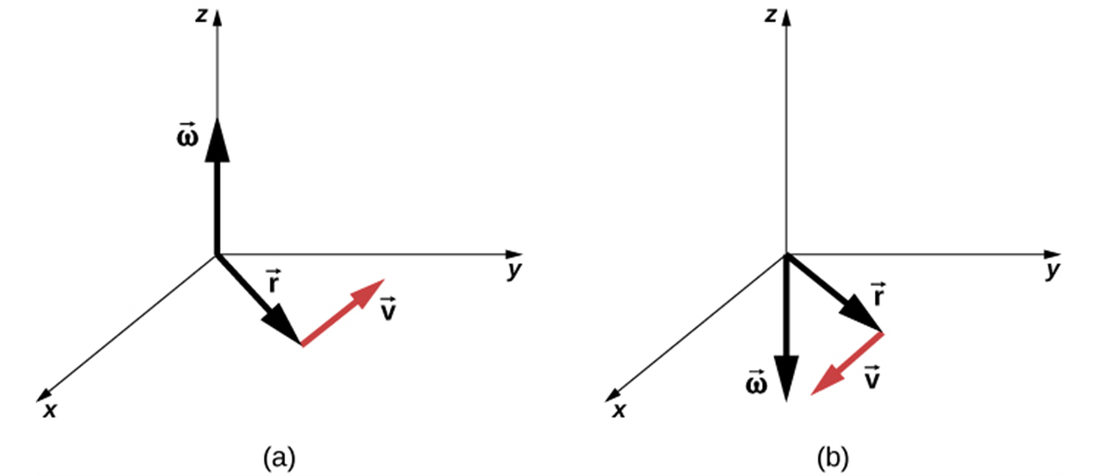
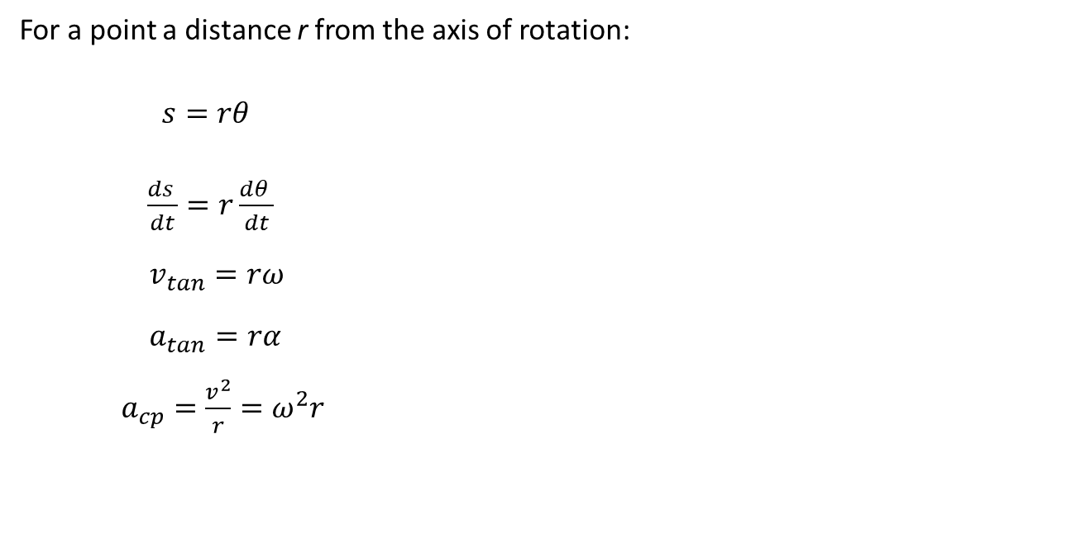
Relating linear and angular kinematics
For a point a distance r from the axis of rotation:
$s=rθ$
$\frac{ds }{dt}=r\frac{dθ }{dt}$
  $v_{tan}=rω$
  $a_{tan}=rα$
  $a_{cp}={\frac{v^{2}}{r}=ω}^{2}r$
The vectors shown are the angular velocity, position, and tangential velocity.
The angular velocity points in the positive z-direction, giving a counterclockwise rotation in the xy-plane.
The angular velocity points in the negative z-direction, giving a clockwise rotation.

Slide 10
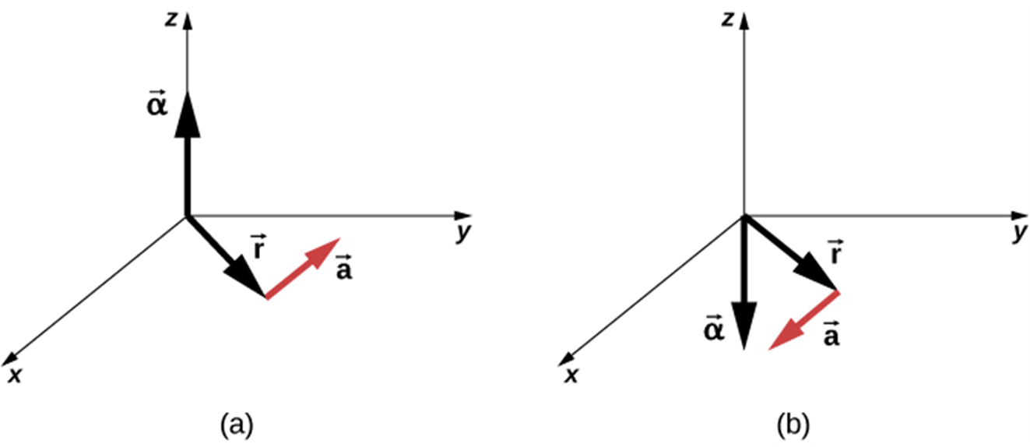
Relating linear and angular kinematics, continued
The angular acceleration is the positive z-direction and produces a tangential acceleration in a counterclockwise sense.
The angular acceleration is in the negative z-direction and produces a tangential acceleration in the clockwise sense.
Note: Always use angles in radians as you relate angular and linear quantities!

Slide 11
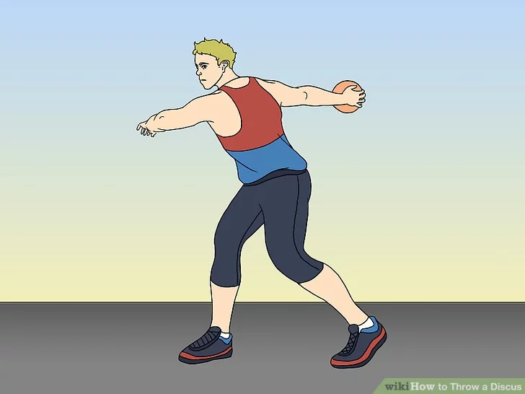
An athlete throwing a discus
A discus thrower moves a discus in a circle with radius 80.0 cm. At a certain instant, the thrower is spinning at an angular speed of 10.0 rad/s and the angular speed is increasing at 50.0 rad/s². At this instant, find the tangential and centripetal components of the acceleration and its magnitude.

Slide 12
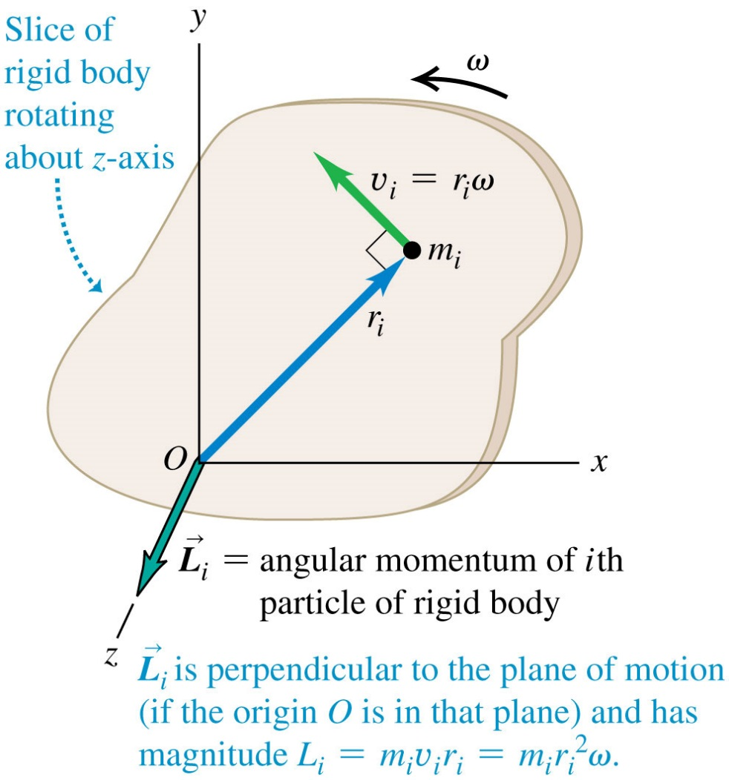
Angular momentum definition
For a particle with mass m, and momentum $\vec{p}$ :
For a particle with mass m, and momentum 𝑝 ⃗ :
$$\vec{L}=\vec{r} ×\vec{p}$$
𝑳 ⃗=𝒓 ⃗ ×𝒑 ⃗
To find the total angular momentum of a rigid body rotating with angular speed ω,
Each particle in the slice with mass m_{i} has angular momentum:
$$L_{i}=m_{i}{r_{i}}^{2}ω$$
𝐿_i=𝑚_𝑖 〖𝑟_𝑖〗^2 𝜔
first consider a thin slice of the object.

Slide 13
Angular Momentum, Continued
For a rigid body rotating around an axis of symmetry,
$$\vec{L}=I\vec{ω}$$
𝐿 ⃗=𝐼𝜔 ⃗
where $I$is the moment of inertia of rigid body, and
where 𝐼 is the moment of inertia of rigid body, and
$\vec{ω}$ is the angular velocity
𝜔 ⃗ is the angular velocity
For any system of particles, the rate of change of the total angular momentum equals to
$$\sum{\vec{τ}}=\frac{d\vec{L}}{dt}$$
∑▒𝜏 ⃗ =(𝑑𝐿 ⃗)/𝑑𝑡
Note:
Value of angular momentum depends on the choice of origin
SI units - kg-m ²/s
the angular momentum is:
the sum of the torques of all forces acting on all the particles:

Slide 14
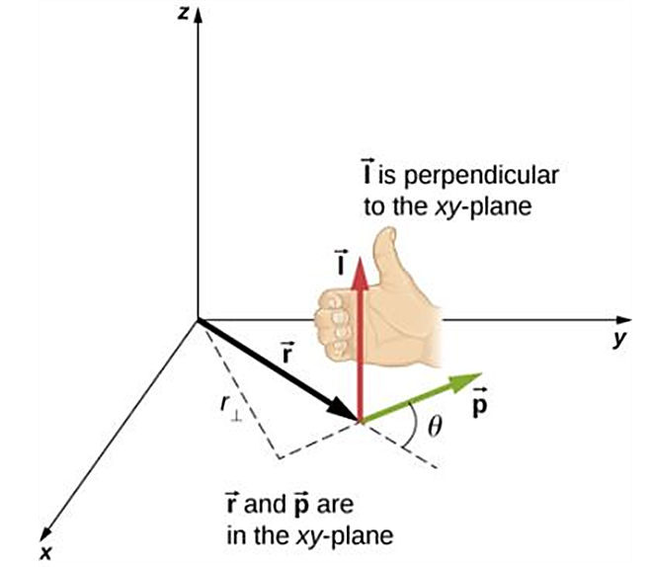
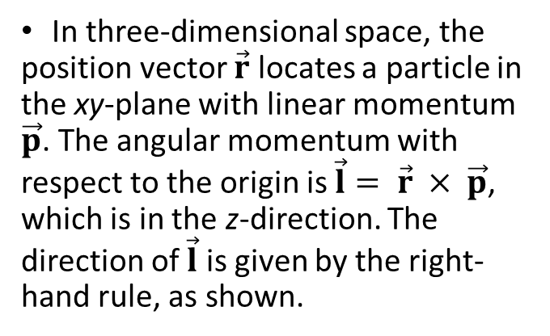
Angular momentum: direction
In three-dimensional space, the position vector $\vec{r}$ locates a particle in the xy-plane with linear momentum $\vec{p}$. The angular momentum with respect to the origin is $\vec{l}= \vec{r} × \vec{p}$, which is in the z-direction. The direction of $\vec{l}$ is given by the right-hand rule, as shown.

Slide 15
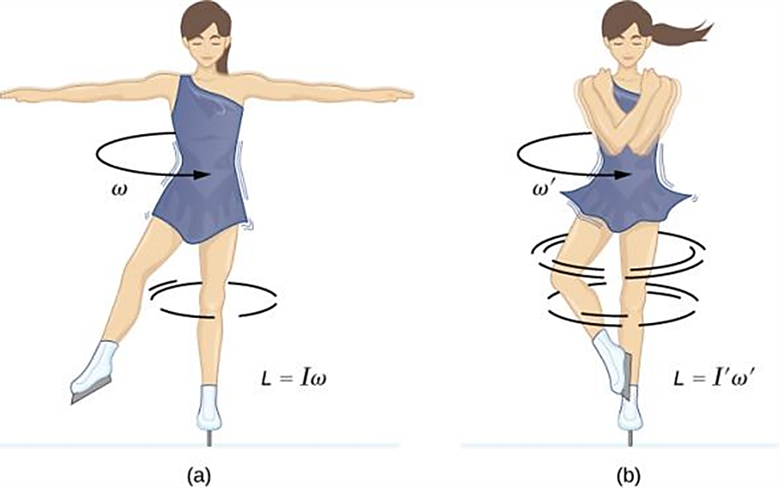
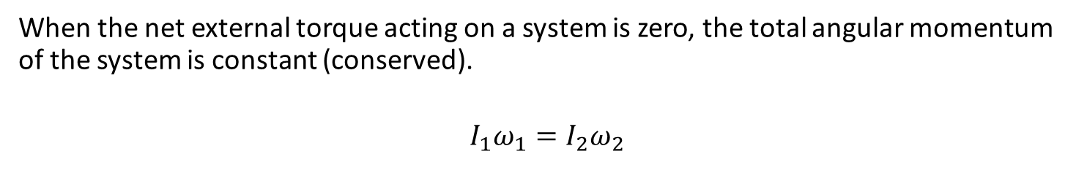
Conservation of angular momentum
When the net external torque acting on a system is zero, the total angular momentum of the system is constant (conserved).
$$I_{1}ω_{1}=I_{2}ω_{2}$$
An ice skater is spinning on the tip of her skate with her arms extended. Her angular momentum is conserved because the net torque on her is negligibly small.
Her rate of spin increases greatly when she pulls in her arms, decreasing her moment of inertia. The work she does to pull in her arms results in an increase in rotational kinetic energy.

Slide 16
Rotational Kinetic Energy
The rotating object consists of mass in motion,
Let’s consider a body made up of a large number of particles
Kinetic energy of an $i^{th}$ particle is
Kinetic energy of an 𝑖^𝑡ℎ particle is
$$\frac{1}{2}m_{i}v_{i}^{2}=\frac{1}{2}m_{i}(r_{i}ω_{i})^{2}$$
1/2 𝑚_𝑖 𝑣_𝑖^2=1/2 𝑚_𝑖 (𝑟_𝑖 𝜔_𝑖 )^2
Total kinetic energy is
$$KE=\sum_{i}{\frac{1}{2}m_{i}(r_{i}ω_{i})^{2}}=\frac{1}{2}(\sum_{i}{m_{i}r_{i}^{2})ω^{2}}$$
𝐾𝐸=∑1_𝑖▒〖1/2 𝑚_𝑖 (𝑟_𝑖 𝜔_𝑖 )^2 〗=1/2(∑1_𝑖▒〖𝑚_𝑖 𝑟_𝑖^2)𝜔^2 〗
so, it has kinetic energy
with masses $m_{1},{ m}_{2}, m_{3},…$
with masses 𝑚_1,〖 𝑚〗_2, 𝑚_3,…
at distances $r_{1},{ r}_{2}, r_{3},…$from the axis of rotation
at distances 𝑟_1,〖 𝑟〗_2, 𝑟_3,… from the axis of rotation
$$KE=\frac{1}{2}Iω^{2}$$
𝐾𝐸=1/2 𝐼𝜔^2

Slide 17
Rotational kinetic energy and moment of inertia
The rotational kinetic energy of a rigid body is:
The moment of inertia, I, is obtained by multiplying the mass of each particle by the square of its distance from the axis of rotation and adding these products:
The SI unit of I is the
$$KE=\frac{1}{2}Iω^{2}$$
𝐾𝐸=1/2 𝐼𝜔^2
$$\text{kilogram}\text{−}\text{mete}{\text{r}}^{2}(\text{kg}⋅m^{2}).$$
"kilogram−mete" "r" ^2 ("kg"⋅m^2).
$$I=m_{1}r_{1}^{2}+m_{2}r_{2}^{2}+ m_{3}r_{3}^{2}+⋯=\sum_{i}{m_{i}r_{i}^{2}}$$
𝐼=𝑚_1 𝑟_1^2+𝑚_2 𝑟_2^2+ 𝑚_3 𝑟_3^2+⋯=∑_𝑖▒〖𝑚_𝑖 𝑟_𝑖^2 〗

Slide 18
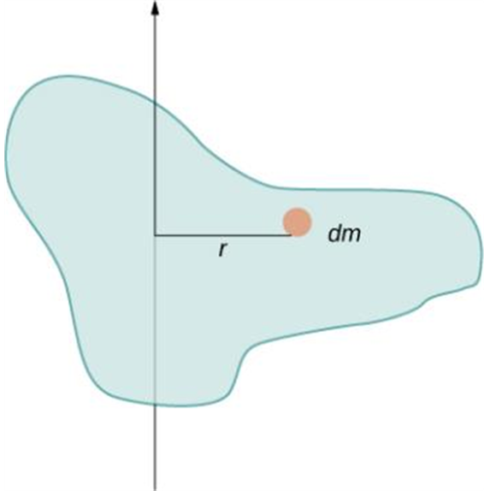
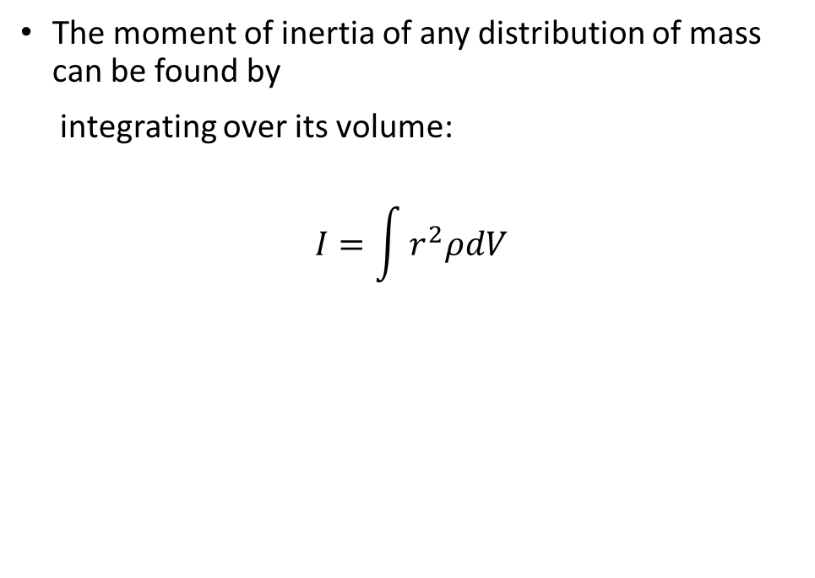
Moment of inertia of continuous distribution of mass
The moment of inertia of any distribution of mass can be found by
integrating over its volume:
$$I=\int{r^{2}ρdV}$$
Using an infinitesimally small piece of mass to calculate the contribution to the total moment of inertia.

Slide 19
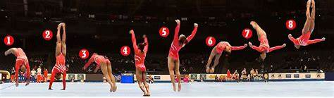
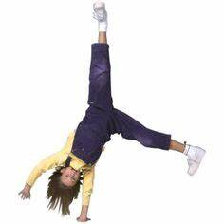
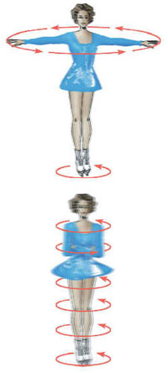
Moment of inertia, continued
Moment of inertia depends on
Mass of an object
Size and shape of the object
How the mass is distributed
Axis of rotation

Slide 20
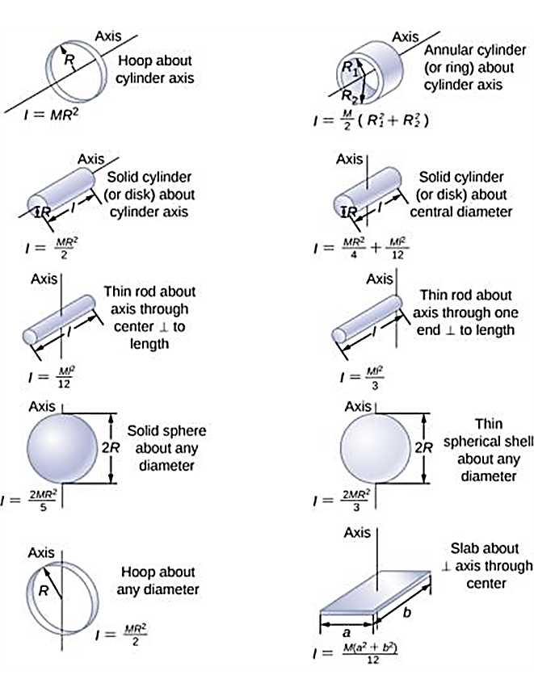
Moments of inertia of some common objects

Slide 21
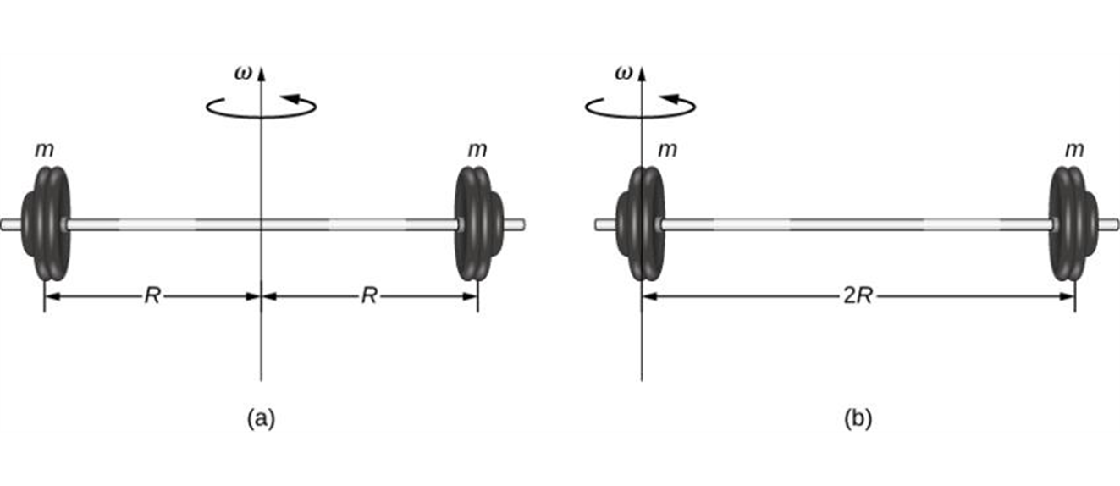

The parallel-axis theorem
There is a simple relationship, called the parallel-axis theorem, between the moment of inertia of an object about an axis through its center of mass and the moment of inertia about any other axis parallel to the original axis.
$$I_{p}=I_{cm}+Md^{2}$$
(a) A barbell with an axis of rotation through its center; (b) a barbell with an axis of rotation through one end.

Slide 22
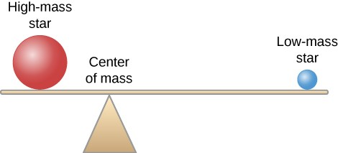

Center of mass
$$x_{CM}=\frac{{x_{1}m}_{1}+x_{2}m_{2}+x_{3}m_{3}+…}{m_{1}+m_{2}+m_{3}+…}$$

